Slide 1
What's inside an
asyncio event loop?
Taras Kozlov
PyCon NL 2026
Notes:
Opening (~30s)
The goal is not to teach async/await syntax. We will temporarily forget async/await and build the machinery underneath it from small, understandable pieces. By the time Tasks and networking appear, they should feel inevitable rather than magical.

Slide 2
1 · ASYNCIO MODULE
asyncio: more than an event loop
High-level coordination around a loop that owns the operating-system-facing work.
TASKS & FUTURES
Task · Future
cancellation · context
EVENT LOOP
WAIT · SCHEDULE · DISPATCH
WORK DISTRIBUTION
Queue · PriorityQueue
CALLBACKS
TIMERS
I/O
ORCHESTRATION
TaskGroup · gather · wait
as_completed · timeout
SIGNALS HANDLING
FUTURE / TASK FACTORY
PROGRAM LIFECYCLE
run · Runner
loop factory · shutdown
ASYNC SOCKET OPS
TRANSPORTS / STREAMS FACTORY
EXECUTORS BRIDGE
SYNCHRONIZATION
Lock · Event · Semaphore
Condition · Barrier
OBSERVABILITY
current_task · all_tasks · debug
stacks · call graphs
TRANSPORTS
STREAMS

Slide 3
2 · ASYNCIO LOOP
asyncio event loop at a glance
A large API — but only a small part of it is fundamental.
>50
public methods on
AbstractEventLoop
3
fundamental mechanisms
callbacks · timers · I/O
LOOP API SURFACE
SOCKET OPS
DNS
SIGNALS
SUBPROCESSES
EXECUTORS
TRANSPORTS
STREAMS
RUNTIME
DIAGNOSTICS
BUILT ON
FUNDAMENTAL CORE
CALLBACKS · TIMERS · I/O
one iteration at a time: run_once()
IMPORTANT CONSTRAINTS
ONE THREAD
cooperative scheduling
NOT GENERALLY THREAD-SAFE
cross-thread → call_soon_threadsafe()
NO PREEMPTION
blocking code blocks the loop

Slide 4
2 · THE CORE
asyncio event loop: the core
At its lowest useful level, the loop manages callbacks, timers, and I/O readiness.
call_soon(callback,*)
call_later(delay,callback,*)
add_reader(fd, callback, *)
add_writer(fd, callback, *)
run_forever()
stop()
READY QUEUE
TIMER HEAP
I/O REGISTRATION
LOOP CONTROL
FIFO queue
ordered by deadline
wait for readiness
repeat run_once()
Everything converges on one simple operation:
run_once()
collect work that became ready → run the callbacks
Let's have a closer look at these pieces.
Notes:
~1.5 min
Now narrow the discussion to asyncio. At its core, the event loop has only a few basic responsibilities.
call_soon puts callback work into the ready queue. call_later manages callbacks that should become ready in the future. add_reader and add_writer register I/O readiness interest. run_forever repeatedly performs one loop iteration until stop is requested.
The real signatures have some extra details, but these are the essential pieces.
The next few slides build these functions one by one.

Slide 5
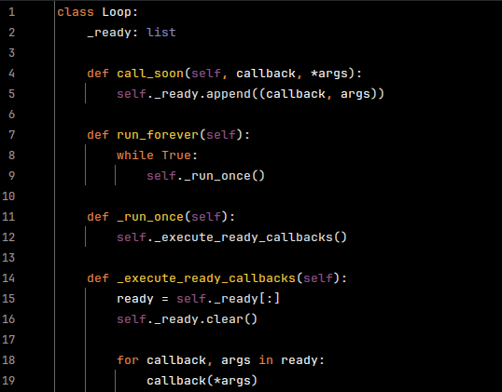
3 · CALLBACKS
The smallest possible event loop
It begins with only two ideas: enqueue a callback, then keep executing callbacks from the queue.
READY QUEUE
cb₁
cb₂
cb₃
Notes:
~2 min
Start with the smallest thing that deserves to be called an event loop. call_soon just appends a callback and its arguments to a deque. run_forever repeatedly takes the next item and calls it.
For the mental model, deliberately omit lifecycle details such as stop(): they are trivial compared with the scheduling mechanism we want to understand.
At this point there is no async/await, no Tasks, no sockets — just callbacks.
The obvious problem is that when the ready queue is empty this implementation busy-spins. We will fix that gradually.

Slide 6
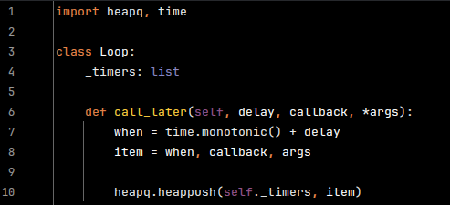
4 · TIMERS
We need timers too
A callback that must be run after some time. A min-heap keeps the earliest callback on top.
MIN-HEAP
1.2s
3.7s
2.4s
8.0s
5.1s
Notes:
~2.5 min
Next add timers. call_later calculates an absolute deadline using monotonic time and pushes the callback into a min-heap.
Each iteration checks the heap. Every timer whose deadline has passed is removed and moved into the same ready queue that call_soon uses. Then we execute the ready callbacks.
If there is nothing ready, we can now avoid busy-spinning: look at the earliest timer and sleep until that deadline.
This is an important step because timers do not create a separate execution mechanism. They only decide when a callback becomes ready.
And now we are ready for the next problem: time.sleep knows only about time, but an event loop also needs to wake for I/O.

Slide 7
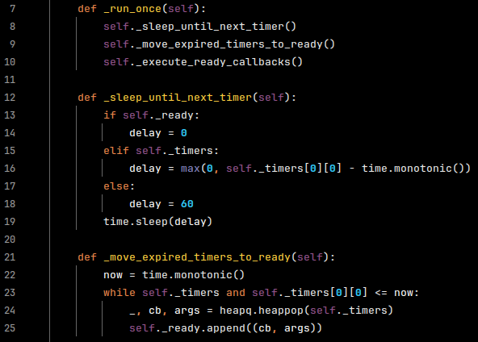
4 · TIMERS
We need timers too
A callback that must be run after some time. A min-heap keeps the earliest deadline on top.
MIN-HEAP
1.2s
3.7s
2.4s
8.0s
5.1s
expired timers → ready queue
Notes:
~2.5 min
Next add timers. call_later calculates an absolute deadline using monotonic time and pushes the callback into a min-heap.
Each iteration checks the heap. Every timer whose deadline has passed is removed and moved into the same ready queue that call_soon uses. Then we execute the ready callbacks.
If there is nothing ready, we can now avoid busy-spinning: look at the earliest timer and sleep until that deadline.
This is an important step because timers do not create a separate execution mechanism. They only decide when a callback becomes ready.
And now we are ready for the next problem: time.sleep knows only about time, but an event loop also needs to wake for I/O.

Slide 8
5 · I/O CHANGES THE PROBLEM
Sleep only knows about time
We want to sleep until the next timer… unless a socket becomes ready first.
time.sleep(8.5s)
I/O
timer
now
socket ready
next timer
We need a “sleep” that can be interrupted by I/O readiness.
Notes:
~1 min
This is the narrative hinge. time.sleep knows only time. If the next timer is 8 seconds away but a socket receives a packet after 2 ms, sleep cannot wake early.
So replace “sleep until timeout” with “wait for I/O, but no longer than timeout”. That is exactly the service a selector provides.

Slide 9
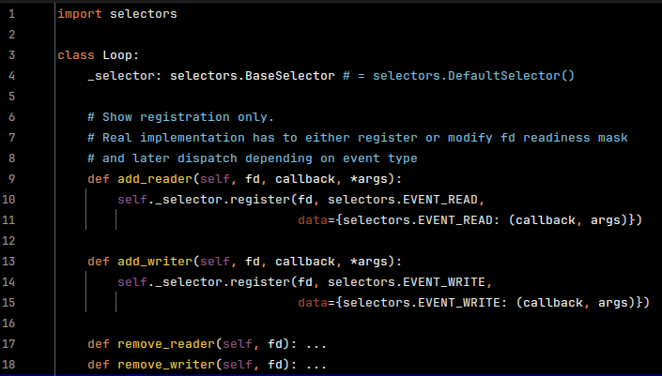
6 · READINESS I/O
Selectors: register file descriptor for readiness event
Notes:
~2 min
Now add I/O registration. add_reader and add_writer associate a file descriptor plus an event mask with the callback that should become runnable when the descriptor is ready.
The implementation on the slide is deliberately small but handles the important case where the same fd may be watched for both reading and writing: update the combined selector mask and keep a callback per event.
Then selector.select(timeout) is the blocking point. It returns either because an fd became ready or because the timer-derived timeout expired.
Explain select/poll/epoll/kqueue only as examples of the same readiness abstraction; do not dive into their differences.

Slide 10
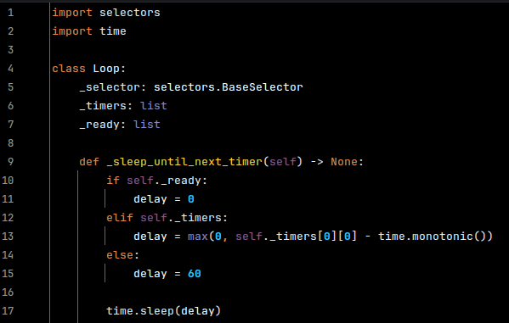
6 · READINESS I/O
Selectors: sleep until next timer or I/O event
Notes:
~2 min
Now add I/O registration. add_reader and add_writer associate a file descriptor plus an event mask with the callback that should become runnable when the descriptor is ready.
The implementation on the slide is deliberately small but handles the important case where the same fd may be watched for both reading and writing: update the combined selector mask and keep a callback per event.
Then selector.select(timeout) is the blocking point. It returns either because an fd became ready or because the timer-derived timeout expired.
Explain select/poll/epoll/kqueue only as examples of the same readiness abstraction; do not dive into their differences.

Slide 11
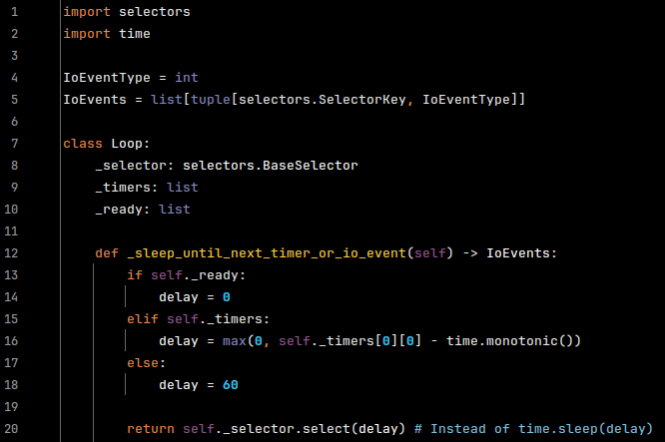
6 · READINESS I/O
Selectors: sleep until next timer or I/O event
Notes:
~2 min
Now add I/O registration. add_reader and add_writer associate a file descriptor plus an event mask with the callback that should become runnable when the descriptor is ready.
The implementation on the slide is deliberately small but handles the important case where the same fd may be watched for both reading and writing: update the combined selector mask and keep a callback per event.
Then selector.select(timeout) is the blocking point. It returns either because an fd became ready or because the timer-derived timeout expired.
Explain select/poll/epoll/kqueue only as examples of the same readiness abstraction; do not dive into their differences.

Slide 12
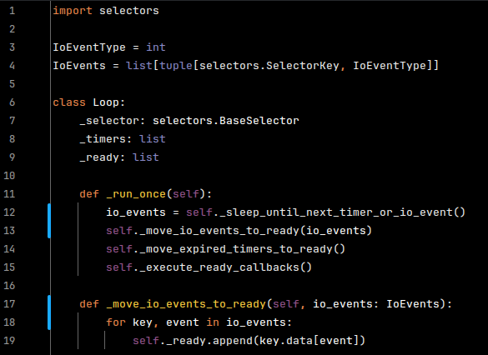
7 · PUT THE PIECES TOGETHER
Selectors: run_once
Notes:
~2 min
This is the slide to dwell on. The exact CPython implementation has cancellation cleanup, clock resolution handling, debug timing, etc., but conceptually the loop does these four things.
Important subtlety: run a snapshot/current batch of ready callbacks, not an unbounded loop over callbacks appended by callbacks. Newly scheduled callbacks generally wait for the next iteration.

Slide 13
8 · CALLBACK EVENT LOOP
So far: zero async / await
We already have a useful event-driven runtime.
call_soon()
ready queue
Callbacks can express everything…
but complex control flow becomes painful.
call_later()
timer heap
add_reader() / add_writer()
I/O registrations
We want COROUTINES!
run_forever()
repeat run_once()
Notes:
~30s
Pause and emphasize this. Nothing about an event loop inherently requires coroutines. libevent, GUI loops, Node's internals, and old-school async code can all be callback-driven.
Now introduce coroutines as a control-flow abstraction layered on top of the callback scheduler.

Slide 14
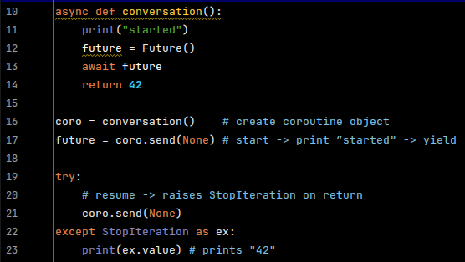
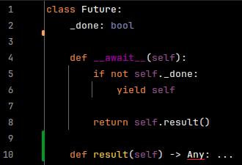
9 · COROUTINES + FUTURES
Pausing and resuming a coroutine
The suspension point comes from the awaitable: Future.__await__() can yield control.
Drive the coroutine by hand
Future: the suspension point
First send → runs until Future.__await__() yields. Second send → continues after await.
Notes:
~2 min
This is the direct answer to “how do you actually pause and resume a coroutine?”
The coroutine itself contains `await future`. Python enters Future.__await__(). If the Future is not done, that method executes `yield self`. That yield is what gives control back to the coroutine driver.
The first coro.send(None) therefore runs conversation() until the Future yields itself. Later we mark the Future done and send None again. Execution continues inside Future.__await__(), which returns the stored result; that becomes the value of the await expression.
The example mutates private fields only to keep this slide focused. The next slide introduces the public completion API: set_result(), set_exception(), and add_done_callback().
When conversation() finally returns, send(None) raises StopIteration to its driver; mention this only if useful.

Slide 15
10 · FUTURES
Future: completing something later
A Future is pending until somebody supplies either a result or an exception.
add_done_callback(cb)
set_result(value)
set_exception(exc)
register interest
complete successfully
complete with failure
Task uses this to say: resume me when you are done.
Store a value and transition the Future to DONE.
Store an exception and transition the Future to DONE.
set_result / set_exception
for each done callback
PENDING
DONE
loop.call_soon(cb, future)
Future completion becomes ordinary work in the event loop’s ready queue.
Simplified model: real Future also handles cancellation, context, callbacks added after completion, and more.
Notes:
~1.5 min
Now introduce the Future API that replaces the private field manipulation from the previous slide.
add_done_callback(cb): somebody can register interest in completion. A Task will use this to arrange its own resumption.
set_result(value) and set_exception(exc) are the two important ways to complete the Future.
The key connection back to our event loop: asyncio schedules Future done callbacks through loop.call_soon rather than invoking them inline. So Future completion simply creates normal ready-queue work.
Keep this conceptual; cancellation and other production details are deliberately omitted.

Slide 16
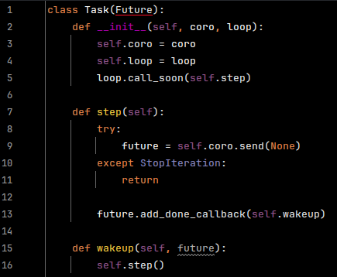
11 · TASKS
Task: automating coroutine resumption
A Task owns a coroutine and repeatedly drives it while the coroutine yields a Future until StopIteration
Task.step()
coro.send(None)
Future is yielded
add_done_callback(wakeup)
When the Future completes, its done callback enters the ready queue. That callback drives the coroutine again.
Notes:
~2 min
Now the three pieces join together. A Task owns a coroutine. Its step callback calls coro.send(None).
If the coroutine reaches `await future`, Future.__await__() yields that Future back to Task.step(). The Task registers wakeup as a done callback and stops doing anything.
When the Future completes, Future schedules wakeup through loop.call_soon. Because wakeup itself is now an event-loop callback, it can immediately drive the coroutine again by calling step().
Notice the important detail from slide 10: we send None when resuming. Future.__await__() returns its stored result internally, so that value becomes the result of the await expression.
This pseudocode intentionally ignores cancellation and exception injection. The payoff slide next shows the whole cycle.

Slide 17
12 · THE PAYOFF
The trick: Tasks turn “await” into callbacks
I/O or timer
completes
Future becomes
DONE
loop.call_soon
(task wakeup)
Task drives
coroutine
next
await
The loop only sees Task.wakeup callbacks.
Task and Future provide the coroutine semantics above it.
That is the bridge between event-driven callbacks and async / await.
Notes:
~2 min
This is the conceptual reveal. Trace one complete cycle from an I/O event to the next await.
Be precise: Futures and Tasks are attached to / use an event loop; they are not literally disconnected. The useful architectural point is that the event-loop iteration does not need to understand Python coroutine control flow. It executes scheduled callbacks; Task/Future machinery converts coroutine suspension/resumption into those callbacks.

Slide 18
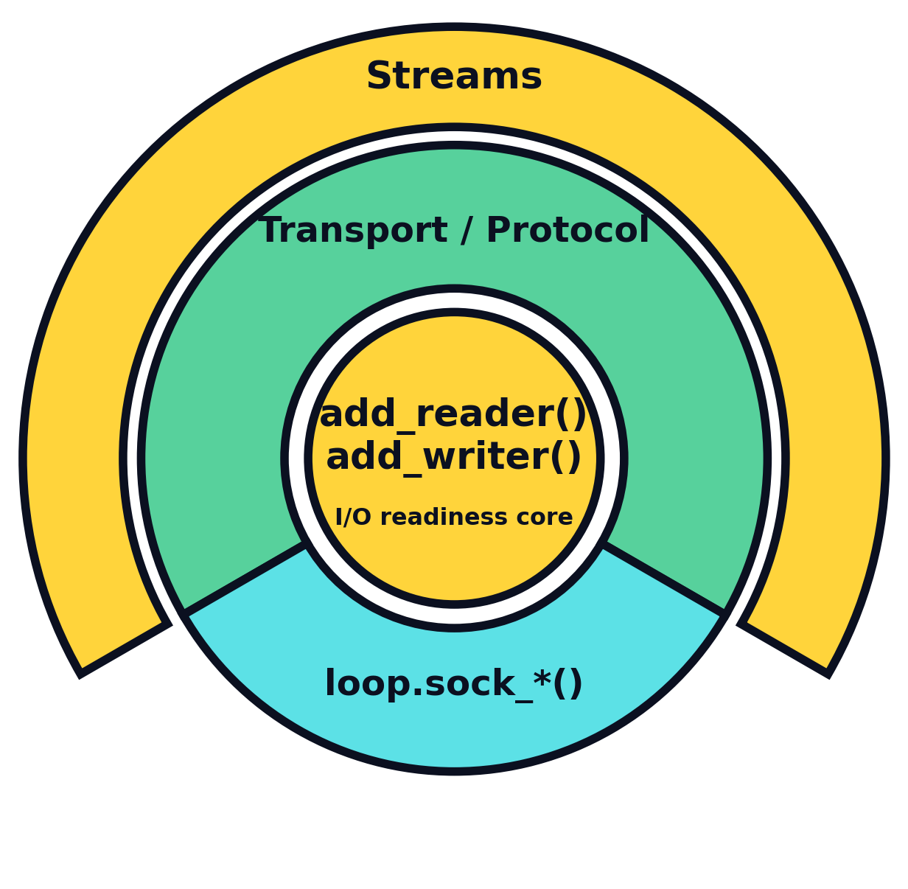
13 · ASYNCIO NETWORKING
Where does networking fit?
SelectorEventLoop view: networking builds outward from readiness callbacks.
Streams
async def loop.open_connection(...)
async def loop.start_server(...)
Transport / Protocol
async def loop.create_connection(...)
async def loop.create_server(...)
Socket coroutines
async loop.sock_recv()
async loop.sock_sendall()
...
Streams use Transport / Protocol; sock_* is a parallel path.
Notes:
~1 min
This is the networking map for a SelectorEventLoop. At the center are readiness callbacks: add_reader() and add_writer(). One layer out there are two paths. Transport/Protocol is created through create_connection()/create_server(). The sock_* coroutines are a parallel path that works directly with non-blocking sockets. Streams are built on the Transport/Protocol path: open_connection() uses create_connection(), and start_server() uses create_server(). Later I will qualify the center for Windows, where ProactorEventLoop uses IOCP completion operations instead.

Slide 19
14 · LOWER-LEVEL NETWORKING
Transport + Protocol: a connection as callbacks
PROTOCOL
TRANSPORT
send bytes
connection_made(transport)
write(data)
data_received(data)
pause_reading() / resume_reading()
received bytes
connection_lost(exc)
close()
1 : 1 pair
Your application reacts to events.
asyncio owns the I/O channel.
Notes:
~1.5 min
Keep this concrete. Protocol is the application-facing callback object; Transport abstracts the channel and exposes write/control methods. The event loop constructs them together.
Mention flow control only briefly if time allows. BufferedProtocol is appendix material, not part of the main path.

Slide 20
15 · TWO COROUTINE-FACING APIS
Streams vs. loop.sock_*()
Streams
loop.sock_*()
reader, writer = await open_connection(...)
data = await loop.sock_recv(sock, 4096)
data = await reader.read(4096)
await loop.sock_sendall(sock, data)
writer.write(data)
await writer.drain()
sock must be non-blocking
• buffering
• backpressure helpers
• convenient application API
• direct socket ownership
• fewer abstractions
• separate API path
• replicate socket stdlib module, but with async
Notes:
~1.5 min
The audience probably uses Streams. The useful architectural fact is that loop.sock_* gives a separate coroutine-facing path for working with non-blocking socket objects directly.
Do not claim that sock_* is always faster; the current docs explicitly say transport-based APIs are generally faster than direct socket implementations, though direct sockets can be convenient.

Slide 21
16 · THE BOTTOM LAYER CAN DIFFER
Reactor vs. Proactor: event loop implementation details
REACTOR
PROACTOR
1. Ask: “when is this socket ready?”
1. Start the I/O operation
2. readiness notification
2. OS performs it asynchronously
3. perform recv()/send()
3. completion notification
Windows default: ProactorEventLoop (IOCP).
Same high-level asyncio; different mechanics underneath.
Notes:
~1.5 min
This is the caveat to our selector-based construction. We built a reactor: readiness arrives, then code performs I/O. Windows' default ProactorEventLoop uses IOCP/completion-style mechanisms, so add_reader/add_writer are not supported.
The high-level Task/Future/callback mental model still helps, but the bottom I/O mechanism is different.

Slide 22
BACKUP
BufferedProtocol
Useful when receive-buffer ownership and copying matter — but not needed for the main mental model.
Protocol
BufferedProtocol
event loop allocates / receives bytes
→ data_received(data)
protocol provides receive buffer
→ buffer_updated(nbytes)
simple, common
can reduce allocations / copies
Notes:
Backup / Q&A only. This topic matches a performance-oriented audience but costs too much main-talk time. Use it if someone asks about lower-level protocol performance or receive-buffer allocation.

