Slide 1
Robobot - description

Slide 2
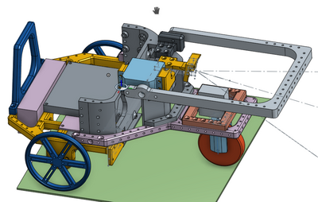
Robobot
Introduction
Hardware
Sammenkobling
Software
Client
23 January 2018

Slide 3
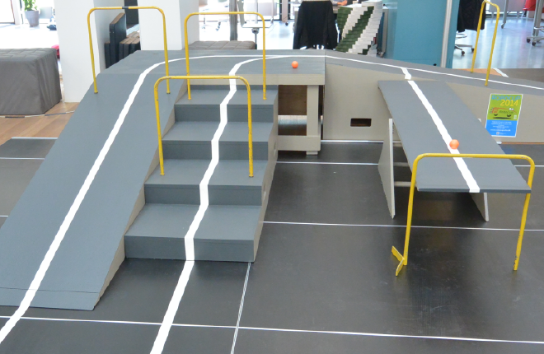
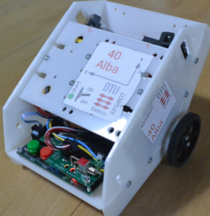
Introduktion
Robobot
Robobot is intended as basis for
participation in DTU Robocup.
Robobot is an extension of Regbot and includes:
  Linesensor
  Raspberry Pi
  Camera
  Bigger wheels
  2 servos
Regbot
DTU Robocup

Slide 4
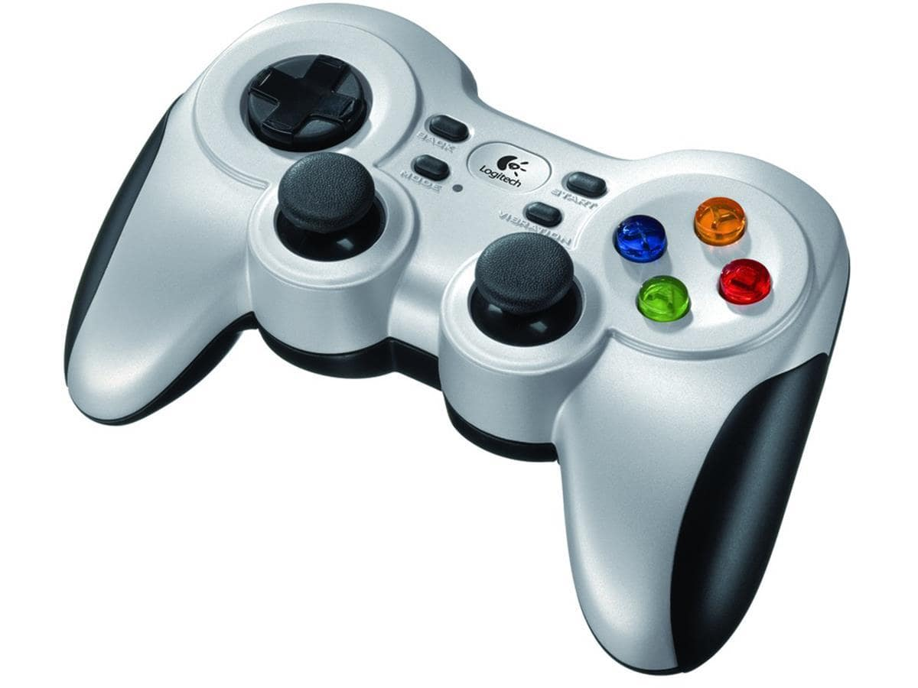
Robobot
camera
Wifi
Eduroam or other
Wifi Eduroam
or other
display
Network cable
(when bad wifi)
Raspberry PI
mission master
PC
5V
USB
Non-real time, Mission control
Regbot
Real time control
start
Battery 2.2 Ah 12V
(more than 4 hours)
Charger
0.8A
Wheels and servo
Controls motors, steering, servo and power
Reads linesensor, IR-sensor, IMU, battery voltage

Slide 5
REGBOT
power
control
LiPo battery
Force
power
on
Buck conv
5V 2.5A
Power off
On
3 cells
12V
Current
measurement
5V
5V
Current x2
Teensy 3.2-5
MK20DX256
96 MHz
Motor driver
Dual
5A
Motor
Pololu 25D
6V/2A
9.68 : 1
USB
PWM x2
3.3V
Encoder ~0.5 mm/tick
I2C
Wheel
8cm Ø
Acc-gyro
MPU9250
3D 1kHz
IR sensor, servo,
Line sensor, ...
optional
Start
WiFi
optional

Slide 6
Robobot
camera
Raspberry PI
PC
16/32 GB flash
Compile
Log files
Configuration
Development
Documentation
Disk mirror
display
Bridge
Mission
Regbot

Slide 7
Mission software
start
Send mission segment
to Regboot
Events:
* Regbot event (drive event)
* Camera detection
* Time event
* Gamepad (joystick)
Event ?
no
yes
Finished ?
end
yes
no
Calculate next segment
or wait for new event

Slide 8
Mission segment
Raspberry pi
Regbot
Mission execute
Char s[2] = {“vel=0.7 ...”,
“event=8 : ti...”}
missionSendAndRun(s,2);
While (missionRunning)
{
switch (event) {
Case 8: // finished
Send new lines
Break;
Case x: // found something
Send new lines
break;
Case 0: // finished
missionRunning = false
}
Regbot mission
thread 1
irsensor=1, vel=0
thread 100, event=30 : event=31
vel=0.7,edgel=0,white=1:dist=2.2
event=8 : time=1000
vel=0
vel=0
thread=101, event=31 : event=30
vel=0
vel=0
vel=0
Mission
lines +
events
Events
and
measure-
ments

Slide 9
Software tools
Log on to Raspberry (using e.g. putty)
Username: local
password: ******
On cable direct from Robobot to PC:
Robobot gets IP: 192.168.0.2
Source code:

