Slide 1
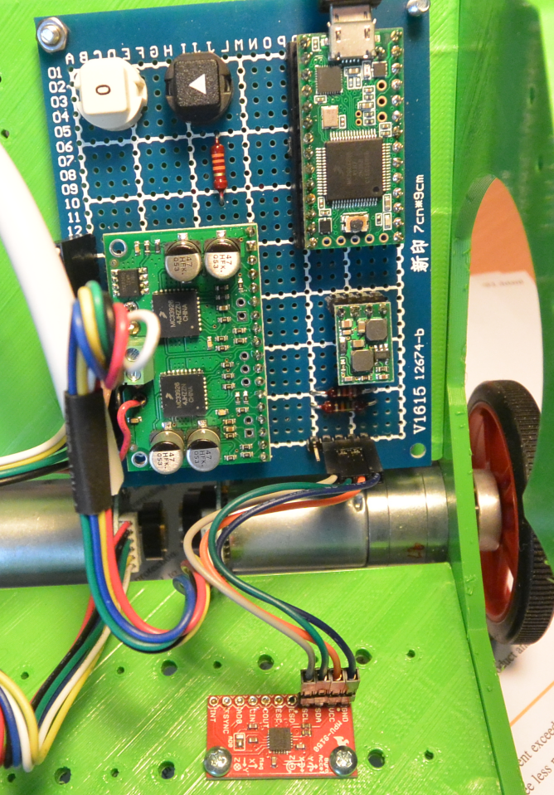
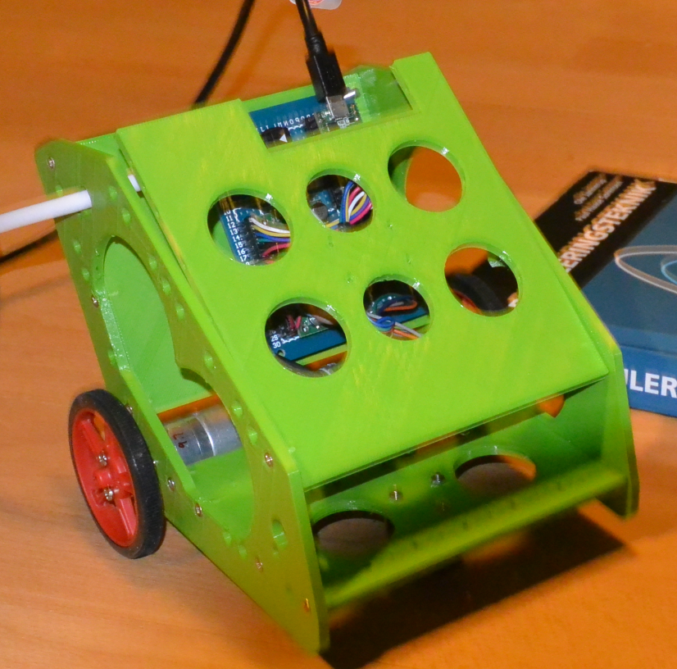
Automation and Control
REGBOT
Opbygning
Model
Hastighed
Vinkel
Balance

Slide 2
REGBOT Opbygning
power
12V 3A
220V
Reset
Buck-boost
5V 0.5A
12V
Current
measurement
5V
5V
Current x2
Teensy 3.1
MK20DX256
96 MHz
Motor driver
MC33926
dual
Motor
Pololu 25D
6V/2A
9.68 : 1
USB
PWM x2
3.3V
Encoder
48 (464) CPR
0.2 mm/tick
I2C
Wheel
6cm Ø
Acc-gyro
MPU9150
3D 1kHz
Start

Slide 3
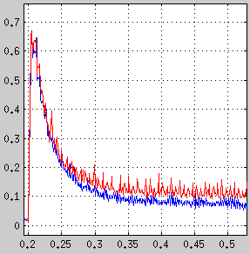
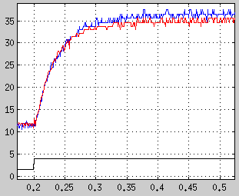
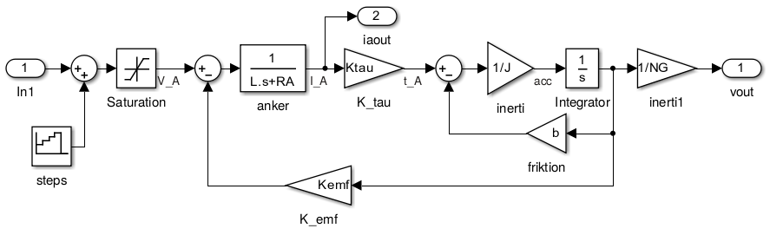
Model parametre
Ankerstrøm (A)
Wss = 36r/s
Hastighed (rad/s)
Iss = 0.1 A
Tau = 35ms
V_A = 2V
V_A = 4V
L = 7mH
R = 3.3 Ohm
Kemf=Ktau=0.0105 Vs/r
b = 3e-6 Nms/r
J = 1.3e-6

Slide 4
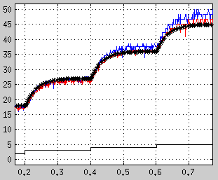
Model parametre
Ankerstrøm (A)
Hastighed (rad/s)
Iss = 0.1 A
* simuleret
L = 7mH
R = 3.3 Ohm
Kemf=Ktau=0.0105 Vs/r
b = 3e-6 Nms/r
J = 1.3e-6
2V
4V
5V
3V
gear_motor

Slide 5
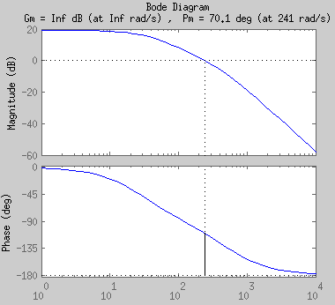
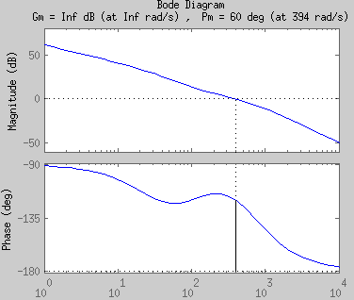
Velocity regulator motor med gear
En passende velocity regulator
  Phase margin 60º
  Lead med alpha=0.5
  I-led med Ni=4
Giver en regulator
  Kp = 1.3
  Taui = 0.01
  Taud = 0.0036
Se /svnjca/31301/robot-kit/matlab/motor_vel_PI_design.m

Slide 6
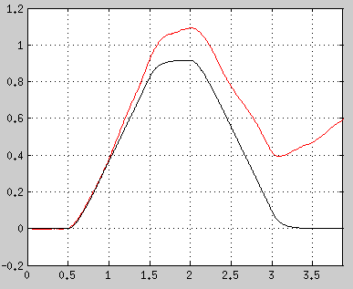
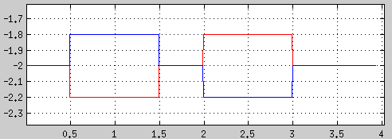
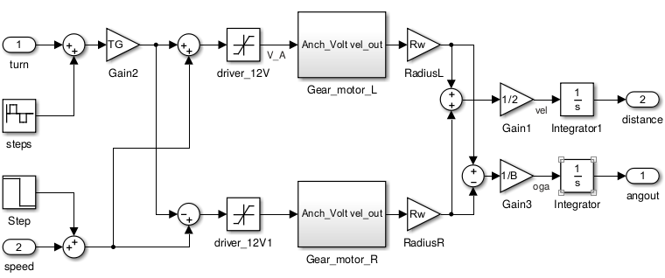
Turn model
- open loop
Motor spænding (Volt, målt)
målt
simuleret
Pose vinkel (rad)
J_M=1.3e-6
J_T +=2.5e-6
(estimeret)

Slide 7
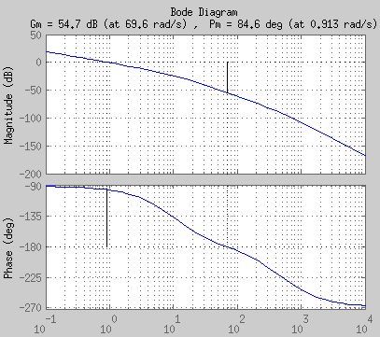
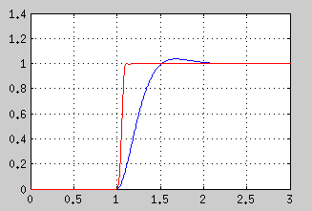
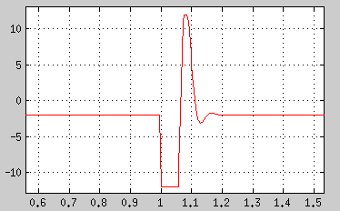
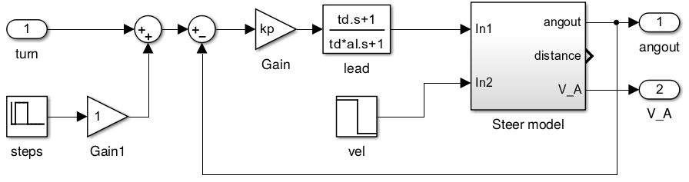
Heading regulator
P-Lead
Alpha=0.2
gamm=40º
P-Lead
Kp=306
Td=0.028
-14dB, 120º
P regulator
(Kp = 5)
Bode (Turn model)
Motor spænding
P-Lead
Step responce

Slide 8
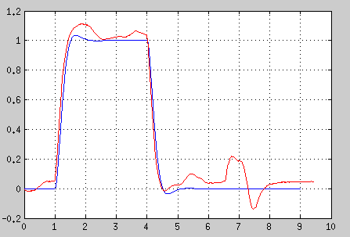
Turn measurements
Pose vinkel (rad)
Measured – P reg
Simulated – P-reg
Ramte stol
P-regulator - målt

