Slide 1
Modern Control Methods
for Agricultural Irrigation
MPC vs. Reinforcement Learning in Water-Constrained Crop Systems
Tara Torbati | ITMO University, R4237c
Supervisor: Peregudin A. A. | MSc Defence, 2026
Study site: Gilan Province, Iran • 6 ha Hashemi rice field • 38.298°N, 48.847°E

Slide 2
Presentation Outline
01
Motivation & Problem Statement
05
Results: Baselines & MPC
02
Simulation Environment (ABM)
06
Results: SAC Training & Evaluation
03
Controller Designs — MPC & SAC
07
Head-to-Head Comparison
04
Experimental Setup
08
Conclusions & Future Work

Slide 3
Motivation: The Anthropogenic Drought Crisis
70%
40%
238k
of global freshwater
of world population
hectares of paddy
consumed by agriculture
under water stress by 2030
in Gilan Province alone
The Control Engineering Gap
Traditional irrigation is reactive and open-loop; no forecast, no constraint awareness
MPC can enforce strict seasonal water budgets but requires expensive online optimisation
RL offers millisecond-latency decisions after training but constraint satisfaction is not guaranteed
This thesis rigorously benchmarks both on a high-fidelity ABM of a real Iranian rice field

Slide 4
The Simulation Environment: Agent-Based Model
130 crop-soil agents on 10×13 DEM grid
Elevation range 74–181 m (Talish Mountains)
25-year NASA POWER climate dataset (2000–2025)
Cascade water routing → eliminates 'bathtub' mass-balance errors
Decoupled surface & subsurface hydrology (corrects original framework)
Drought stress integrated into biomass eq. (FAO AquaCrop approach)
Per-agent state vector
x₁ Root moisture (mm)
x₂ Thermal time (GDD)
x₃ Maturation stress
x₄ Biomass (g/m²)
x₅ Surface ponding (mm)

Slide 5
Crop & Scenario Parameterisation
Test Scenarios
Hashemi Rice
Cultivar
Hashemi rice
Dry 2022
39.7 mm
Season
DOY 141–233 (93 days)
Kc
1.15 | Depletion p = 0.20
Moderate 2018
108.8 mm
Root depth
400 mm | HI = 0.45
Drought sens. θ₁₄
0.80 (high)
Wet 2024
Maturity GDD
1 250 °C·day
176.8 mm

Slide 6
MPC Design: Cost Function & Calibration
Five-term cost function J (recommended operating point α*)
α₁ = 1.0
Terminal biomass reward
anchor term
α₂ = 0.016
Water cost (Iranian domestic-base tariff)
7 000 toman/m³
α₃ = 0.1
Drought stress regulariser
<1% yield sensitivity
α₅ = 0.005
Actuator smoothing ΔU²
tie-breaking
α₆ = 8.0
FC-overshoot soft penalty (x₁ > FC)
eliminates waterlogging
Hp* = 8 days | 3 120 decision vars, 2 081 constraints (per step) | warm-start: 2.5× solver speedup | solver: CasADi + IPOPT

Slide 7
SAC Design: CTDE Architecture
Actor (deployed online)
Critic (training only)
Input: 62-dim per-agent obs
(5 local + 57 global features)
Arch: 62 → 128 → 128 → 1
Shared weights across all 130 agents
Output: 130 actions in ~1 ms (CPU)
Input: 837-dim (707 obs + 130 actions)
Arch: 837 → 256 → 256 → 1
Never used at deployment time
CTDE
707-dimensional observation space
650-dim
9-dim
48-dim
Per-agent block
5 states × 130 agents
Global scalars
(day, budget, weather)
8-day forecast
(6 vars × 8 days)

Slide 8
Experimental Setup: 9-Cell Evaluation Grid
Scenario \ Budget
100% 484 mm
85% 411 mm
70% 339 mm
Dry (2022)
1×MPC + 5×SAC
+ 1 fixed-schedule
1×MPC + 5×SAC
+ 1 fixed-schedule
1×MPC + 5×SAC
+ 1 fixed-schedule
Moderate (2018)
1×MPC + 5×SAC
+ 1 fixed-schedule
1×MPC + 5×SAC
+ 1 fixed-schedule
1×MPC + 5×SAC
+ 1 fixed-schedule
Wet (2024)
1×MPC + 5×SAC
+ 1 fixed-schedule
1×MPC + 5×SAC
+ 1 fixed-schedule
1×MPC + 5×SAC
+ 1 fixed-schedule
Data split: 20 training | 3 dev | 3 test years (stratified by rainfall tercile)
Test years never touched during training or hyperparameter selection.

Slide 9
Baseline Results: No-Irrigation & Fixed Schedule
Key Findings
Wet 100% fixed: 83.7 waterlog-days
Reducing budget to 70% in wet year INCREASES yield (2790 → 3024 kg/ha)
Fixed schedule cannot respond to dry spells
Open-loop scheduling is fundamentally inadequate
⚠ Wet year: fixed-schedule 83.7 waterlog-days vs. MPC 19.0 days

Slide 10
MPC Results: Perfect Forecast, Hp = 8
Cell | Yield (kg/ha) | Water (mm) | Wlog-d | Wall-min
Dry / 100% | 4 145 | 469.1 | 0.8 | 44.1
Dry / 85% | 4 069 | 409.9 | 0.3 | 32.7
Dry / 70% | 3 766 | 338.7 | 1.4 | 22.0
Moderate / 100% | 3718 | 399.8 | 5.8 | 85.2
Moderate / 85% | 3 725 | 397.4 | 5.5 | 375.6
Moderate / 70% | 3 612 | 338.6 | 1.3 | 31.9
Wet / 100% | 3 759 | 310.2 | 19.0 | 43.1
Wet / 85% | 3 743 | 308.3 | 16.9 | 48.3
Wet / 70% | 3 754 | 307.8 | 18.2 | 51.0
+14.9%
vs fixed-schedule
dry/100%
+34.7%
vs fixed-schedule
wet/100%
64%
budget used
wet year

Slide 11
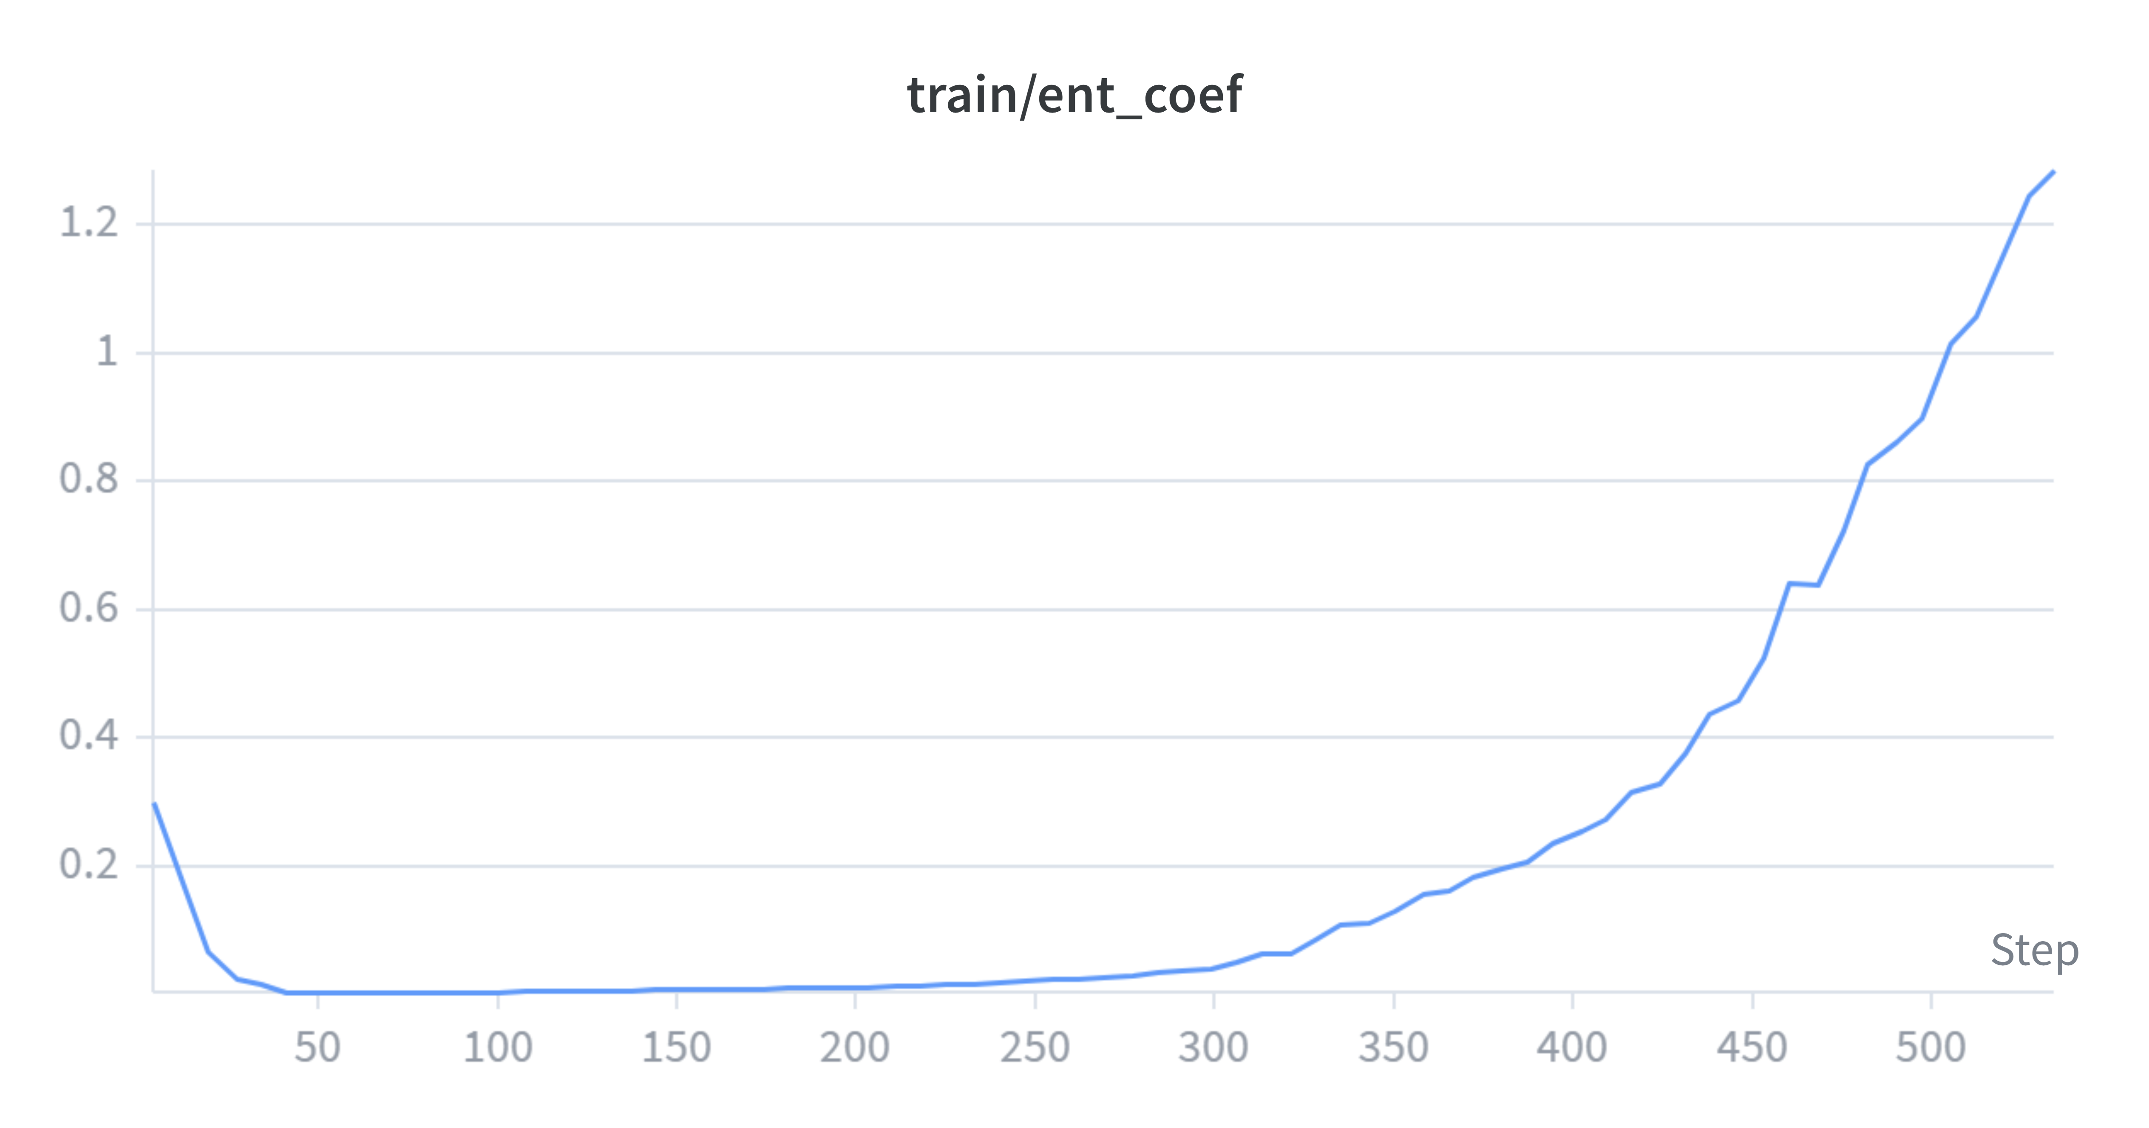
SAC Training: Three-Phase Trajectory
0 – 25k steps
25k – 96k steps
96k – 200k steps
Phase 1
Healthy Convergence
Phase 2
Productive Plateau
Phase 3
Q-value Divergence
Critic loss 2713 → 0.67
Full-season completion ✓
Best eval R = −0.37
best_model.zip captured ✓
Critic loss → 84 693
ent_coef spike 0.03 → 1.29
Root Causes of Divergence
c_term = 5: terminal bonus 300× larger than per-step rewards → Bellman error accumulation
130-dim joint action: critic Q(s,a) overfits; double-Q overestimation accumulates
target_entropy = −13: near-deterministic policy starves critic of action-space coverage
No gradient clipping: large critic updates → larger errors → positive feedback loop

Slide 12
SAC Evaluation: Seed 0, Best Model (~step 96k)
SAC Findings
39–70% budget utilised (never hits constraint)
~2–3 mm/day constant schedule — not scenario-adaptive
Applies MORE water in wetter years (opposite of optimal)
Inference: ~1 ms (25 000× faster than MPC)
Wet-year outperformance over fixed-schedule is coincidental, not learned behaviour.
Training pathology — not an inherent RL limitation. Known fixes specified for next run.

Slide 13
Head-to-Head: The Core Comparison
MPC Hp=8: +492 to +969 kg/ha over fixed schedule in all completed cells
SAC seed 0: −617 to −1130 kg/ha (dry/mod) | +131 to +355 kg/ha (wet, coincidental)

Slide 14
Computational Cost: The Deployment Argument
25.9 min
~1 ms
25 000× faster
wall-clock per day
CPU inference
MPC mean per-decision
SAC mean per-decision
MPC:
22–51 wall-min per season | worst-case single call: 274 s | requires high-performance CPU
SAC:
0.3 s total season | cold start 41 ms | compatible with edge MCU at 3 ms budget

Slide 15
Recommended Fixes for Next SAC Training Run
P1
Remove terminal bonus
Set c_term = 0. Per-step reward integrates to equivalent total biomass signal, distributed smoothly. Eliminates the 300× reward-concentration that causes Bellman error amplification.
P2
Add gradient clipping
max_grad_norm = 1.0 in SAC constructor. Breaks the positive feedback loop: large critic loss → large gradients → larger errors.
P3
Learning rate decay
Linear 3×10⁻⁴ → 5×10⁻⁵ over 500k steps. Prevents noisy late-training updates from destabilising a near-converged Q-function.
P4
Relax target entropy
−13 → −20 to −25 (−0.15 to −0.2 × dim). Improves action-space coverage in late training, reducing Q-overestimation at distribution edges.

Slide 16
Conclusions
✓
MPC outperforms fixed-schedule by 492–969 kg/ha across all completed cells; waterlogging virtually eliminated.
◎
SAC currently underperforms MPC significantly due to a training pathology (Q-value divergence)
⏳
Forecast-noise evaluation runs are to be completed
⚡
SAC delivers 25 000× faster inference (1 ms vs 25.9 min per day), enabling real-time edge deployment. The computational argument for RL holds even before agronomic parity is reached.

Slide 17
Thank You
Questions & Discussion
Tara Torbati | ITMO University R4237c | Supervisor: Peregudin A. A.
github.com/taratorbati/thesis

