Slide 1
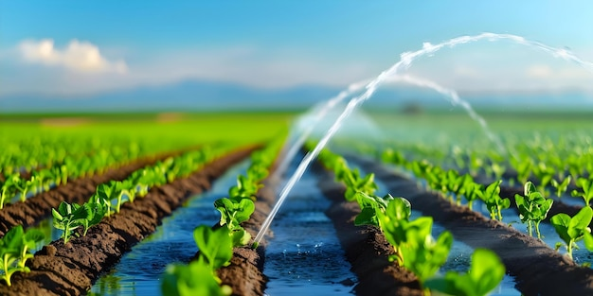
ITMO University
Study of Modern Control Methods for Agricultural Irrigation Systems
Student: Tara Torbati, gr. R4237c
Supervisor: Alexey A. Peregudin
Saint Petersburg 2026

Slide 2

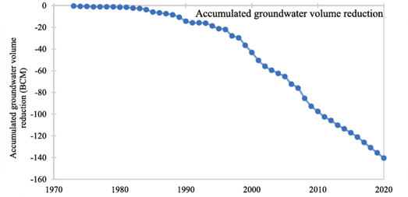
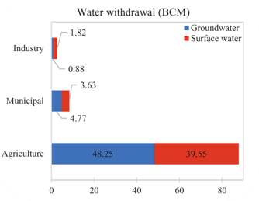
2
Notes:
motivation (here i need to talk about both my country's current water crisis + modern methods of agriculture and precision agriculture + overview of already existing materials and get to the research gap at the end)

Slide 3
Research Goal
The aim was to study the applications of Modern Control Methods in Agricultural Irrigation of a field in Talish mountains, Gilan province Iran under water scarcity
Field and data selection and preprocessing
Mathematical Modeling of the agricultural system
Controller Design and Simulation (MPC vs RL)
Performance Analysis and Comparison of Results
3

Slide 4

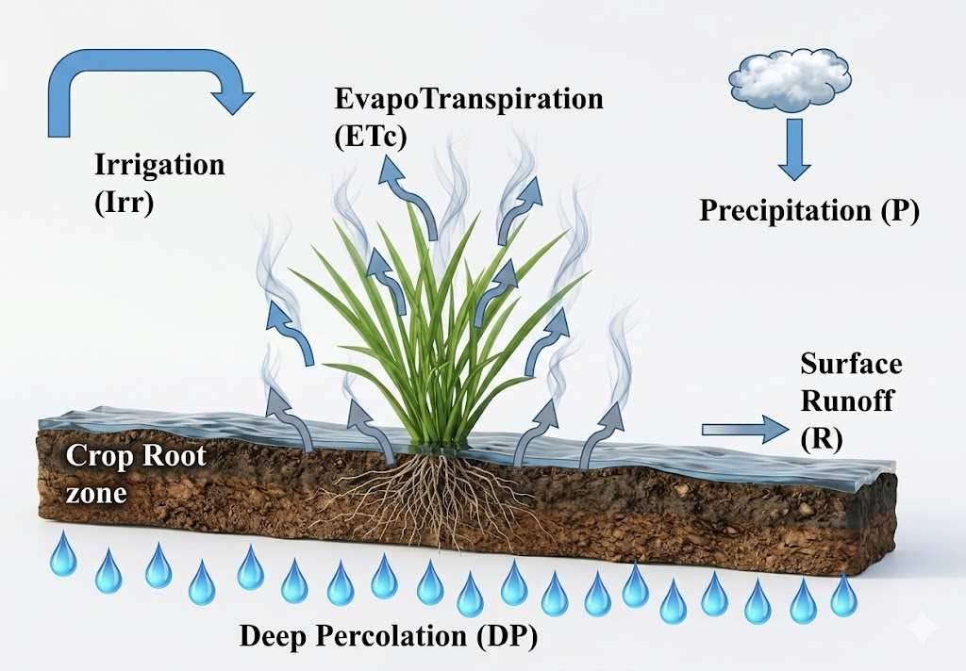
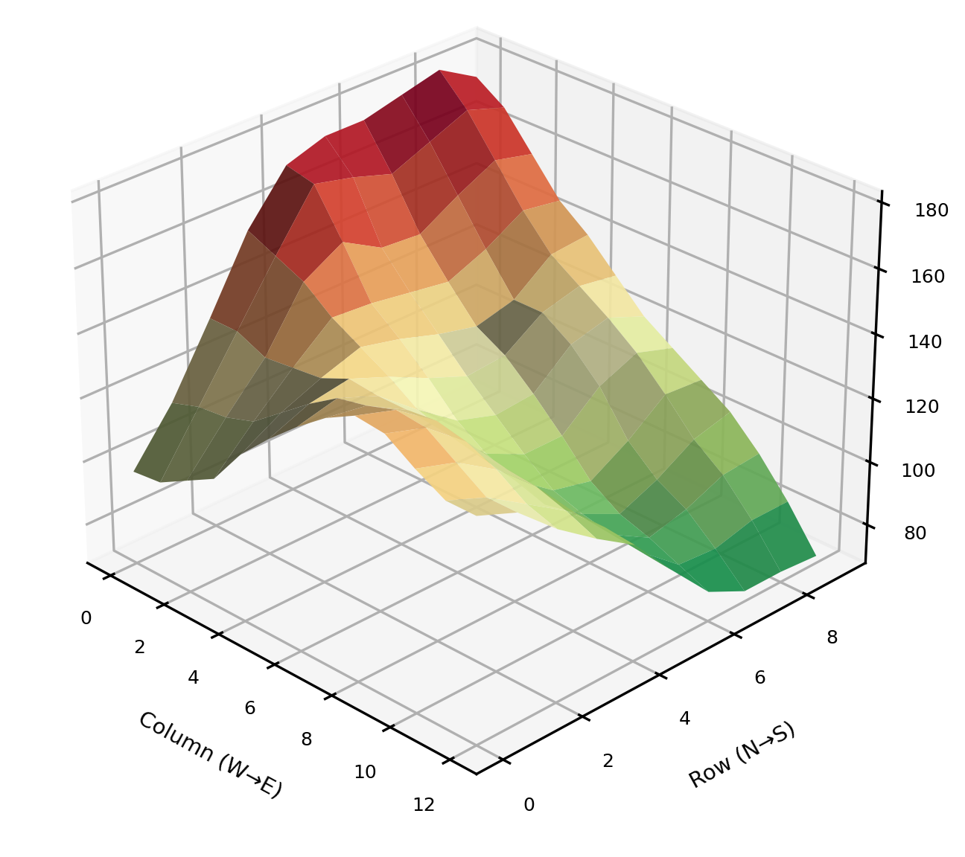



System Overview
López-Jiménez et. al., 2024
“Agent-based model predictive control of soil-crop irrigation with topographical information,”
Control Engineering Practice, vol. 150, p. 106012, 2024.
WEATHER FORECAST
CONTROLLER
$$u\left(k\right)$$
$$x_{1}−r\text{oot} \text{moisture}\text{ (}\text{mm}\text{)}$$
$$x_{2}−t\text{hermal} \text{time}\text{ (}\text{GDD}\text{)}$$
$$x_{3}− \text{maturation} \text{stress}$$
$$x_{4}− \text{biomass}\text{ (}g/m^{2}\text{)}$$
$$x_{5}− \text{surface} \text{ponding}\text{ (}\text{mm}\text{)}$$
SENSORS
System
States
$$x\left(k\right)$$
4
Notes:
Rain, ETc, Radiation, h2, h7, g
general objective (explaining necessary info of model and framing work as stress avoidance control under constraint)

Slide 5


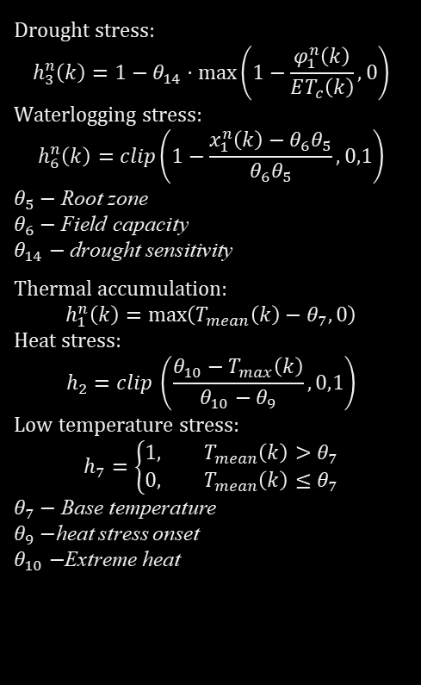

System Modeling and Dynamics
Drought stress:
$$h_{3}^{n}\left(k\right)=1−θ_{14}⋅\max\left(1−\frac{φ_{1}^{n}\left(k\right)}{ET_{c}\left(k\right)},0\right)$$
Waterlogging stress:
$$h_{6}^{n}\left(k\right)=clip\left(1−\frac{x_{1}^{n}\left(k\right)−θ_{6}θ_{5}}{θ_{6}θ_{5}},0,1\right)$$
$θ_{5}−$ Root zone
$θ_{6}−$ Field capacity
$θ_{14}−$ drought sensitivity
Thermal accumulation:
$$h_{1}^{n}\left(k\right)=\max\left(T_{mean}\left(k\right)−θ_{7},0\right)$$
Heat stress:
$$h_{2}=clip \left(\frac{θ_{10}−T_{max}\left(k\right)}{θ_{10}−θ_{9}},0,1\right)$$
Low temperature stress:
$$h_{7}=\left\{\begin{aligned}1, T_{mean}\left(k\right)>θ_{7} \\ 0, T_{mean}\left(k\right)≤θ_{7}\end{aligned}\right.$$
$θ_{7}−$ Base temperature
$θ_{9}−$heat stress onset
$θ_{10}−$Extreme heat
$$x_{1}^{\left(n\right)}\left(k+1\right)=x_{1}^{\left(n\right)}\left(k\right)+I^{n}\left(k\right)−φ_{1}^{\left(n\right)}\left(k\right)−φ_{3}^{\left(n\right)}\left(k\right)$$
$$x_{2}^{\left(n\right)}\left(k+1\right)=x_{2}^{\left(n\right)}\left(k\right)+h_{1}^{\left(n\right)}\left(k\right)$$
$$x_{3}^{\left(n\right)}\left(k+1\right)=x_{3}^{\left(n\right)}\left(k\right)+θ_{11}\left(1−h_{2}\left(k\right)\right)+θ_{12}\left(1−h_{3}^{\left(n\right)}\left(k\right)\right)$$
$$x_{4}^{\left(n\right)}\left(k+1\right)=x_{4}^{\left(n\right)}\left(k\right)+θ_{13}⋅h_{3}^{\left(n\right)}\left(k\right)⋅h_{6}^{\left(n\right)}\left(k\right)⋅h_{7}^{\left(n\right)}\left(k\right)⋅g\left(x_{2}^{\left(n\right)}\left(k\right)\right)⋅R_{s}\left(k\right)$$
$$x_{5}^{\left(n\right)}\left(k+1\right)=W_{surf}^{\left(n\right)}\left(k\right)−φ_{2}^{\left(n\right)}\left(k\right)+I^{\left(n\right)}\left(k\right)$$
Growth function:
$$g\left(x_{2}^{n}\right)=\left\{\begin{aligned}\frac{θ_{19}}{1+\exp\left(−0.01\left(x_{2}^{n}−θ_{20}\right)\right)}, x_{2}^{n}≤θ_{18}/2 \\ \frac{θ_{19}}{1+\exp\left(0.01\left(x_{2}^{n}+x_{3}^{n}−θ_{18}\right)\right)}, x_{2}^{n}>θ_{18}/2\end{aligned}\right.$$
$θ_{18}−$ maturity threshold
$θ_{19}−$ maximum interception
$θ_{20}−$ GDD at 50% interception
5
Notes:
system model (full description of my agent-based math model with special attention to key info)

Slide 6
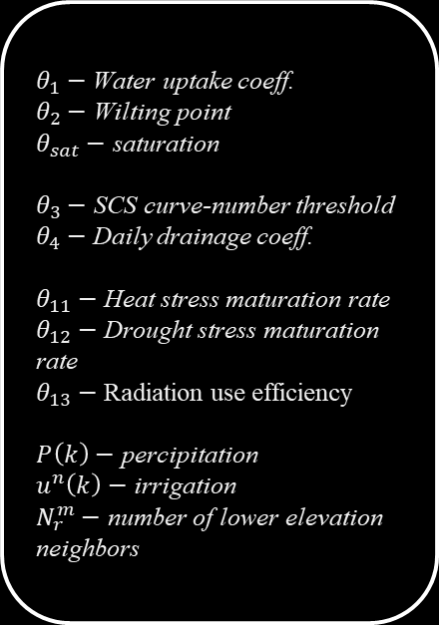

System Modeling and Dynamics
$θ_{1}−$ Water uptake coeff.
$θ_{2}−$ Wilting point
$θ_{sat}−$ saturation
$θ_{3}−$ SCS curve-number threshold
$θ_{4}−$ Daily drainage coeff.
$θ_{11}−$ Heat stress maturation rate
$θ_{12}−$ Drought stress maturation rate
$θ_{13}−$ Radiation use efficiency
$P\left(k\right)−$ percipitation
$u^{n}\left(k\right)−$ irrigation
$N_{r}^{m}−$ number of lower elevation neighbors
Infiltration:
$$I^{n}\left(k\right)=\min\left(W_{surf}^{n}\left(k\right)−φ_{2}^{n}\left(k\right),θ_{sat}θ_{5}−x_{1}^{n}\left(k\right)+φ_{1}^{n}\left(k\right)\right)$$
Total surface water available:
$$W_{surf}^{n}\left(k\right)=x_{5}^{n}\left(k\right)+P\left(k\right)+u^{n}\left(k\right)+\sum_{m∈U\left(m\right)}{\frac{φ_{2}^{m}\left(k\right)}{N_{r}^{m}}}$$
Crop transpiration:
$$φ_{1}^{\left(n\right)}\left(k\right)=\min\left(\max\left(θ_{1}\left(x_{1}^{\left(n\right)}\left(k\right)−θ_{2}θ_{5}\right),0\right),ET_{c}\left(k\right)\right)$$
Surface runoff:
$$φ_{2}^{\left(n\right)}\left(k\right)=\left\{\begin{aligned}\frac{{\left(W_{surf}^{\left(n\right)}\left(k\right)−θ_{3}\right)}^{2}}{W_{surf}^{\left(n\right)}\left(k\right)+4θ_{3}}, \\ 0,\end{aligned}\right. \begin{matrix}if N_{r}^{\left(n\right)}>0 and W_{surf}^{\left(n\right)}\left(k\right)>θ_{3} \\ otherwise\end{matrix}$$
Deep vertical percolation:
$$φ_{3}^{\left(n\right)}\left(k\right)=θ_{4}⋅\max\left(x_{1,temp}^{\left(n\right)}\left(k\right)−θ_{6}θ_{5},0\right)$$
6

Slide 7
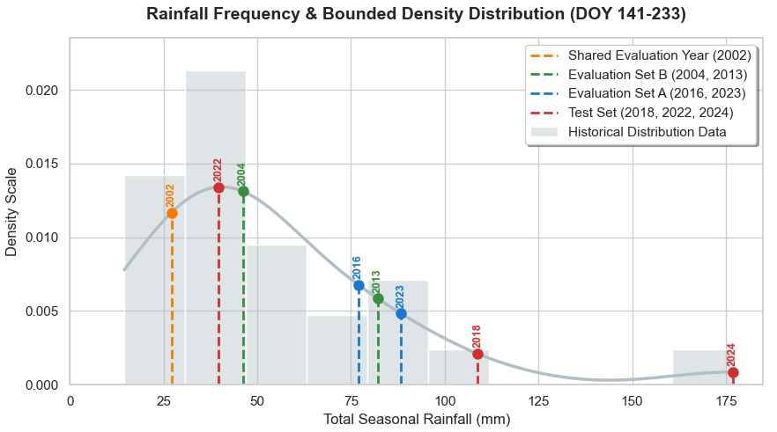
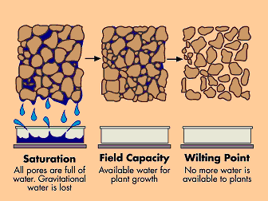
Control Problem Overview
Saturation
Waterlog Stress
Field Capacity
Desired Zone
Stress Threshold
Fixed-Schedule Controller
Reactive Controller
Drought Stress
Model Predictive Controller
Soft Actor-Critic Controller (SAC)
Twin Delayed Deep Deterministic Policy Gradient (TD3)
Wilting Point
7
Notes:
controller overview (brief overview of all controllers designed)
reactive controllers (fixed schedule + reactive controller recently designed and now existing in repo)

Slide 8
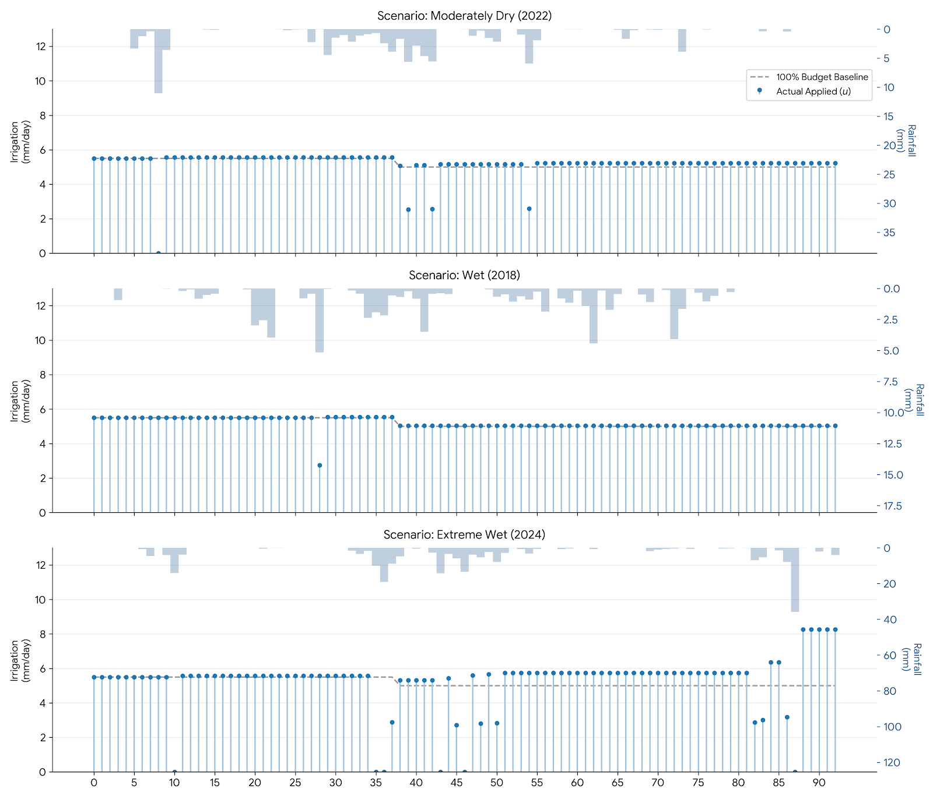
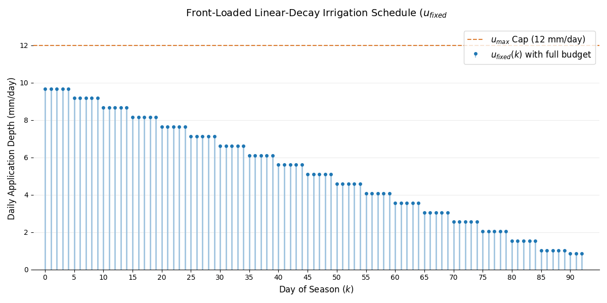
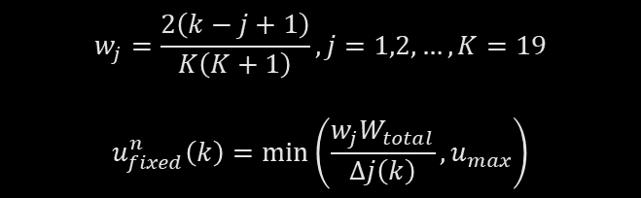
Heuristic Controllers
Fixed-Schedule Controller
Reactive Controller
$$w_{j}=\frac{2\left(k−j+1\right)}{K\left(K+1\right)}, j=1,2,…,K=19$$
$$u_{fixed}^{n}\left(k\right)=\min\left(\frac{w_{j}W_{total}}{Δj\left(k\right)},u_{max}\right)$$
8
Notes:
controller overview (brief overview of all controllers designed)
reactive controllers (fixed schedule + reactive controller recently designed and now existing in repo)

Slide 9
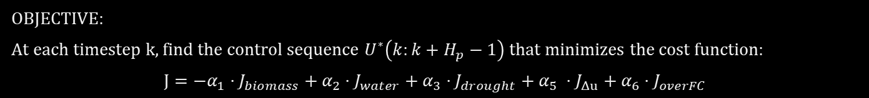
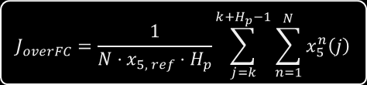
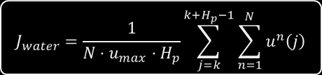
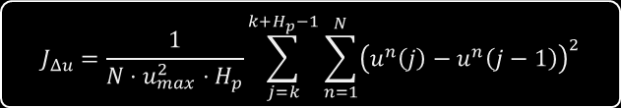
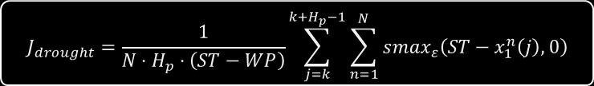
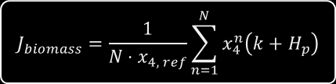

MPC Problem Statement
OBJECTIVE:
At each timestep k, find the control sequence $U^{∗}\left(k:k+H_{p}−1\right)$ that minimizes the cost function:
$$J=−α_{1}⋅J_{biomass}+α_{2}⋅J_{water}+α_{3}⋅J_{drought}+α_{5} ⋅J_{Δu}+α_{6}⋅J_{overFC}$$
$$J_{biomass}=\frac{1}{N⋅x_{4, ref}}\sum_{n=1}^{N}{x_{4}^{n}\left(k+H_{p}\right)}$$
$$J_{water}=\frac{1}{N⋅u_{max}⋅H_{p}}\sum_{j=k}^{k+H_{p}−1}{\sum_{n=1}^{N}{u^{n}\left(j\right)}}$$
$$J_{overFC}=\frac{1}{N⋅x_{5, ref}⋅H_{p}}\sum_{j=k}^{k+H_{p}−1}{\sum_{n=1}^{N}{x_{5}^{n}\left(j\right)}}$$
$$J_{drought}=\frac{1}{N⋅H_{p}⋅\left(ST−WP\right)}\sum_{j=k}^{k+H_{p}−1}{\sum_{n=1}^{N}{smax_{ε}\left(ST−x_{1}^{n}\left(j\right),0\right)}}$$
$$J_{Δu}=\frac{1}{N⋅u_{max}^{2}⋅H_{p}}\sum_{j=k}^{k+H_{p}−1}{\sum_{n=1}^{N}{{\left(u^{n}\left(j\right)−u^{n}\left(j−1\right)\right)}^{2}}}$$
CONSTRAINTS:
$$x^{n}\left(j+1\right)=f\left(x^{n}\left(j\right),u^{n}\left(j\right),w\left(j\right);𝒢\right), n=1,…,N, j=k,…,k+H_{p}−1$$
$$0≤u^{n}≤u_{max}, ∀n,∀j$$
$$\sum_{j=k}^{k+H_{p}−1}{\sum_{n=1}^{N}{u^{n}\left(j\right)}≤N⋅W_{remaining}\left(k\right)}$$
9
Notes:
controller overview (brief overview of all controllers designed)
reactive controllers (fixed schedule + reactive controller recently designed and now existing in repo)

Slide 10
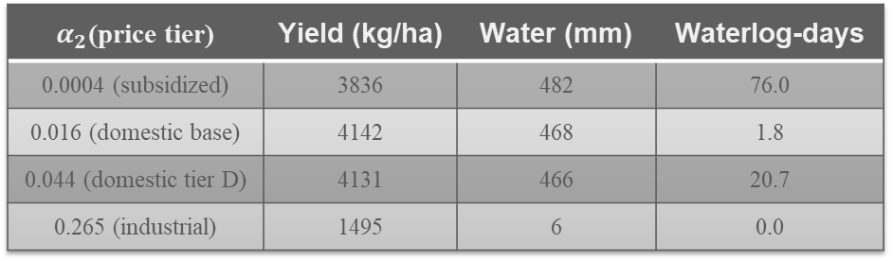
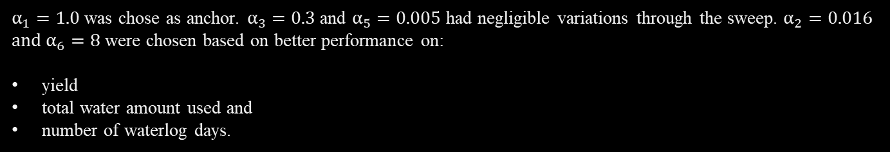
MPC Parameter Selection
Selection of Receding Horizon Hp
Hp | Yield (kg/ha) | Mean solve time | Total wallclock/season
3 | 3791 | 3.2s | 0.05-0.1h
8 | 3810 | 23.5s | 0.7-1.4h
14 | 3819 | 105.0s | 1.0-7.6h
Selection of cost function parameters
$α_{1}=1.0$ was chose as anchor. $α_{3}=0.3$ and $α_{5}=0.005$ had negligible variations through the sweep. $α_{2}=0.016$ and $α_{6}=8$ were chosen based on better performance on:
yield
total water amount used and
number of waterlog days.
$α_{2}$(price tier) | Yield (kg/ha) | Water (mm) | Waterlog-days
0.0004 (subsidized) | 3836 | 482 | 76.0
0.016 (domestic base) | 4142 | 468 | 1.8
0.044 (domestic tier D) | 4131 | 466 | 20.7
0.265 (industrial) | 1495 | 6 | 0.0
10
Notes:
(+ weights sweep, horizon analysis)

Slide 11
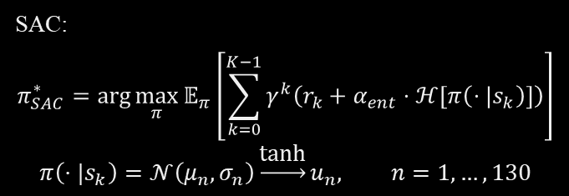
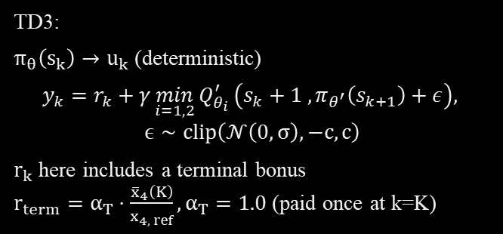
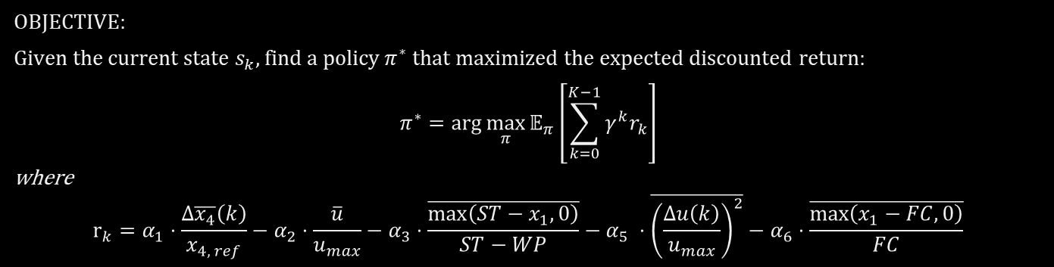
RL Controller Problem Statement
OBJECTIVE:
Given the current state $s_{k}$, find a policy $π^{∗}$ that maximized the expected discounted return:
$$π^{∗}=\arg{\max_{π}{𝔼_{π}\left[\sum_{k=0}^{K−1}{γ^{k}r_{k}}\right]}}$$
where
$$r_{k}=α_{1}⋅\frac{Δ\overline{x_{4}}\left(k\right)}{x_{4, ref}}−α_{2}⋅\frac{\overline{u}}{u_{max}}−α_{3}⋅\frac{\overline{\max\left(ST−x_{1},0\right)}}{ST−WP}−α_{5} ⋅\overline{{\left(\frac{Δu\left(k\right)}{u_{max}}\right)}^{2}}−α_{6}⋅\frac{\overline{\max\left(x_{1}−FC,0\right)}}{FC}$$
SAC:
$$π_{SAC}^{∗}=\arg{\max_{π}{𝔼_{π}\left[\sum_{k=0}^{K−1}{γ^{k}\left(r_{k}+α_{ent}⋅ℋ\left[π\left(⋅|s_{k}\right)\right]\right)}\right]}}$$
$$π\left(⋅|s_{k}\right)=𝒩\left(μ_{n}, σ_{n}\right)\underset{→}{\text{tanh}}u_{n}, n=1,…,130$$
TD3:
$π_{θ}\left(s_{k}\right)→u_{k}$ (deterministic)
$$y_{k}=r_{k}+γ\min_{i=1,2}{Q_{θ_{i}}^{′}}\left(s_{k}+1 ,π_{θ^{′}}\left(s_{k+1}\right)+ε\right),$$
$$ϵ∼clip\left(𝒩\left(0,σ\right),−c,c\right)$$
$r_{k}$ here includes a terminal bonus
$r_{term}=α_{T}⋅\frac{{\overline{x}}_{4}\left(K\right)}{x_{4, ref}},α_{T}=1.0$ (paid once at k=K)
11
Notes:
RL problem statement: cost function + network structure (for training and execution) 1. sac 2. td3

Slide 12



RL Controller Network Architecture
ACTOR
CRITIC
$$μ_{n}$$
128 dims
TD3
Linear
Linear
Linear
Q
LayerNorm
ReLU
LayerNorm
ReLU
LayerNorm
ReLU
$$μ_{n}$$
66 dims
67 dims
128 dims
128 dims
256 dims
256 dims
$$σ_{n}$$
128 dims
SAC
2
12

Slide 13
Primary Results
Controller | Yield (kg/ha) | % of Ceiling | Drought-days | Waterlog-days | Water Usage (mm) | Decision latency (ms)
No irrigation | 1728 | 43.5 | 86.5 | 1.4 | 0 | -
Fixed schedule | 3314 | 82.7 | 28.2 | 54.3 | 411 | -
Reactive controller | 3532 | 88.2 | 33.0 | 41.7 | 411 | -
SAC (Pool A) | 3785 | 94.6 | 25.6 | 18.2 | 382 | 1.0
SAC (Pool B) | 3777 | 94.4 | 32.4 | 16.1 | 376 | 1.0
MPC (Hp = 8) | 3810 | 95.2 | 16.0 | 7.7 | 364 | 52,603
TD3 (Pool B, 3-seed) | 3800 | 95.0 | 35.2 | 6.5 | 358 | 1.3
TD3 (Pool A, 3-seed) | 3805 | 95.1 | 33.7 | 7.2 | 362 | 1.3
13
Notes:
results (maybe more than one slide): yield, water used, number of drought and waterlog days, soil moisture level plots, latency, mean delta u

Slide 14
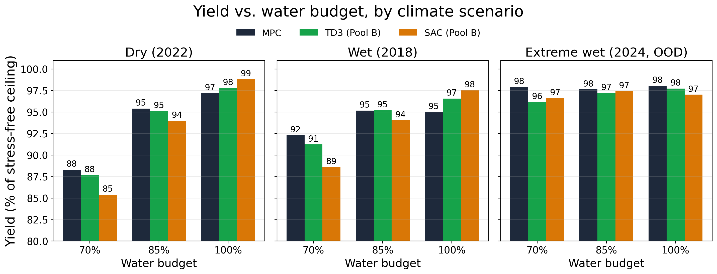
Per Scenario Analysis
14

Slide 15
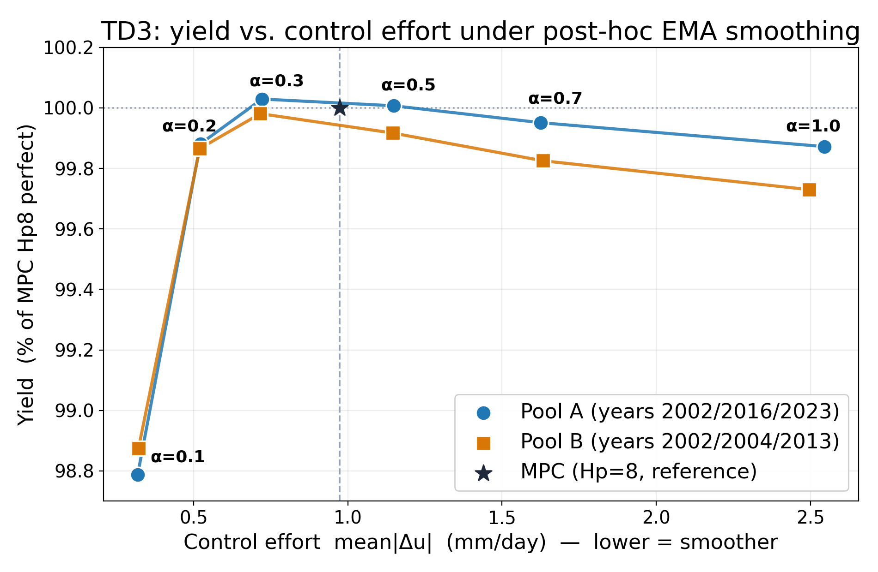
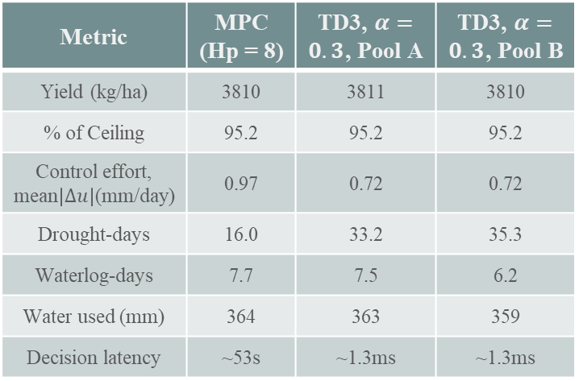
Mean ∆u Smoothing
Metric | MPC (Hp = 8) | TD3, $α=0.3$, Pool A | TD3, $α=0.3$, Pool B
Yield (kg/ha) | 3810 | 3811 | 3810
% of Ceiling | 95.2 | 95.2 | 95.2
Control effort, mean$\left|Δu\right|$(mm/day) | 0.97 | 0.72 | 0.72
Drought-days | 16.0 | 33.2 | 35.3
Waterlog-days | 7.7 | 7.5 | 6.2
Water used (mm) | 364 | 363 | 359
Decision latency | ~53s | ~1.3ms | ~1.3ms
15
Notes:
results (maybe more than one slide): yield, water used, number of drought and waterlog days, soil moisture level plots, latency, mean delta u

Slide 16
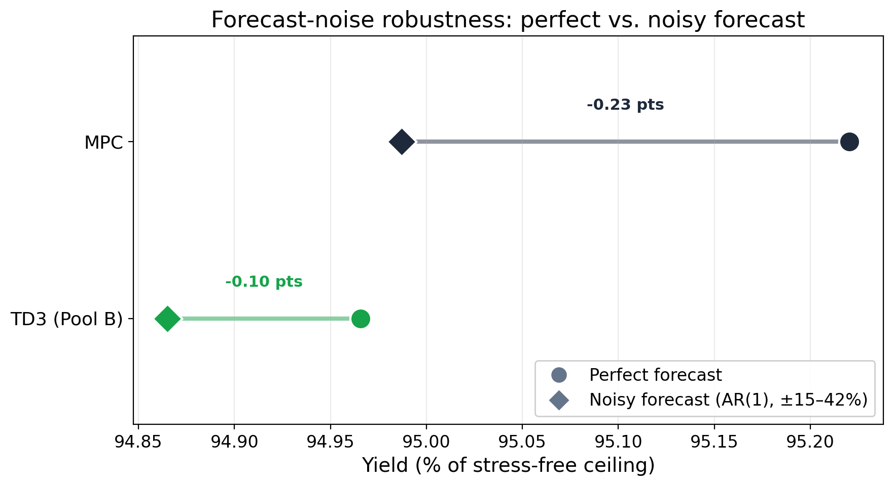
Robustness to Noise
Controller | %Yield, perfect | %Yield, noisy | ∆, pts
MPC (Hp = 8) | 95.2 | 95.0 | -0.23 pts
SAC (Pool A) | 94.6 | 93.8 | -0.78 pts
MPC (Hp = B) | 94.4 | 93.6 | -0.83 pts
TD3 (Pool A) | 95.1 | 94.9 | -0.21 pts
TD3 (Pool B) | 95.0 | 94.9 | -0.10 pts
TD3
16

Slide 17

Conclusion
A model-free TD3 policy matches MPC's yield (99.7%, 3800 vs 3810 kg/ha) at ~1ms vs ~53s per decision and exceeds it on waterlog control and water efficiency.
Post-hoc EMA smoothing (α=0.3) closes 70% of TD3's control-effort gap to MPC.
A pool-composition decomposition shows ~70% of the apparent SAC-vs-TD3 drought gap was training-data artifact, not algorithm choice.
17

Slide 18
Supervisor’s Comment
Студент имеет публикацию в рецензируемом издании, индексируемом в Scopus, по материалам международной https://www.sciencedirect.com/science/article/pii/S2405896325028101 конференции.
17

Slide 19
Reviewer’s Question
Какой из рассмотренных в работе подходов к управлению орошением, на ваш взгляд, наиболее перспективен для практического внедрения в условиях Ирана и почему?
Answer: As MPC controllers require centralized processing, the cost of their implementation can be very high. It is also difficult to implement them in rural areas on large fields with unreliable network connections and power supplies. Since RL can be implemented fully decentralized on low-power edge controllers and has shown a performance on par with MPC, I assume RL is a better choice.
17

Slide 20

THANK YOU FOR YOUR TIME!
taratorbati@yahoo.com
18

