Slide 1
Ransomware encryption techniques
Tarcísio Marinho
Na beira do rio, 04/09/18

Slide 2
Ransomware purposes
Get money from ransom
Encrypt and decrypt files
Greatest damage possible

Slide 3
Encryption schemes
Only AES
Only RSA
AES + ClientRSA + ServerRSA

Slide 4
Security measures
RSA-2048 keys for each new infection
AES-256 key to each file
Securely random generated keys
Tor network for communication with C&C servers
Cryptocurrency for payment
Wipe memory after use

Slide 5
Encryption walkthrough
Generate RSA key pair
Encrypt Cpriv.key with Spub.key
Generate random AES key for each file
Encrypt AES key with Cpub.key
Write to disk encrypted_aes_keys encrypted_private_key

Slide 6
Decryption walkthrough
Send to server Encrypted_private_key
Decrypt AES keys with Cpriv.key
Decrypt each file with AES keys

Slide 7
Nowadays ransomware features
(Campaign dependent)
Exploit vulnerabilities
Stop services / antivirus
Close opened ports
Create several threads to multiple tasks
network / create files on disk / check internet / find files / check for connected devices
Tor connection and cryptocurrency payment
persistence

Slide 8
Infections
Telefonica (spain)
FedEx (us)
University of Waterloo (Canada)
VTB (russian bank)
Portugal Telecom (biggest telecommunication company in portugal)
ATM’s / Hospitals / Libraries / Schools

Slide 9
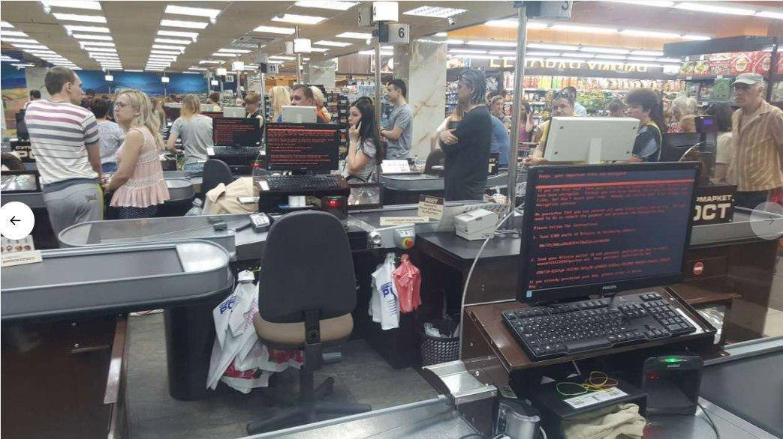

Slide 10
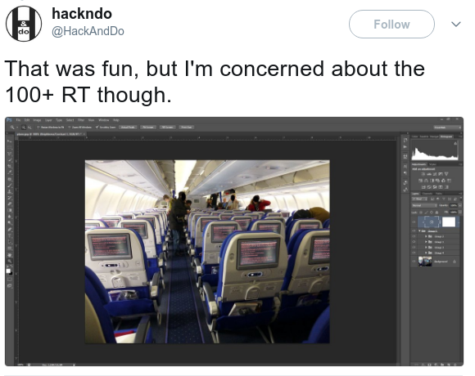

Slide 11
Links
https://gist.github.com/rain-1/989428fa5504f378b993ee6efbc0b168
https://www.secureworks.com/research/wcry-ransomware-analysis
https://www.sentryo.net/petya-ransomware-quick-analysis/
https://securelist.com/schroedingers-petya/78870/
https://research.checkpoint.com/ryuk-ransomware-targeted-campaign-break/
https://www.techrepublic.com/article/the-top-10-worst-ransomware-attacks-of-2017-so-far/
https://blog.comae.io/petya-2017-is-a-wiper-not-a-ransomware-9ea1d8961d3b
https://medium.com/@thegrugq/pnyetya-yet-another-ransomware-outbreak-59afd1ee89d4
https://www.comparitech.com/antivirus/ransomware-statistics/#gref
https://www.dimensiondata.com/insights/-/media/dd/corporate/pdfs/gtir-executive-guide-2018.pdf

