Slide 1
Ransomware encryption techniques
Tarcísio Marinho
Na beira do rio

Slide 2
Trends in ransomware encryption
Standard encryption algorithms (AES, RSA, RC4, Blowfish)
Hashing (SHA1, SHA256, MD5)
Usage of OS API or OpenSSL

Slide 3
Key management
Download secret key to encrypt all user files
Generating a random key to encrypt all user files and uploading to a server
Using hardcoded keys
Hardcoded server public key to encrypt random generated AES keys used to encrypt user files

Slide 4
Using public key cryptography
Server pubkey to encrypt global AES key used to encrypt user files
Server pubkey to encrypt random generated AES keys
Server pubkey to encrypt random generated Client privkey and encrypt AES keys with Client pubkey

Slide 5
Some ransomware implementation flaws

Slide 6
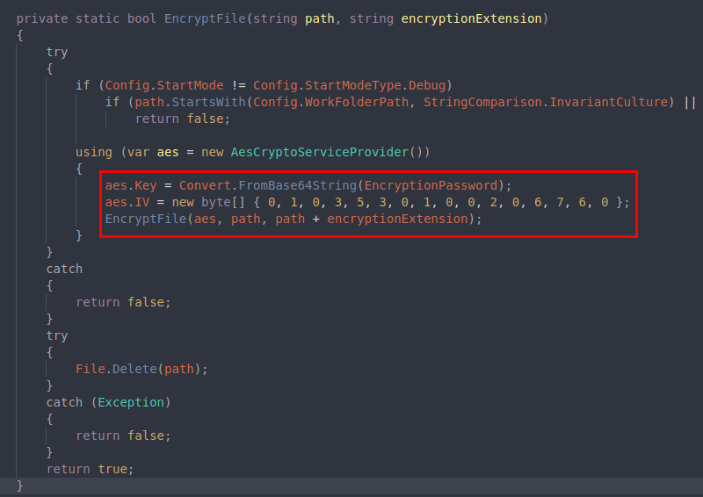
Jigsaw

Slide 7
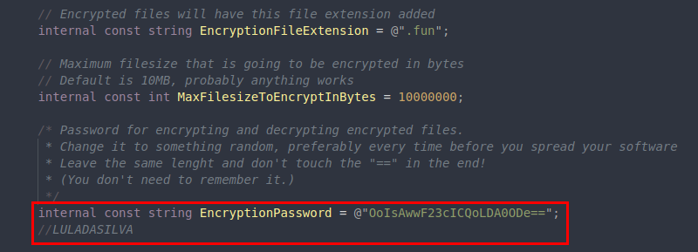
Jigsaw

Slide 8
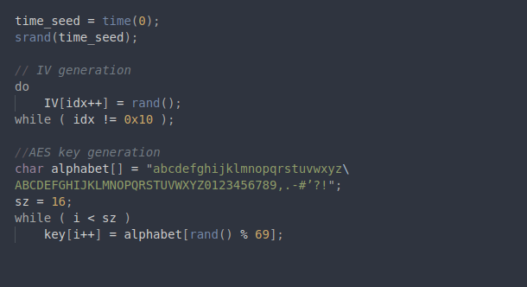
Linux.Encoder.1

Slide 9
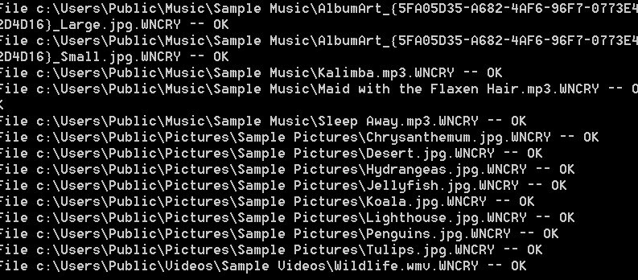
WannaCry

Slide 10
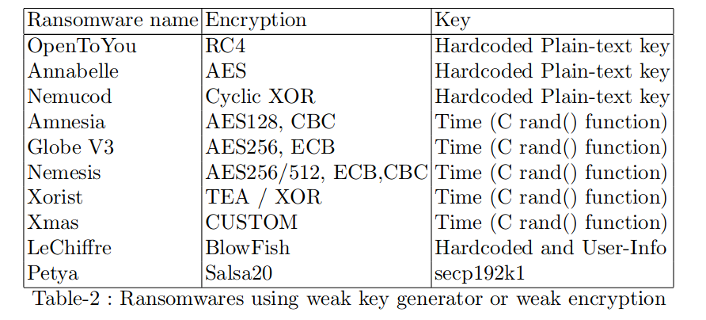
Other ransomwares

Slide 11
Things that shouldn’t happen
Saving keys on disk as plain text
Hardcoded keys
Poorly random generated keys
Keys in memory after encryption
Manually implementing an encryption algorithm

Slide 12
Nomeclatures
Server private key → Spriv.key
Server public key → Spub.key
Client private key → Cpriv.key
Client public key → Cpub.key

Slide 13
Encryption walkthrough
Generate RSA key pair for each new infection
Encrypt Cpriv.key with Spub.key
Generate random AES keys for encrypting files
Encrypt AES keys with Cpub.key
Write to disk all encrypted_aes_keys and encrypted_Cpriv.key

Slide 14
Decryption walkthrough
Send to server the encrypted_Cpriv.key to it decrypt after paying the ransom
Server send back to client the Cpriv.key
Decrypt the AES keys with Cpriv.key
Decrypt each file with AES keys

Slide 15
POC
Encrypt all files
Encrypted keys are stored on disk
New process called Daemon, waiting for new files to be encrypted
Decryptor communicating with server

Slide 16
Thank you !

Slide 17
Links
https://labs.bitdefender.com/wp-content/uploads/2015/11/1251711000741210279.pdf
https://eprint.iacr.org/2018/598.pdf
https://gist.github.com/rain-1/989428fa5504f378b993ee6efbc0b168
https://www.secureworks.com/research/wcry-ransomware-analysis
https://www.sentryo.net/petya-ransomware-quick-analysis/
https://securelist.com/schroedingers-petya/78870/
https://research.checkpoint.com/ryuk-ransomware-targeted-campaign-break/
https://www.techrepublic.com/article/the-top-10-worst-ransomware-attacks-of-2017-so-far/
https://blog.comae.io/petya-2017-is-a-wiper-not-a-ransomware-9ea1d8961d3b
https://medium.com/@thegrugq/pnyetya-yet-another-ransomware-outbreak-59afd1ee89d4
https://www.comparitech.com/antivirus/ransomware-statistics/#gref
https://www.dimensiondata.com/insights/-/media/dd/corporate/pdfs/gtir-executive-guide-2018.pdf

