Slide 1

Robot Cognition System for Wheelchair
Faculty of Electrical Engineering and Computation
Professor: Ph.D Eric Rohmer
Student: Tarcisio Franco de Carvalho

Slide 2
Index
Architecture Overview
System Components
Components Testing
Experimental Demo Video

Slide 3
Architecture Overview
Use case context
  The main users of this solution would be persons with body disabilities that uses a robot wheelchair to move safely considering terrain unevenness.
  The two solutions below will be considered as central input components for this project to produce the desired user target location classification as safe or unsafe considering the robot’s climb capabilities against the unevenness of the terrain:
    The Ph.D Eric Rohmer has developed the idea to have a diode laser in a wheelchair that can be pointed to a desired user target goal based on where the user is looking.
    The Ph.D Mauro Bellone has developed the UPD library that classifies the unevenness of a terrain using traversability analysis on point cloud data.

Slide 4
Architecture Overview
Goals in scope
  The components should be developed considering the re-usability for further researches
  The control of the cognition system should be developed in a way to have flexibility in choosing the user interface
  The environment can be simulated to avoid costs and speed up the research

Slide 5
Architecture Overview
Goals out of scope
  User Interface adapted for person with disabilities as face recognition approach will be considered in further researches. For this current project a simple web user interface are in scope to simulate all the solution controls
Constraints and limitations
  The test in a real environment will depend of the availability of the robot wheelchair during the project life cycle.

Slide 6
Architecture Overview
Architecture decisions
Decision | Why
Use ROS (Robot Operational System) framework as platform for components of this system | - ROS has many built-in components that can be reused as robot navigation stack, point cloud data conversions and messages, etc. - The custom components developed for this project can be encapsulated as ROS node and take the advantages of the integration with other ROS built-in nodes.
Component oriented development as a service concept | - To speed up and help further research projects, the components developed for this project should be designed as a service to be reused in order projects. Also, these components should have its own documentation regarding its setup and run.
Gazebo Software as Environment Simulation | - As the ROS was selected as main framework for this project, we decided to use Gazebo that has more built-in integration components with ROS. In case of using another software as V-REP, the solution should work as well with no much adjustments.

Slide 7
Architecture Overview
Architecture decisions cont..
Decision | Why
Python as main language | - The project will use C++ and Python. The priority is to use Python as it has less complexity the C++ for build and run, and it has more libraries for modern API architectures as REST APIs.
REST API architecture for interface controls | - Looking forward to help other researches in the user interface field for persons with disabilities, all the control of this solution should be developed in REST APIs, then modern user interfaces as mobile applications can take the advantage of this architecture.
UPD library for unevenness terrain classification | - The Ph.D Mauro Bellone has developed a library that uses traversability analysis to classify the unevenness of a terrain that will be an input for wheelchair robot passage classification.
Path planning | - The robot wheelchair should move in a smooth way to the target ensuring the comfort of the user during the movement and avoiding instabilities.

Slide 8
System Components
The system components have the following layers:
      Simulated Environment: Represents all components related to the user environment simulation as depth sense device, laser and the wheelchair itself.
      Back-end Environment: Represents all the logical components related to this solution, as to move the robot to the target point, classify the robot passage condition, convert laser range data to point cloud data, etc.
      Front-end Environment: Represents all the controls for this solution, defined in a REST API architecture. For testing purposes was developed a web user interface layer to present the controls functionalities.

Slide 9
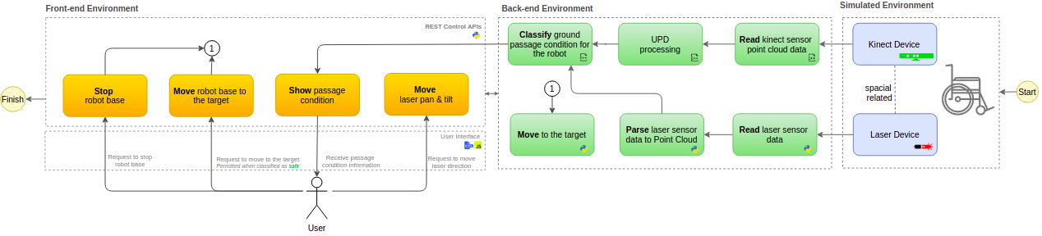
System Components
Components Iteration Diagram

Slide 10
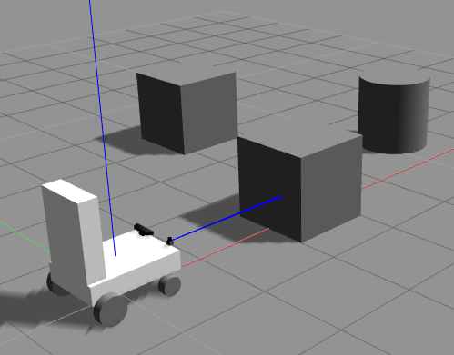
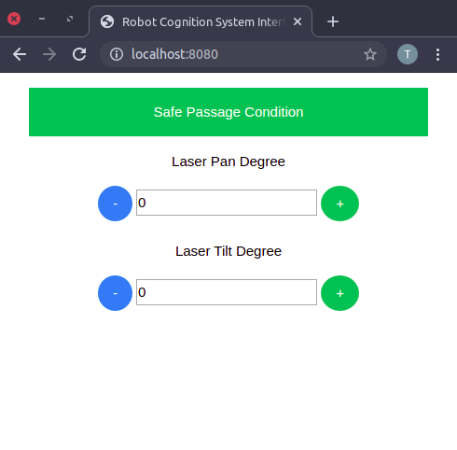
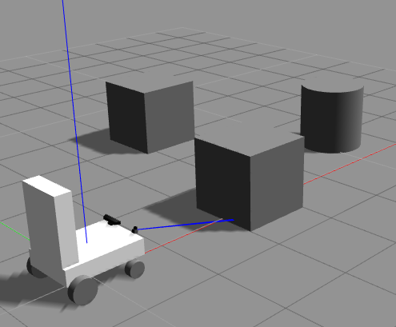
Components Testing
Before
Test case A: Laser Tilt Control
Test: In the UI, in Laser Tilt Degree control click in the green (+) button until getting 15 degrees. You should see in the Gazebo the laser tilt movement expected
After

Slide 11
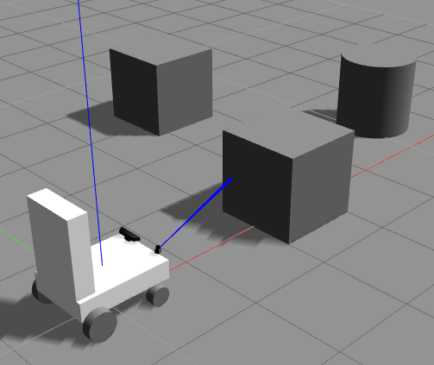
Components Testing
Before
Test case B: Laser Pan Control
Test: In the UI, in Laser Pan Degree control click in the green (+) button until getting 20 degrees. You should see in the Gazebo the laser tilt movement expected
After

Slide 12
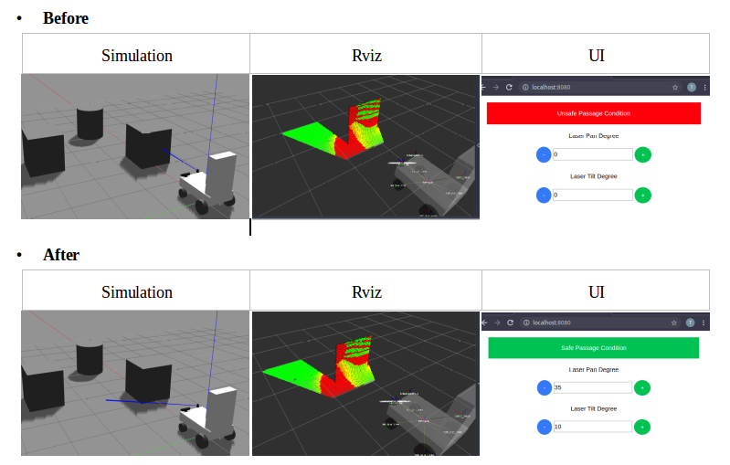
Components Testing
Test case C: Laser pointing to a safe passage condiction
Test: In the UI, move the laser pan and tilt to reach green UPD classified points cloud in Rviz, then verify if the box message color in UI will change to green.

Slide 13
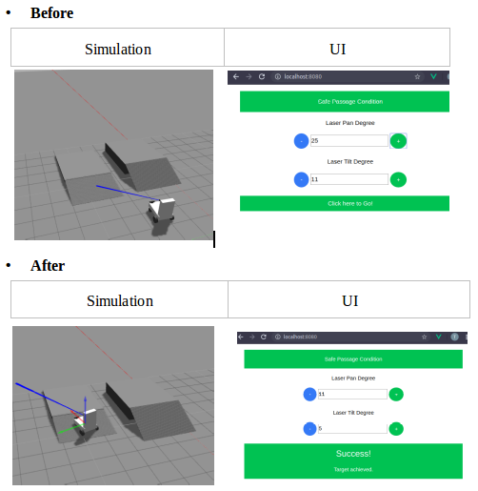
Components Testing
Test case E: Move the Robot to a target point
Test: In the UI, move the laser pan and tilt to reach green UPD classified points cloud in Rviz, then verify if the box message color in UI will change to green, then click in the “Click here to go button”

Slide 14
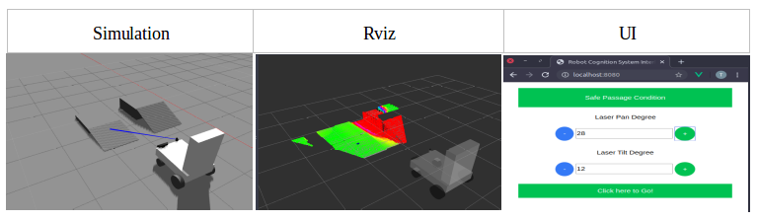
Components Testing
Test case F: Target point goal accepted for a ramp with less than 15 degrees
Test: In the UI, move the laser pan and tilt to reach the left ramp and check if the passage condition was classified as “safe” in the web interface

Slide 15
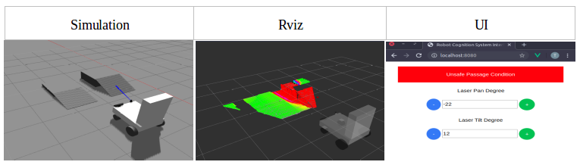
Components Testing
Test case G: Target point goal not accepted for a ramp with more than 15 degrees
Test: In the UI, move the laser pan and tilt to reach the left ramp and check if the passage condition was classified as “unsafe” in the web interface

Slide 16
Experimental Demo Video
The videos contains an initial experimental demo where the cognition system classifies a high ramp in front it as unsafe, blocking the user to move to there and move the wheelchair robot to a safe target point selected by the user
Demo 1 – Safe ramp with less than 15 deg: https://youtu.be/pBJWWjMs2dI
Demo 2 – Unsafe ramp with more than 15 deg: https://youtu.be/ezVCY6FqzY8

