Slide 1
Desenvolvimento de Jogos Digitais II
Ely Prado

Slide 2
Unity
A Unity permite que você compile e publique seus jogos em diversas plataformas:
PC, Mac, and Linux Standalone
tvOS
Lumin Magic Leap (óculos de realidade virtual)
iOS
Android
WebGL
PlayStation 4, Xbox One e Nintendo Switch

Slide 4
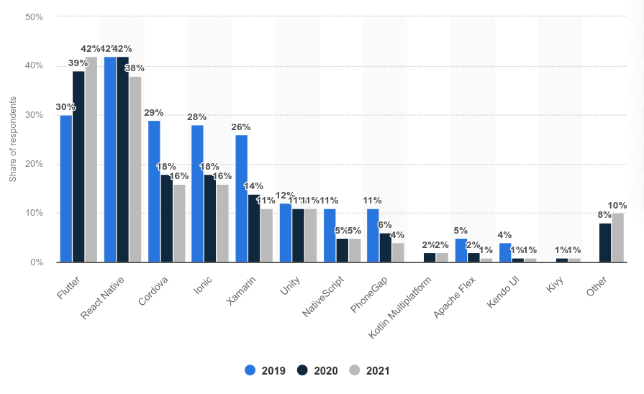
https://www.statista.com/statistics/869224/worldwide-software-developer-working-hours/

Slide 5
Compilador para Android

Slide 6
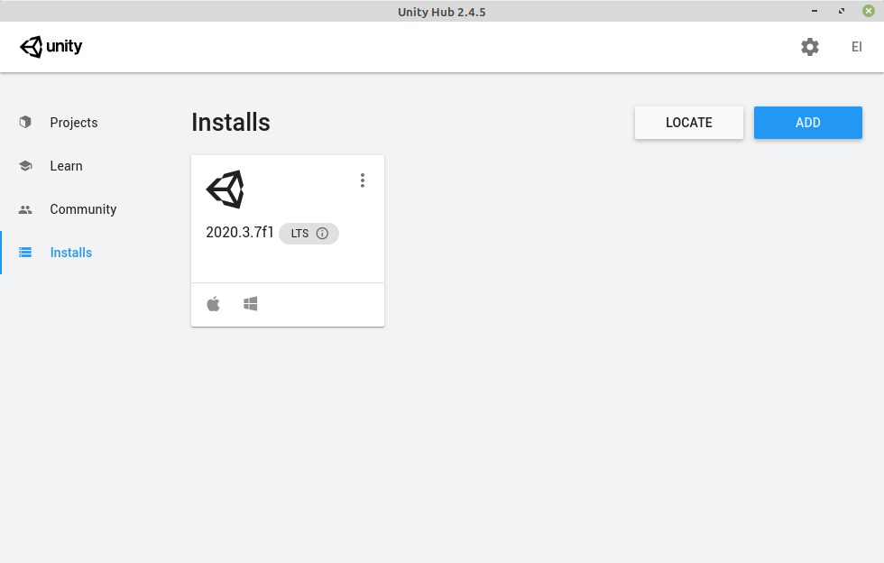

Slide 7
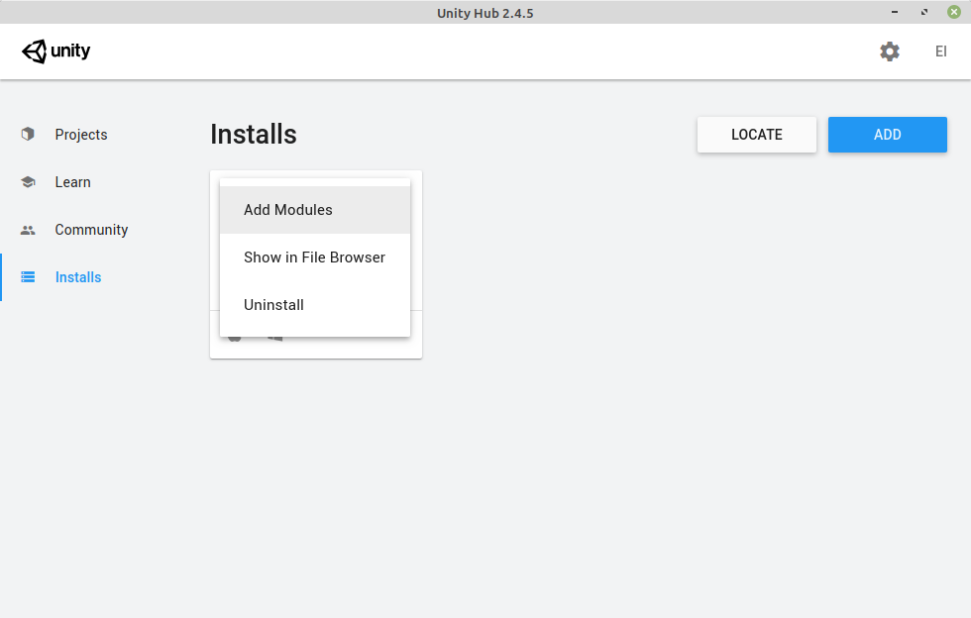

Slide 8
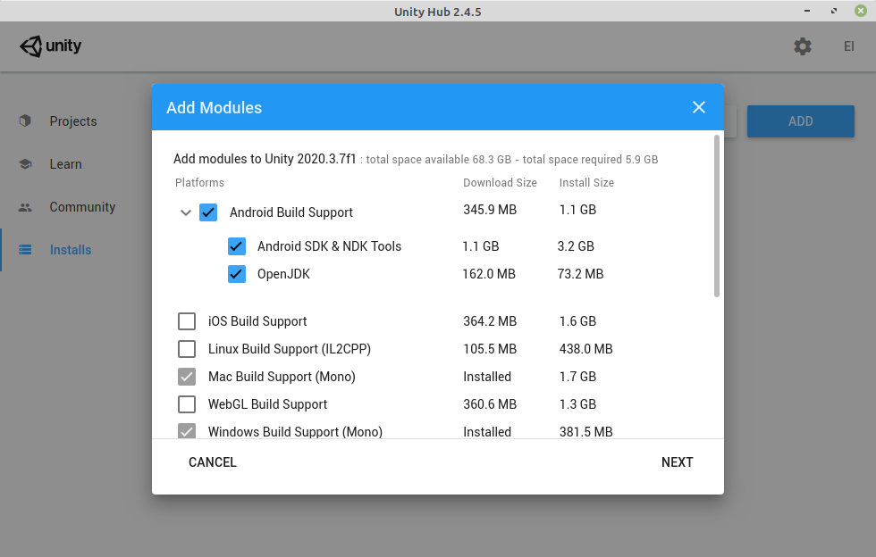

Slide 9
Controle Touch Screen

Slide 10
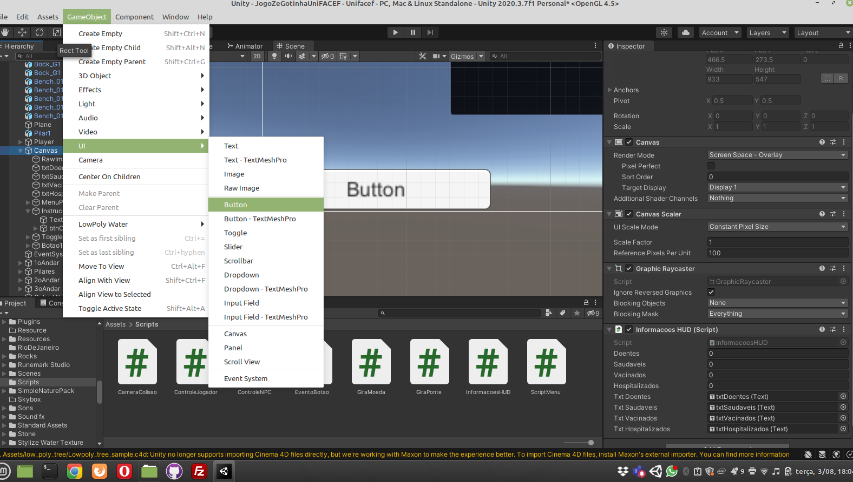

Slide 11
Script: EventoBotao.cs
using UnityEngine;
using System.Collections;
using UnityEngine.EventSystems;
public class EventoBotao : MonoBehaviour, IPointerDownHandler, IPointerUpHandler {
public bool buttonPressed;
public void OnPointerDown(PointerEventData eventData){
buttonPressed = true;
}
public void OnPointerUp(PointerEventData eventData){
buttonPressed = false;
}
}

Slide 12
Script: ControleJogador.cs
...
public GameObject botao1;
...
void Update() {
...
if (Input.GetButton("Jump") || botao1.GetComponent<EventoBotao>().buttonPressed)
...

Slide 13
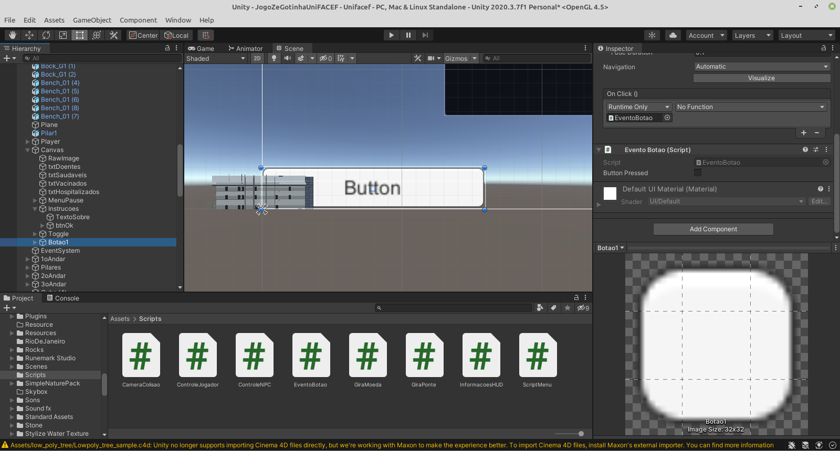

Slide 14
