Slide 1
Desenvolvimento de Jogos com Unity
Prof. Me. Ely Prado

Slide 2
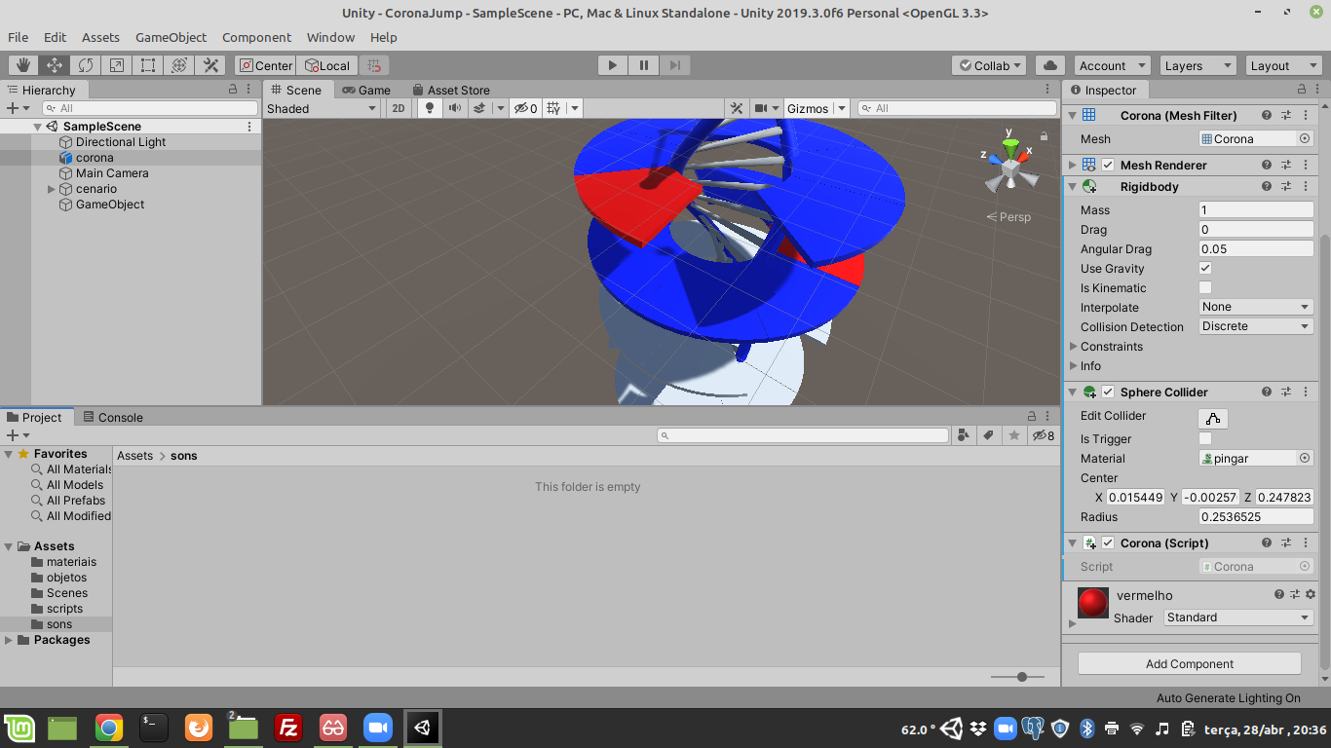

Slide 3
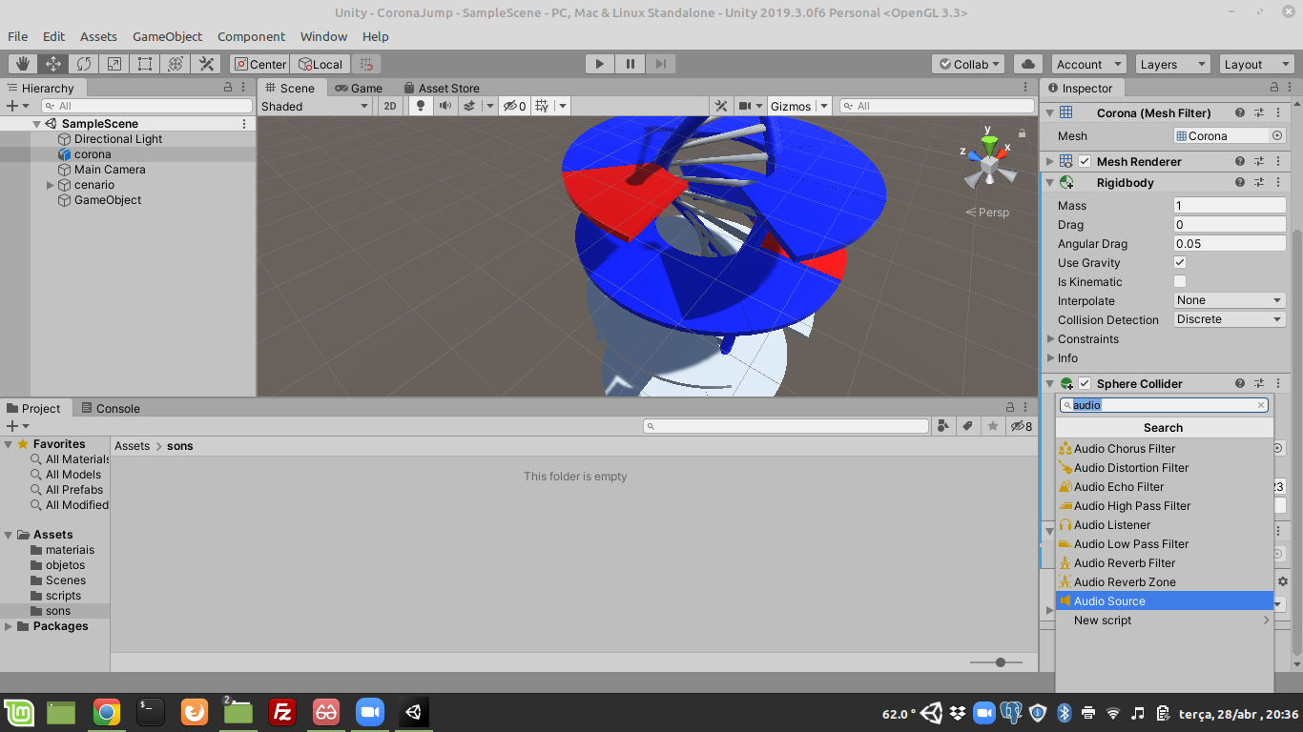

Slide 4
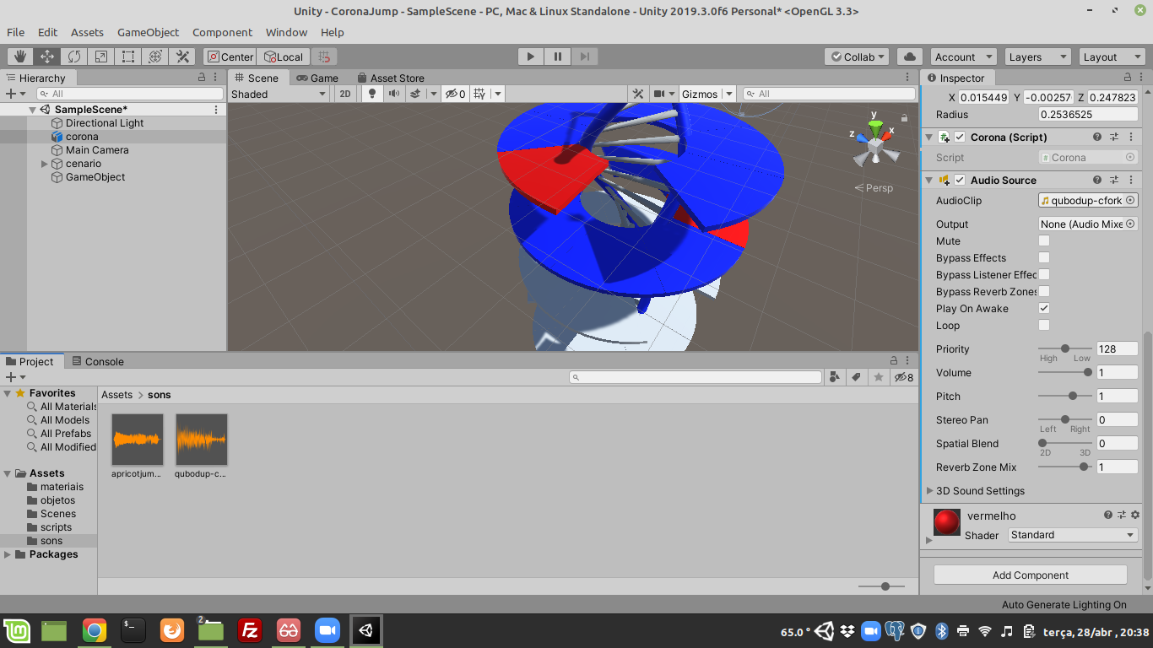

Slide 5


Slide 6
using System.Collections;
using System.Collections.Generic;
using UnityEngine;
using UnityEngine.SceneManagement;
public class Corona : MonoBehaviour {
public AudioSource som1;
public AudioSource som2;
void Start() {
som1 = GetComponents<AudioSource>()[0];
som2 = GetComponents<AudioSource>()[1];
}
void OnCollisionEnter(Collision collision) {
if (collision.relativeVelocity.magnitude > 2) {
som1.Play();
}
}
void OnTriggerEnter(Collider other) {
if (other.gameObject.CompareTag ("vermelho")) {
som2.Play();
InvokeRepeating("reiniciar", 0.5f, 1);
}
}
void reiniciar() {
SceneManager.LoadScene(0);
}
}

