Slide 1

Spectra Generation
Skills Meeting July 10th

Slide 2
photons
Photosphere
Ejecta

Slide 3

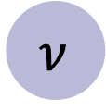
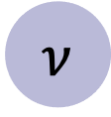
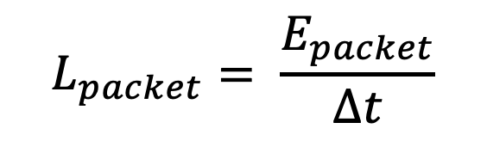


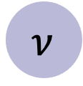
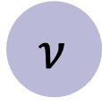

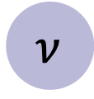
Energy Packets
Bundles of photons of the same frequency
$$ν$$
$$ν$$
Photosphere
$$ν$$
$$ν$$
$$ν$$
$$L_{packet}= \frac{E_{packet}}{Δt}$$
$$ν$$
$$ν$$
$$ν$$
$$ν$$

Slide 4
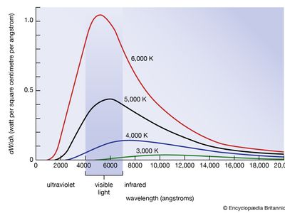

Photosphere
$$T_{inner}$$

Slide 5
Photosphere
$$T_{inner}$$

Slide 6
Photosphere
Outer boundary
$$T_{inner}$$

Slide 7
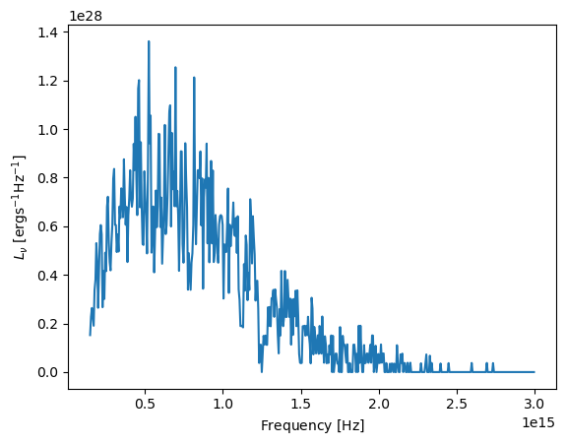
Basic Spectrum
Select only packets that escaped
Bin them!
Let’s look at that in a
tutorial notebook

Slide 8
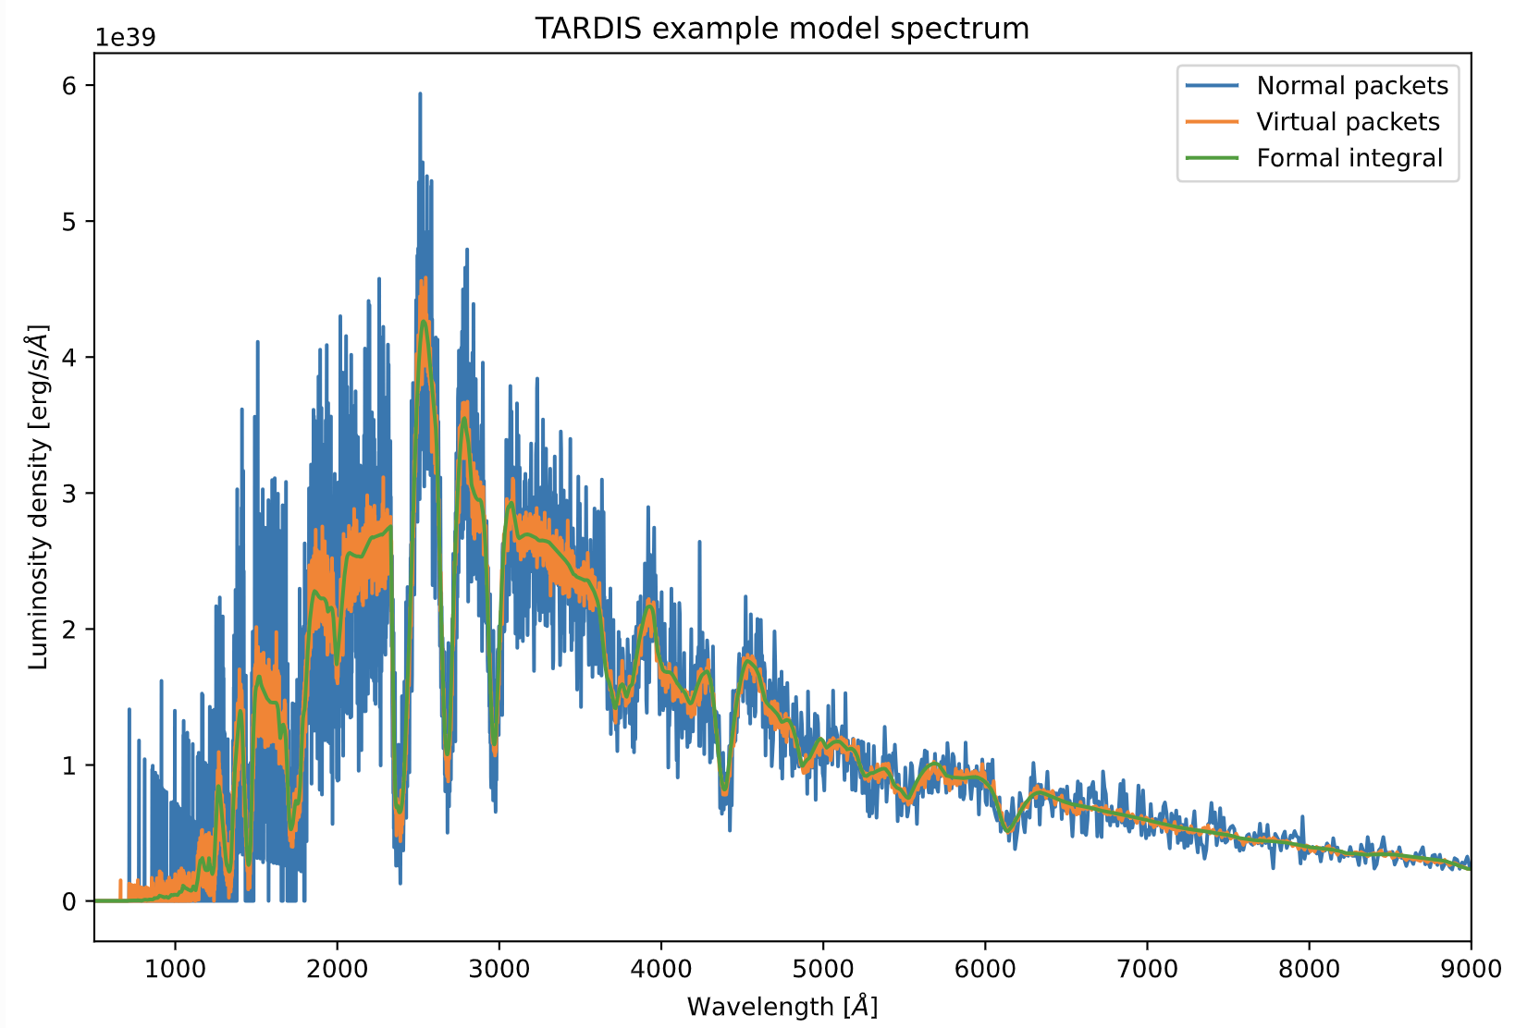
Other TARDIS Spectra

