Slide 1

Light and Matter Interactions
Skills Meeting June 13th

Slide 2
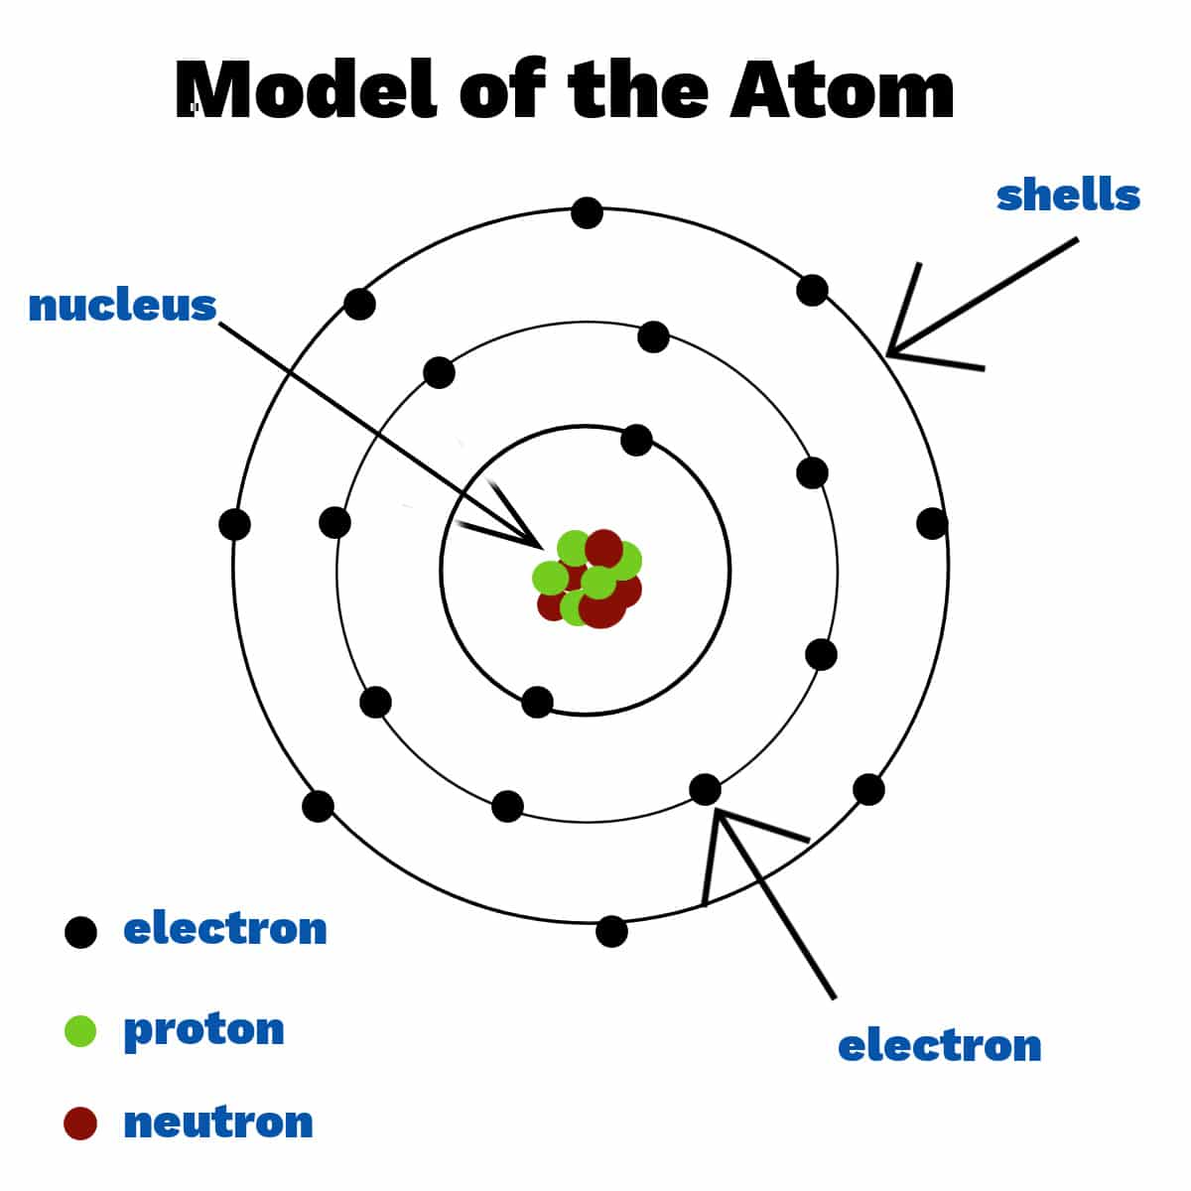
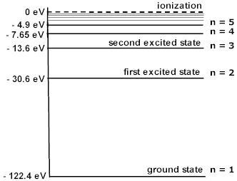
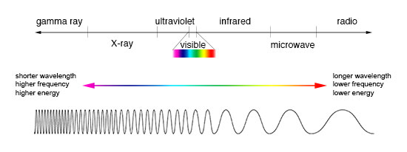
Light
Each photon has
Speed c (3e8 m/s, in a vacuum)
Wavelength * frequency = c
Energy ∝ frequency (or color)
Matter
Notes:
So first the basics on both light and matter
Light comes in quanta known as photons and these can behave both like a wave and a particle, and thus have properties of both. They propograte at speed c and as all waves its speed is related to the wavelength and frequency. Photons also have energy which they can give up to matter, and this is related to the frequency of the photon. Below is the electromagnetic spectrum and it shows how increasing frequency decreases the wavelength but also increases the energy
Matter exists as atoms, which are comprised of a proton and neutron nucleus and electrons orbiting outside. The number of protons determines the element and the number of neutrons determines the isotope of that element. Electrons will be a key component to understanding interactions with light and they have a key property when bound to atoms, when bound they can possess only certain values of energy dependent on the atom which it resides, these are known as excitation state. Normally, the atom lives in the ground state, the normal assortment of the electrons in the atom, but if given the exact amount of energy, it will then be boosted into an excited state and if left alone will eventually come back down to the ground state.

Slide 3
Notes:
With that, let then connect back to what we already discussed, SN spectra, Here is what Anirban talked about last time: the supernovae explodes and emits light which is then observed and broken into its component colors producing the observed spectra seen on the right. Now I will describe more of what happens as the light leave the sn before getting to our telescopes

Slide 4
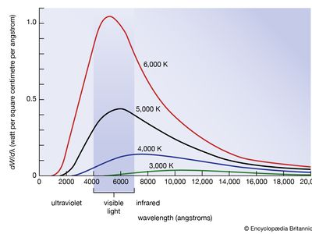
Photosphere
Notes:
When the supernova explodes, the inner parts are really hot and opaque, which is called the photosphere and modeled as a blackbody. A property of matter is that anything with a temperature emits light following this distribution and the temperature is related to where the peak is.
These photons from the inside then are sent through the material shot out in the blast, and this is where light and matter can interact

Slide 5
Possible interactions
Excitation
Ionization
Electron Scattering
Notes:
The light we observe may not be straight from the source, there are some things that can happen to the light before it reaches the telescope, all of which need to be account for by tardis when modeling supernova spectra

Slide 6
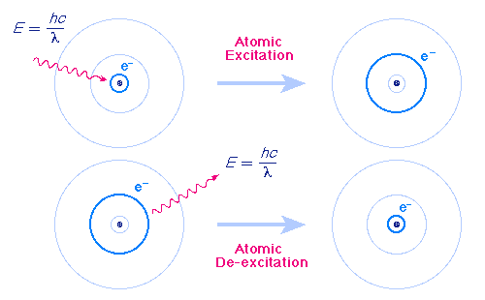
Possible interactions
Excitation
Ionization
Electron Scattering
Notes:
As discussed before if given a specific amount of energy an electron can enter an excited state, and if it is in an excited state is can go to a lower state by emitting a photon of energy equal to difference in energy between the two states. Each element has its own configuration of states giving rise to the absorption and emission spectra mentioned last time

Slide 7
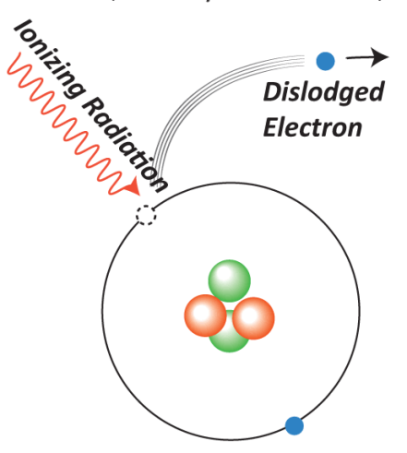
Possible interactions
Excitation
Ionization
Electron Scattering
Notes:
Like before, if a photon can given enough energy, it will be absorbed and the electron will be fully unbound from its atom and sent free.

Slide 8
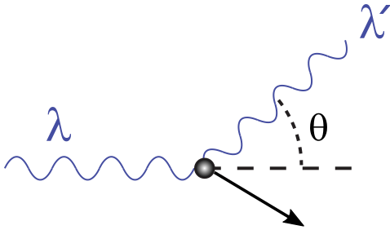
Possible interactions
Excitation
Ionization
Electron Scattering
e⁻
Notes:
Then the last one is electron scattering, a photon can be redirected by a free electron
However, if the electron is moving with a speed similar to that of the speed of light the electron can recoil from the interaction and take away some of the energy from the photon, increasing its wavelength. This interaction is more relevant at higher energies (x/gamma rays)

