Slide 1
MSBA Financial Group’s Updated Cloud Environment

Slide 2




Cloud Architecture
COMPANY’s DATA DATA LAKE ETL DATA WAREHOUSE ML Model
[AWS S3 Buckets]
[AWS GLUE]
[AWS Redshift]
[AWS SageMaker]
Canvas
datacorp_financial_data.csv
msba_fg_ratios_data.csv
Data_files/
[Visualize Data and columns,
Make Predictions on Data]
msba_fg_bankruptcy.txt
prediction/
bankruptcy_prediction.csv
company_profiles_to_predict_unlabeled.csv
msba-fingroup-690
MSBA Fingroup Financial ETL,
Train_Set_ETL
msba-fingroup-cluster

Slide 3
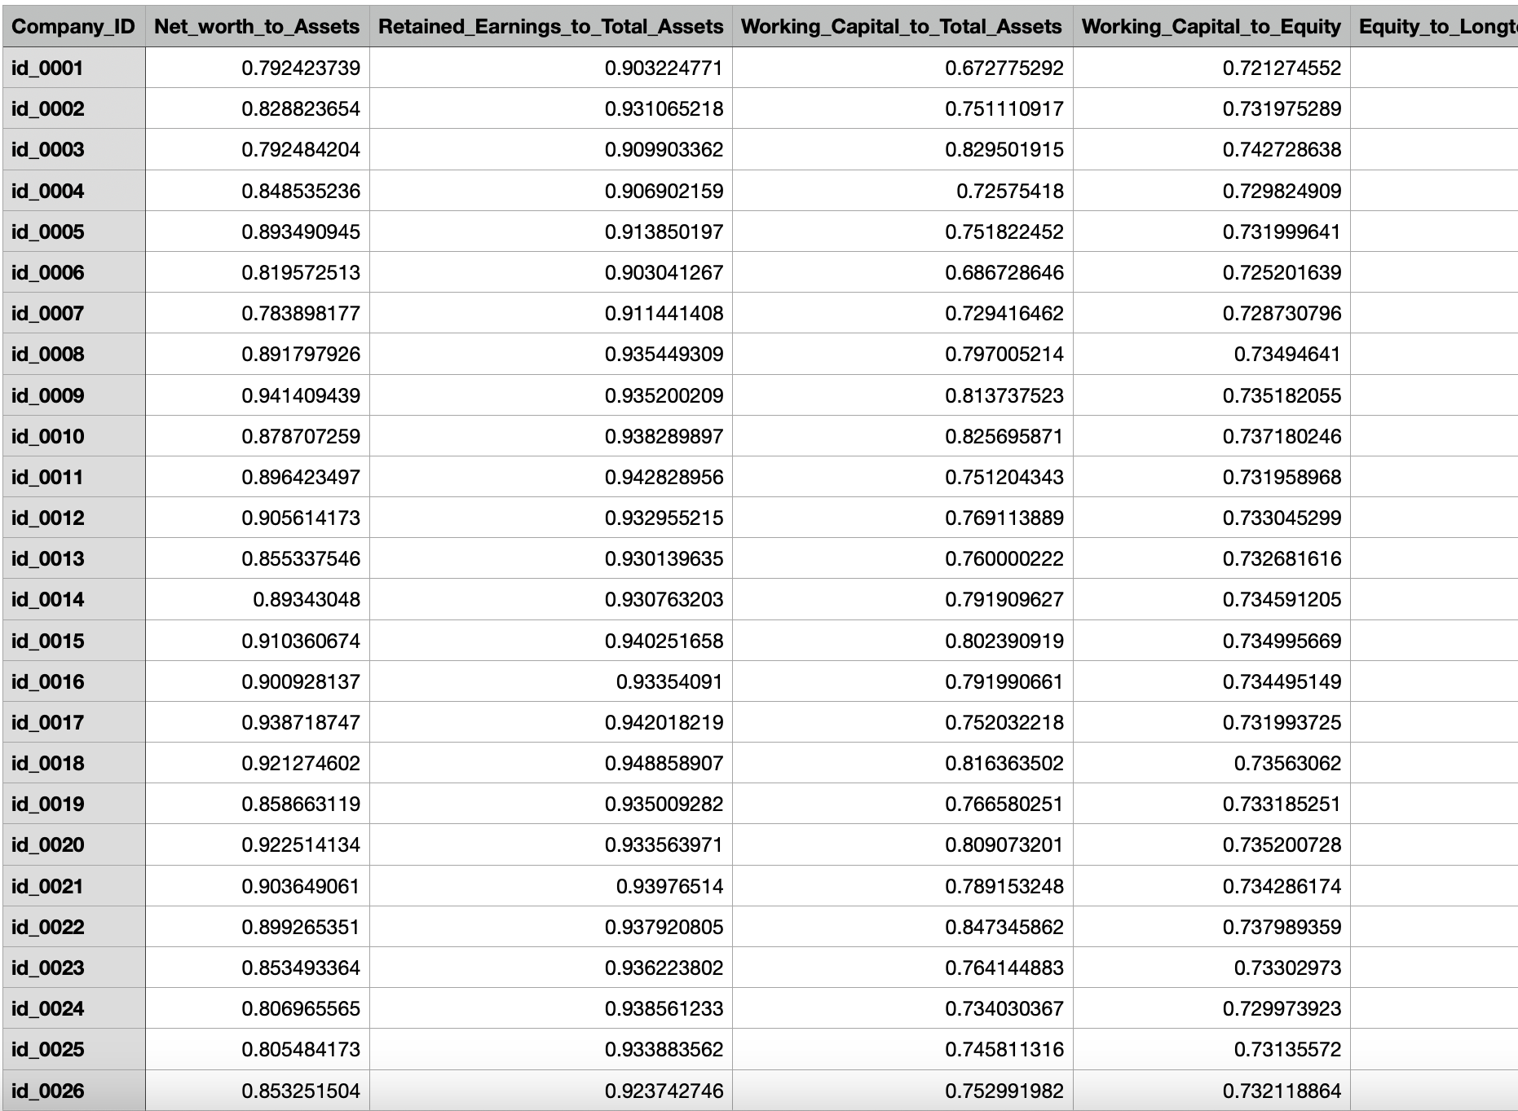
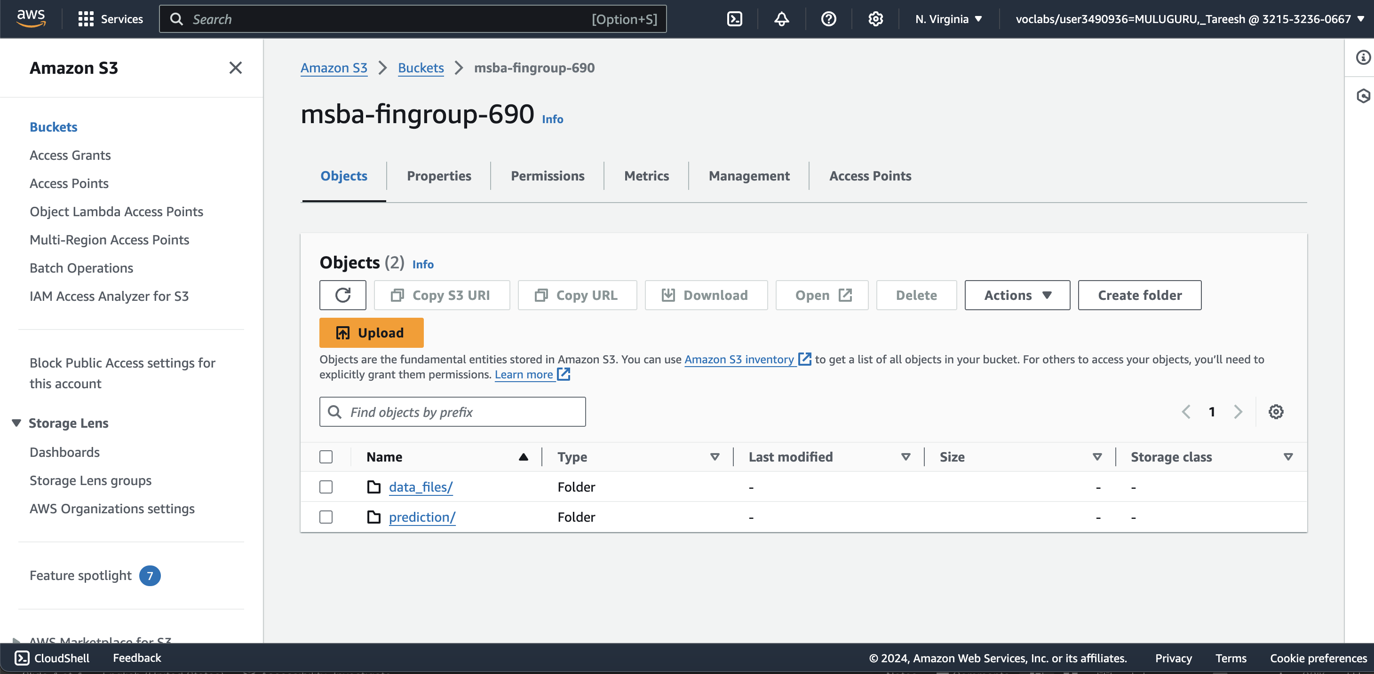
AWS S3
Store the Company Data(.csv, .xls, etc.)
Both Structured and Unstructured Data

Slide 4
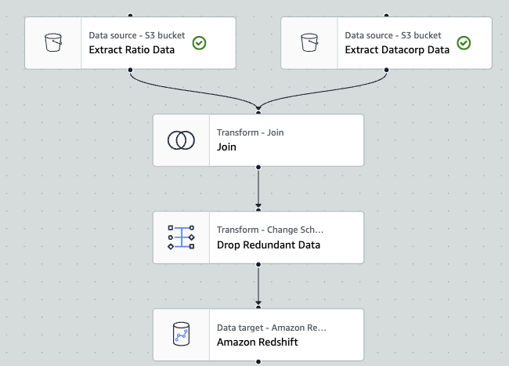
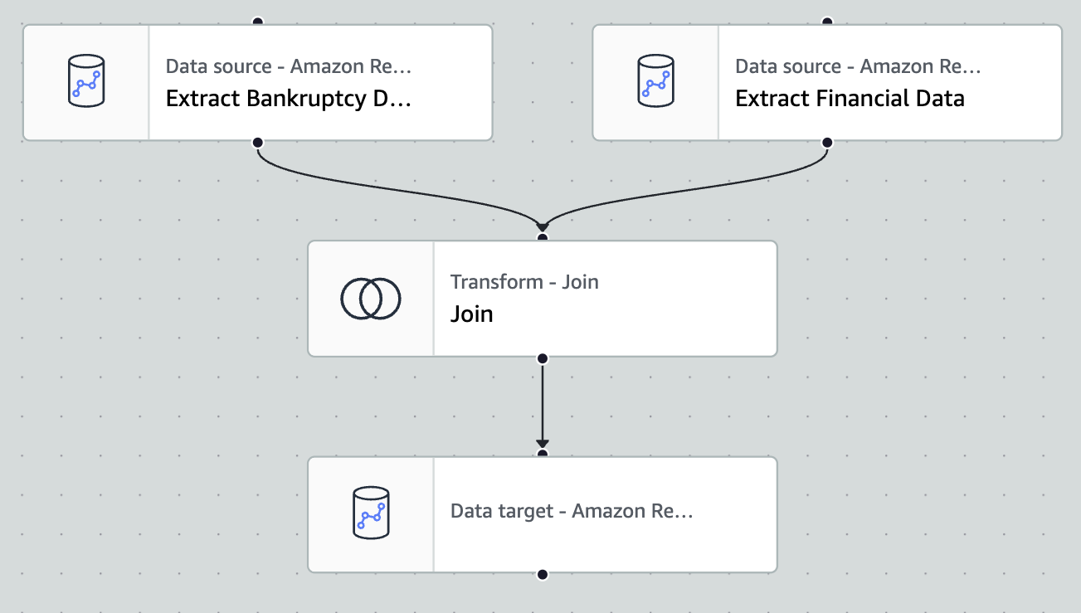
AWS GLUE
ETL: Extract, Transform, Load
Extracting Data from source
Transforming Data with necessary changes like joining, change schema
Loading into Data Warehouses like Redshift
Connects Data source to Datawarehouse
MSBA Fingroup Financial ETL
Training_Set_ETL

Slide 5
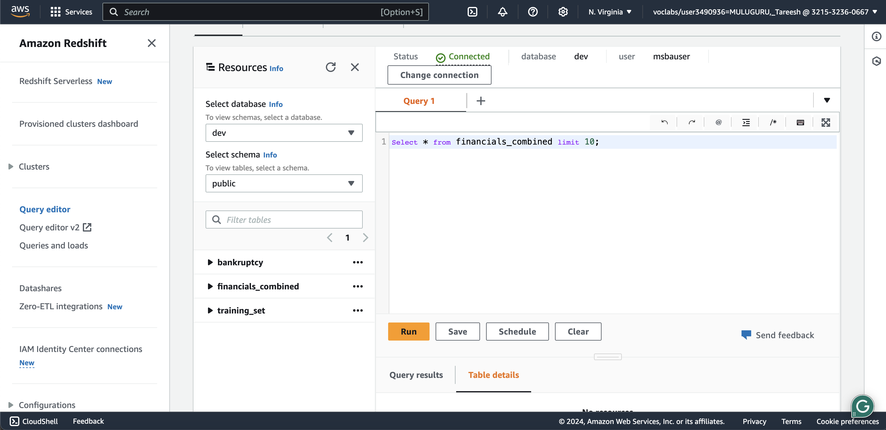
AWS Redshift
Data from S3 buckets is integrated and loaded into redshift warehouses
Has Query editor to transform and load data into tables

Slide 6
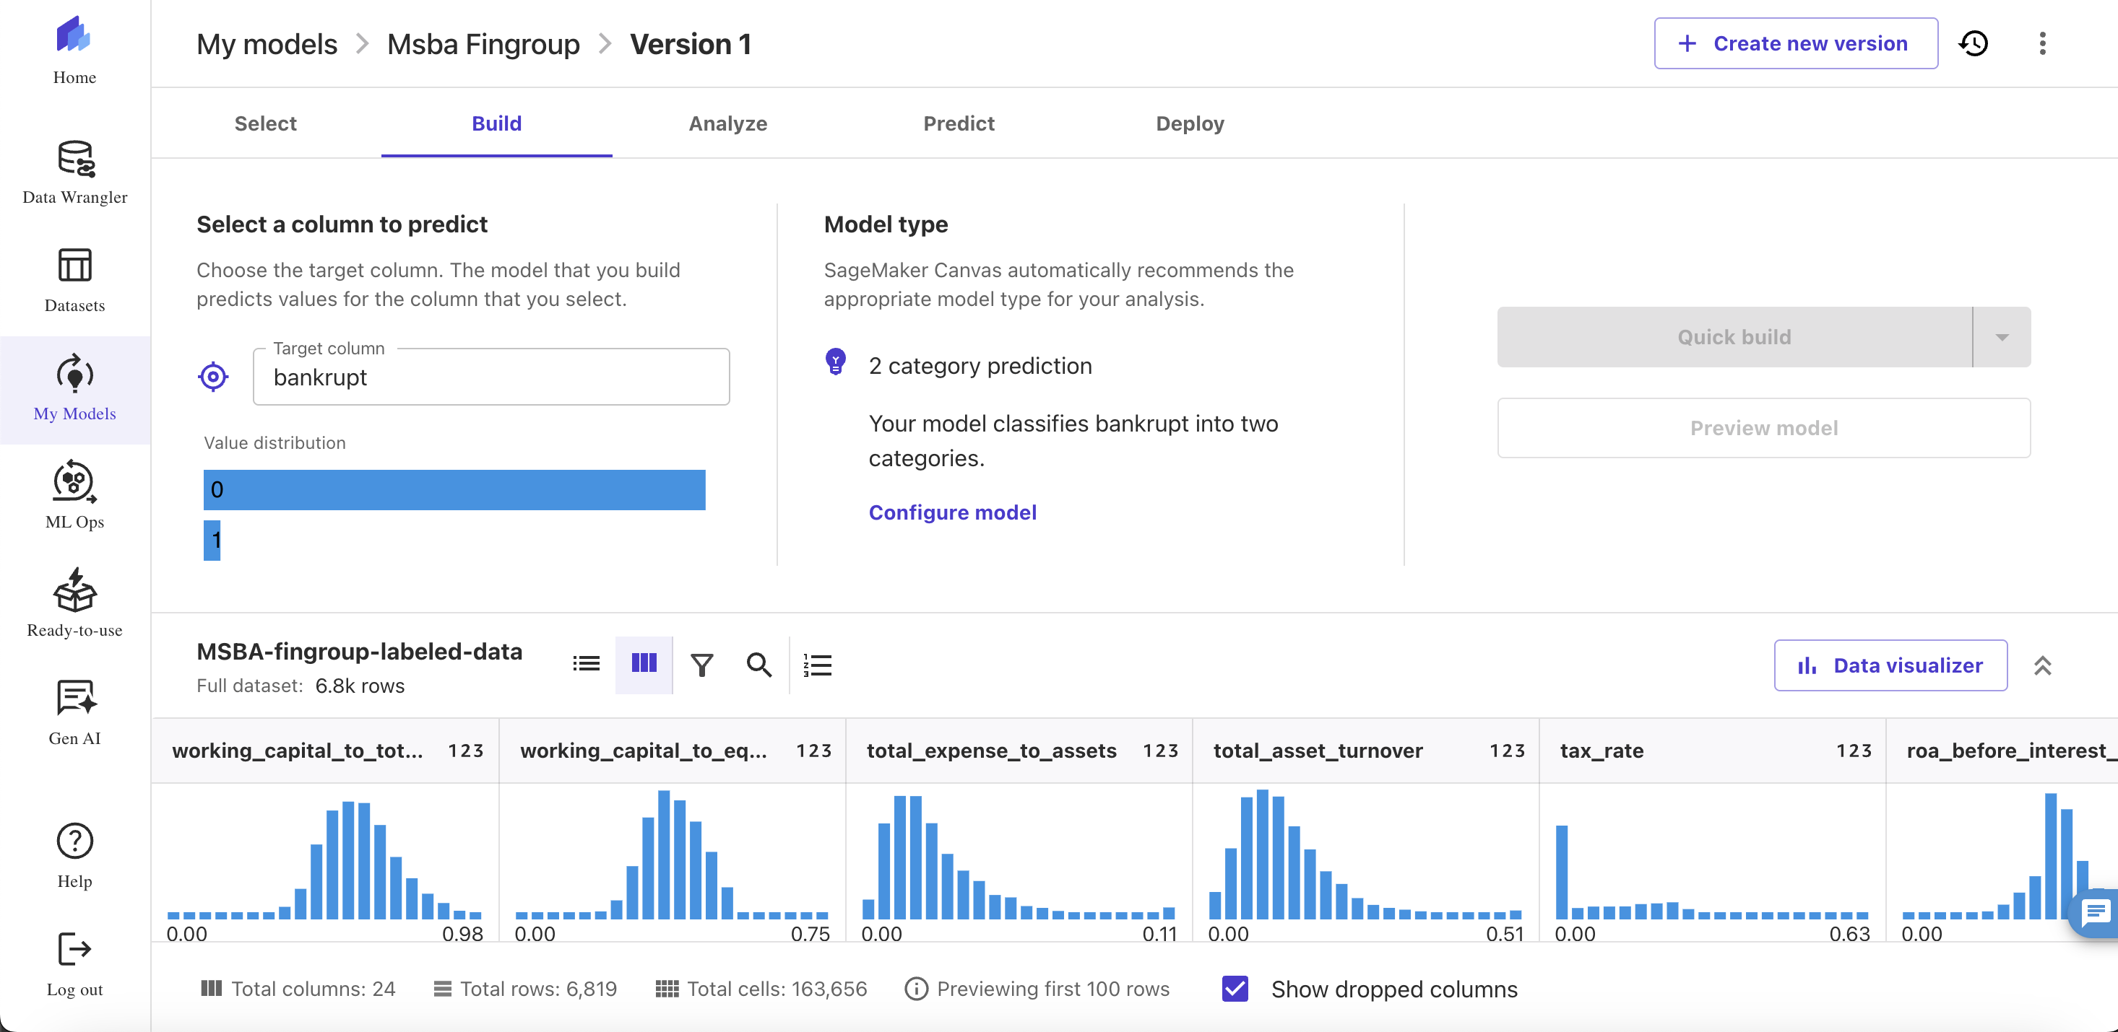
AWS SageMaker
Build, train, make predictions on test data, and deploy models
Visualize your data columns, note correlations in data
Train model to determine accuracy scores and confusion matrix
Make predictions on unlabeled Test Data

Slide 7
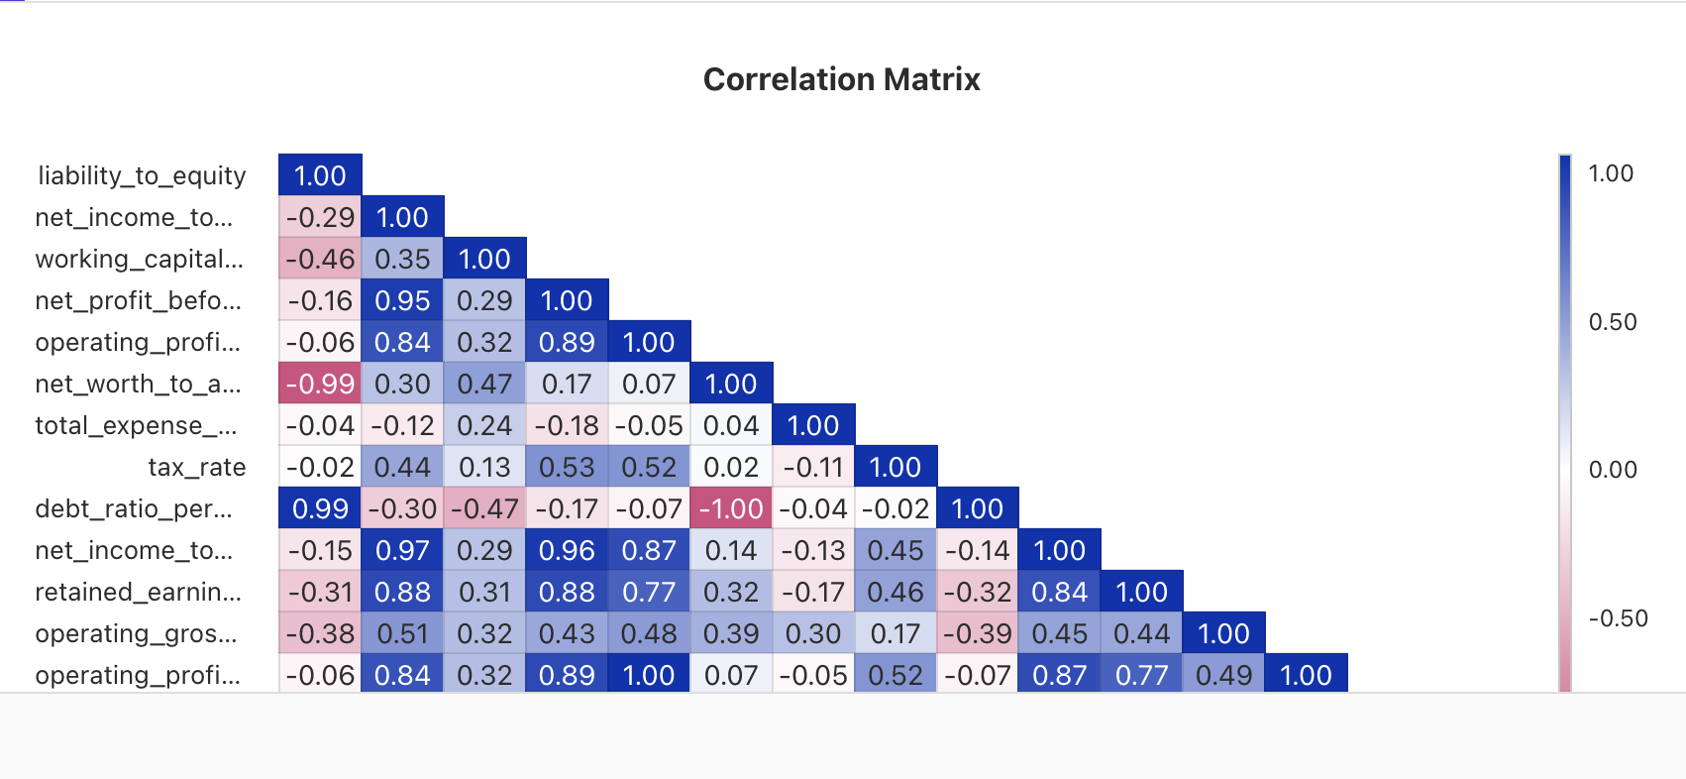
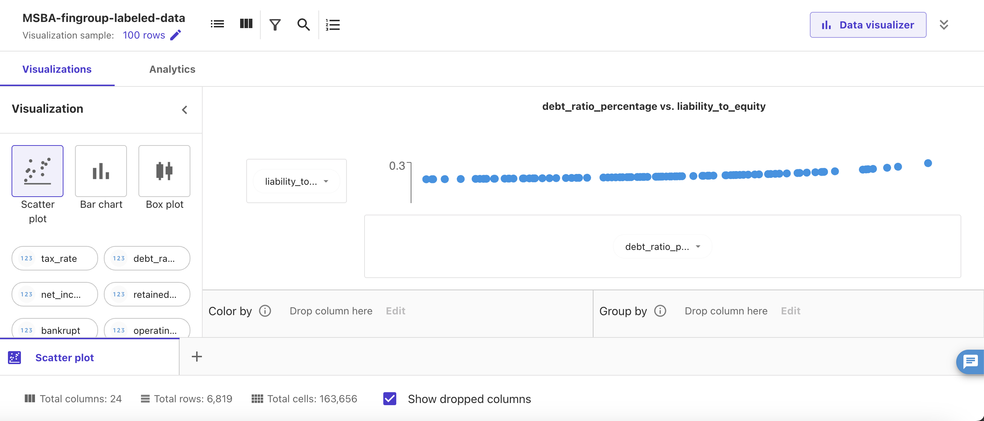
Finding 1
Correlation in Data
Liability_to_Equity to Debt_ratio_percentage

Slide 8
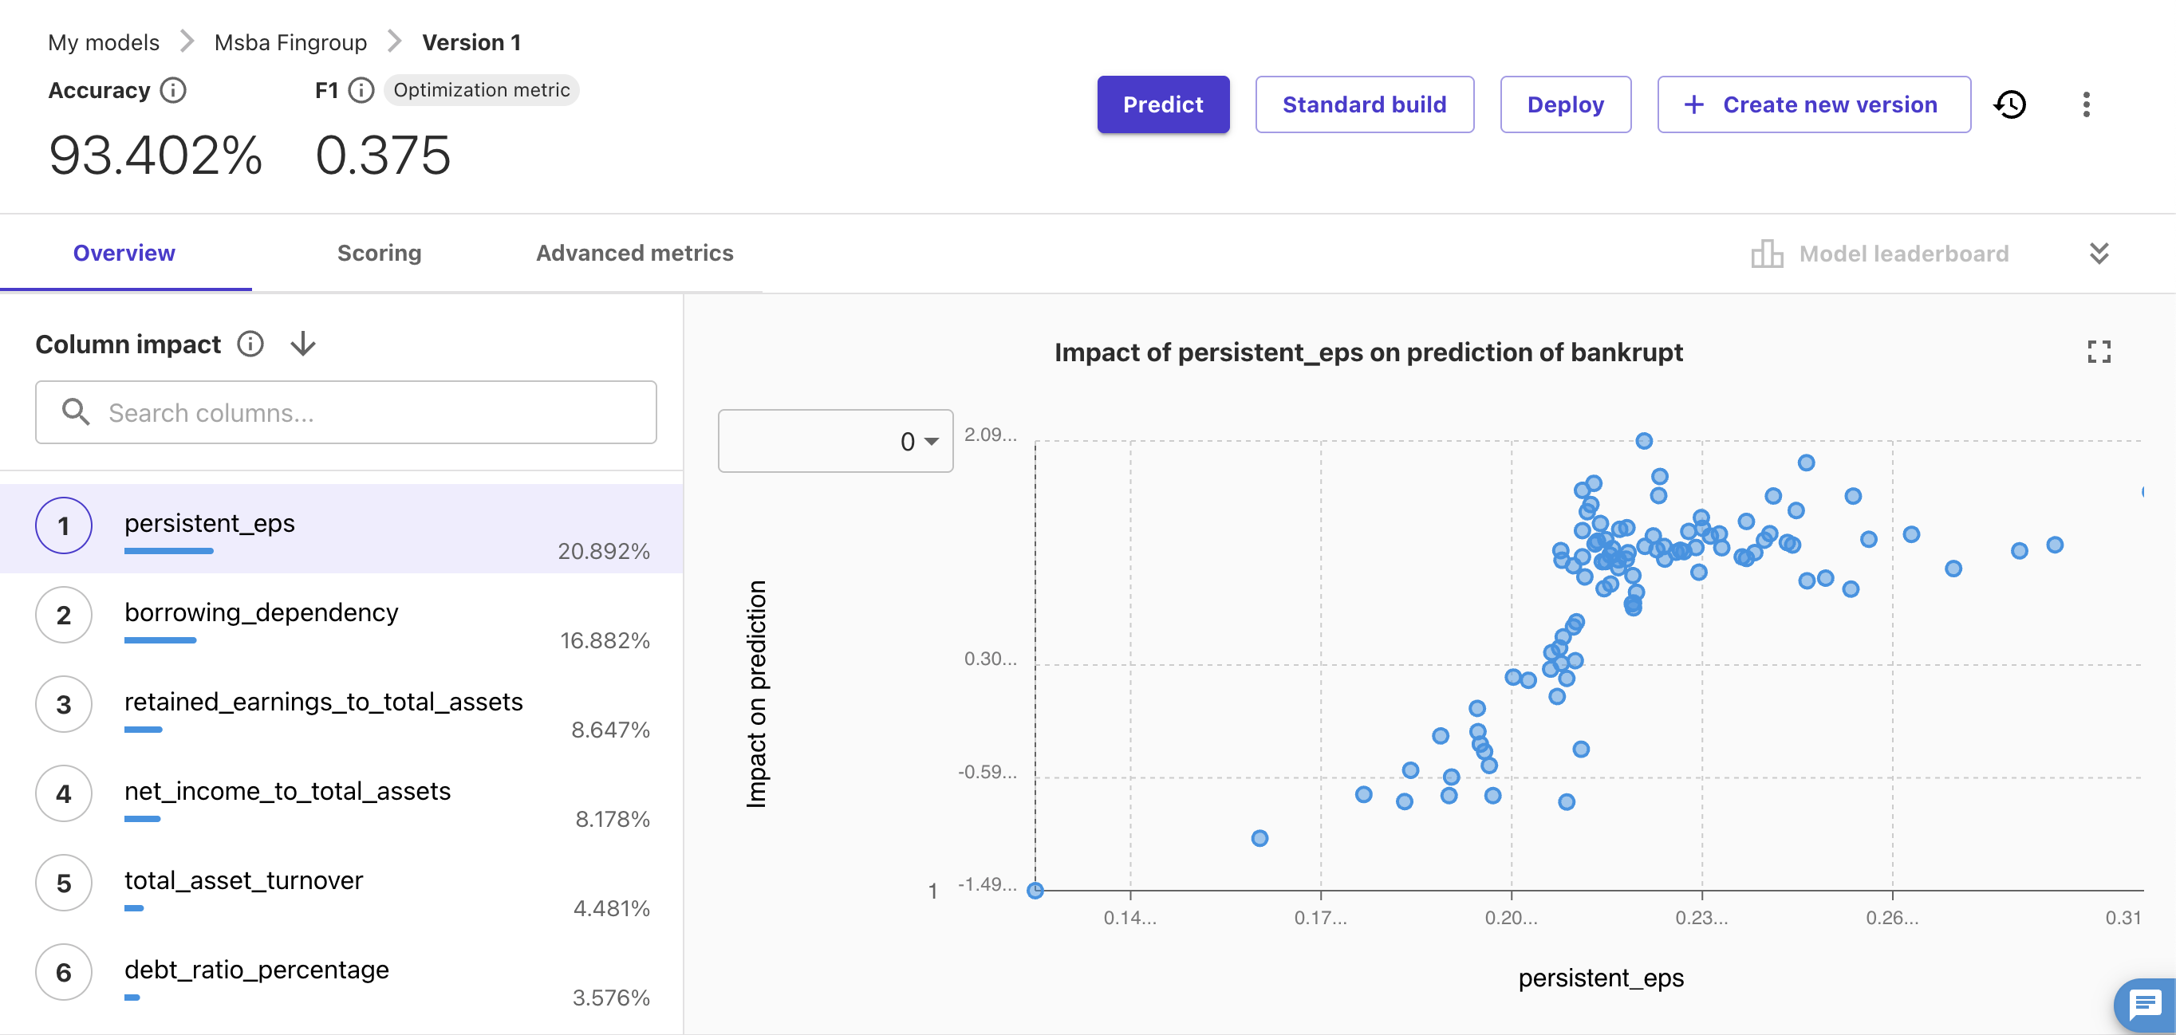
Finding 2
Persistant_eps has the highest column impact on the training the ML model with a 20.89%.

Slide 9
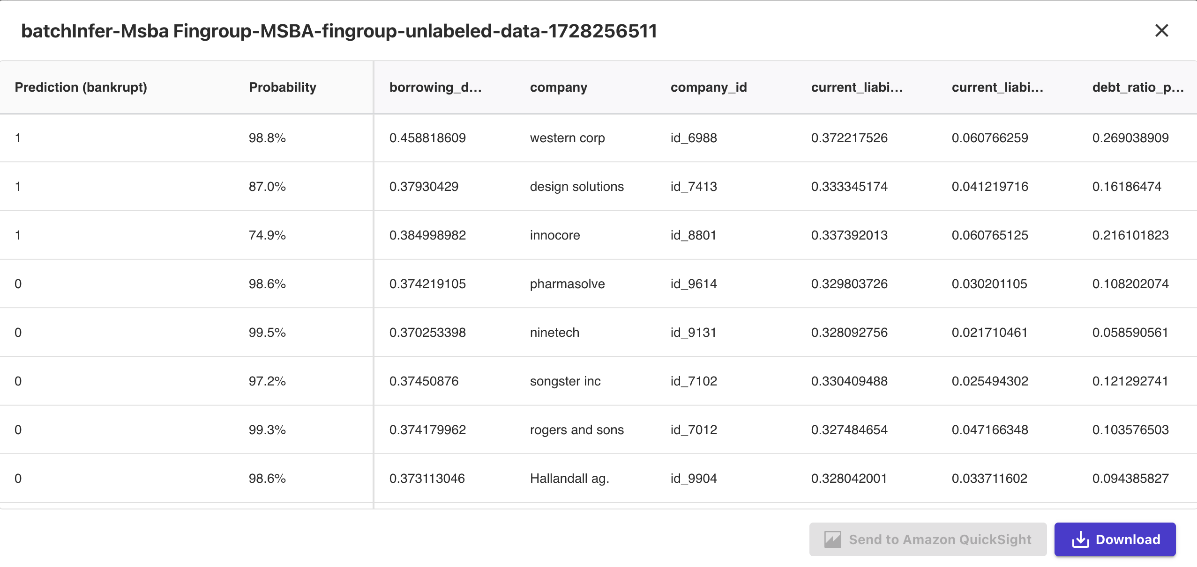
Test Data Prediction

Slide 10
Analysis of Companies
Companies to add to the portfolio are:
Ninetech – 99.5%
Rogers and Sons – 99.3%
Pharmasolve – 98.6%
Hallandall ag. – 98.6%
Songster INC. – 97.2%
Companies to avoid:
Western Corp. – 98.8%
Design Solutions – 87%
Innocore – 74.9%

