Slide 1

Hello again
Who am I ,
I'm Tarek , Embedded Software Engineer ,
LinkedIn

Slide 2
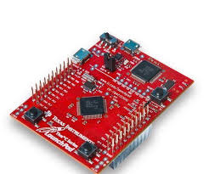
Bootloader Project for Tiva-C

Slide 3

Project consists of 3 parts
Bootloader
Main Application
Host

Slide 4
Bootloader functions
Get Version
Get Help Command
Chip Identification
Going to address
Erasing sectors or all
Writing data to memory

Slide 5
Host
This is a script file written in python this part will communicate with Tiva_c specially with the boot loader to run the commands the microcontroller need

Slide 6
Main Application
In this part is the part which is being updated from bugs or to add new features , all this from bootloader with host

Slide 7
Challenges
How to dealing with new Microcontroller to me
Adding RTOS feature in this Microcontroller
Writing the libraries that I need to finish the project

Slide 8
Exp I gained
Knowing how to search for a problems and get the solutions to it
Learning python
Debugging and analysis the code
Understand linker script and startup code

