Slide 1
College Choices Case Study
Presented by: Tarek Ayman Hasballa
Last Updated: 9/23/2022

Slide 2
High School Counselor’s Strategy
Preparing a graphic for a high school students and their parents to give them insight for college choices depending on the average cost of attending a public college among six states: California (CA), Texas (TX), New York (NY), Michigan (MI), Georgia (GA), and Illinois (IL) regarding to cost of out-of-state tuition, room, and board

Slide 3
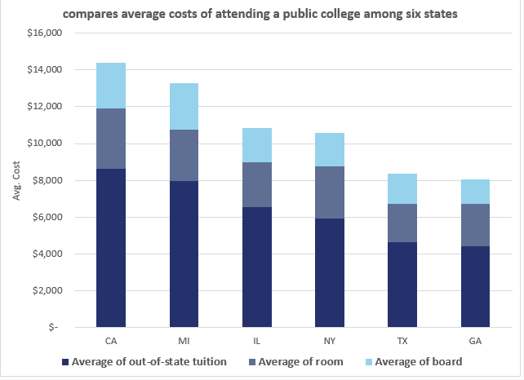
Stacked Bar Chart

Slide 4
About the Data Set
The data set used in this case study is available here : https

Slide 5

Thanks

