Slide 1
Computer Science Workshop 4516CSQR
Covid-19 in Qatar
Tariq Hasbullah, Rahma , Ahmed El-waleed, Abdullah Hany, Ahmad Al-Rumaihi

Slide 2

TIMELINE
Data Preparation
18th Feb-8th March
Insights
8th April-10thApril
Topic and Dataset
1st Feb-16th Feb
Data visualization
15th March-7th April

Slide 3
Topic and Dataset
01

Slide 4
Why we chose this?
TOPIC: COVID-19 in Qatar
We chose COVID-19 in Qatar since it's based on a country that we live in thus giving us insightful information on our area that can hopefully also be useful to others.
Though that was our main reasoning behind our choice of the topic we also found that this topic contained:
Broad topic around the world
Availability of data that can be used for predictions
Based on an area that we live in (Qatar)

Slide 5
02
Data Preparation

Slide 6

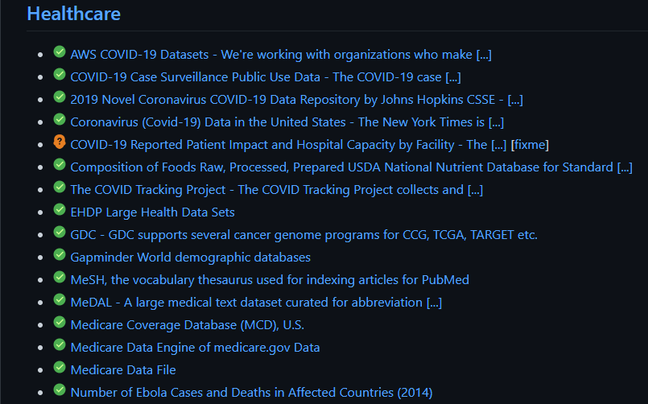
SOURCING THE DATASET
The datasets given on GitHub were mainly gathered data from the United States and lacked information on Qatar,

Slide 7
Dataset
Choosing the suitable dataset
To find a suitable analysis material we had to narrow our search on datasets that contained information about Qatar, since that is where the focus of our topic lies.
The datasets given on Canvas where mainly gathered data from the United States and lacked information on Qatar.
So, we had to use links from the Qatar government sites such as.
“https://www.data.gov.qa/explore/dataset/covid-19-cases-in-qatar/table/?sort=date”

Slide 8
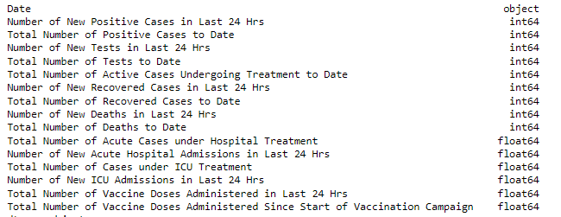
Dataset
Here are the features present in the dataset:

Slide 9
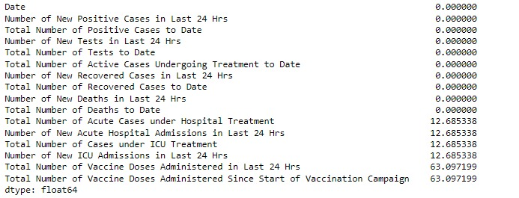
NULL VALUES
Checking for the columns that have null values
Dropping unwanted columns with that contained missing values of more than 50%
Revising the dataset for further cleaning
Fig1.1: Our dataset did not contain any columns with null values except for one column (Vaccines).

Slide 10

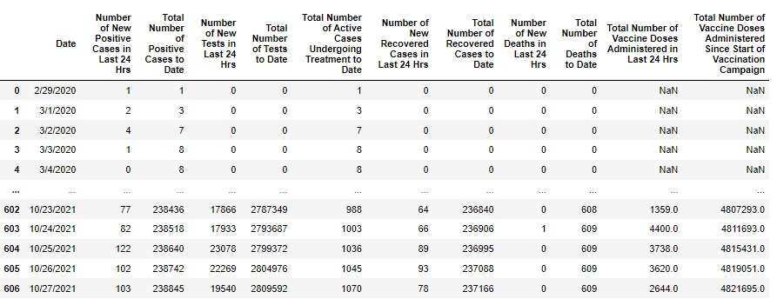
Removing Columns

Slide 11
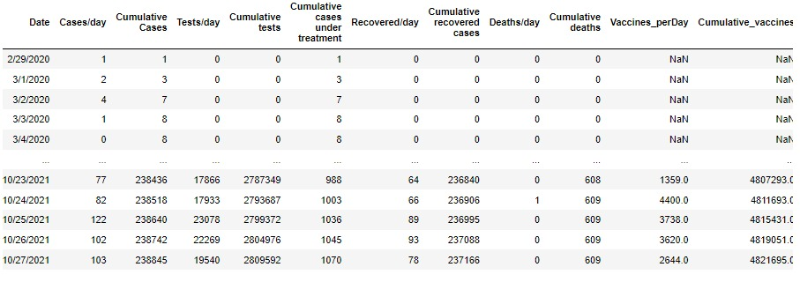
Re-naming Columns

Slide 12
Datetime object
This code will change the ‘Date’ column into a datetime object for datetime manipulation

Slide 13
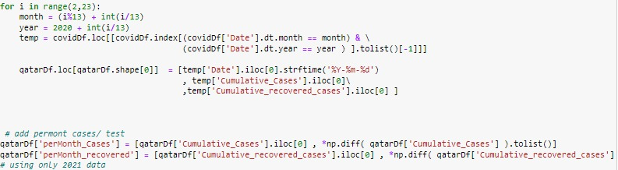
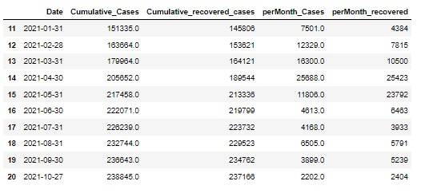
Finding Positive and Recovered per month

Slide 14
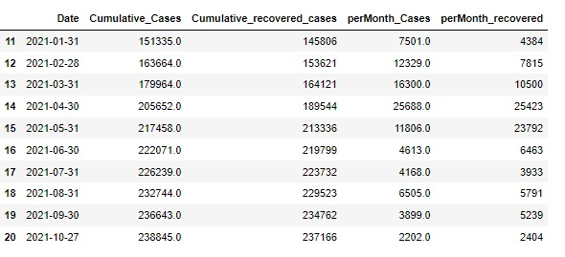
Row filtering
This code will filter the dataset and obtain specific years

Slide 15

Factors we could not change
Beginning of 2020 missing
End of 2021 missing
Vaccines data

Slide 16
03
Data Visualization

Slide 17
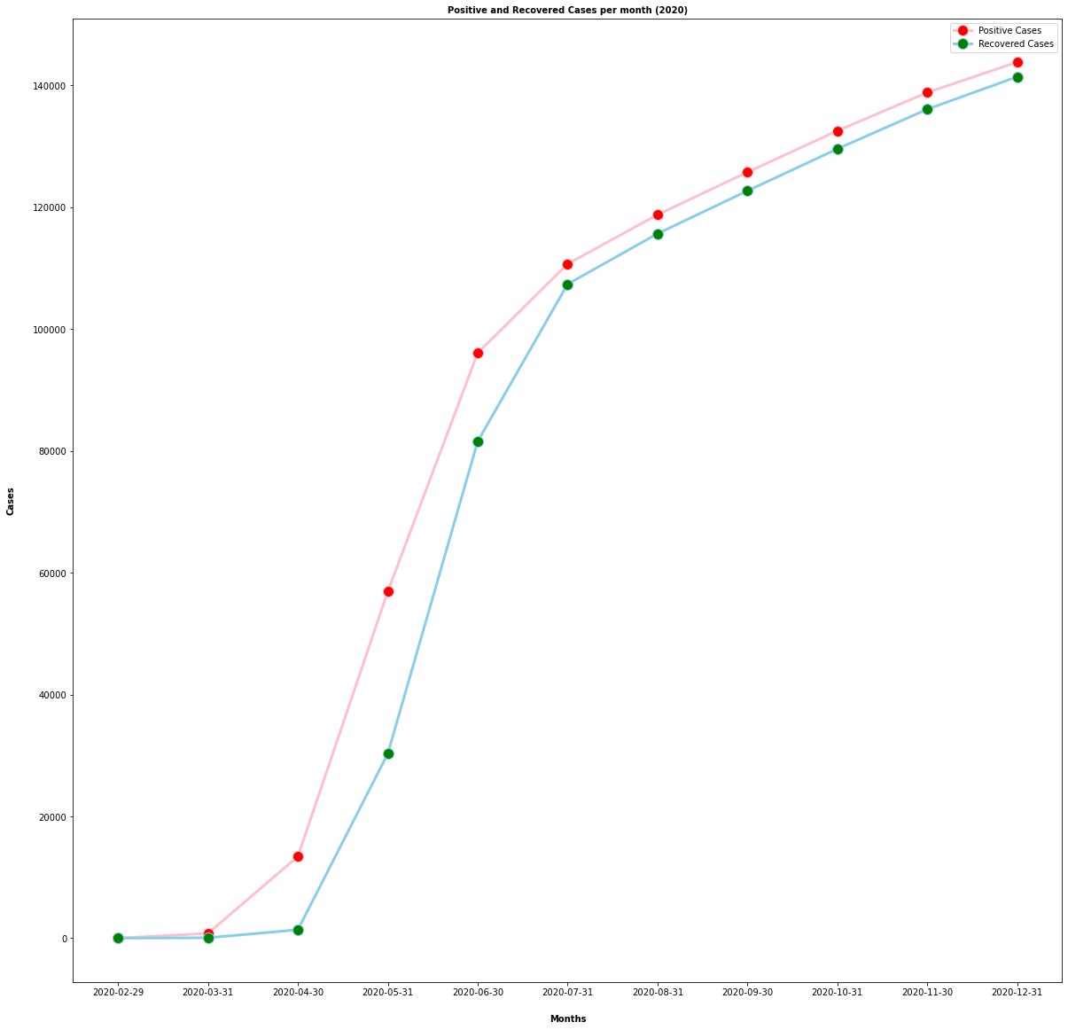
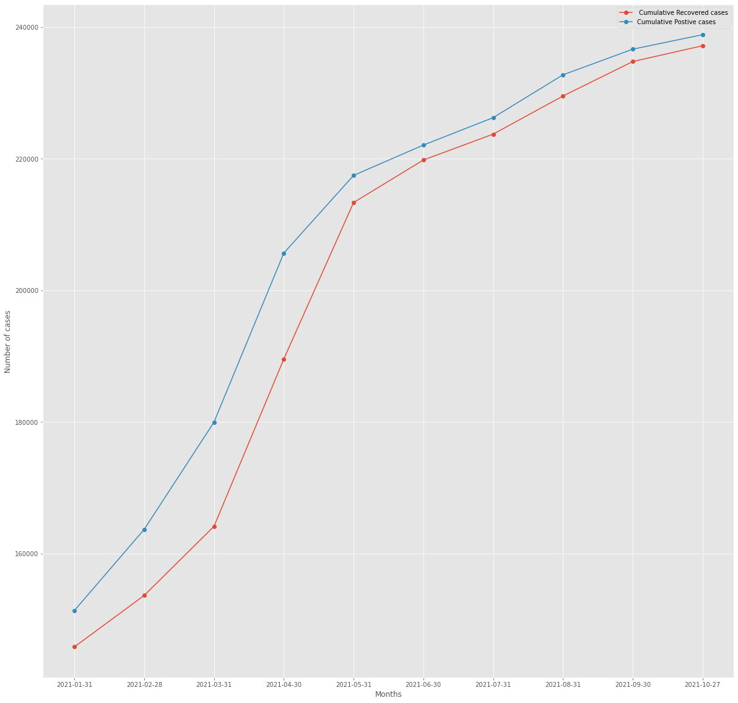
Visualization
Tariq, 100330
Rahma, 100490
2020 and 2021

Slide 18
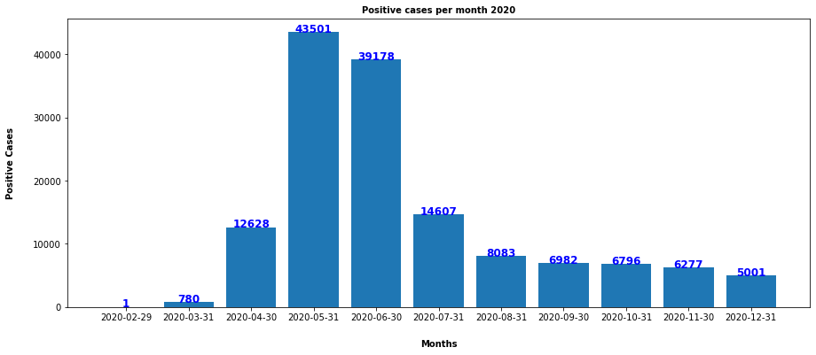
Visualization
Rahma, 100490
2020

Slide 19
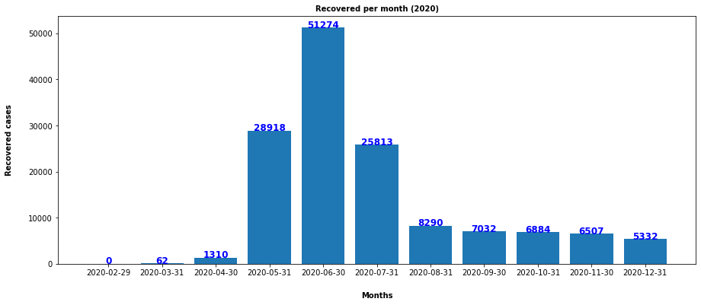
Visualization
Rahma, 100490
2020
This graph shows

Slide 20
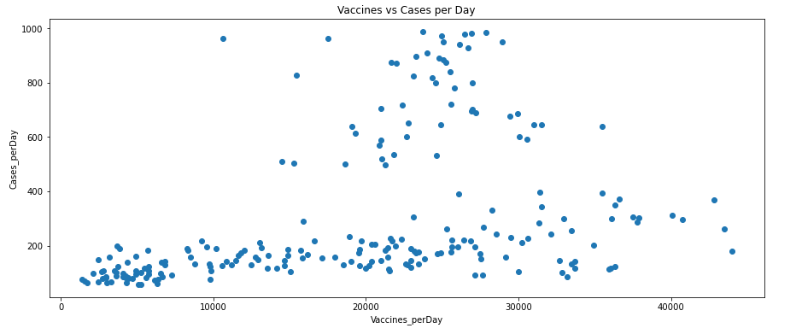
Visualization
By: Abdallah Ahmed
The figure shows the relation between cases per day along with vaccines per day through out late 2020-21

Slide 21
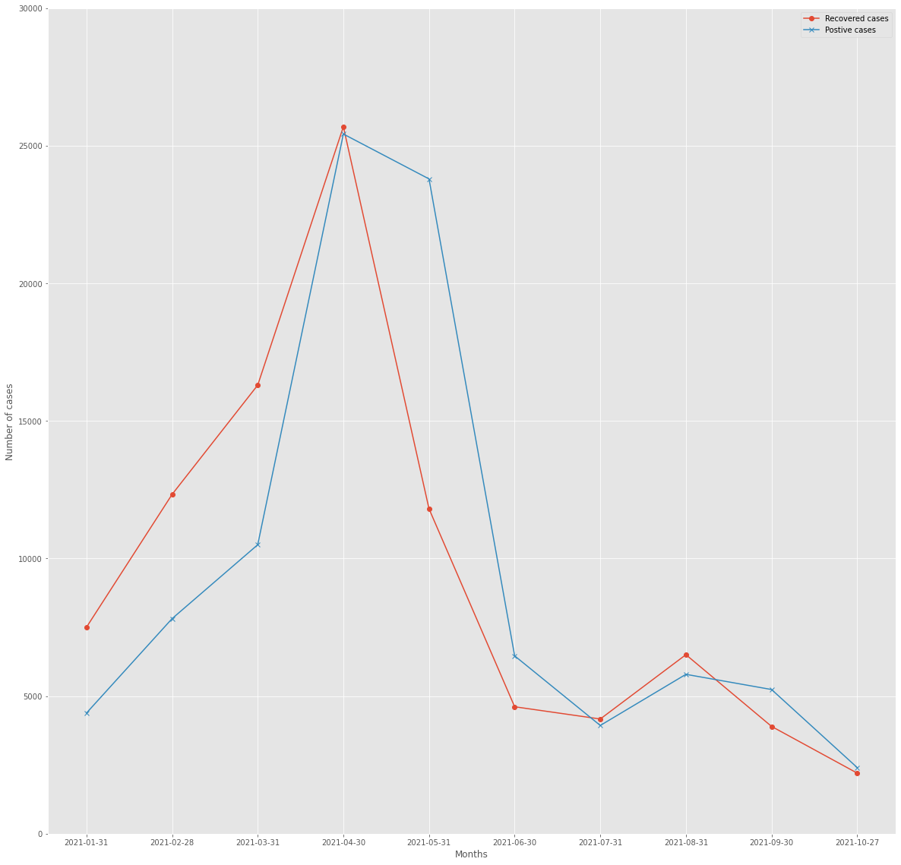
Visualization
By: Tariq Hasaballah
The figure shows the relation between
positive cases AND recovered cases
PER MONTH in 2021

Slide 22
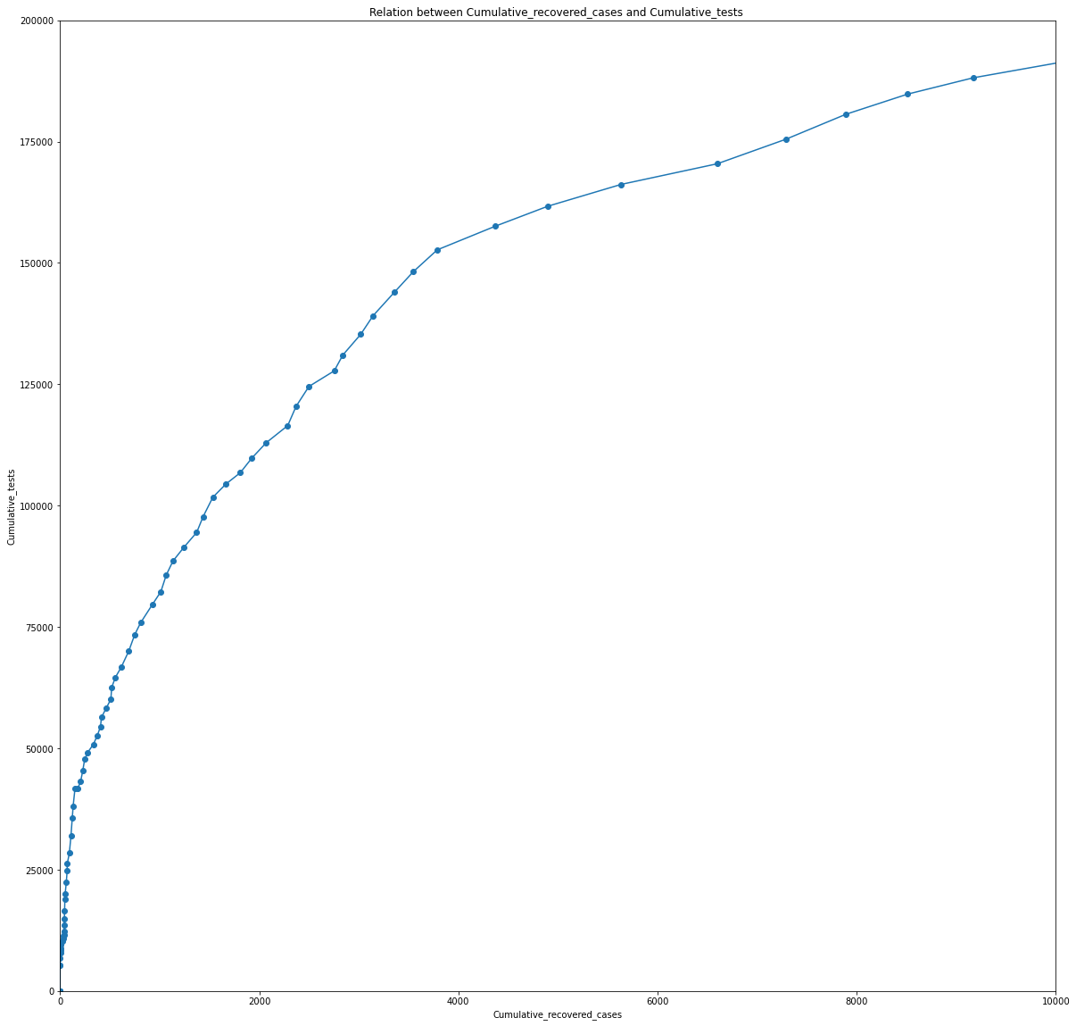
Visualization
By: Ahmed Al-Waleed
This graph shows the relation between cumulative test and cumulative recovered cases in 2020 and 2021.

Slide 23
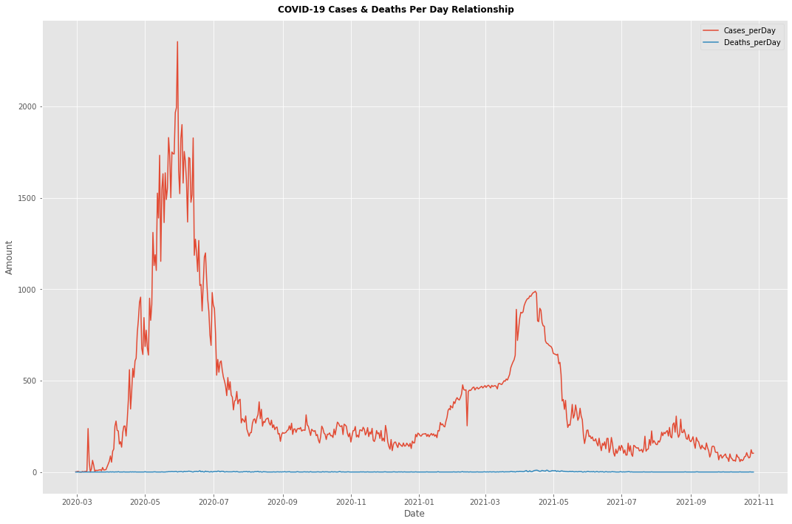
Visualization
By: Ahmed El-Rumaihy
This graph shows COVID-19 Cases
& Deaths Per Day Relationship in
2020 and 2021.

Slide 24
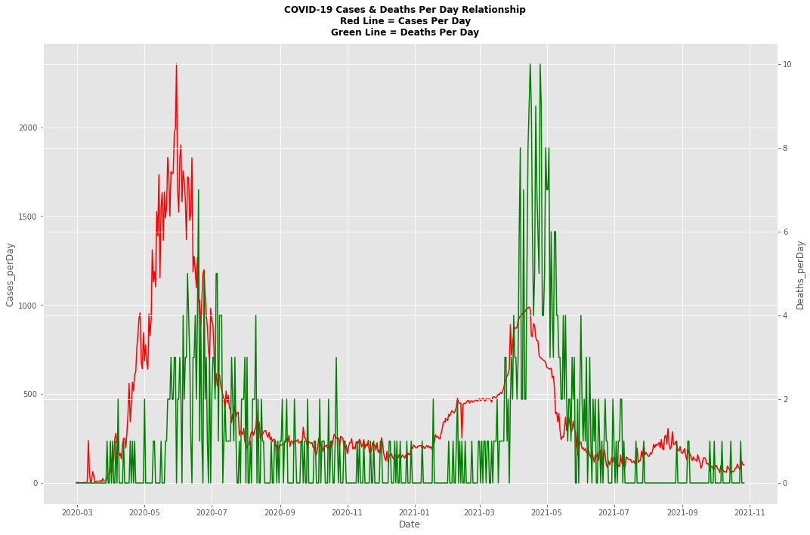
Visualization
By: Ahmed El-Rumaihy
This graph shows the positive cases and deaths per day in 2020 and 2021

Slide 25
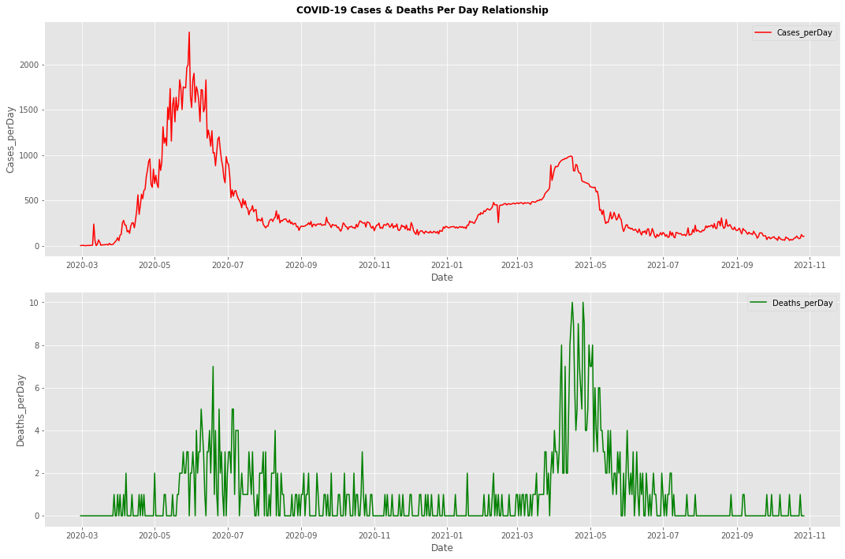
Visualization
By: Ahmed El-Rumaihy
This graph shows the positive cases and deaths per day in 2020 and 2021 (separately)

Slide 26
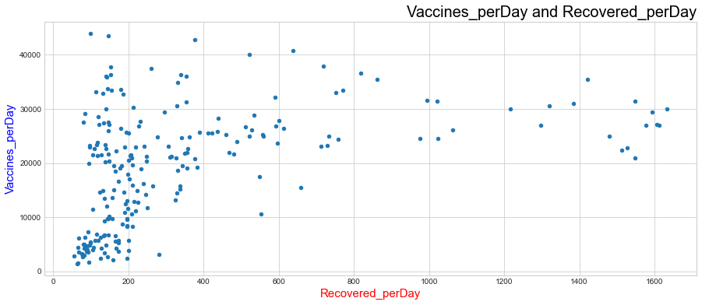
Visualization
By: Abdullah Hany
This graph shows the relations between total vaccines per day and recovered cases per day

Slide 27
04
CONCLUSION

Slide 28
TIME MANAGEMENT
DATASET RESOURCE
DIFFICULTIES FACED

