Slide 1

Refer Engine

Slide 2
Marketing Apps is Hard
App Stores are broken
Marketing solutions:
Expensive
Need skills and optimization campaigns
Take time to on-board
Small development teams: not enough time/money for marketing
Notes:
App Stores: discoverability is minimal
AppGratis
TradeMob and Fiksu
Facebook / Google Advertising

Slide 3
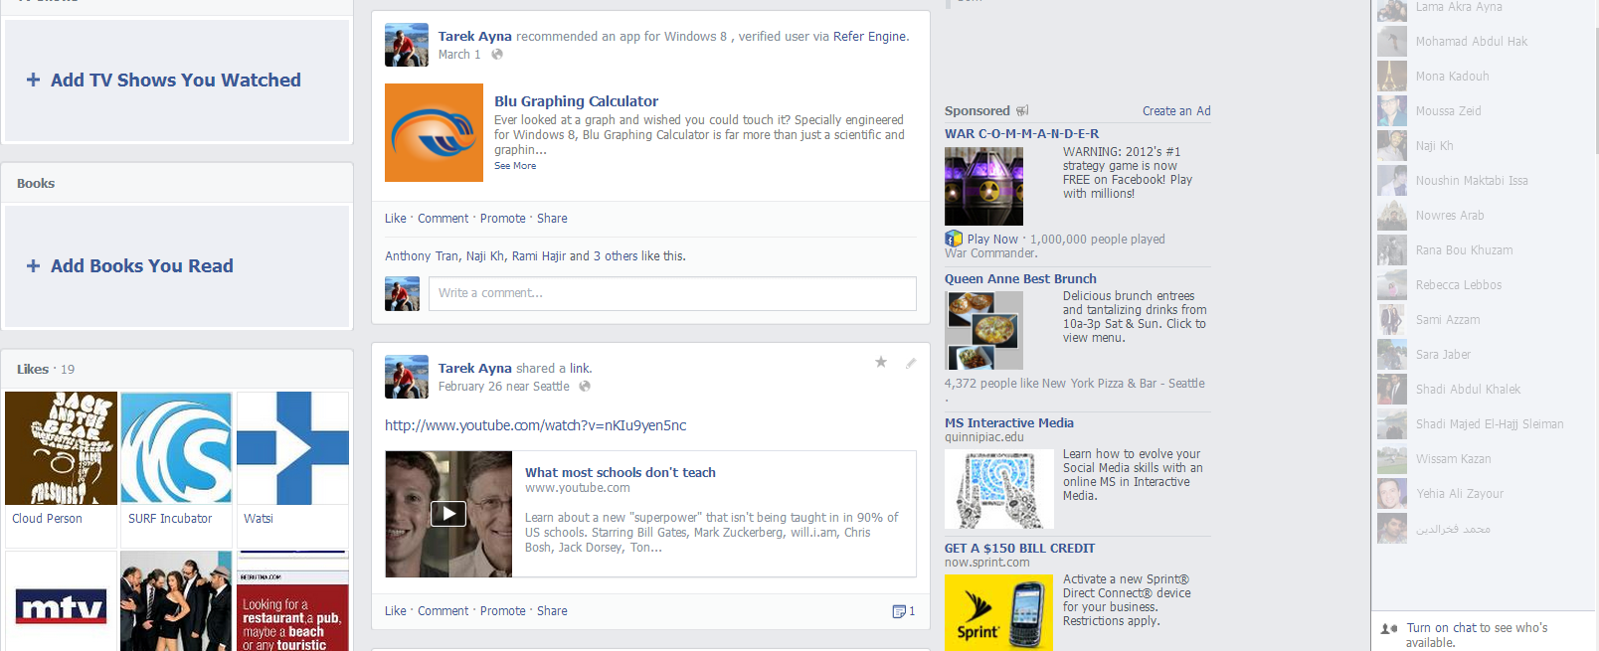
Refer Engine
Facebook marketing for Apps:
Customer recommendations using the Graph API
Trusted recommendations only
Custom messages with friend tagging
Optional rewards
Instant setup
Low cost per click
Notes:
No coding required: signup and
Facebook ads cost > $1 / click.
Current prototype is at 60 clicks / month for $20 / month plan
Plans will be targeted to make this a better value

Slide 4
What’s different?
Instant-setup marketing: no coding required
Automatic optimization across apps
First to market for Windows 8 apps
Demo
Notes:
In other platforms, every app has to optimize for itself
Optimization tests: at least 3 versions at one time
Lessons already learned
Stays up to date with Facebook developer changes (they happen monthly)

Slide 5
Business Model
Monthly subscription service based on number of active users
Free 45-day trial
Plans at: $20, $80, $150 and more
Notes:
Pricing is modeled after many existing B2D solutions (MixPanel, Optimizely, Rollbar, Olark)
Free until May 2013
Might be altered according to real usage of customers within the next couple of months

Slide 6
Status and Timeline
11/2012 | Start
01/2013 | Release working prototype within Blu Graphing Calculator
03/2013 | Release private beta to limited number of developers
05/2013 | Release publically with payment system
06/2013 | Release private beta of iOS client
You are here

Slide 7
Go To Market
Very early customers are lined up
Attend Windows 8 Dev meetups
Targeted email marketing
Online advertising
Notes:
Early test end of last year: $7.5 per signup

Slide 8
Competition
Full marketing solutions
Fiksu and TradeMob
Do-it-yourself Online Ads
Google and Facebook ads
Different ideas
AppGratis
Notes:
Full marketing solutions: expensive and take time to onboard
Online ads are cheaper but require a long process of learning and optimizing campaigns, except if you hire an external agency then you’re back to #1
AppGratis (one free app a day), good but limited

Slide 9
Team
Tarek Ayna, Founder and Developer
ex-Microsoft
Windows 8 and Web developer
Blu Graphing Calculator

Slide 10
Market and Projections
Total > 1.2M apps (all platforms)
> 30,000 Windows Apps for first release
Projections:
Year | 2014 | 2015 | 2016 | 2017 | 2018
Proj. Rev. (in $1000) | 62 | 249 | 1,220 | 5,006 | 19,757
Notes:
Addressable market:
>12,000 Windows 8 apps (paid apps and free apps with in-app purchases)
The second release increases the addressable market to >300,000 paid iOS apps
the third >200,000 paid Android apps.
Projected Revenue Assumptions (on average):
12% increase in signups per month
12% monthly churn
$21/month revenue per customer (60% free, 25% $20/month, 10% $80/month, 5% $150/month)

