Slide 1
Lecture 3
Ethereum
&
Hyperledger

Slide 2
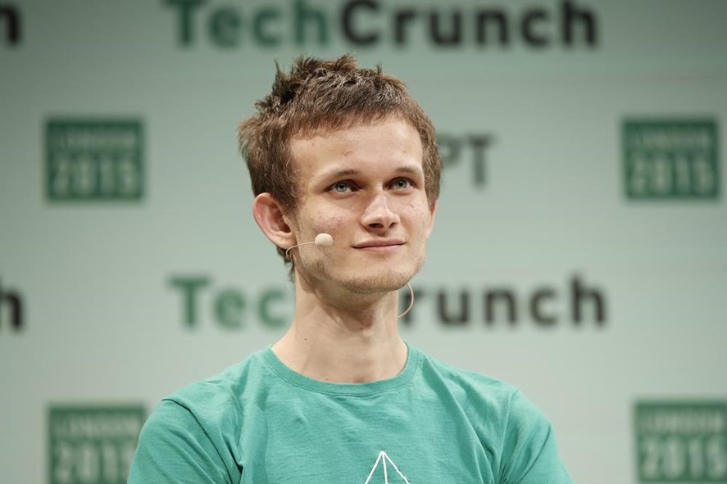
Ethereum
We need to have more advance
ScriptSig language
1.Almost like Bitcoin
2. Have Smart Contracts
Vitalik Buterin

Slide 3
Smart Contracts
- Written in Solidity.
- scripting language specially
created for Ethereum

Slide 4
Smart Contracts
Live example…
https://remix.ethereum.org

Slide 5
Hyperledger

Slide 6
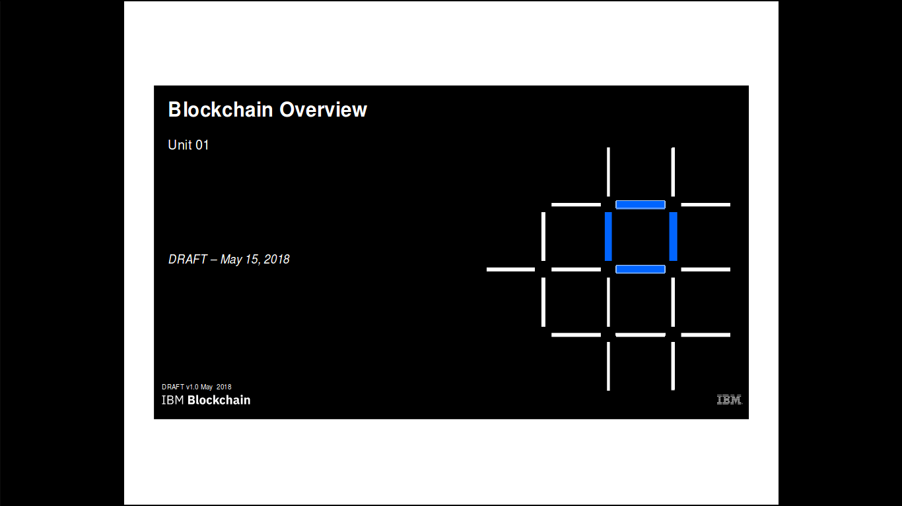

Slide 7
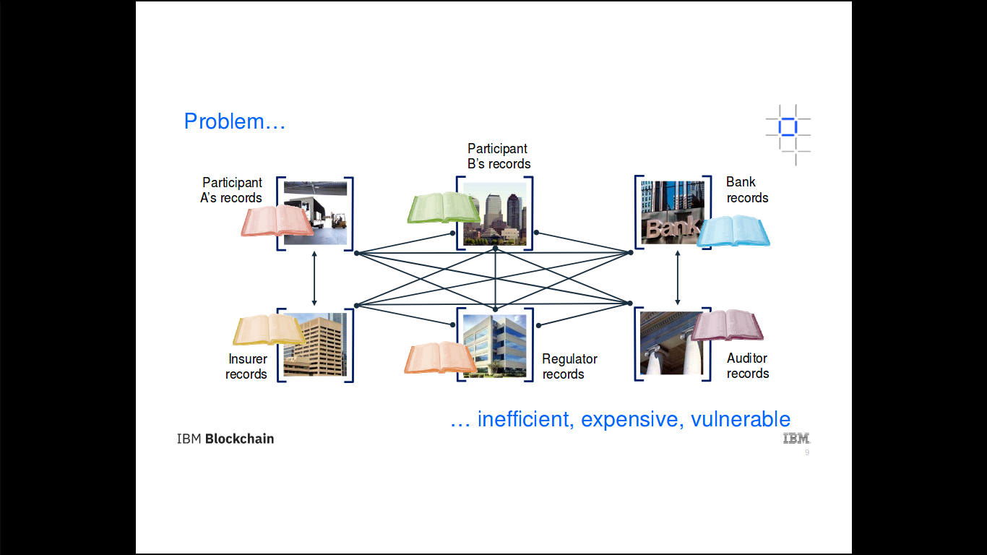

Slide 8
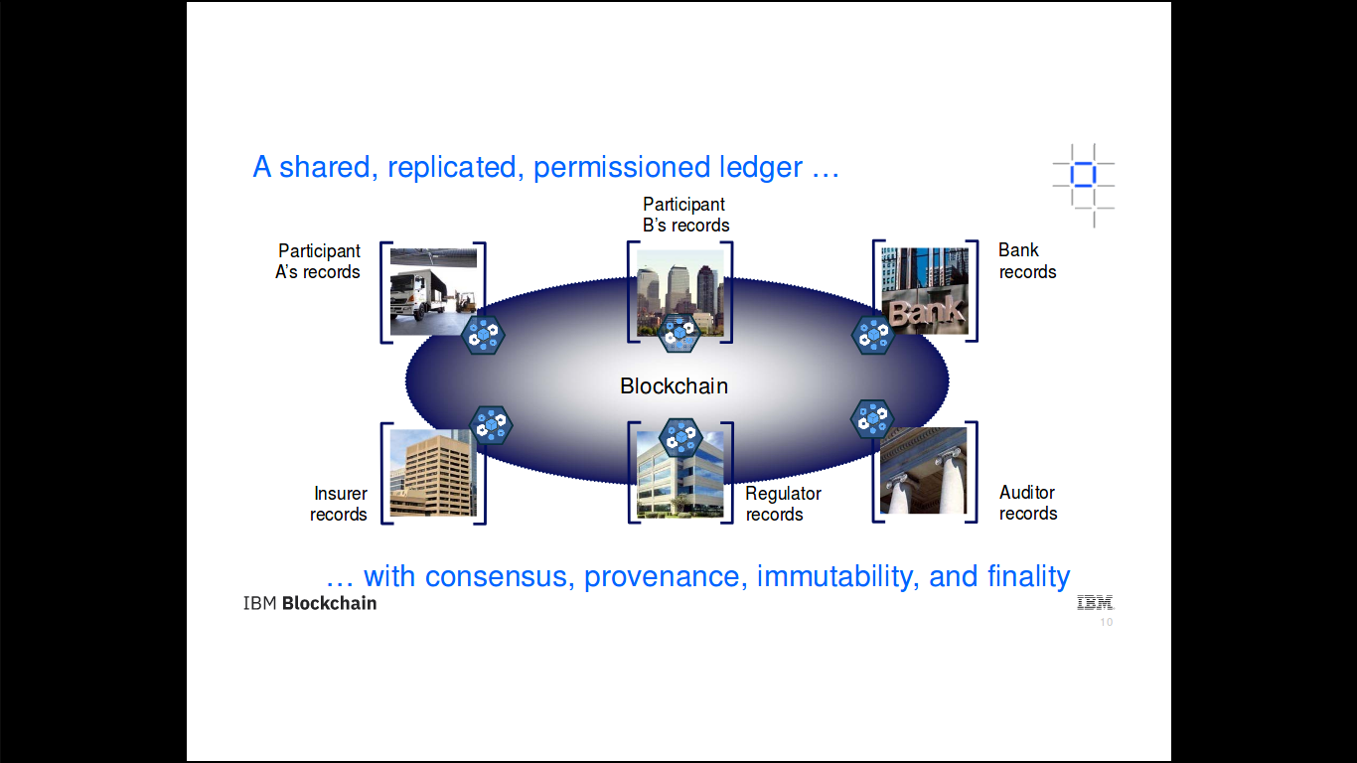

Slide 9
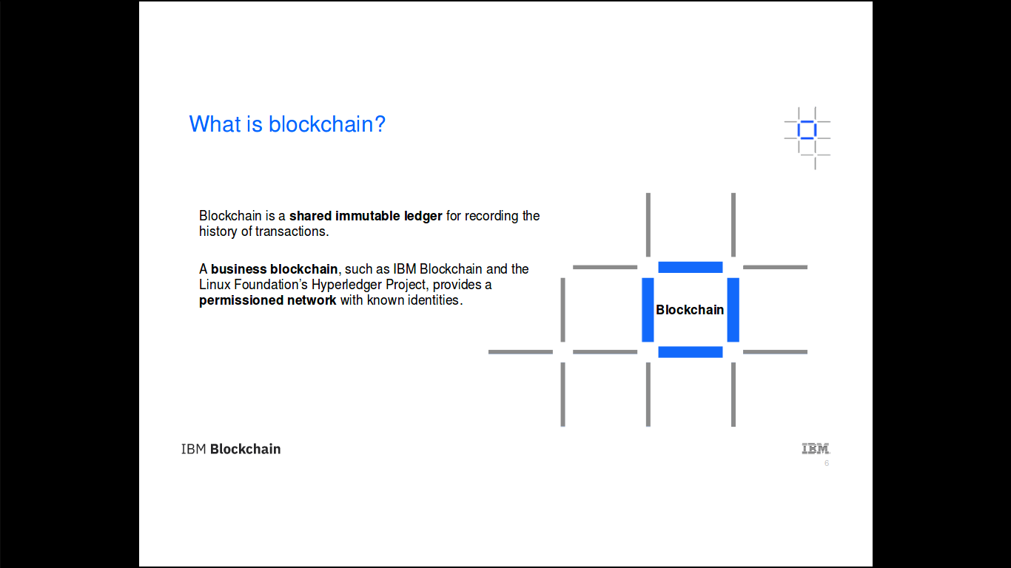

Slide 10
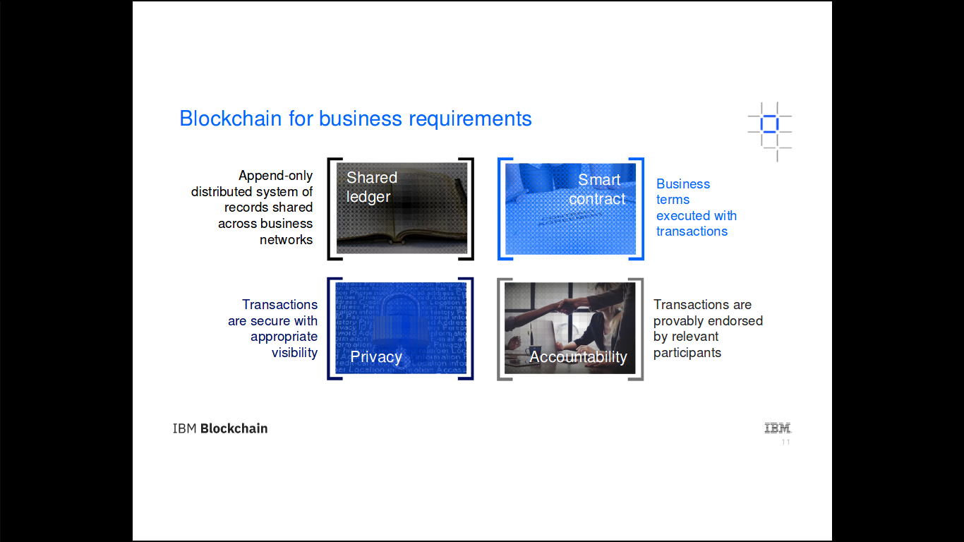

Slide 11
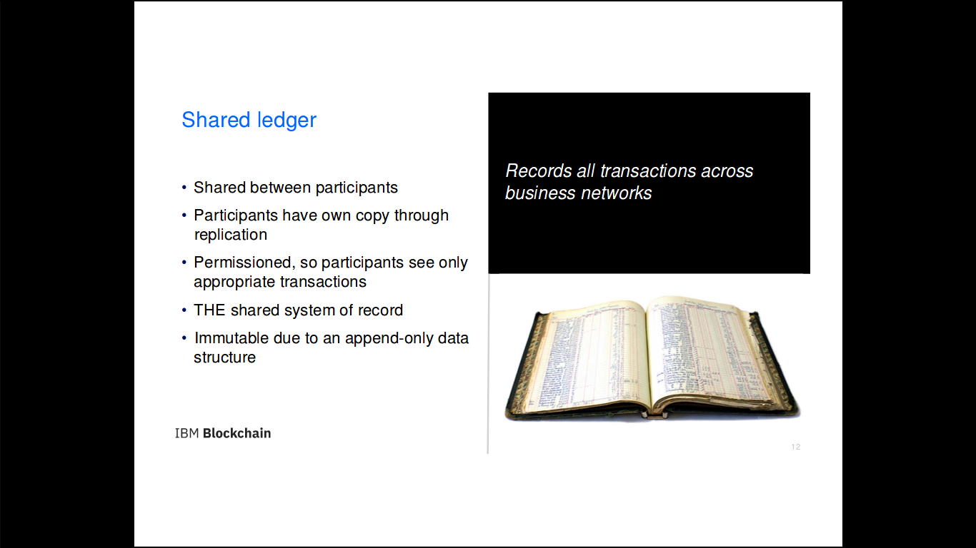

Slide 12
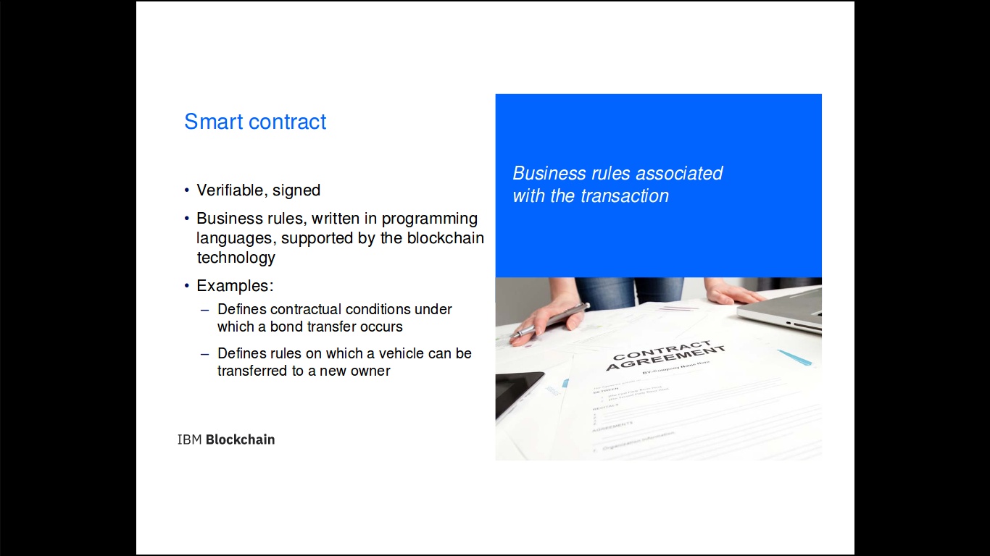

Slide 13
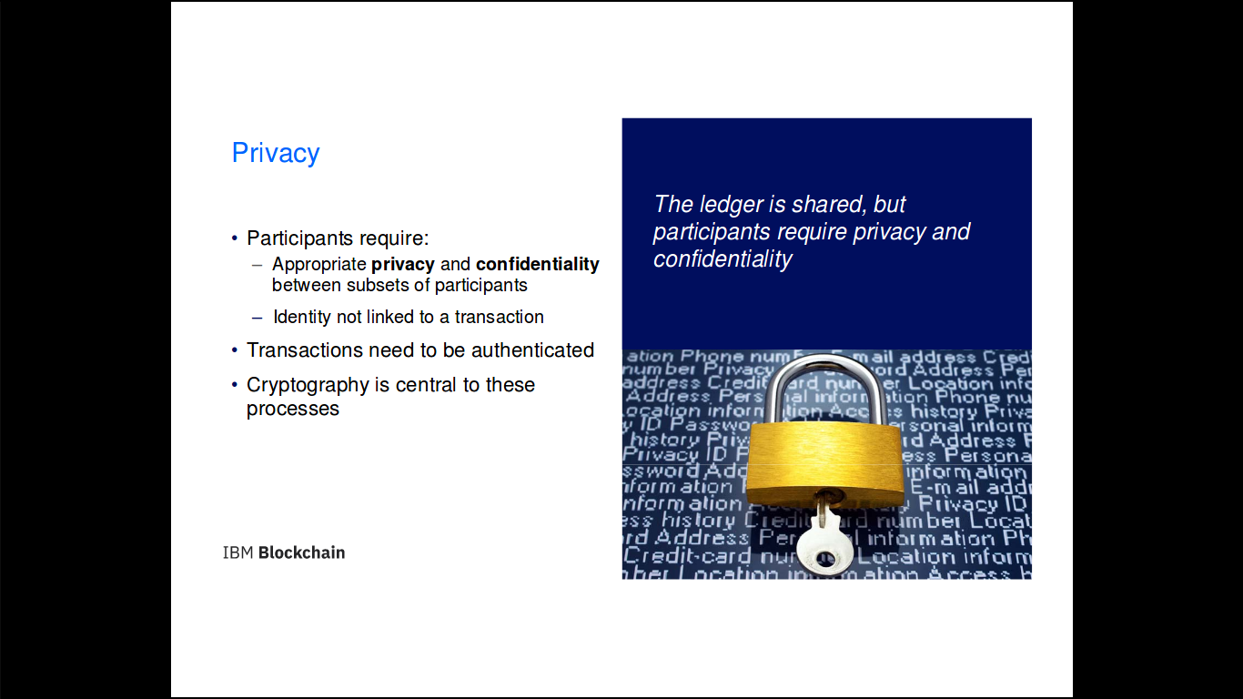

Slide 14
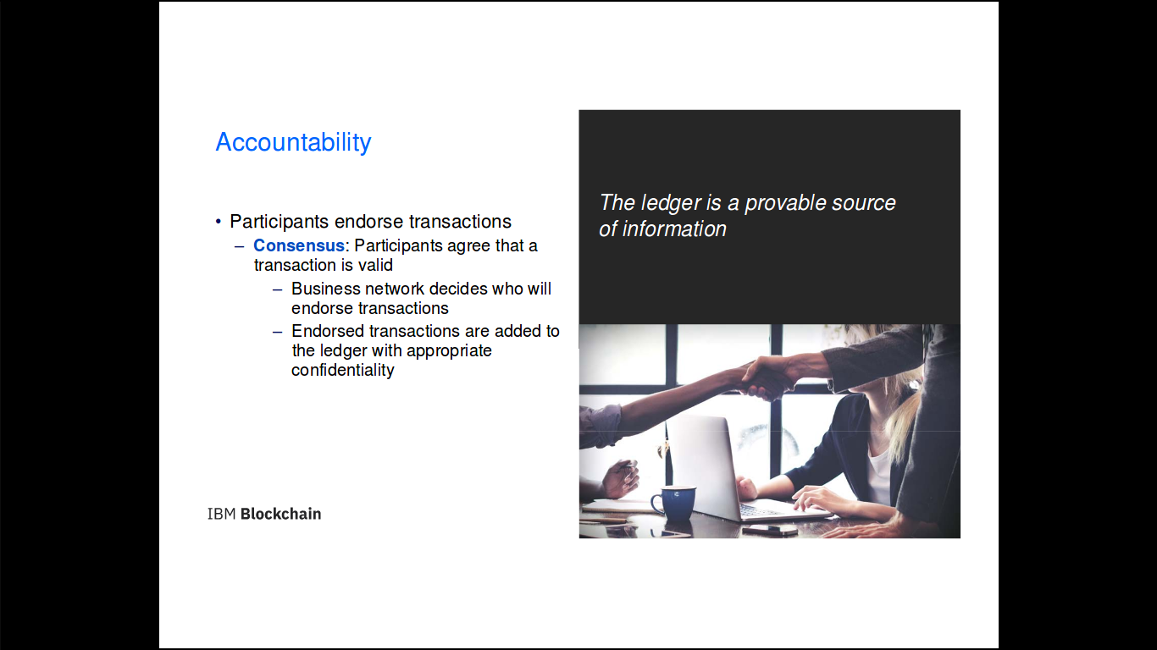

Slide 15
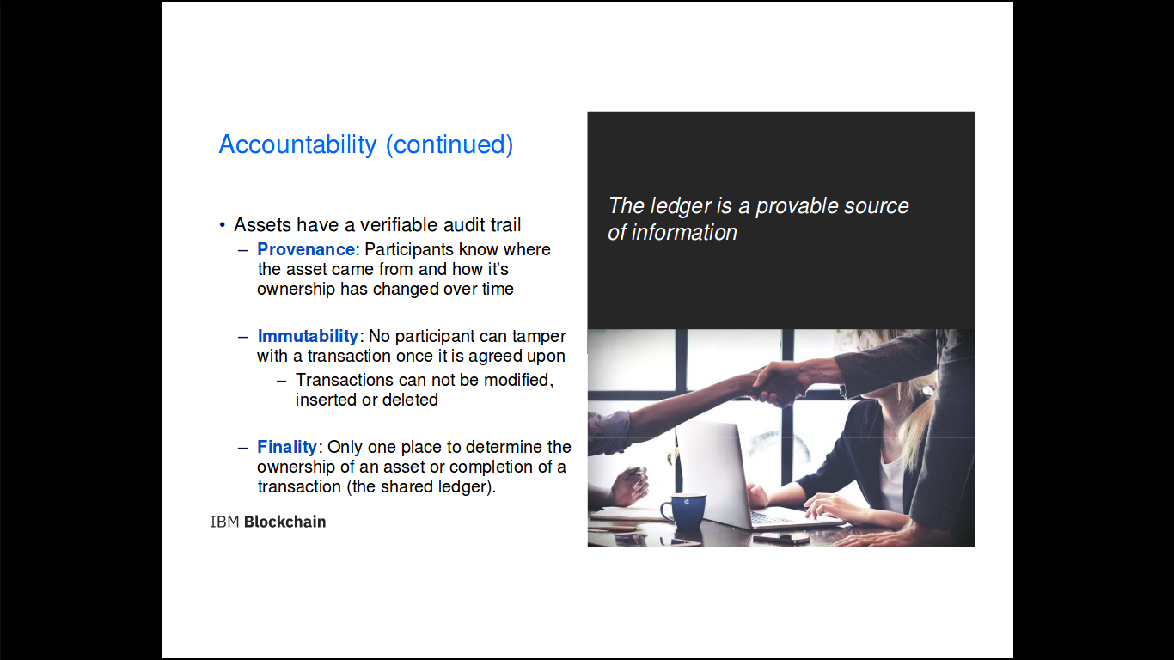

Slide 16
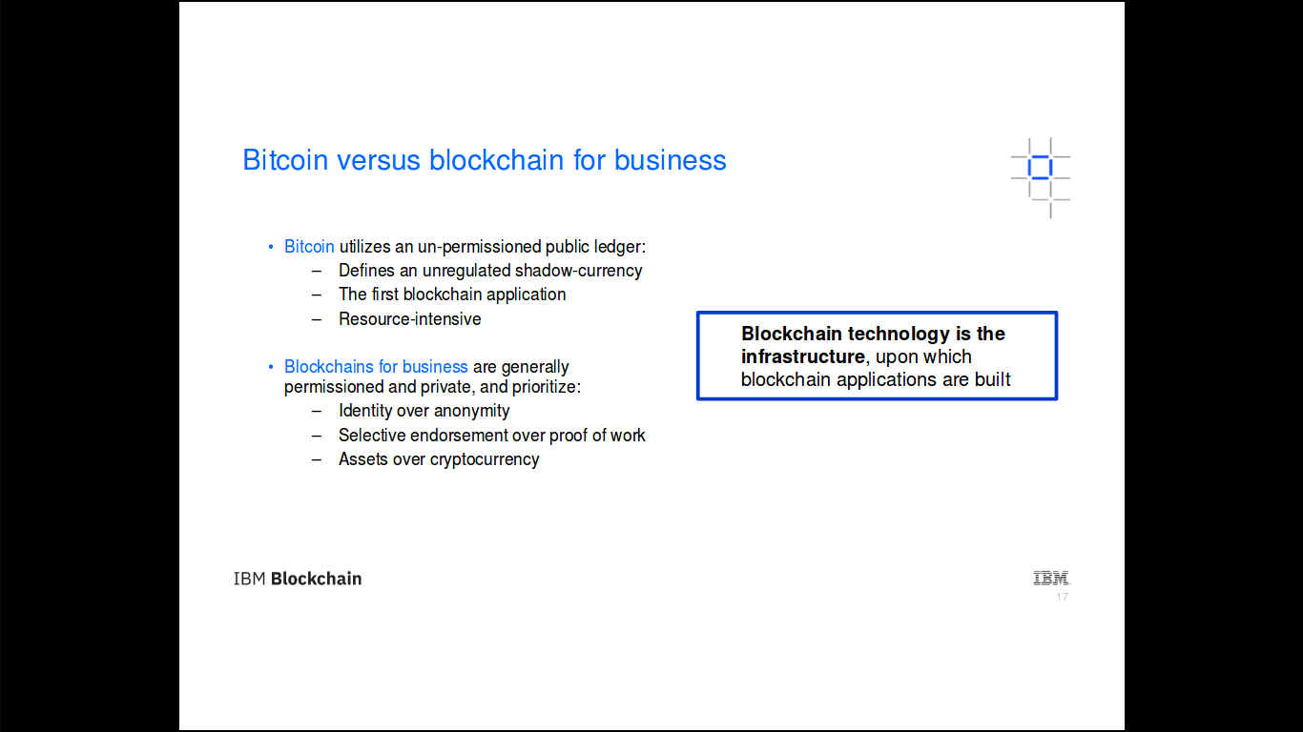

Slide 17
Hyperledger
Transaction Flow

Slide 18

Assumptions
https://hyperledger-fabric.readthedocs.io/en/release-1.2/txflow.html

Slide 19
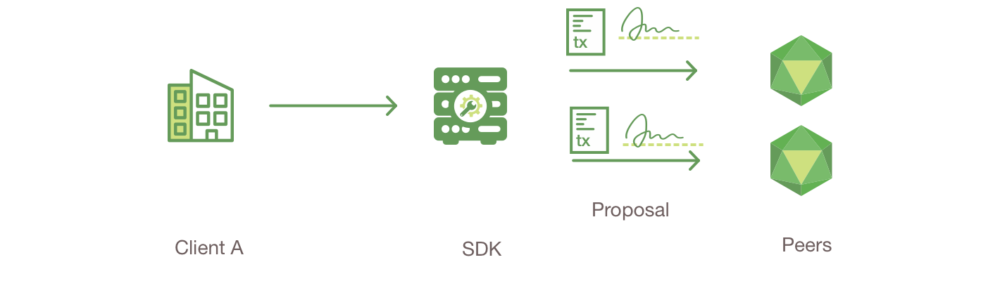
Client A initiates a transaction
https://hyperledger-fabric.readthedocs.io/en/release-1.2/txflow.html

Slide 20
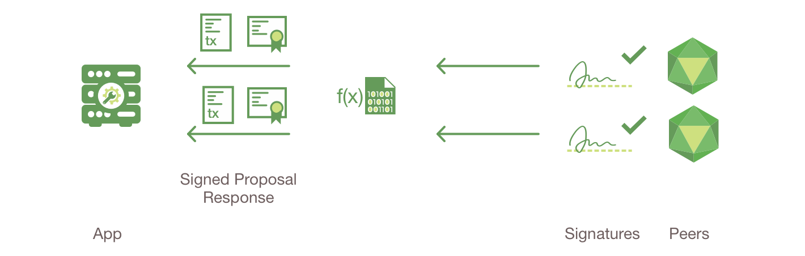
Endorsing peers verify signature
execute the transaction
https://hyperledger-fabric.readthedocs.io/en/release-1.2/txflow.html

Slide 21
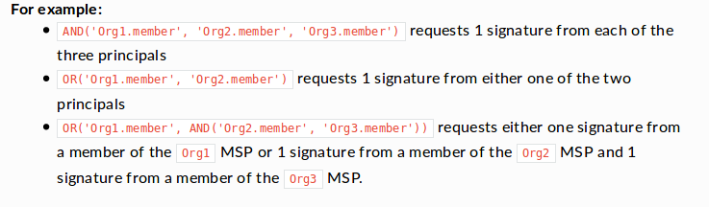
How we set Endorsing peers
https://hyperledger-fabric.readthedocs.io/en/release-1.2/txflow.html

Slide 22

Proposal responses are inspected
https://hyperledger-fabric.readthedocs.io/en/release-1.2/txflow.html

Slide 23
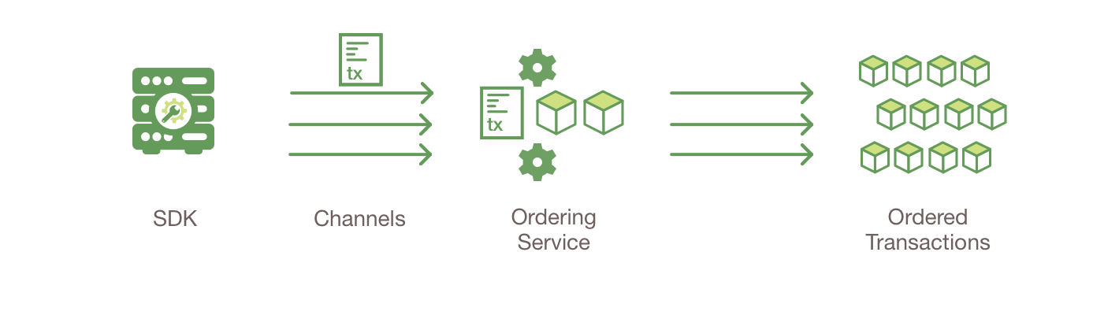
Client assembles endorsements
into a transaction
https://hyperledger-fabric.readthedocs.io/en/release-1.2/txflow.html

Slide 24
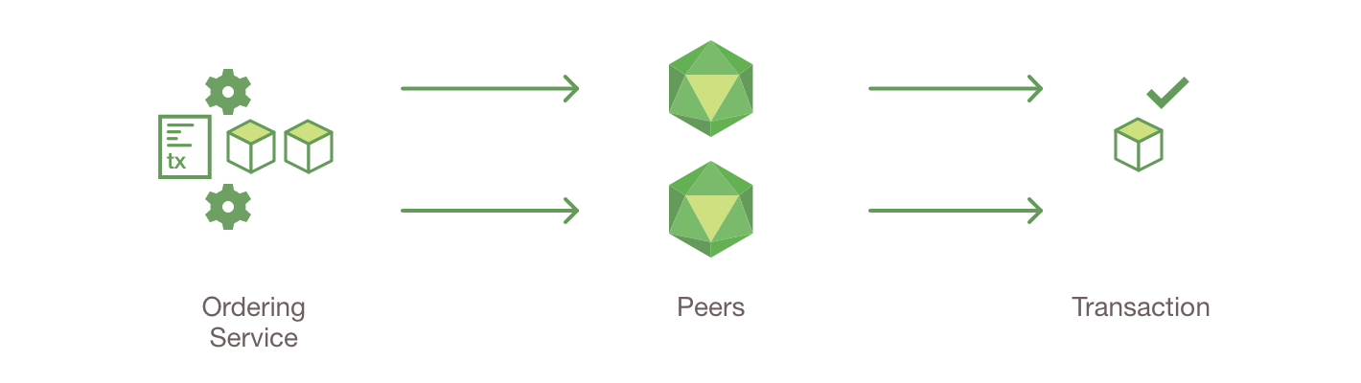
Transaction is validated and committed
https://hyperledger-fabric.readthedocs.io/en/release-1.2/txflow.html

Slide 25

Ledger updated
https://hyperledger-fabric.readthedocs.io/en/release-1.2/txflow.html

Slide 26
