Slide 1
Lecture 2
Bitcoin & Ethereum

Slide 2
Bitcoin Keys
private key → public key → Address

Slide 3
Bitcoin Keys
Private :
9f86d081884c7d659a2feaa0c55ad015a3bf4f1b2b0b822cd15d6c15b0f00a08
Public :
045f81956d5826bad7d30daed2b5c8c98e72046c1ec8323da336445476183fb
7ca54ba511b8b782bc5085962412e8b9879496e3b60bebee7c36987d1d5848
b9a50
Address :
1HKqKTMpBTZZ8H5zcqYEWYBaaWELrDEXeE

Slide 4
Bitcoin Keys
Live example…

Slide 5
Bitcoin
Transactions
No sender, No Receiver,
Only Inputs and outputs

Slide 6
Transactions
Live example…

Slide 7
Transactions
let me explain…

Slide 8
Transactions
The “Script” Language

Slide 9
Transactions
The “Script” Language
let me explain…

Slide 10
Bitcoin Blockchain
let me explain…

Slide 11
Bitcoin
Mining

Slide 12
Mining
Just Creating New
BLOCK

Slide 13
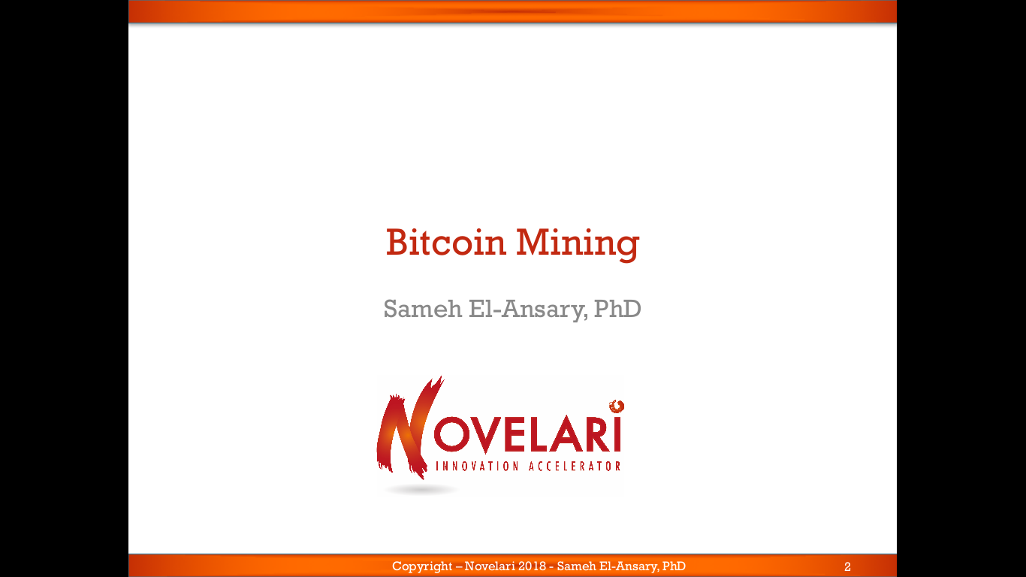

Slide 14
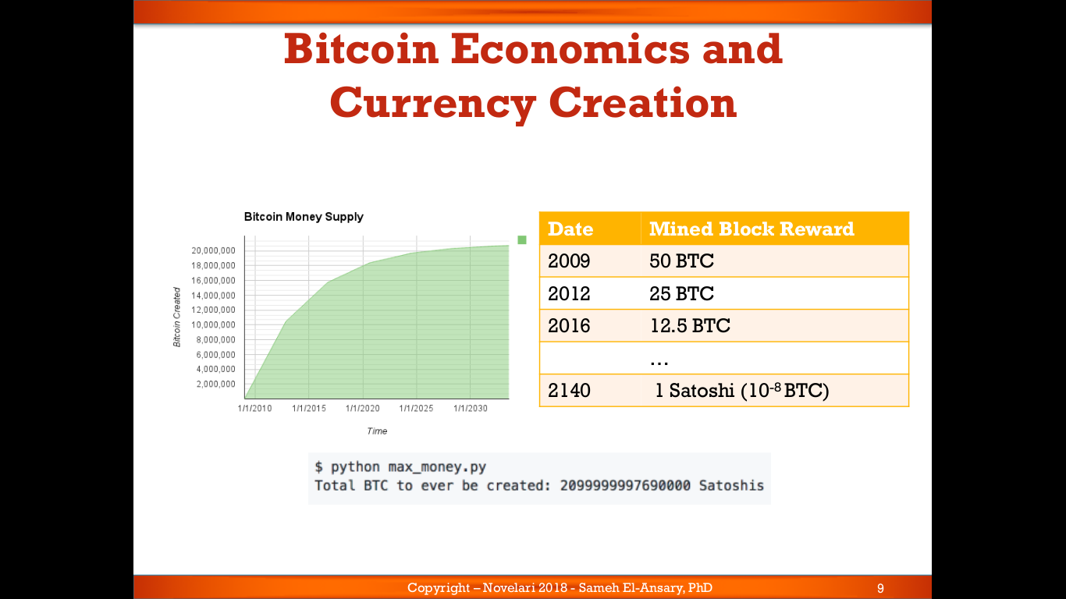

Slide 15
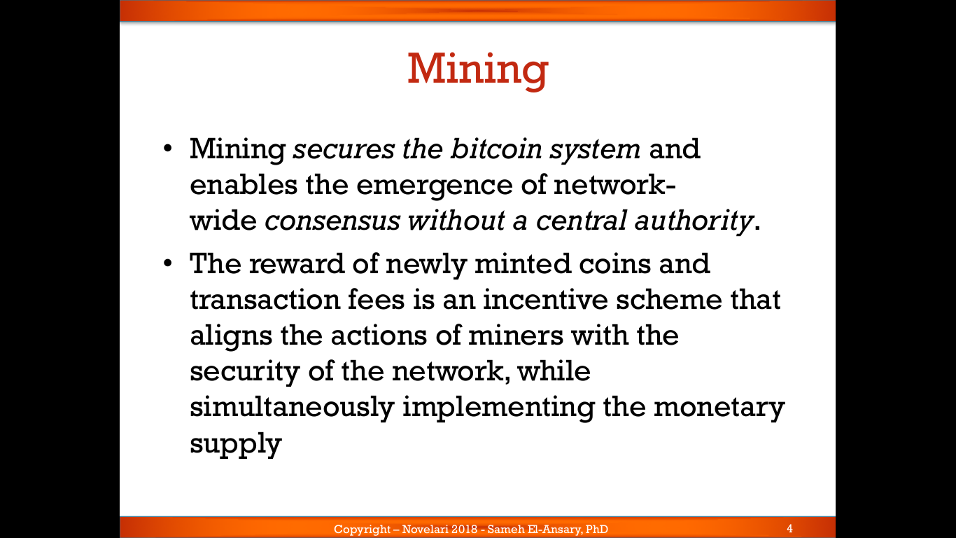

Slide 16
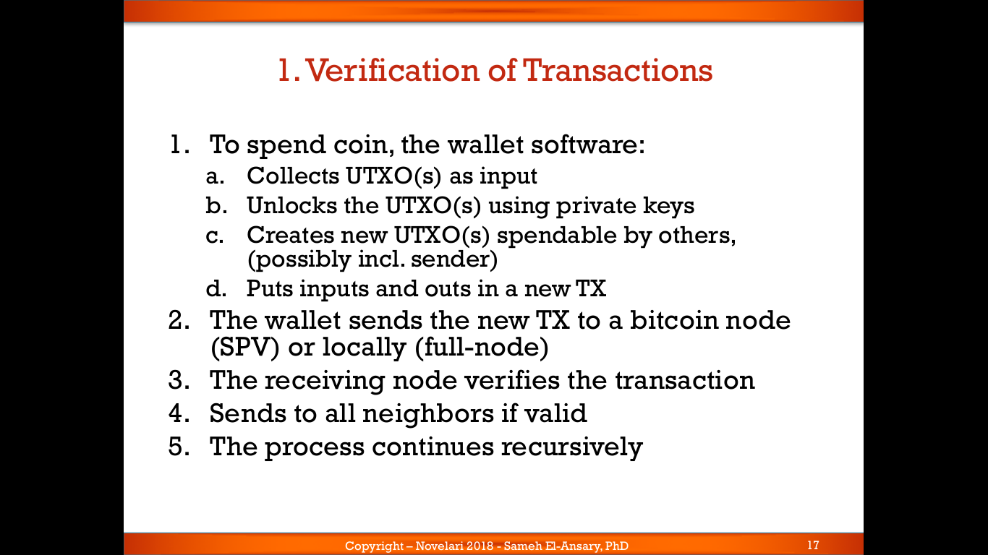

Slide 17
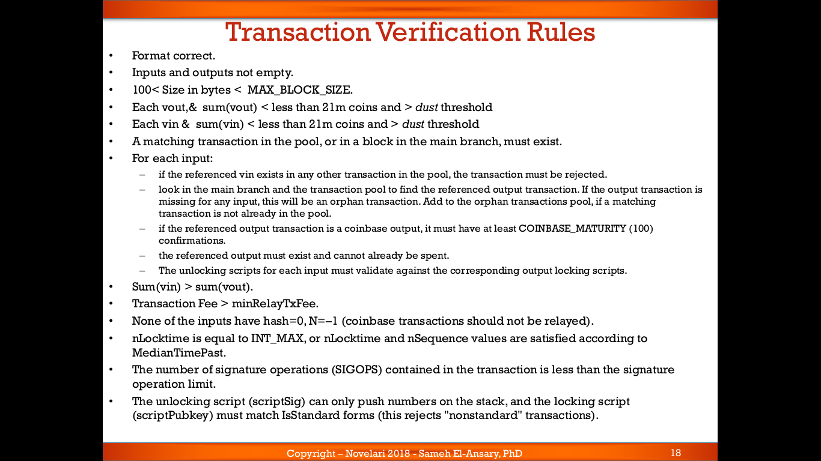

Slide 18
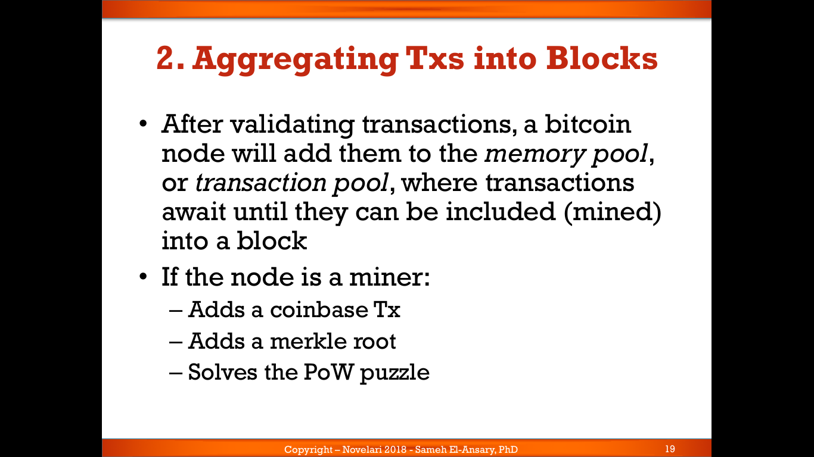

Slide 19
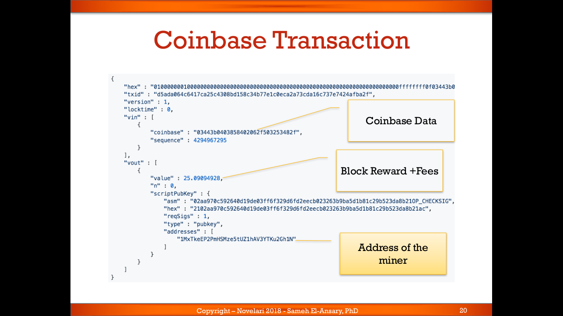

Slide 20
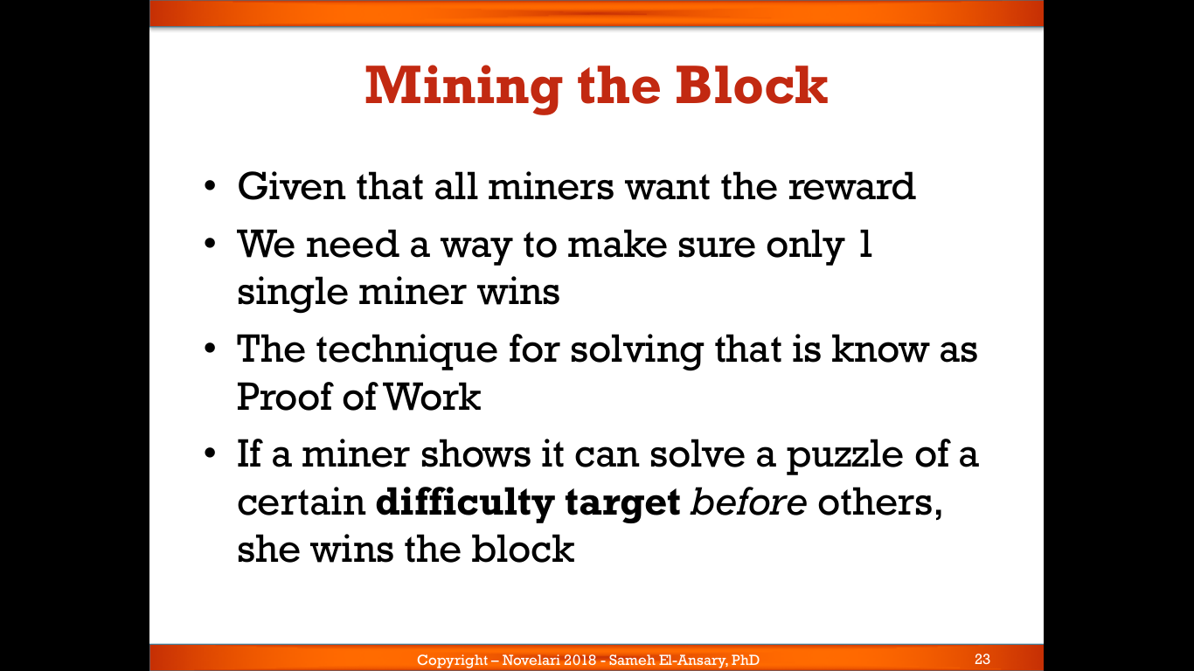

Slide 21
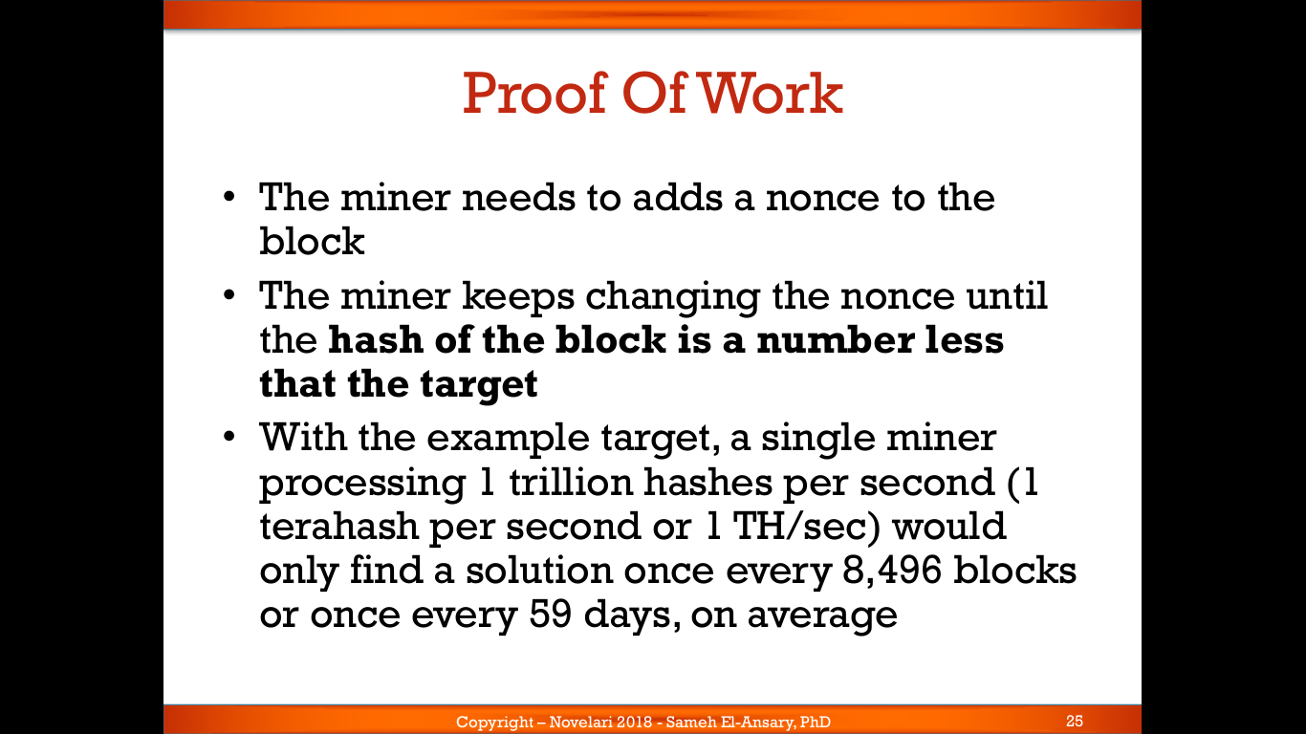

Slide 22
Bitcoin Mining
Live example…

Slide 23
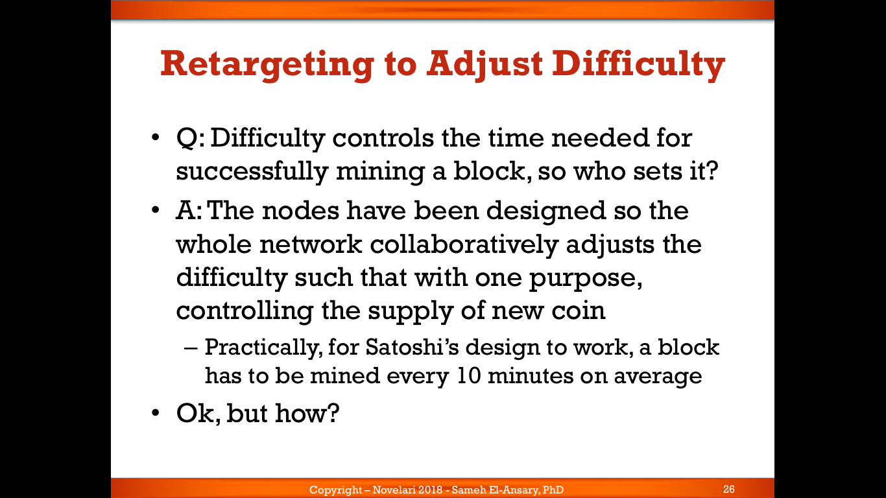

Slide 24
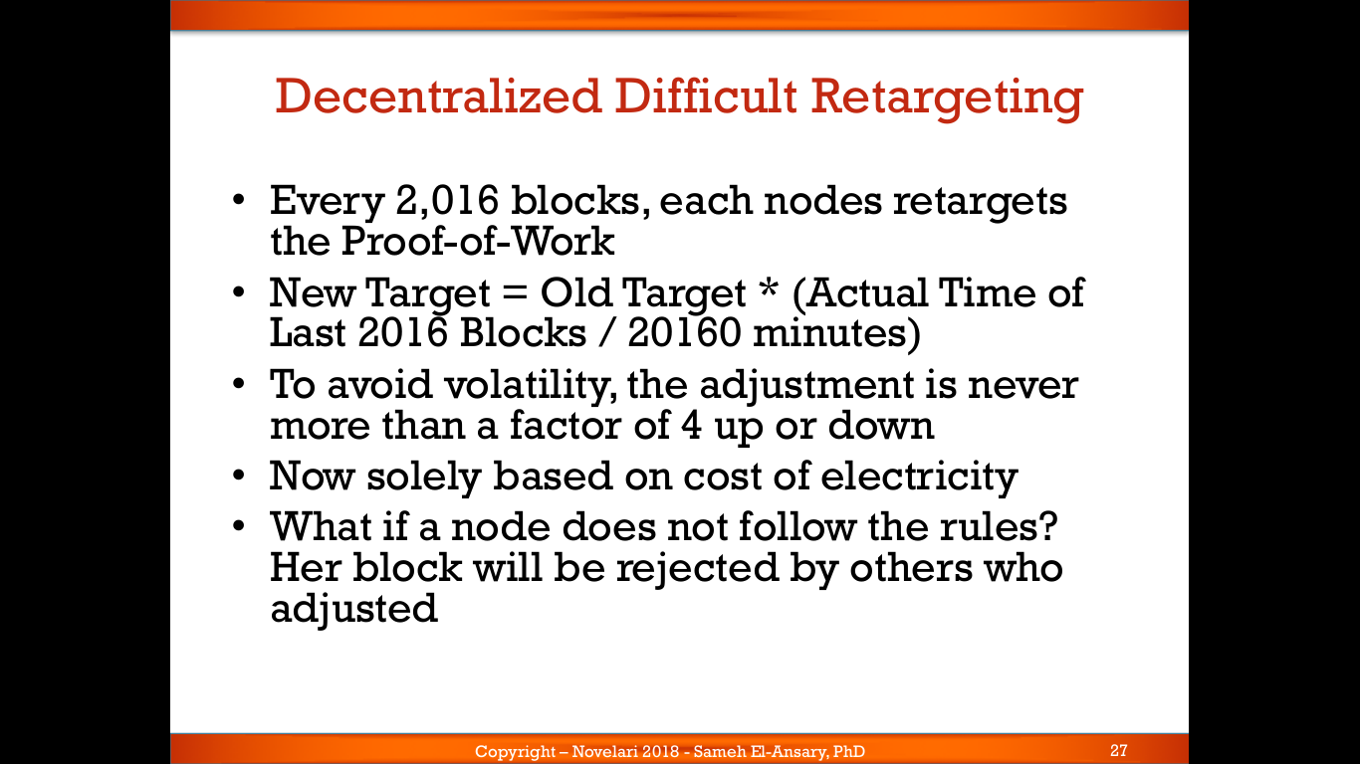

Slide 25
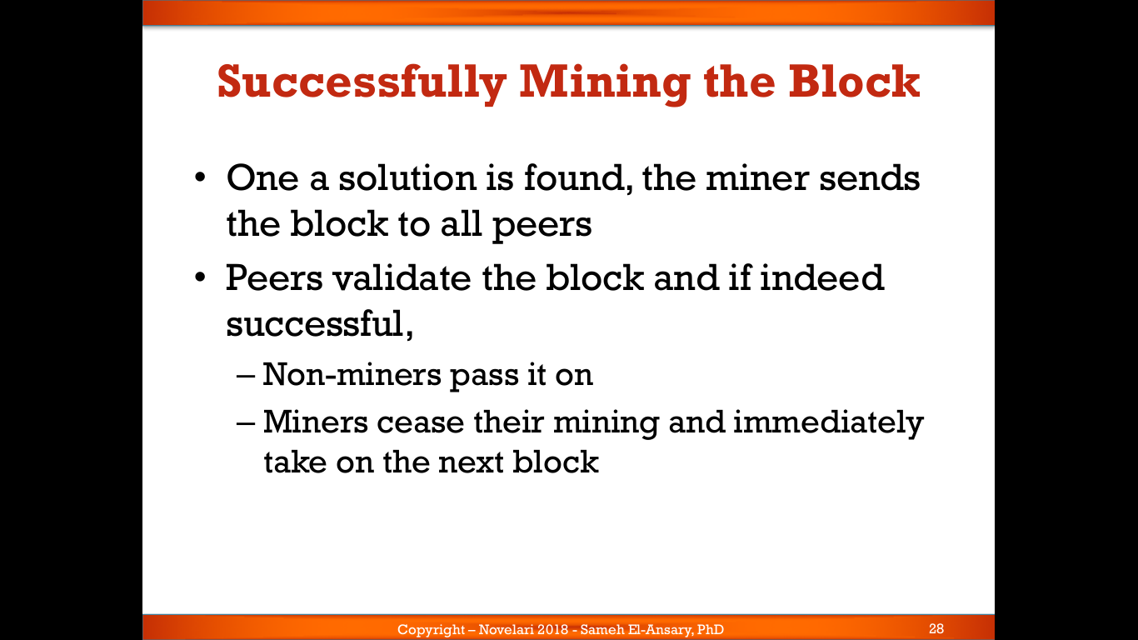

Slide 26
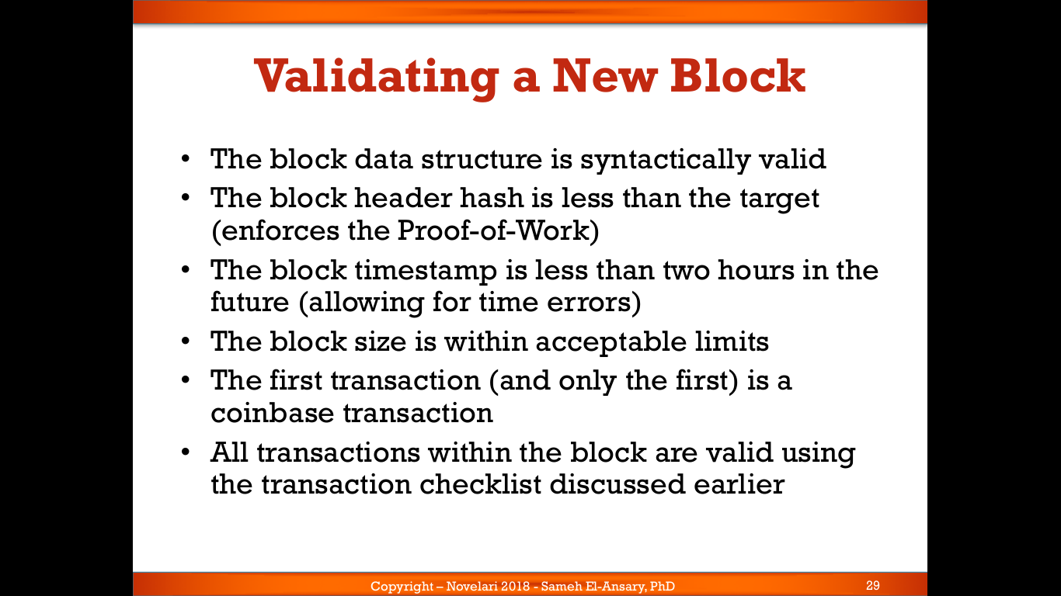

Slide 27
Bitcoin
P2P Network

Slide 28
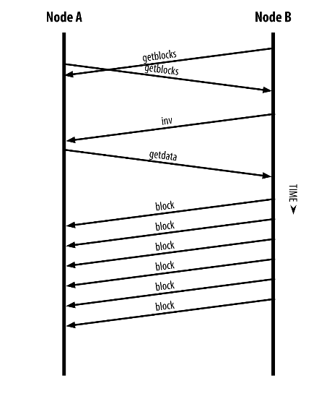
P2P Network

Slide 29
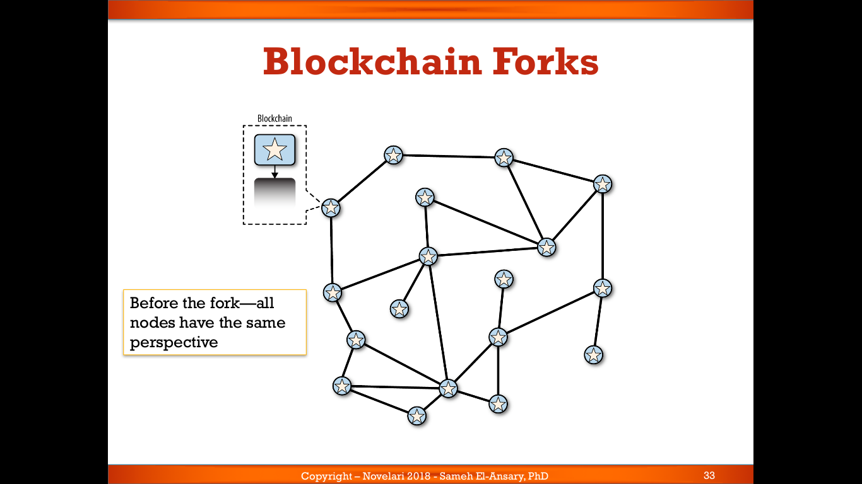

Slide 30
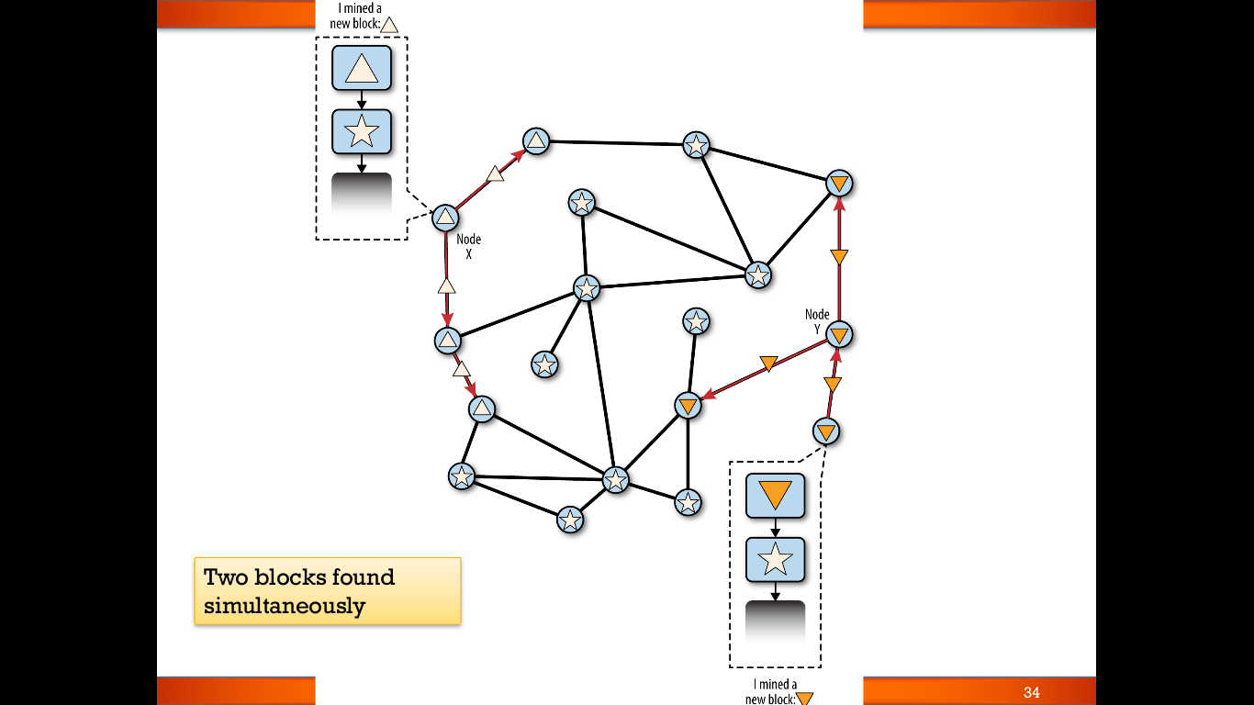

Slide 31
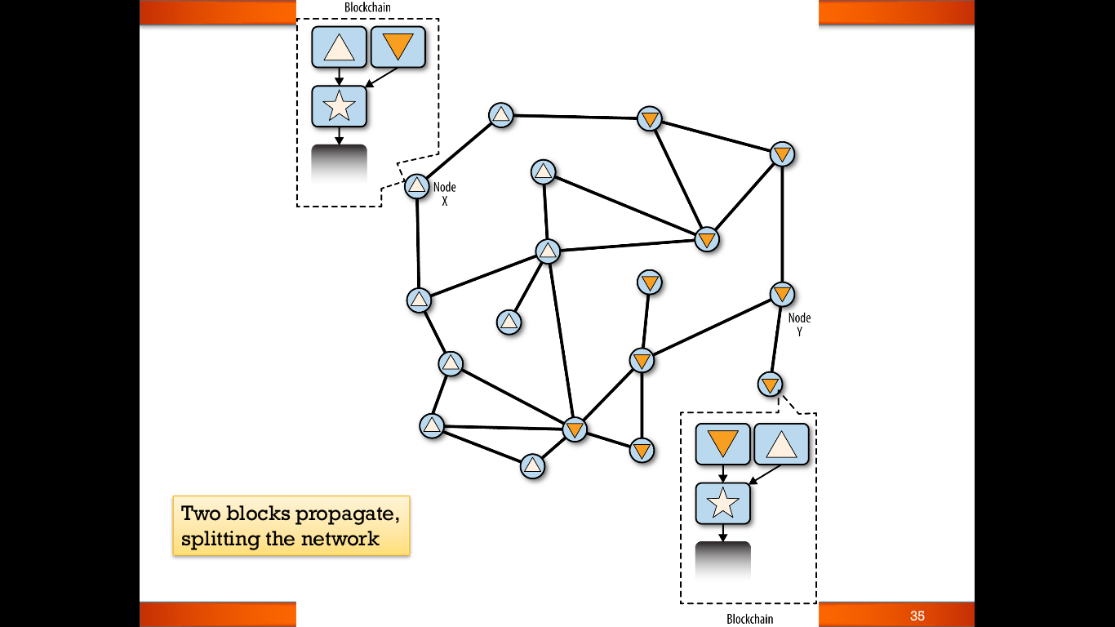

Slide 32
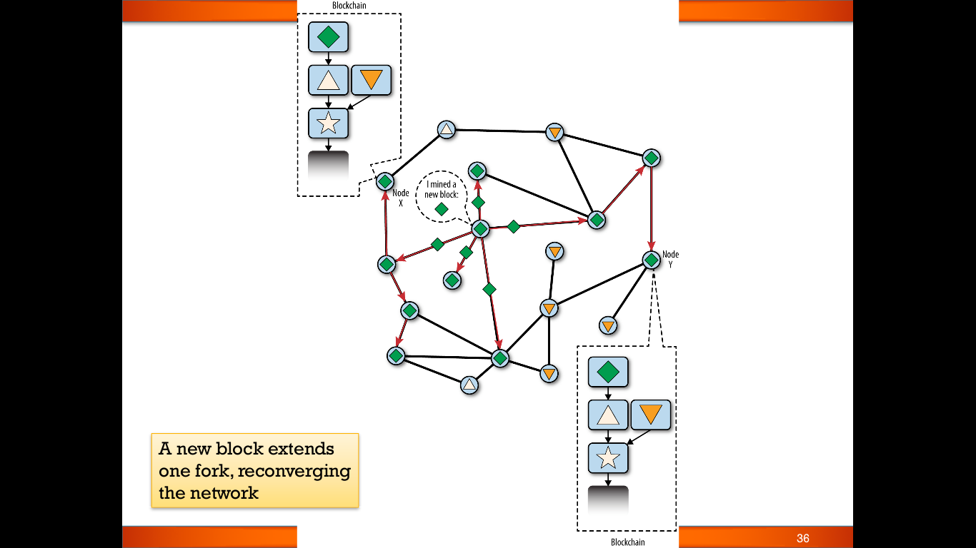

Slide 33
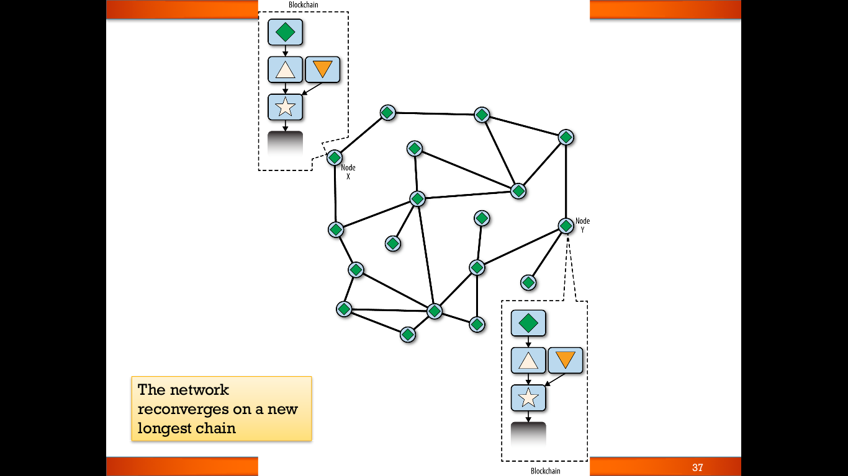

Slide 34
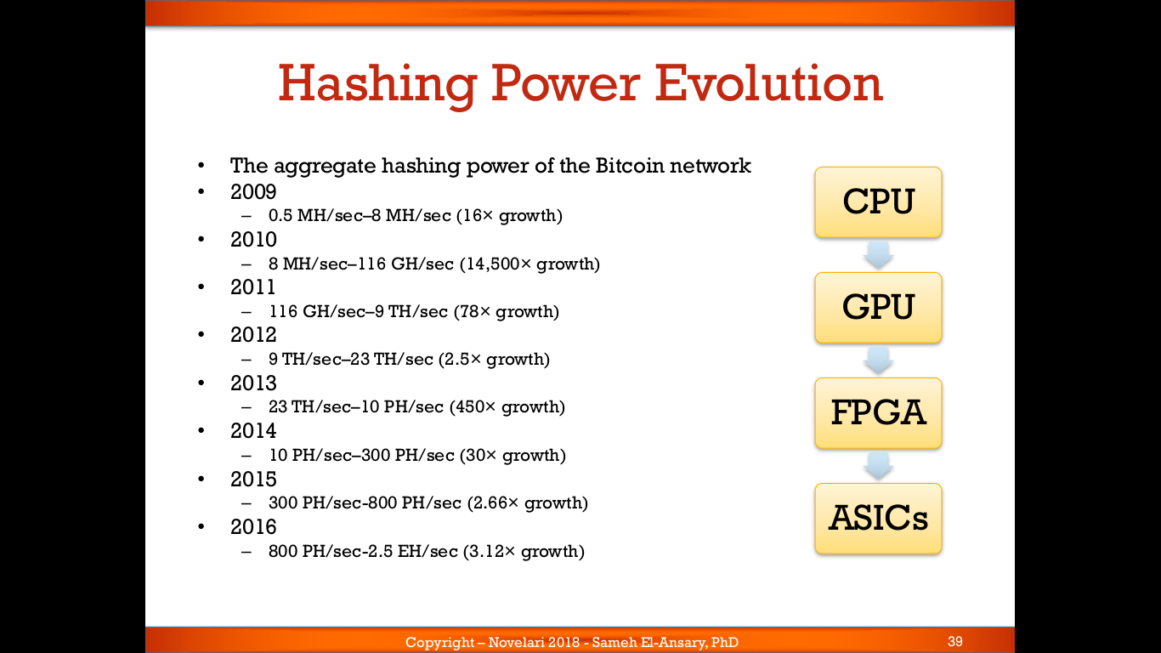

Slide 35
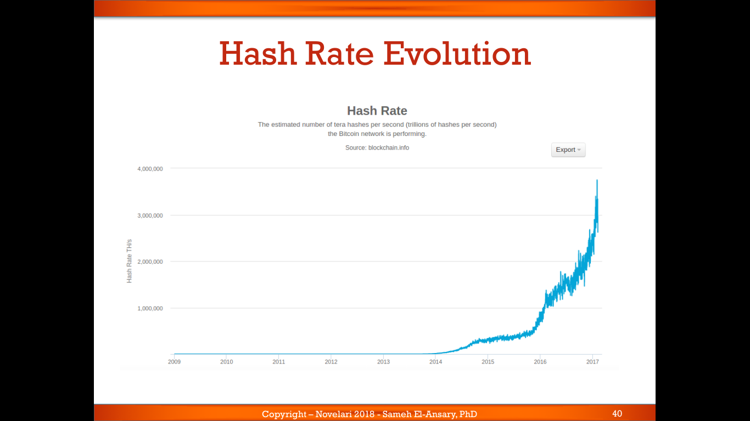

Slide 36
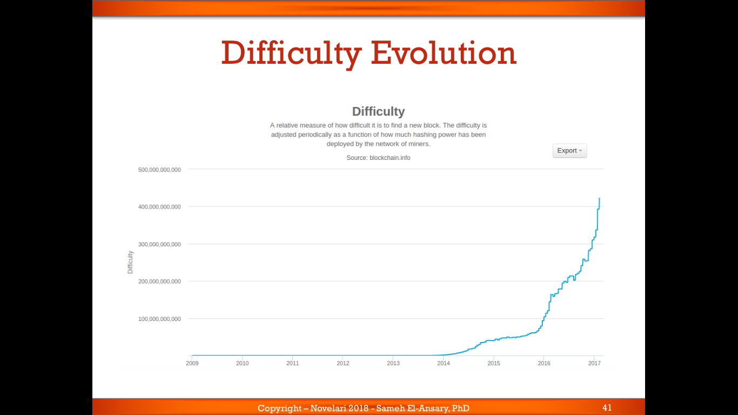

Slide 37
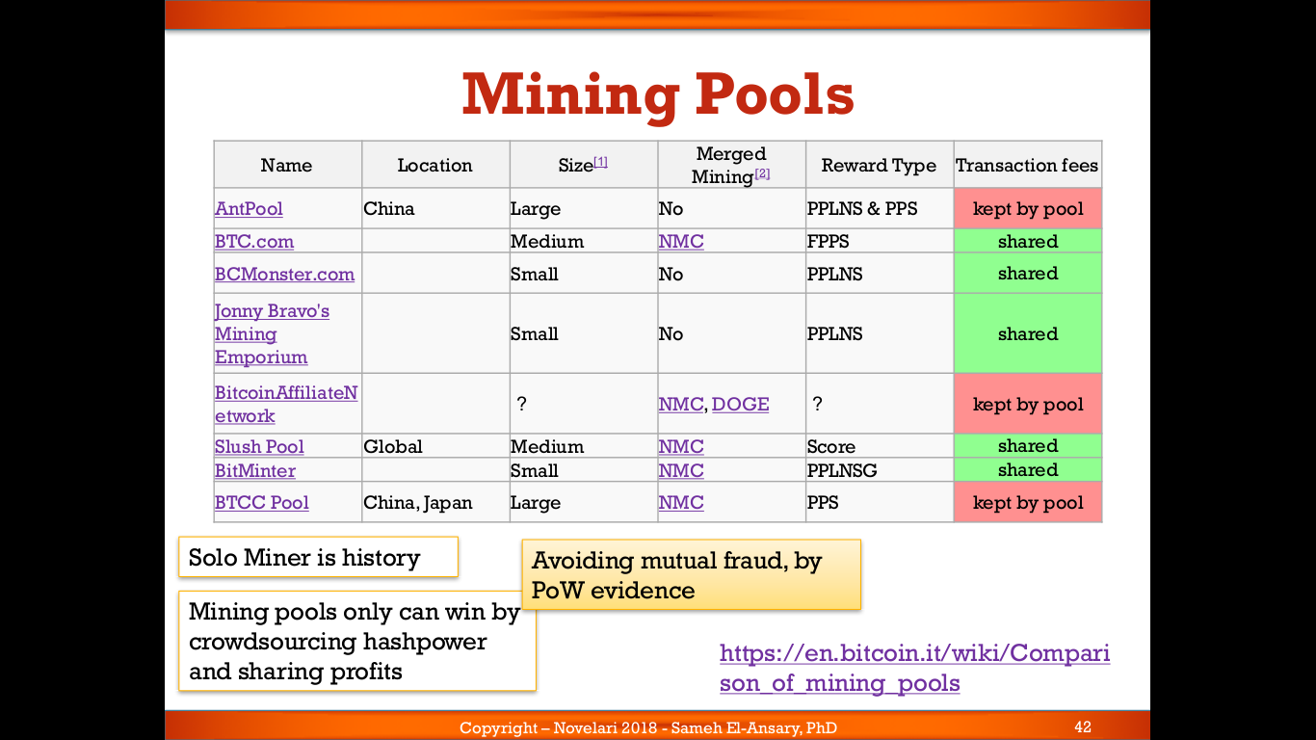

Slide 38
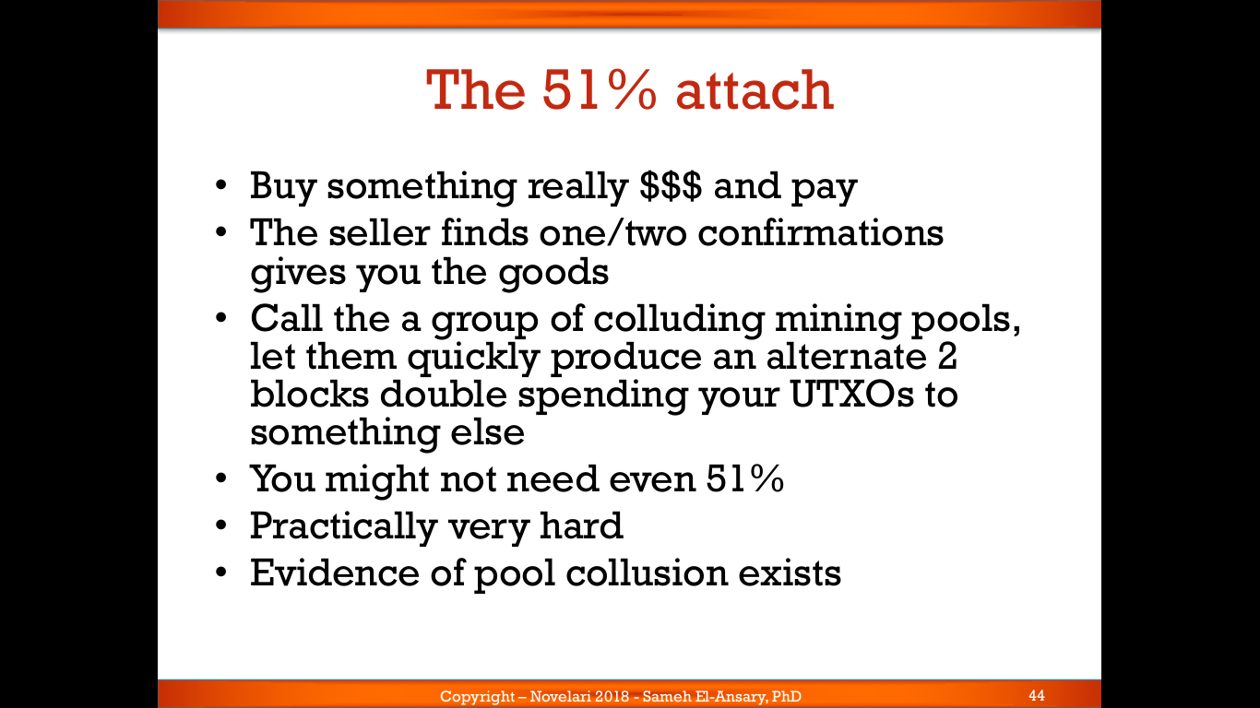

Slide 39
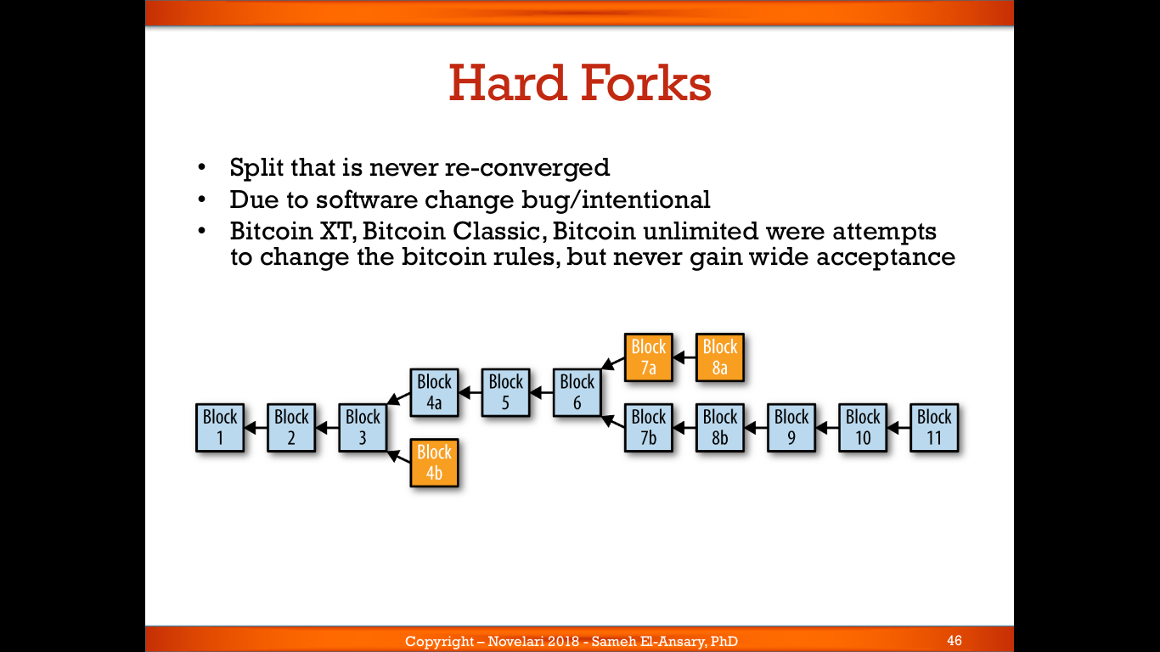

Slide 40
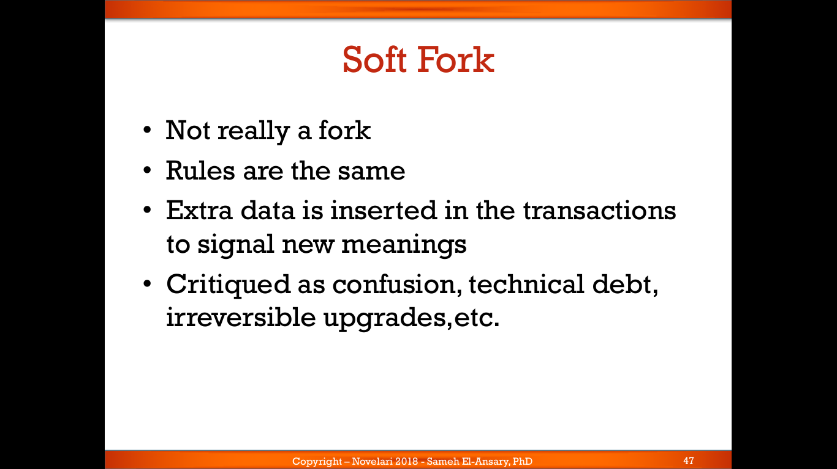

Slide 41
