Slide 1

Dynamic Workflow Engine

Slide 2
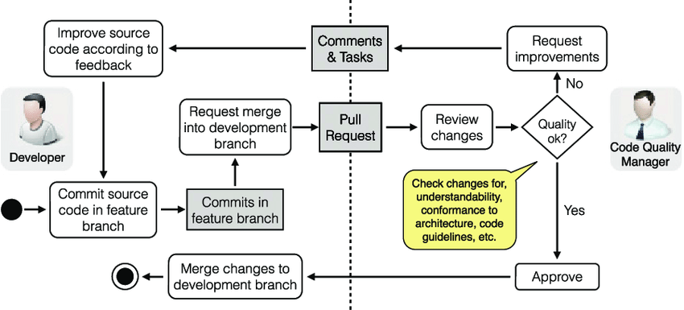
Let's see workflow examples

Slide 3
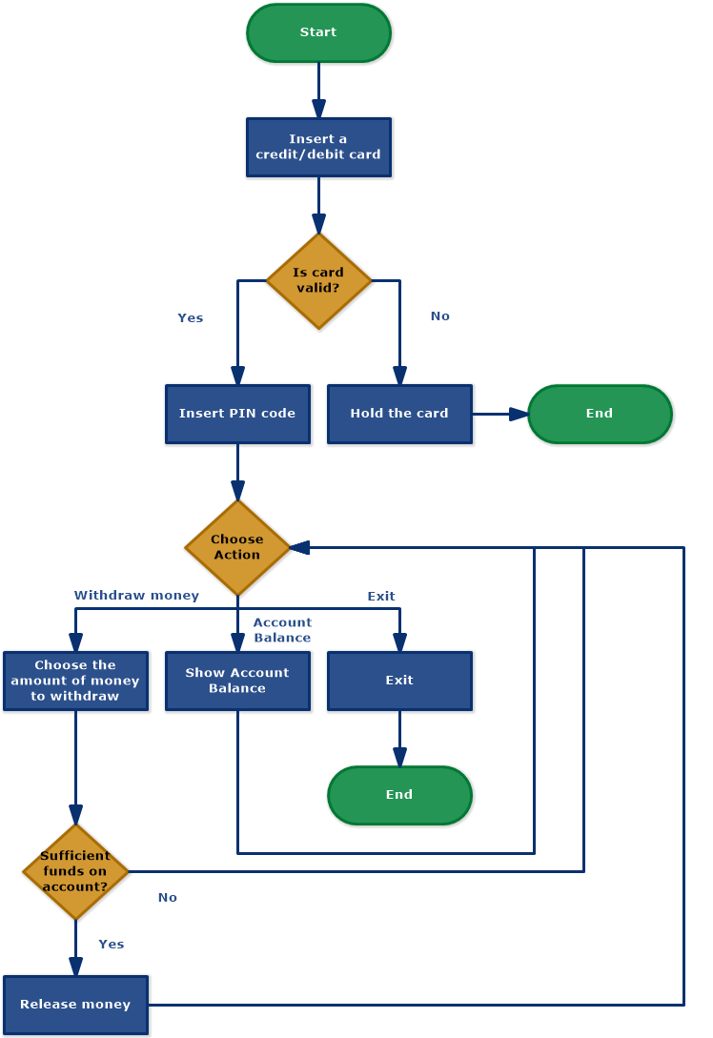
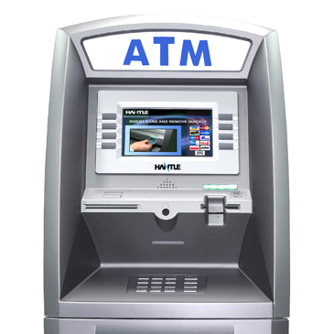
Another example
ATM Process

Slide 4
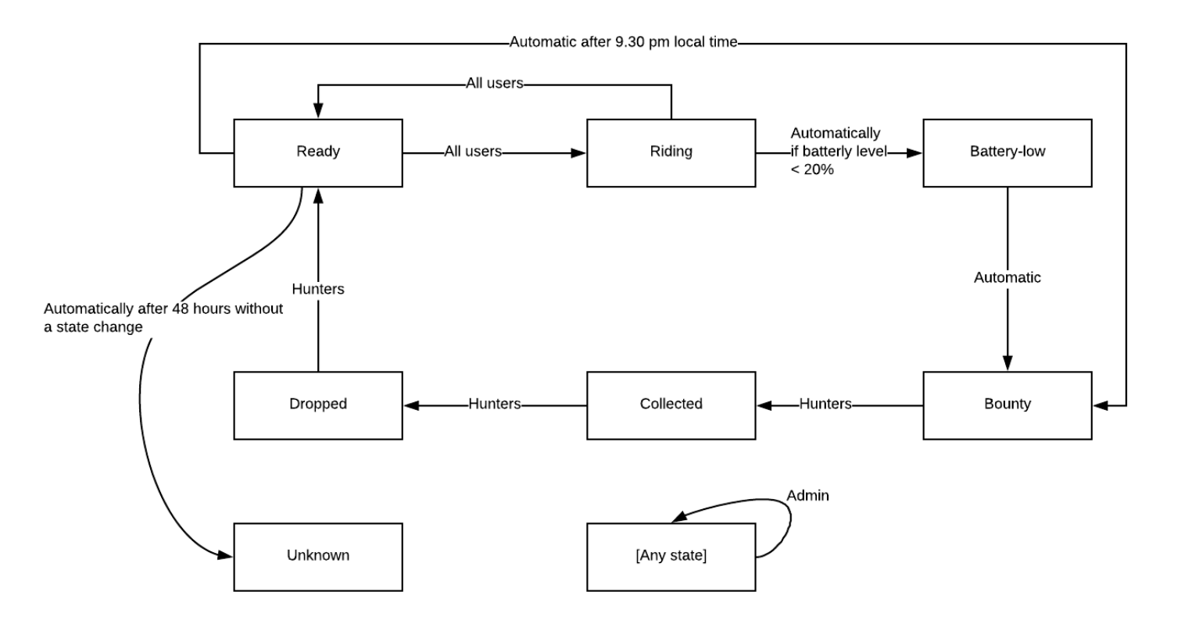
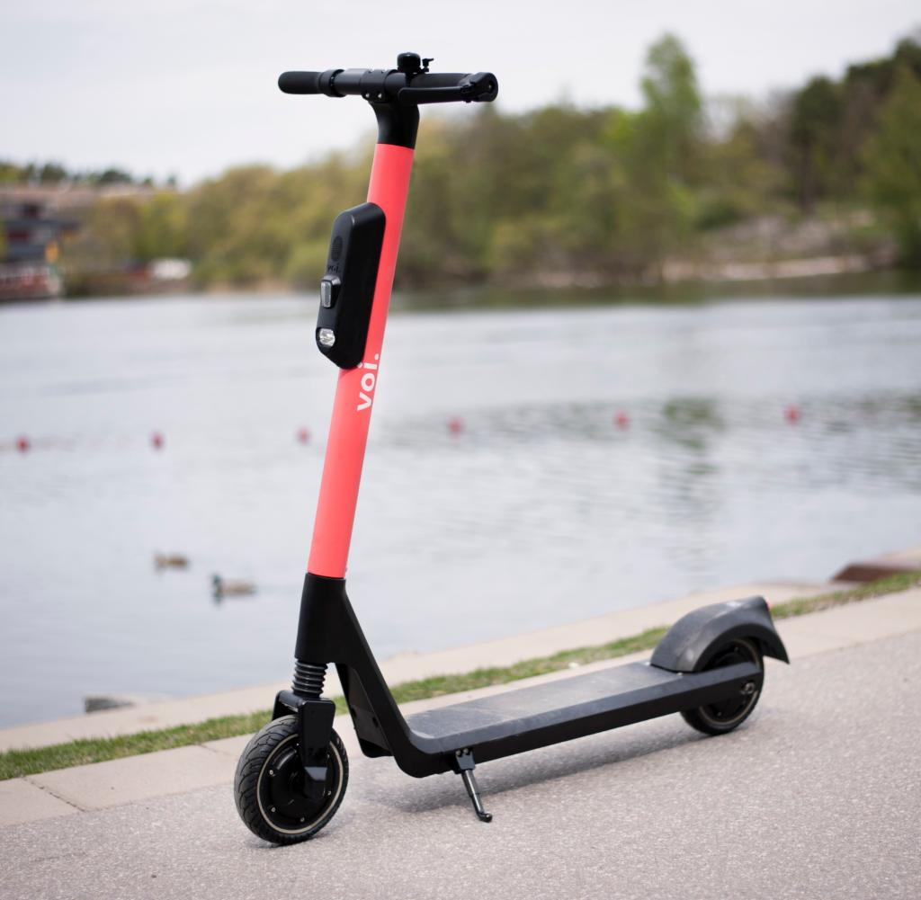
Another example
Vehicle running flow

Slide 5
So with a deep look in all pervious example
Workflow Features
- Any workflow manage different objects with different features
- Any workflow Consists of multiple Status
- Each Status could lead to one or more status or end the flow.

Slide 6
Workflow Change Status
Condition to move form status to another
This condition could be:
- Human Execution
- Automatic Execution
- Logical Execution
- Timing Execution
- Admin Force Change

Slide 7

Introduction to
Dynamic-Workflow-Engine
(DWE)

Slide 8
Dynamic Workflow Engine
(DWE)
Engine to make your life easy with any workflow

Slide 9
Dynamic Workflow Engine
Status flow strategy
Status is the base unit to the flow system.
Status contains name and available status.
Two conditions to move
Function Condition
Authority Condition

Slide 10
Dynamic Workflow Engine
Live Example … Vehicle flow

Slide 11
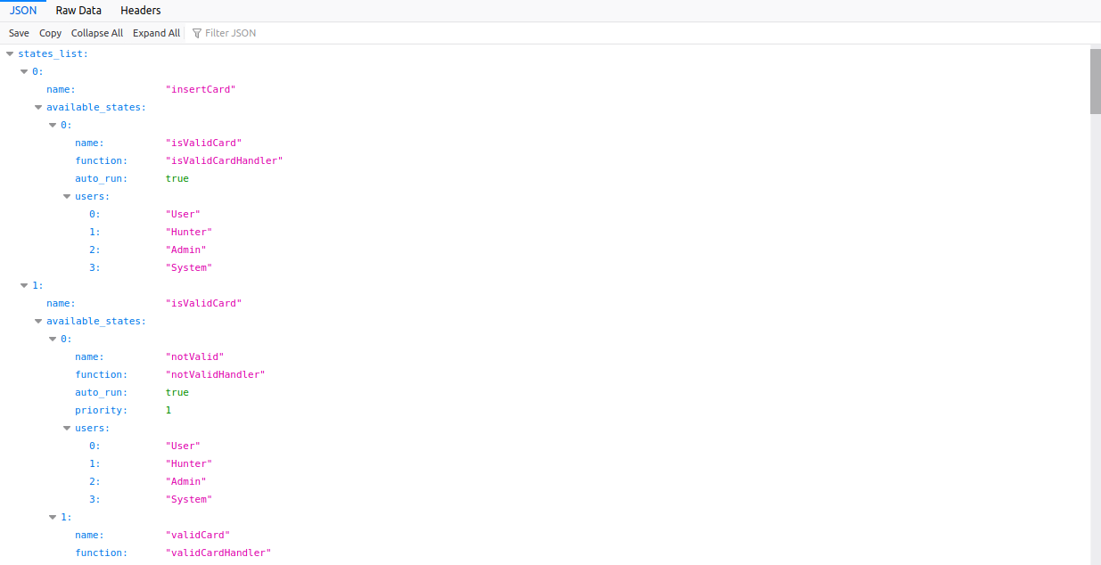
Dynamic Workflow Engine
status
Features already done:
Define workflow within configuration file - Done✔
Define handler for each status - Done✔
Define user access for each status - Done✔
Define automatic/manual run - Done✔
Define running priority - Done✔

Slide 12
Dynamic Workflow Engine
status
Features need to be implemented:
Pass data throw status handler
More abstraction between layers
More performance optimization

Slide 13
Dynamic Workflow Engine
Live Example … ATM Process
To Prove that the system able to work with any
Kind of workflow

Slide 14
Dynamic Workflow Engine
Discussion ….

