Slide 1
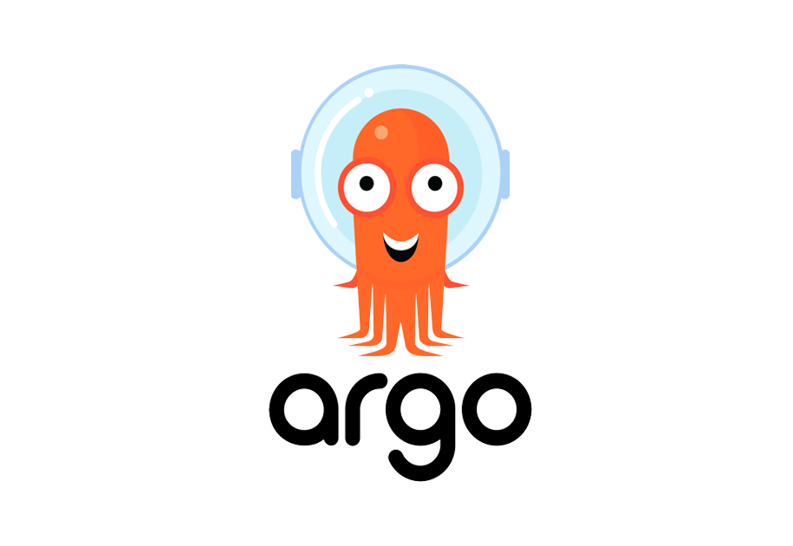

Slide 2

ArgoCD
ArgoCD is a declarative GitOps tool built to deploy applications to Kubernetes

Slide 3
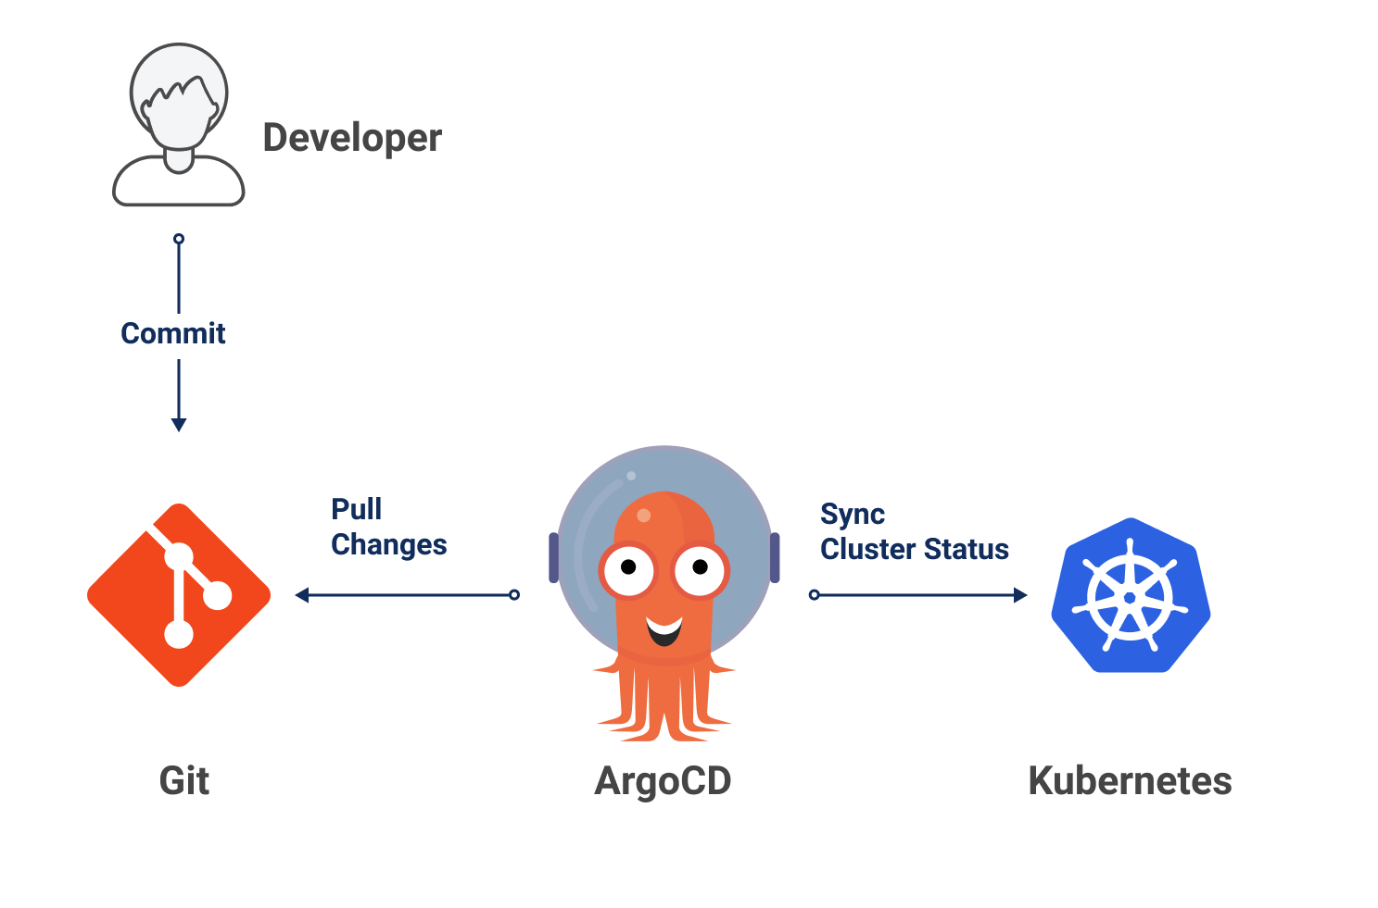

Slide 4

End of the presentation Questions …!?

Slide 5
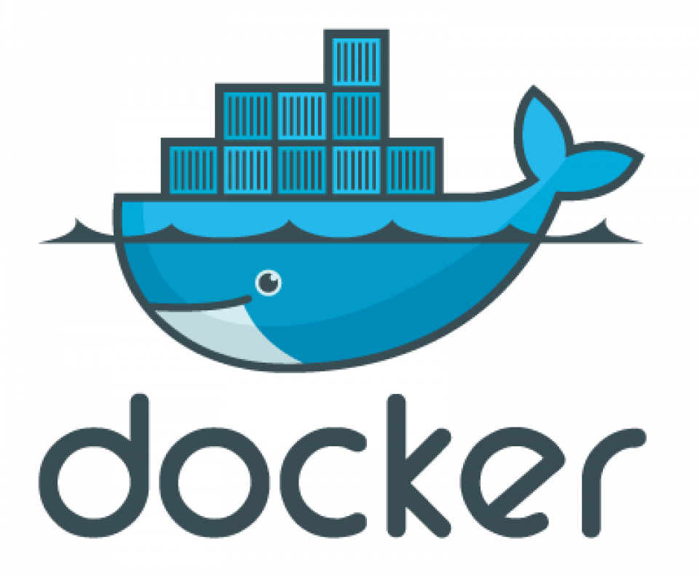
Let's start with Docker
What's Docker
Level virtualization to deliver software in packages called containers.

Slide 6

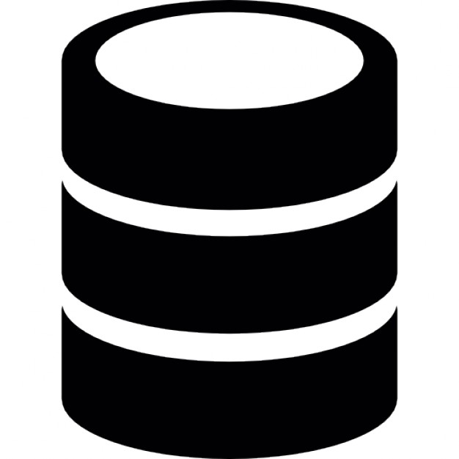
Live example ...
End Points:
1- /Hello-world return Hello world!
2- /insert-into-Database

Slide 7
Live example ...

Slide 8
Issues with using just docker standalone
Hard to scale.
A lot of manual steps which leads to many other issues.
Not valid for a production environment.
Instead, we can use Docker-Compose or Kubernetes.

Slide 9
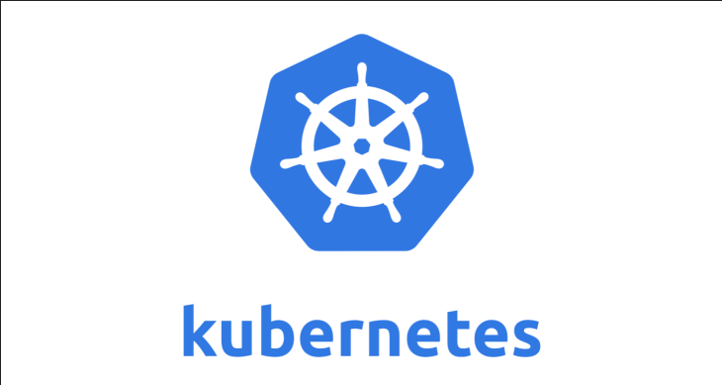
What's Kubernetes
Kubernetes is a container orchestration system for automating software deployment, scaling, and management.

Slide 10
Main Kubernetes Components:
1- Pod (Deployment + service + ingress)
2- Volume
3- ConfigMap
4- Secrets
5- StatefulSet

Slide 11
Live example ...
We need the application to be able to:
1- Automatically Deploy
2- Automatically Configure
3- Automatically Scale

Slide 12
Live example ...

Slide 13
Issues with using just Kubernetes
Manual update & Manual Configure

Slide 14
Live example ...

Slide 15
What's Argocd
Argo CD automates the deployment of the desired application states in the specified target environments.

Slide 16
Live example ...

Slide 18

Questions …!?

