Slide 1
PlantPulse
What is new · November 2026
Clear colours, targets for every KPI, control charts with Nelson rules, a dashboard each person chooses, and root cause analysis
Maintenance management for industrial plants · updated 12 November 2026
PlantPulse · What is new · November 2026
1
Notes:
Update to the PlantPulse modules and benefits presentation: what changed since the last session. Everything shown is live on the server (app.plantpulse-cmms.com).

Slide 2
OVERVIEW
What is new
One colour code
Customise dashboard
KPI targets
Result vs target
Red act now · amber attention · green all clear · grey information
Each person chooses sections, counters and KPIs; same on phone and PC
Set a target on any KPI, for the plant or a department
KPI tiles: result, target, Met / Close / Missed
Nelson control charts
Clear alarm levels
Company KPIs in the app
RCA, search, presentation
8 rules with probable cause on readings and KPIs
“Alarm limit” / “Warning limit” instead of “Critical”; counts match lists
Add a KPI and enter months without Excel
Root cause analysis, one search box, PowerPoint per period
PlantPulse · What is new · November 2026
2
Notes:
Eight changes. The next slides show each one with the screen and the benefit.

Slide 3
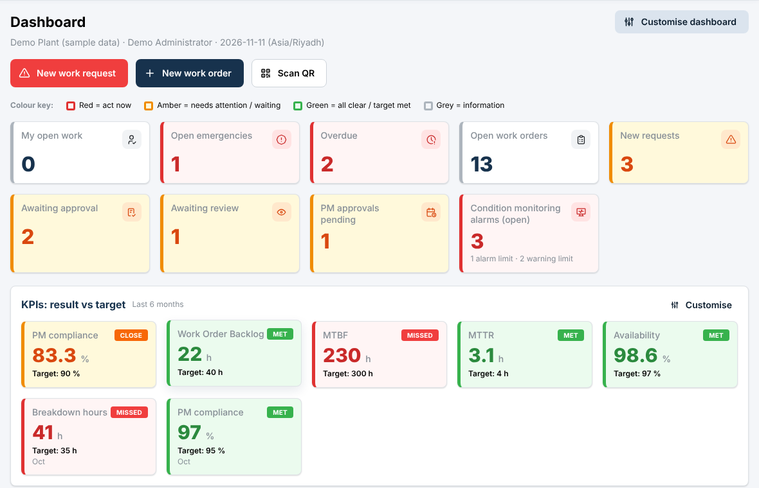
DASHBOARD
One colour code for the whole dashboard
Red
Act now
Emergencies, overdue work, alarm limit, KPI target missed
Amber
Needs attention / waiting
New requests, approvals, warning limit, KPI close to target
Green
All clear / target met
Counter at zero, target met, reading normal
Grey
Information
My open work, open work orders, KPI without target
PlantPulse · What is new · November 2026
3
Notes:
Before, each counter had a fixed colour by type, even at zero. Now colour means one thing everywhere. The key is shown on the dashboard itself. Counters at zero turn green with a tick. The condition monitoring counter counts every open alarm, so the number matches the list it opens, and the line under it splits alarm limit and warning limit.

Slide 4
DASHBOARD
Each person chooses their dashboard
1. Press Customise dashboard (top right)
2. Tick the sections: quick actions, counters, needs attention, work orders per week, KPIs vs target, condition monitoring
3. Untick counters you do not need
4. Pick the calculated KPIs and company KPIs to show as tiles
5. Save – the same layout on phone and computer
Manager
KPIs vs target, alarms, approvals – no technician lists
Technician
My work, emergencies, quick report and scan
Reliability
Condition monitoring signals and alarms first
PlantPulse · What is new · November 2026
4
Notes:
Customise dashboard, top right. Sections, counters, calculated KPIs and company KPIs can be switched on and off. The choice is saved on the server for that person and plant, so the phone app and the computer show the same. Reset to default restores the standard layout.

Slide 5
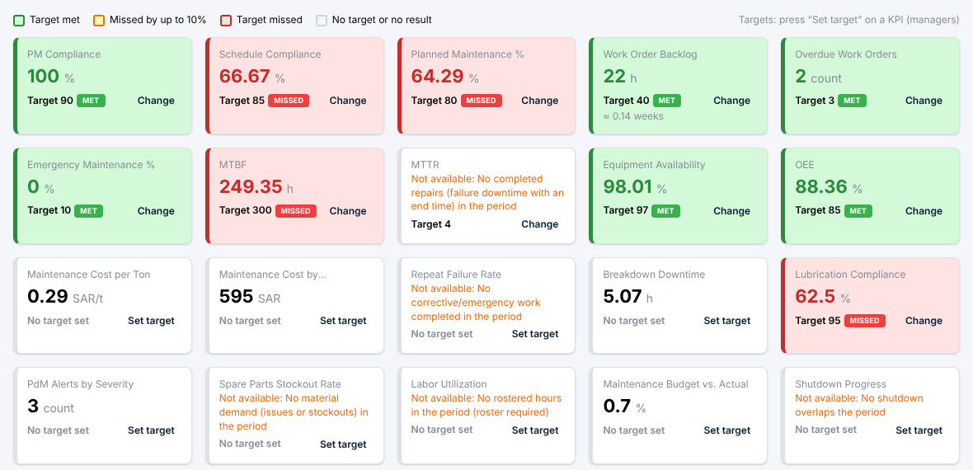
KPIS
Result against target, for every KPI
Met
Result at or better than target
Close
Missed by up to 10 %
Missed
More than 10 % off target
PlantPulse · What is new · November 2026
5
Notes:
Any calculated KPI can have a target: press Set target on the KPI card. The direction is preset (higher is better for PM compliance, MTBF and availability; lower for MTTR, backlog, cost). Choose a department at the top of the page to set a department target; otherwise it applies to the whole plant. Close means missed by no more than 10 percent. The same targets drive the dashboard tiles and the management presentation.

Slide 6
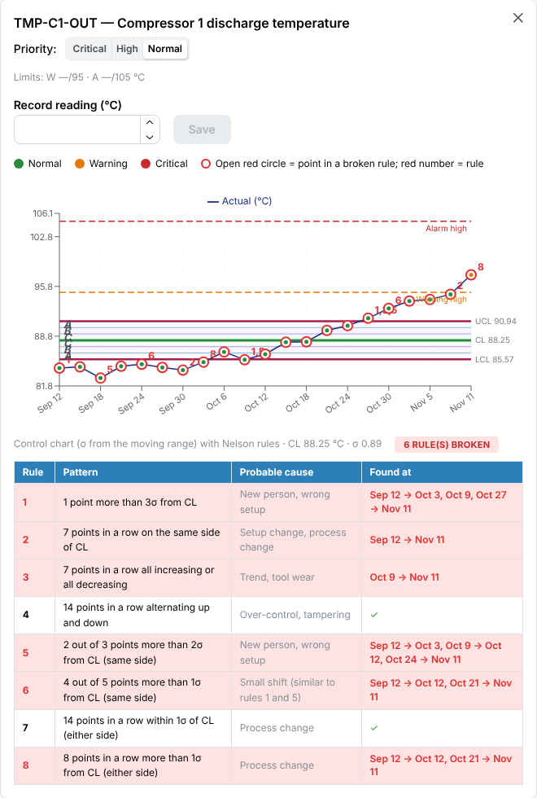
CONTROL CHARTS
Nelson rules: see a change early
Rule | Pattern | Probable cause
1 | 1 point more than 3σ from CL | New person, wrong setup
2 | 7 in a row on the same side of CL | Setup or process change
3 | 7 in a row all rising or all falling | Trend, tool wear
4 | 14 in a row alternating up and down | Over-control, tampering
5 | 2 of 3 beyond 2σ (same side) | New person, wrong setup
6 | 4 of 5 beyond 1σ (same side) | Small shift
7 | 14 in a row within 1σ | Process change
8 | 8 in a row beyond 1σ (either side) | Process change
PlantPulse · What is new · November 2026
6
Notes:
Every measurement point and every KPI now has a control chart like the plant's control-chart sheet: CL the average, UCL and LCL at 3 sigma, zones A, B and C. An open red circle marks a point inside a broken rule and the red number is the rule. The table lists pattern, probable cause and where it was found. In the point list a Nelson column shows the rules broken now, and the dashboard lists those points.

Slide 7
CONDITION MONITORING
Alarm levels in plain words
Alarm limit
Warning limit
Normal
The reading passed the alarm limit set for the point: act soon. Not a plant shutdown.
The reading passed the warning limit: watch and plan the work.
Inside the limits. Nelson rules still warn about trends.
• Dashboard counter = the list it opens (e.g. 3 = 1 alarm limit + 2 warning limit)
• Alerts tab: All open / Alarm limit exceeded / Warning limit exceeded
• Point list: Level and Nelson columns; the chart shows warning and alarm limit lines
PlantPulse · What is new · November 2026
7
Notes:
Management read Critical alerts as a plant emergency, and the counter showed only critical while the list showed all alarms. Now: the level says Alarm limit (red) or Warning limit (amber); the counter counts every open alarm with the split under it; the Alerts tab filters by level; and the dashboard counter only covers the departments a person may see, like the list.

Slide 8
KPIS AND RELIABILITY
Company KPIs in the app, and root cause analysis
Company KPIs
1. Waiting for decision
• Add KPI: name, department, unit, better when higher / lower
• Enter month: actual and target, phone friendly
• Coloured months, YTD average
• Control chart with target line
• Link to a calculated KPI to show its target
2. Investigation (5 Whys, fishbone)
3. Approval
4. Action plan
5. Effectiveness check
PlantPulse · What is new · November 2026
8
Notes:
Company KPIs: Add KPI and Enter month, no Excel needed (Excel still works). Each month is coloured and the name opens the control chart. RCA: major breakdowns are proposed automatically by rules; the manager starts it; the team uses 5 Whys and fishbone; actions are followed and an effectiveness check reopens the RCA if the failure returns.

Slide 9
EVERYDAY USE
Search everywhere, report in one click
Search everywhere
Management presentation
• Magnifier in the top bar, or Ctrl+K
• Words in any order: “crusher motor”, “MIX bearing”
• Finds work by its equipment code or name
• Arabic spelling variants treated alike
• Period and department → PowerPoint in one click
• Scorecard: this period, previous, target, status
• Trends, bad actors, cost vs budget, RCAs
• Condition monitoring: alarm levels, Nelson signals
• Native charts – edit before the meeting
PlantPulse · What is new · November 2026
9
Notes:
Search: magnifier or Ctrl+K, finds equipment, work orders, requests, parts, plans, points, RCAs and shutdowns. Management presentation: one click on the KPI page builds an editable PowerPoint in English, Arabic or Bengali; the scorecard now shows target and On target / Close / Off target, and the condition slide shows alarm levels and points breaking a Nelson rule.

Slide 10
NEXT STEPS
To get the full benefit
• Manager sets targets for the main KPIs (PM compliance, MTBF, MTTR, availability, backlog)
• Each person customises the dashboard for their job
• Train with the workbook: sessions A–F, exercises and quiz
• Reliability engineer reviews points with Nelson signals every week
• Use the management presentation in the monthly meeting
• PlantPulse on Google Play after closed testing (about 22 November)
PlantPulse · What is new · November 2026
10
Notes:
Targets are the one thing the system cannot know by itself: the manager sets them once. Then train each group with the workbook (sessions A to F). Google Play: closed testing ends around 22 November; then the production application is submitted.

