Slide 1
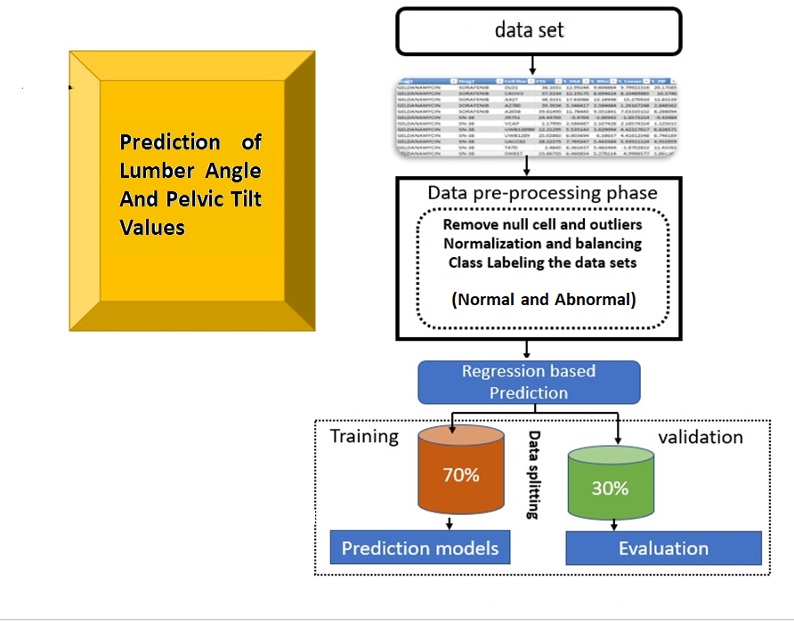
Apply Models
Decision Tree
SVM
Random Forest
AdaBoost
Performance Metrics
MSE | RMSE | MAE | R2

