Slide 1
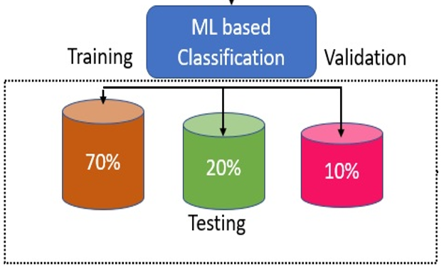
Dataset
Data Pre-Processing
(StandardScaler, LabelEncoder)
Split Dataset
Accuracy | Precision | Recall | F1 Score | Time
Performance Evaluation
Proposed Gradient Boosting Classifier with PCA
Proposed Voting Classifier
FourMachine Learning Regressors
Feature Selection
F-value selector
Mutual information selector
RFE with logistic regression
PCA
Select from model with random forests
Variance thresholding
RFE with random forests
Feature importance with random forests
Qxford scale | Qxford scale Classification
1 | Flicker
2 | Weak
3 | Moderate
4 | Good
5 | Strong
VLQ Scale | VLQ Scale classification
1 | Very loose
2 | Slightly loose
3 | Moderate loose
4 | Neither loose/tight
5 | Slightly tight
6 | Moderate tight
7 | Very tight

