Slide 1
F5 & Intel Demonstrating ODL Enabled NSH-Based Service Function Chaining in Gi-LAN
9/27/2016 1:45pm
Tarek Radi, Comms Service Provider Solution Technology Enabling Manager, Intel
Randall Cleveland, Director of Solution Architecture, F5 Networks
Kevin Smith, Director of Platform Solutions, Intel

Slide 2
Agenda
Problem Statement & F5 contributions to date
Demo Topology and Flow
Demo
Key Learnings & Call to action
Questions and Comments

Slide 3
Problem Statement
Demo ODL-provisioned Network Service Header (NSH) Service Function Chaining using F5 commercial VNFs
Primary goal of use case is functional integration of all disparate components
Using existing open source technologies and F5 VNFs
Based on publicly available open source technology as of Q1 2016 (ODL Lithium SR1)
Open Daylight Controller provisioning of Service Function Classifiers and Forwarders
Show case this solution with VNFs typically in Gi-LAN (applicable to other use-cases as well)
Target Solution Outputs
Upstream patches and fixes as required
Share Key Learnings and Interoperability considerations
For more information about NSH in Gi-LAN see https://networkbuilders.intel.com/docs/Intel_evaluation_of_SFC_for_Gi-LAN_use_case.pdf

Slide 4
F5 Virtual Network Functions (VNFs)
F5 have S/W defined applications that work in a S/W Defined Data Center (SDDC)
F5 BIG-IP Virtual Edition has a portfolio of VNFs that can be used in Gi-LAN & Enterprise infrastructures
Virtual Firewall (vFW)
Virtual URL Filtering (vURL Filtering)
Virtual Bandwidth Controller (vBWC)
Virtual Application Delivery Controller (vADC)
Virtual DNS (vDNS)
Virtual Web Application Firewall (vWAF)
Virtual Access Policy Manager (vAPM)
Virtual CGNAT (vCGN)
Virtual Traffic Detection Function (vTDF)
Virtual Content Insertion (vCI)
Virtual TCP Optimization (vTCPO)
Virtual SIP Routing and Load Balancing (vSRLB)
Virtual Secure Web Gateway (vSWG)
Note
in this demo, instead of using the F5 L4-L7 TDF, F5 implemented an nsh_classifier iRule in the vADC to create a simpler L3 classifier
For more information about the above, see https://www.f5.com/pdf/solution-center/network-functions-virtualization-nfv-solution-overview.pdf
Notes:
F5 offers a broad portfolio of products and solutions that allow maximum flexibility as you deploy and virtualize your network. Whether you need to virtualize elements in your S/Gi network (such as policy management, Gi Firewall, CGNAT, or intelligent traffic steering), or virtualize your control plane (using DNS and Diameter signaling), F5 VNFs can help you achieve your goals.

Slide 5
Demo Topology and Flow

Slide 6

Service Function Demo Overview
During mobile session establishment, the PGW assigns IP address and binds bearer to the traffic policy. PGW APN definition provides IP Pool info, either provisioned locally on the PGW or retrieved from AAA during authentication/authorization. The PGW also retrieves additional policy rules for bearer from PCRF.
ODL
External Packet Data Network
APN
Default Bearer
Evolved Packet Core
RestfulAPI
URL Filtering
Bandwidth Control
AAA
PCRF
Firewall
APN 1
PGW
Service Function
Classifier
Web Server
APN 2
APN_1 IP Pool
APN_2 IP Pool
APN_3 IP Pool
APN 3
Gi-LAN
For Demo Purposes, Service Function Classification is based on Source IP Address
Scenario #1: Default path SSH to WebServer. (no service function policy match)
Based on Source IP from APN1, no service function policy match in classifier, SSH request does not traverse any SF VNFs
Scenario #2: Secure Web traffic scenario. (SFC_A = Firewall)
Based on Source IP from APN2 IP Pool, SFC resolves to assign SFC_A: Using 1 SFs to secure delivery of HTTP and block SSH based traffic.
Scenario #3: Video/media delivery scenario. (SFC_B = Firewall, URL Filtering, BW Control)
Based on Source IP from APN3 IP Pool, SFC resolves to assign SFC_B. Using 3 SFs to secure, enrich and optimized the delivery of video
Notes:
Improving user experience and providing protection to the mobile network at the connectivity, network, and application levels.
Providing security to the network and context for downstream web applications
Notes for Randy: the F5 VNFs support L4-L7 only, hence NSH is important since it allows for stateful devices to exist in a service chain. This is also why F5 don’t have a lot of interaction with ODL

Slide 7








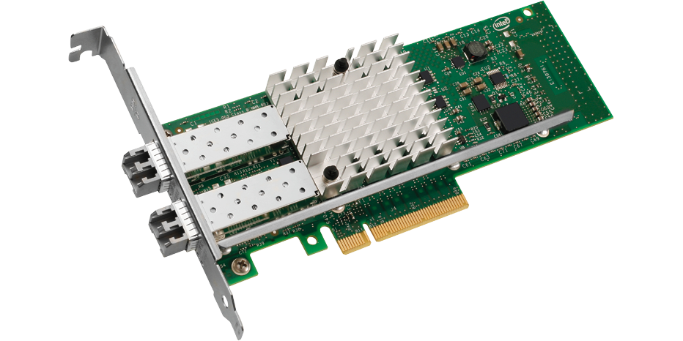
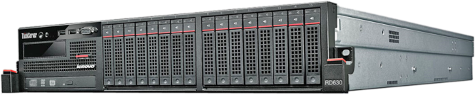
S/W and H/W Stack
WebServer (CentOS 6.6)
Bandwidth control (BIG-IP 12.1.0.0.1434 + HotFix HF1-ENG19
VM3 (Ubuntu 16.04.01)
URL Filter (BIG-IP 12.1.0.0.1434 + HotFix HF1-ENG19
VM2 (Ubuntu 16.04.01)
Firewall (BIG-IP 12.1.0.0.1434 + HotFix HF1-ENG19
VM1 (Ubuntu 16.04.01)
Classifier (BIG-IP 12.1.0.0.1434 + HotFix HF1-ENG19
Lithium SR1
2.4.90 with NSH patch
2.4.90
2.3.90
2.4.90
2.0.0
1.5.3-105.el7+2.1
1.5.3-86.el7+1.8
1.5.3-86.el7+1.8
1.5.3-105.el7+2.1
2.0.0
2.2.1
2.2.1
2.0.0
1.2.17
1.2.17
1.2.17
1.2.8
CentOS 7.1 (kernel = 3.16.3-1.el7)
CentOS 7.1 (kernel = 3.16.3-1.el7)
CentOS 7.1 (kernel = 3.16.3-1.el7)
CentOS 7.1 (kernel = 3.16.3-1.el7)
Niantic 10Gb NIC
Niantic 10Gb NIC
Niantic 10Gb NIC
Niantic 10Gb NIC
Compute (Server#1) hosting user VMs and WebServer
Intel WildCat Pass S2600WTT
Intel® Xeon® E5-2699 v3 2.30GHz,
72 logical cores (Haswell)
Controller (Server2)
Intel WildCat Pass S2600WTT
Intel® Xeon® E5-2699 v3 2.30GHz,
72 logical cores (Haswell)
Compute (Server#3) Hosting F5 Classifier
Dell PowerEdge R730
Intel® Xeon® E5-2690 v3 2.60GHz,
48 logical cores (Haswell)
Compute (Server#4) Hosting F5 VNFs
Dell PowerEdge R730
Intel® Xeon® E5-2690 v3 2.60GHz,
48 logical cores (Haswell)
Infrastructure
VMs
VNFs

Slide 8
Server 2
IF
10.241.105.8
ODL
Lithium
enp3s0f0
1Gbps
Public and Management Network
1Gbps
enp3s0f0
em1
em1
IF
Server 4
IF
10.241.105.5
IF
10.241.105.11
10.241.105.50 (floating)
10.241.105.14
10.241.105.25 (floating)
10.241.105.35 (floating)
10.241.105.45 (floating)
Server 1
Server 3
VM1
Default traffic
172.16.40.101
VNC port 1
VM2
(Accessing Web Traffic)
172.16.40.102
VNC port 2
VM3
(Accessing Video Traffic)
172.16.40.103
VNC port 3
F5 Classifier
Mgt-IP 10.241.105.50
Virtual server pool
Defined with IP
172.16.60.200 with
1 Node (webserver)
F5 Firewall
Mgt-IP 10.241.105.25
F5 Bandwidth-control
Mgt-IP 10.241.105.45
F5 URL-Filter
Mgt-IP 10.241.105.35
172.16.20.200
172.16.60.100
172.16.40.100
172.16.20.23
172.16.20.35
172.16.20.45
tap1
(VLAN tag 4094)
tap2
(VLAN tag 4094)
tap3
(VLAN tag 4094)
VxLAN-GPE
(172.16.50.100)
tap6
(VLAN tag 4093)
tap4
(VLAN tag 4094)
NSH
tap5
VxLAN-GPE (172.16.50.5)
Tap 5
(VLAN tag 4093)
OvS bridge SW3
OvS bridge SW1
OvS-DPDK bridge SW4
( SFF )
172.16.10.3
172.16.20.6
172.16.10.6
Webserver
172.16.60.101
VNC port 5
br-underlay:
172.16.20.5
IF
IF
IF
IF
CentOS 7.1 Core Host
enp3s0f1
em3
em2
em2
Ubuntu 16.04.01 VMs
1Gbps
CentOS 6.6 VM
Internal SWITCH
1Gbps
F5 VNF

Slide 9
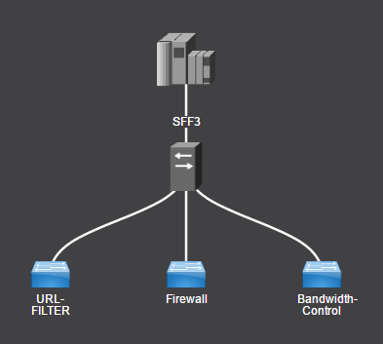
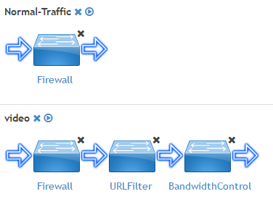
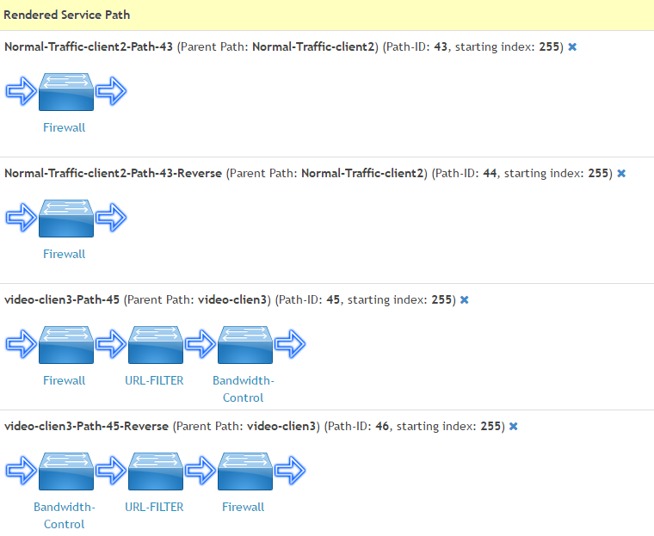
Service Function Nodes/Chains/Paths in this Demo
Service Nodes
Service Function Chains
Service Function Paths

Slide 10
Server 2
Flow for Path #43
IF
10.241.105.8
ODL
Lithium
enp3s0f0
1Gbps
Public and Management Network
1Gbps
enp3s0f0
em1
em1
IF
Server 4
IF
10.241.105.5
IF
10.241.105.11
10.241.105.50 (floating)
10.241.105.14
10.241.105.25 (floating)
10.241.105.35 (floating)
10.241.105.45 (floating)
Server 1
Server 3
VM1
Default traffic
172.16.40.101
VNC port 1
VM2
(Accessing Web Traffic)
172.16.40.102
VNC port 2
VM3
(Accessing Video Traffic)
172.16.40.103
VNC port 3
F5 Classifier
Mgt-IP 10.241.105.50
Virtual server pool
Defined with IP
172.16.60.200 with
1 Node (webserver)
F5 Firewall
Mgt-IP 10.241.105.25
F5 URL-Filter
Mgt-IP 10.241.105.35
F5 Bandwidth-control
Mgt-IP 10.241.105.45
172.16.20.200
172.16.60.100
172.16.40.100
10
172.16.20.23
172.16.20.35
172.16.20.45
3
6
tap1
(VLAN tag 4094)
tap2
(VLAN tag 4094)
tap3
(VLAN tag 4094)
VxLAN-GPE
(172.16.50.100)
tap6
(VLAN tag 4093)
1
9
7
NSH
tap5
tap4
(VLAN tag 4094)
VxLAN-GPE (172.16.50.5)
Tap 5
(VLAN tag 4093)
OvS bridge SW3
OvS bridge SW1
4
OvS-DPDK bridge SW4
( SFF )
172.16.10.3
172.16.20.6
172.16.10.6
13
2
br-underlay:
172.16.20.5
Webserver
172.16.60.101
VNC port 5
12
11
8
5
IF
IF
IF
IF
CentOS 7.1 Core Host
enp3s0f1
em3
em2
em2
Ubuntu 16.04.01 VMs
1Gbps
CentOS 6.6 VM
Internal SWITCH
1Gbps
F5 VNF

Slide 11
Demo Steps
Step 0: Tour ODL & F5 VNFs, especially Classifier and its “client_dg”, and URL filter’s “URL_Block_List”
Step 1: Using VM#1. No Restrictions
Web traffic (HTTP) to WebServer – no restrictions for HTTP, JPG, or MP4
SSH root@webserver. SSH Allowed
Using tcmpdump, show no traffic in any of F5 VNFs
Step 2: Using VM#2: SFC with Firewall only. Firewall blocks SSH but allows HTTP
web traffic to WebServer – no restrictions for HTTP, JPG, or MP4
Using tcpdump, show traffic only in Firewall
SSH root@webserver. SSH Allowed
Classifier->Security->NetworkFirewall->ActiveRules and reject SSH traffic
SSH root@webserver. SSH not allowed. Firewall functional!
Step 3: Using VM#3: SFC with Firewall + URL Filtering + Bandwidth Control
Access http://webserver/MyPics
Using tcpdump, show traffic only in all 3 VNFs
Access http://webserver/MyPics/Pic1.jpg . Blocked due to URL filtering. Filter functional!
Show Bandwidth-Control->Acceleration->RateShaping->Statistics. Reset shaper
Access http://webserver/Videos/movie3.mp4. Access allowed. Show shaper incrementing
Load up same video using VM#2 and compare speed. VM#2 catches up and goes further, faster. Rate Shaping functional!

Slide 12
DEMO

Slide 13
Key Learnings & Call to Action

Slide 14
Summary of key Issues Resolved
# | F5 Issues | Resolution/Workaround
1 | F5 Cross-service interoperability issue identified with OVS-DPDK | F5 provided hotfix HF1-ENG19 for BIG-IP v12.1.
2 | F5 VNFs implementation of NSH required iRule to decrement index | F5 provided sfc-nsh-vnf iRule (outbound & inbound). By Design.
3 | F5 VNFs were not handling traffic returning from WebServer | F5 provided nsh_sfc_proxy iRule for reverse traffic
4 | PMTU in F5 resulted in packet drops for large TCP packets which caused fragmentation in VXLAN tunnel | Config MTU=1300 on the client VMs
MTU = Maximum Transmission Unit

Slide 15
Summary of key Issues Resolved
# | ODL Issues | Resolution/Workaround
5 | Java error after launching ODL indicating too many open files | Workaround =Ulimit –n 32768. Issue confirmed as no longer reproducible in Boron
6 | When DPDK-enabled OVS acts as SFF, it needs a manually-added flow to push traffic to VNFs | Workaround=create separate overlay & underlay bridges Permanent fix = an patch is under development to add the flow automatically. Target to hit Boron SR1

Slide 16
Summary of key Issues Resolved
Infrastructure Issues
# | Infrastructure Issues | Resolution/Workaround
7 | NSH header in OVS 2.4.90 was incompatible with latest IETF NSH draft https://tools.ietf.org/html/draft-ietf-sfc-nsh-10 | The IETF-Compatible NSH patch https://github.com/yyang13/ovs_nsh_patches will be upstreamed to mainline OVS after resolving external dependencies

Slide 17
Summary of Known unresolved issues
in ODL Lithium SR1
# | Area | Issue | Actions taken in this PoC
1 | OVS-DPDK | VLANs could not be enabled with NSH-aware OVS-DPDK | Used non-DPDK OVS on servers where VLANs were needed. This is no longer an issue in Boron. Try it out!
2 | OVS | OVS 2.4.90 does not support NSH and VxLAN-GPE | DPDK-enabled OVS supports NSH (with patch). Switched from OVS to OVS-DPDK on servers where VxLAN-GPE was needed.
3 | F5 VNFs | F5 not fully integrated with ODL | F5 provided REST-ful API + bash scripts to add/delete/list/reset the DGL. F5 is developing an ODL RESTCONF integration to support SFCs
4 | Infrastructure | OpenStack’s implementation of SFC does not integrate with ODL | OpenStack de-scoped from this solution and VNFs deployed manually via QEMU. Others options include use of Tacker or Juju as a VNF-Manager.

Slide 18
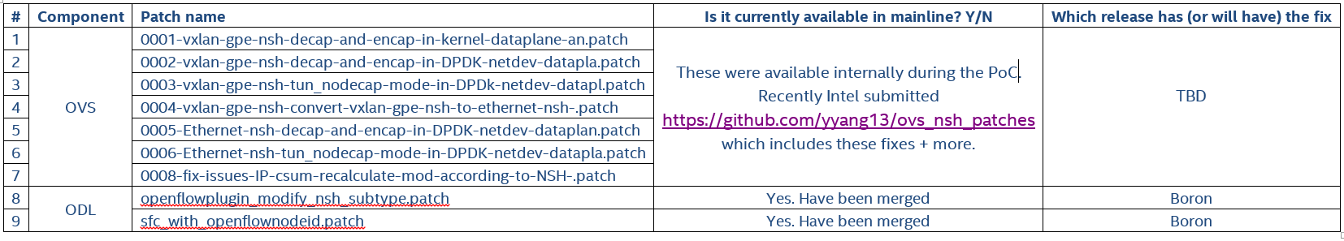
Top 5 takeaways
Intel is taking a solution oriented approach that spans across communities, with contributions to ODL, OVS, FD.io, OpenStack, etc.
NSH-based SFC works with commercial F5 VNFs and ODL
F5 is evaluating accelerating their commercial VNFs using DPDK
Intel plans to enable OpenStack and MANO integration (e.g. OPEN-O and OSM)
vGi-LAN is one of the network segments that benefit from NSH-based SFC
Patches applied in this setup, and will now be available to you!
Notes:
Describe topology and the 2 scenarios:
Scenario #1: APN1: Based on Source IP pick SFC#1: Video/media delivery scenario. Using 3 SFs to secure, enrich and optimized the delivery of video to the subscriber client. Improving user experience and providing protection to the mobile network at the connectivity, network, and application levels.
Scenario #2: APN2: Based on Source IP pick SFC#2: Web traffic scenario. Using 2 SFs to secure and enhance the delivery of HTTP based traffic. Providing security to the network and context for downstream web applications
See Client (VM#3) accessing WebServer for HTTP traffic, but not going through any SFs (no SFC defined) i.e. direct route to WebServer after going through classifier (no SFF)
Show the configurations of the 3 Service Function VNFs
SF1 = AFM (Advanced Firewall Manager), for Firewall and DDos Protection
SF2 = LTM#1 (Local Traffic Manager) header enrichment, inserting subscriber information into the header for determining service context
SF3 = LTM#2. (Local Traffic Manager) bandwidth control
Show the configurations of F5 Classifier (i.e. tour its settings)
Show that the OVS-DPDK ovs rules are empty
Go to ODL and configure new SFC with 3 nodes in the chain (i.e. SFC#1: AFM -> LTM#1 -> LTM#2).
Create 3 Service Functions types
Create 3 Service Functions
Ensure proper Locator IPs and settings
Update SFF to be aware of the 3 SFs
Created Scenario#1 Service Function Chain
Created a Path from that SFC
Deploy the Path enabling symmetry and got the 2 Path IDs (forward and revers)
Show OVS-DPDK SFF details
Updated the iRule in the F5 Classifier to use the new Path ID and the new Reverse Path ID
Run Scenario#1, where Client#1 is accessing the webserver for Video/Media Traffic
See traffic now going through:
Classifier
Incoming packet from client. Classifier encaps this packet
Outgoing packet to webserver. Classifier has decap’d this packet
SFF
from Classifier to SFF,
from SFF to AFM,
from AFM to SFF,
from SFF to LTM#1,
from LTM#1 to SFF,
from SFF to LTM#2,
from LTM#2 to SFF,
from SFF to Classifer
AFM (from SFF to AFM, and from AFM to SFF) ^
LTM#1 (from SFF to LTM#1, and from LTM#1 to SFF) ^
LTM#2 (from SFF to LTM#2, and from LTM#2 to SFF) ^
^Note: Broadcasts will appear in the TCPDump on first packet
< ------------------------- Time permitting ------------------------à
11. Run video traffic and show that it is NOT going through SFC#1
12. Go to ODL and add a new SFC for scenario #2 (Web traffic), that is comprised only of AFM (i.e. SFC#2 = AFM -> LTM#1)
13. Run web traffic scenario from Client #2.
14. See traffic now going through AFM only and not through LTM#1 or LTM#2
15. Rerun scenario where client is accessing HTTP content on the webserver
16. See traffic now going through AFM, LTM#1 and LTM#2

Slide 19
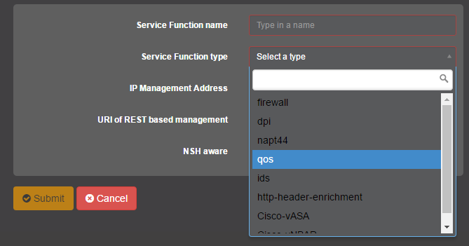
Call to Action to the community
From Intel
Join us to accelerate NSH as well as VxLAN-GPE upstreaming to OVS
We encourage VNF vendors to enable their VNFs to be NSH-aware for easier integration into NSH-based SFC solutions
Provide feedback on similar Solution Implementations & PoCs
Review upcoming whitepaper and Solution Implementation doc (https://networkbuilders.intel.com/network-technologies/solution-blueprints)
From F5
Allow for user-defined Path IDs instead of auto numbering
Enable a more generic list of Service Function Types in ODL
F5 will update this setup with latest ODL Boron release and patched OVS
Notes:
Describe topology and the 2 scenarios:
Scenario #1: APN1: Based on Source IP pick SFC#1: Video/media delivery scenario. Using 3 SFs to secure, enrich and optimized the delivery of video to the subscriber client. Improving user experience and providing protection to the mobile network at the connectivity, network, and application levels.
Scenario #2: APN2: Based on Source IP pick SFC#2: Web traffic scenario. Using 2 SFs to secure and enhance the delivery of HTTP based traffic. Providing security to the network and context for downstream web applications
See Client (VM#3) accessing WebServer for HTTP traffic, but not going through any SFs (no SFC defined) i.e. direct route to WebServer after going through classifier (no SFF)
Show the configurations of the 3 Service Function VNFs
SF1 = AFM (Advanced Firewall Manager), for Firewall and DDos Protection
SF2 = LTM#1 (Local Traffic Manager) header enrichment, inserting subscriber information into the header for determining service context
SF3 = LTM#2. (Local Traffic Manager) bandwidth control
Show the configurations of F5 Classifier (i.e. tour its settings)
Show that the OVS-DPDK ovs rules are empty
Go to ODL and configure new SFC with 3 nodes in the chain (i.e. SFC#1: AFM -> LTM#1 -> LTM#2).
Create 3 Service Functions types
Create 3 Service Functions
Ensure proper Locator IPs and settings
Update SFF to be aware of the 3 SFs
Created Scenario#1 Service Function Chain
Created a Path from that SFC
Deploy the Path enabling symmetry and got the 2 Path IDs (forward and revers)
Show OVS-DPDK SFF details
Updated the iRule in the F5 Classifier to use the new Path ID and the new Reverse Path ID
Run Scenario#1, where Client#1 is accessing the webserver for Video/Media Traffic
See traffic now going through:
Classifier
Incoming packet from client. Classifier encaps this packet
Outgoing packet to webserver. Classifier has decap’d this packet
SFF
from Classifier to SFF,
from SFF to AFM,
from AFM to SFF,
from SFF to LTM#1,
from LTM#1 to SFF,
from SFF to LTM#2,
from LTM#2 to SFF,
from SFF to Classifer
AFM (from SFF to AFM, and from AFM to SFF) ^
LTM#1 (from SFF to LTM#1, and from LTM#1 to SFF) ^
LTM#2 (from SFF to LTM#2, and from LTM#2 to SFF) ^
^Note: Broadcasts will appear in the TCPDump on first packet
< ------------------------- Time permitting ------------------------à
11. Run video traffic and show that it is NOT going through SFC#1
12. Go to ODL and add a new SFC for scenario #2 (Web traffic), that is comprised only of AFM (i.e. SFC#2 = AFM -> LTM#1)
13. Run web traffic scenario from Client #2.
14. See traffic now going through AFM only and not through LTM#1 or LTM#2
15. Rerun scenario where client is accessing HTTP content on the webserver
16. See traffic now going through AFM, LTM#1 and LTM#2

Slide 20
Other recommended sessions
Sessions:
Fix Openflow Multiwriter issues in OpenStack + OVSDB + SFC Integration by using Genius and flow programmer (Yi Yang)
Demos:
ODL SFC Solution with Integrated MANO in NFV (Yi Yang)
We will provide a live demo of this PoC at the booth

Slide 21
Questions/Comments?

Slide 22
Backup

Slide 23
Service Function Chaining Overview in NFV Systems
VNF Orchestrator (e.g. OpenStack) +
SDN Controller (e.g. ODL)
NSH VxLAN-GPE De-encapsulation
Deployment, Chaining, Steering
Server A
Server B
L2/L3 Forwarding
Server C
NSH Forwarding
VNF1
VNF2
VNFn
VNF1
VNF2
VNFn
VNF1
VNF2
VNFn
vSwitch
vSwitch
vSwitch
L2/L3 Forwarding
Classification & NSH VxLAN-GPE Encapsulation
NIC
NIC
NIC
Service Chain #1
Service Chain #2
NSH: Network Services Header
VNF: Virtual Network Function
Service Function Chain starts and ends with the classifier
Notes:
vSwitches are becoming overloaded
Difficult to handle high data bandwidth with predictable latency
Complex features such as NSH tunneling and forwarding consume CPU cores

Slide 24
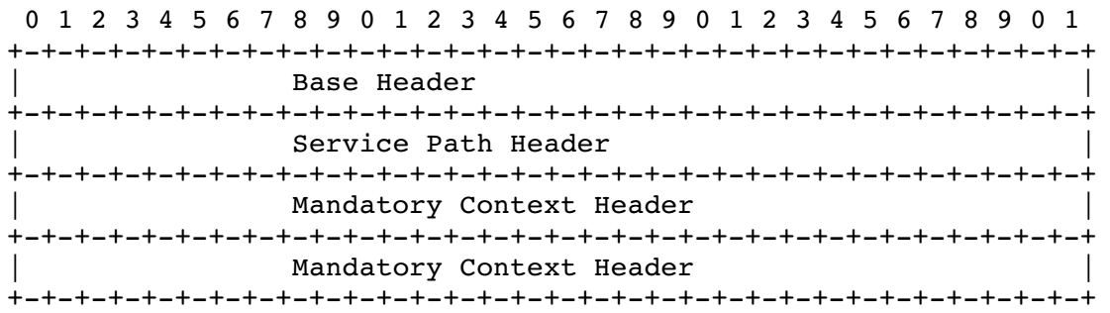
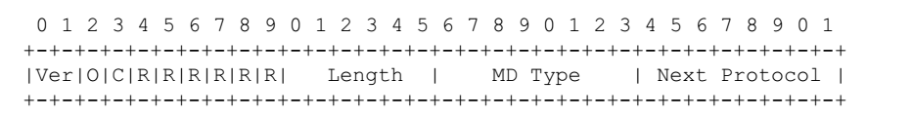
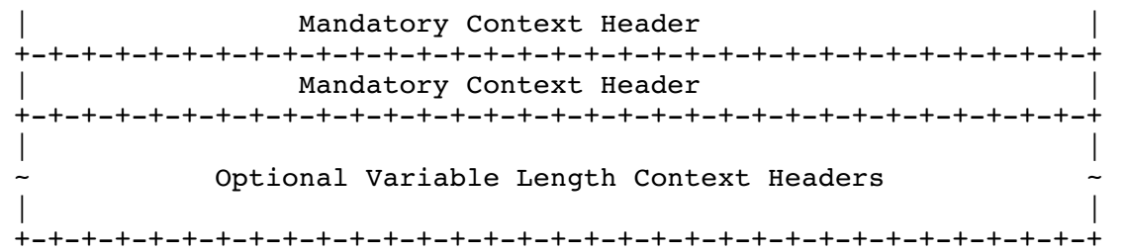
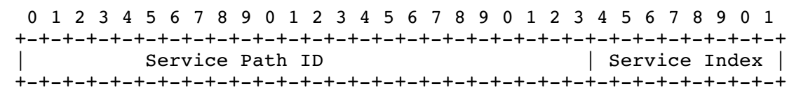
NSH Structure
Metadata Type indicates what context is being
included
Abstracted ID for Service Chain SC TTL
Examples:
TCP port 80,21,23 = SPI 12
IMEI iPhone6= SPI 10
16 bytes of mandatory context headers. These pass information between network nodes, classifiers and service functions.

Slide 25
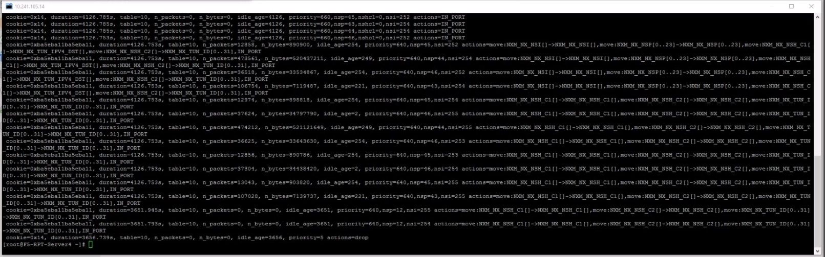
Running “ovs-ofctl dump-flows SW4” on Server4
OVS-DPDK on Server4 has a table of OpenFlow rules for each of the Service Function Paths
Rules show the ingress and egress points given a particular Index

