Slide 1
It's Getting Cloudy out There
Dave Syer, VMware, 2012

Slide 2
Agenda
From the viewpoint of an application developer:
“The Cloud” - what does it all mean?
Platform Services

Slide 3
What is The Cloud?
“The cloud” is another term for the internet
        amazon.com
I can't think of anything that isn't cloud computing... Maybe I'm an idiot but I have no idea what anyone is talking about. It's insane...
        Larry Ellison

Slide 4
Clouds and Services
A Cloud is a collection of services for application delivery

Slide 5
What is a Service?
Some operations on some data
Operated remotely (out of band; not in the same VM)
What does it buy me?
  Modularity
  Encapsulation
  Automation
  Decoupling
  Abstraction
  Utility or convenience
Haven't we heard this before somewhere?

Slide 6
Clouds and Services...
An analogy: sending a letter
Without a service | With a service
Write letter Insert into envelope Walk to tube Tube to train station Train to destination Taxi Locate house Deliver Letter … (Reverse trip) Arrive home | Write letter Insert into envelope Walk to postbox Post letter Walk back

Slide 7
Services Impose Constraints
Services constrain their users to follow some rules (API, protocol, security, etc.)
The analogy: sending a letter
Without a service | With a service
Write letter Insert into envelope Walk to tube Tube to train station Train to destination Taxi Locate house Deliver Letter … (Reverse trip) Arrive home | Write letter Insert into envelope Add address Add postcode Put on a stamp Walk to postbox Post letter Walk back

Slide 8
What did we learn from that?
Low-level, composable services are really useful
It's all about packaging
  Provider: delivery, efficiency, marketing
  Consumer: availability, cost, usability
So the Post Office is a Cloud?
Well, sort of...

Slide 9
Cloud Layering
Software Services
Platform Services
Infrastructure Services

Slide 10
Why do I Need a Service for That?
Dev: I need a new server
Ops: OK, no problem. We've got this great new system. Done!
Dev: Cool, what's the IP address?
Ops: Don't know. Hang on... er, 172.128.111.156. Can you remember that?
Dev: Hmm. No problem, thanks!
(Ed: how long do you think he's going to remember that for?)
Ops: Any time.
Dev: Wait! Is Tomcat installed?
Ops: What's Tomcat?
...etc.

Slide 11
Software Service Examples
Google
  Mail
  Documents
  Payments
Amazon
  Cloud Drive
  Cloud Player
AcadiaSoft
  Collateral Management application
  Messaging Platform service

Slide 12
Platform Service Examples
VMware CloudFoundry: Java, Ruby, JS + MySQL, Mongo, RabbitMQ
Google AppEngine: PHP, Java + Google services
Amazon Beanstalk: Java + AWS services
Dreamhost: PHP, static content
VMForce: Java + Salesforce services
Nodester: JS + continuous deployment with git
In-house private builds (various)

Slide 13
Infrastructure Service Examples
VMware vCloud
Amazon EC2
Amazon S3
Terremark

Slide 14
Cloud Layering
Software Services
Platform Services
Infrastructure Services

Slide 15
Cloud Layering: Software Services
App
End User Service
API Service
Platform Services
Infrastructure Services

Slide 16
Cloud Layering: Platform Services
End User Service
API Service
Platform Services
App
App
Infrastructure Services

Slide 17
Cloud Layering: Platform Hosting API Service
App
End User Service
API Service
Platform Services
App
App
API
Infrastructure Services

Slide 18
Cloud Layering: Platform Hosting All Software Services
App
App
Platform Services
End User Service
End User Service
API Service
API Service
App
App
API
Infrastructure Services

Slide 19
Cloud Layering: Infrastructure Hosting Everything
App
App
Infrastructure Services
Platform Services
End User Service
End User Service
API Service
API Service
App
App
API

Slide 20
Platform Services
Provisioning: install dependencies
Deployment: stand up an instance of this application
Versioning: upgrade and revert
Management: What have I got deployed? Is it working?
Elastic scale: increase the number of workers
Dynamic load: re-balance thread pools

Slide 21
Benefits of Platform Services
Spend more time on business functionality less time on non-functional capabilities and common components making savings provide route to hybrid cloud in future
Platform as a Service
Rapid provisioning of environments by self-service and via API to allow applications to be elastic
Provisioning Automation
Infrastructure as a Service
Value
Capex savings by better asset utilisation as we only use resources when we need them not by under-specifying individual resources
Virtual Environments
Physical Environments

Slide 22
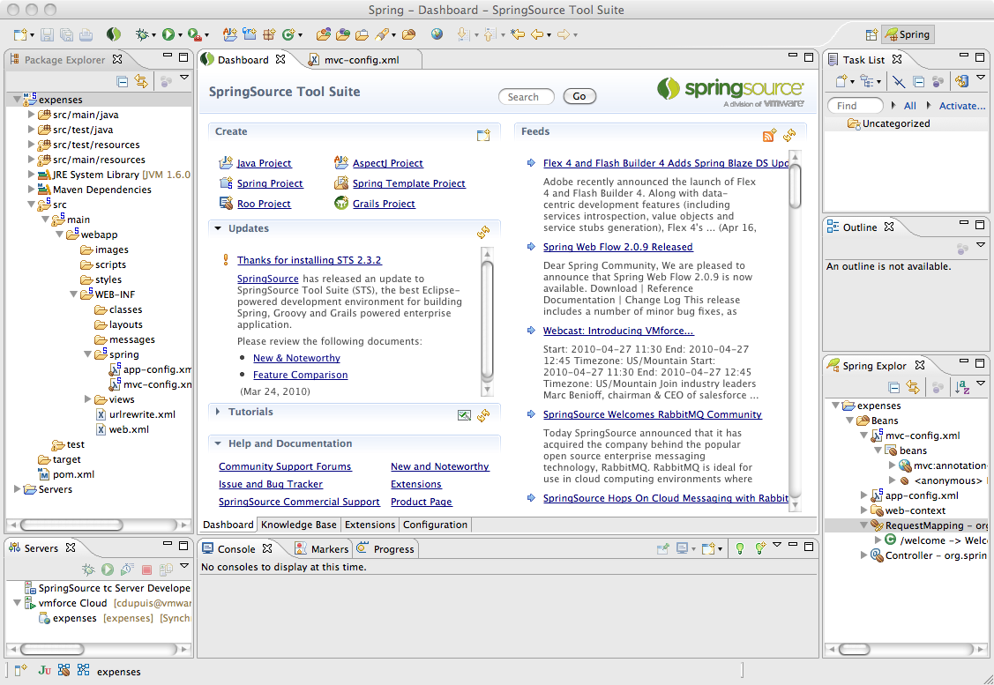


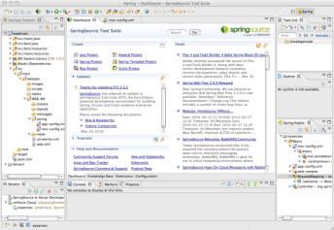



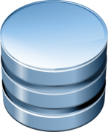

Application Portability, Environment Adaptation
Dev
Your Java Spring App
Test
Production

Slide 23
Platform Evolution
Manual Command Line
Homebrew Automation
Platform Service: private or public

