Slide 2
K8s Cluster
Infra Providers
Gateway Class
Pod
nginx-gateway
Pod
coffee
/coffee
n
/tea
Pod
tea
Clients
Public IP
café.example.com
Gateway
m
Cluster Operator
App Developer/Owner
Notes:
AIX 7.3 TL2

Slide 3
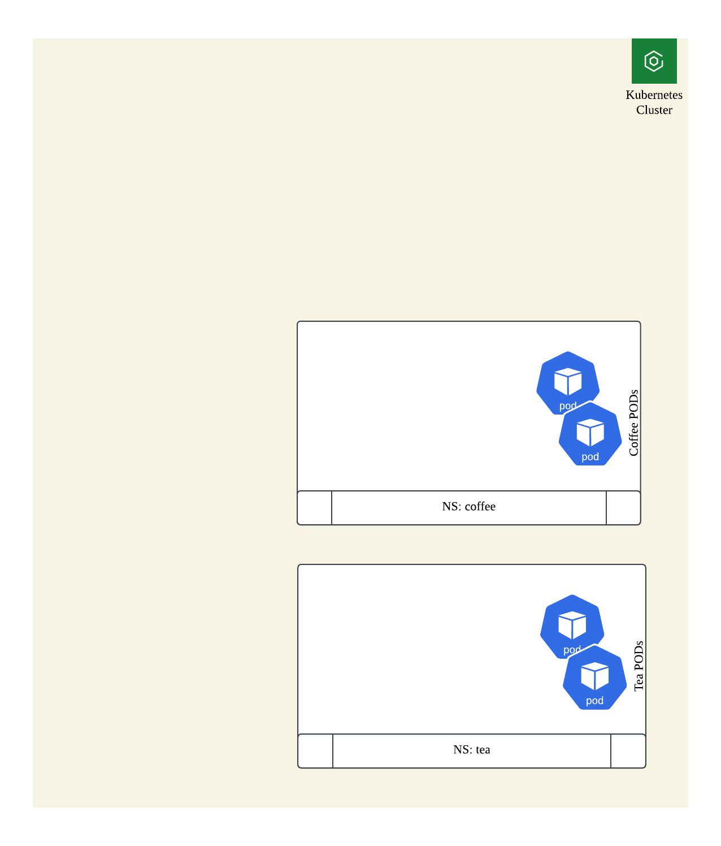
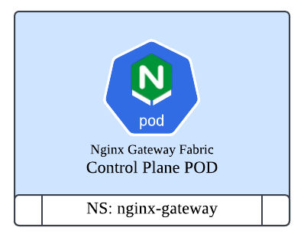

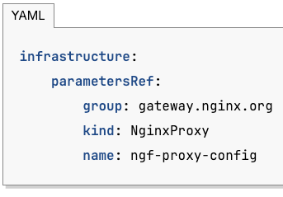



Infra Provider Creates GatewayClass
Cluster Ops Installs NGF – CRDs and Only Control Plane
Cluster Ops creates Gateway for caféApps
– Triggers 1st Data Plane Deployment
AppDev creates HTTPRoutes for coffee and tea
Teams have full control and update Proxy features on-demand
– Define app-specific NGINX proxy behavior (NginxProxy CRD)
– Edit NginxProxy CRD and attach to Gatewayclass OR Gateway Objects
– Scale Independently
https://docs.nginx.com/nginx-gateway-fabric/how-to/
Notes:
FEATURES new in 2.0.0:
Support for creating and deploying multiple Gateways. 3318
NginxProxy resource can now additionally be attached to a Gateway, and will overwrite any settings that are attached at the GatewayClass level, for the Gateway that it's attached to. 3318
Listener isolation supported for all routes. 3067
Allow configuration of NGINX Plus API access. 3066
Adds regex matching for headers and query params for HTTPRoutes and headers for GRPCRoutes. 3093
Add support for request mirroring using the RequestMirror filter. 3066
Adds support for Secrets to be used in BackendTLSPolicy for TLS certificates and CA certificates. 3084. Thanks to porthorian.

Slide 5
NGF 2.0.0+ (An example flow)
Infra Provider Creates GatewayClass
Cluster Ops Installs NGF – CRDs and Only Control Plane
Cluster Ops creates Gateway for Coffee Apps
– Triggers 1st Data Plane Deployment
- Define app-specific NGINX proxy behavior (NginxProxy CRD)
Coffee AppDev creates HTTPRoute
Cluster Ops creates Gateway for Tea Apps
– Triggers 2nd Data Plane Deployment
- Define app-specific NGINX proxy behavior using NginxProxy CRD
Tea AppDev creates HTTPRoute
– Tea AppDev team decides to add Auth (SnippetsFilter + HTTPRoute)
Teams have full control and update Proxy features on-demand
– Edit NginxProxy CRD and attach to Gatewayclass OR Gateway Objects
– Scale Independently
https://docs.nginx.com/nginx-gateway-fabric/how-to/
Notes:
FEATURES new in 2.0.0:
Support for creating and deploying multiple Gateways. 3318
NginxProxy resource can now additionally be attached to a Gateway, and will overwrite any settings that are attached at the GatewayClass level, for the Gateway that it's attached to. 3318
Listener isolation supported for all routes. 3067
Allow configuration of NGINX Plus API access. 3066
Adds regex matching for headers and query params for HTTPRoutes and headers for GRPCRoutes. 3093
Add support for request mirroring using the RequestMirror filter. 3066
Adds support for Secrets to be used in BackendTLSPolicy for TLS certificates and CA certificates. 3084. Thanks to porthorian.

