Slide 1

Brand style guide
With you every step of the way.
Version 2026 · Replaces the 2024 Target3D guide

Slide 2
Why this guide exists
Introduction
The purpose of this style guide is to keep every Atomic Orbital touchpoint consistent, online and offline, and to make sure our materials represent the company’s values in the same way, every time.
Logo
Globe A, colour step 3
Colour
Teal and orange, light and dark
It covers our messaging, our logo, colour, typography and how the brand comes together on letters, cards and the web. Everything in it is available to download from the brand and press kit page.
Type
Space Grotesk and IBM Plex
Voice
Clear, expert, collaborative

Slide 3
Mission, vision and values
Key messaging
Core values
Mission
To deliver the best innovative motion capture, 3D technologies, virtual production and volumetric capture technologies to our customers.
1
Attention to detail
2
Innovative and dynamic
3
Knowledgeable and informative
Vision
Globally the most trusted supplier of motion capture, 3D technologies, virtual production and volumetric capture technology solutions.
4
Unbiased, consultative and trustworthy
5
Collaborative and solutions oriented

Slide 4
Built on the Target3D story
Our story
Target3D was founded in May 2017 by Allan Rankin and Ashley Keeler. Beginning as resellers of motion capture equipment, the company expanded over the following years to operate globally, with headquarters in London, Target3D Iberia in Valencia, Spain and Target3D New Zealand in Gisborne, New Zealand.
Target3D became the leading reseller of a diverse range of 3D and immersive technologies, and the sole distributor for key brands including OptiTrack, Noitom and Captury, offering a full consultancy service from purchase to installation and training.
Its London studio is part of the Advanced Media Production network of studios, in partnership with Digital Catapult and Innovate UK, offering motion capture, virtual production, volumetric capture and post production. Atomic Orbital carries that heritage forward.
2017
Founded in London
3
Offices: London, Valencia, Gisborne
20+
Years of mocap install experience

Slide 5
Six reasons customers choose us
What makes us unique
In your time zone
Try before you buy
All logistics covered
Access our experts in real time, when your business needs us, so your project stays on time and on target.
Meet the onsite experts and experience our biomechanics area, edit suite, VR area, VP and mocap stages.
We handle shipping, duties and customs. Our one-year support contract keeps our expertise with you after set-up.
Install and training
Consultancy service
Hire and backup
From design to install and training. Our engineers have installed mocap tech for 20+ years, with an SLA as standard.
A team of independent, unbiased motion capture experts with over 30 years’ combined experience.
For affordability, or if you need the kit just once, we offer wet and dry system hire.

Slide 6
Our logo
The Globe A is our signature, identifier and stamp of quality. It should be the most consistent part of everything we make, so a few simple rules keep it that way.

Slide 7

Globe A, colour step 3
The logo
Teal ring
The globe. Always teal, always the outer element.
Orange orbit and nucleus
The only orange in the logo. Never recoloured.
Meridian
A quiet grey line that gives the globe depth.
The A
Upright, never rotated. Dark on light, light on dark.

Slide 8
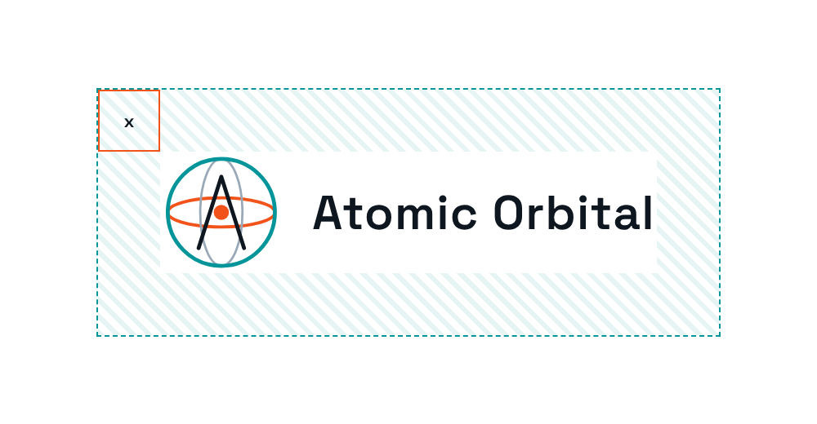


Size and clear space
Logo usage
Minimum size
Clear space
Never smaller than 24 px on screen or 8 mm in print. At 44 px and under, switch to the small-size mark: its thicker lines stay crisp at icon sizes.
Keep one eighth of the logo’s width (x) clear on every side. No text, photo edges or graphics inside that zone.
44 px
24 px
Full lockup

Slide 9

Pick the file for the background
Logo variations
Lockup, for light backgrounds
Lockup, for dark backgrounds
Primary use: white and light grey.
Brighter teal and orange for dark surfaces.
Mark, for light backgrounds
Mark, for dark backgrounds
Avatars, stickers, tight spaces.
Social profiles, video end cards.

Slide 10
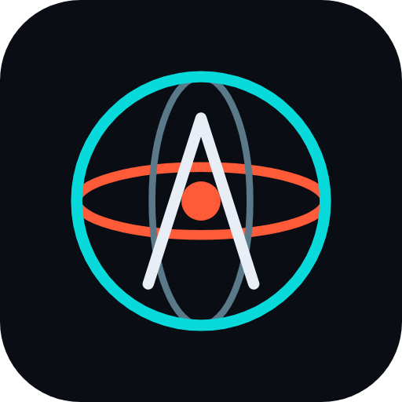
Favicons and the animated hero
Icons and motion
Favicons
Animated hero
favicon.svg follows the visitor’s light or dark setting. PNG icons at 32, 180 (Apple touch) and 512 px cover everything else.
The orbit spins and the meridian turns. Use it in the website hero banner only.
It stops automatically for visitors who prefer reduced motion. Never use it in documents, email signatures or print.
512 px
180 px
32 px

Slide 11



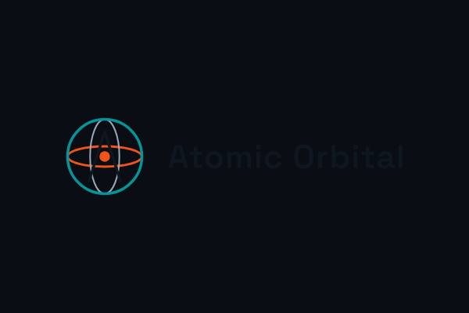


Don’t do this to the logo
Prohibited use
✕
✕
✕
Don’t rotate the logo or the A
Don’t swap the teal and orange
Don’t recolour the orange
✕
✕
✕
Don’t use the light file on dark
Don’t stretch or squash
No shadows or busy backgrounds

Slide 12
Our colour palette
Teal and orange on calm neutrals. Roughly 70% neutrals, 20% teal and 10% orange, with one orange element per view.

Slide 13
The default palette
Colour · light theme
Teal (logo)
Teal (text, links)
Orange
Green (conservation)
Text
#04959B
RGB 4 149 155
#03797F
RGB 3 121 127
#F2531A
RGB 242 83 26
#2E7D4F
RGB 46 125 79
#0E1620
RGB 14 22 32
Muted text
Line
Background
Surface
Text on orange
#4A5A6B
RGB 74 90 107
#D5DCE4
RGB 213 220 228
#F4F6F8
RGB 244 246 248
#FFFFFF
RGB 255 255 255
#0E1620
Dark, never white

Slide 14
When the device is set to dark
Colour · dark theme
Teal (logo, text)
Orange
Green (conservation)
Text
Muted text
#08DADB
RGB 8 218 219
#FF5B38
RGB 255 91 56
#6FE3A0
RGB 111 227 160
#E8EEF5
RGB 232 238 245
#A3B0BF
RGB 163 176 191
Line
Surface
Background
Text on orange
#243040
RGB 36 48 64
#121923
RGB 18 25 35
#0A0E14
RGB 10 14 20
#0A0E14
Dark, never white

Slide 15
70 / 20 / 10
Colour balance
70% neutrals
20% teal
10%
Neutrals do the heavy lifting
Teal carries the brand
Orange is for one thing
Backgrounds, surfaces, body text and lines. They keep pages calm and readable.
Headings, links, card tops, icons and charts. Use the text teal (#03797F) for anything people read.
One orange per view: the main button or the logo. Buttons take dark text, never white.

Slide 16
Our typography
Space Grotesk for headings brings the precision of engineering; IBM Plex Sans keeps body copy warm, open and legible at every size.

Slide 17
Three families, clear jobs
Typefaces
Aa
Aa
Aa
Space Grotesk
IBM Plex Sans
IBM Plex Mono
SemiBold 600
Regular 400 · Medium 500 · SemiBold 600
Regular 400
Headings and short display lines
Body copy, UI and documents
Figures, codes, colour values
Included in the brand kit (SIL OFL).
Free from Google Fonts or IBM (SIL OFL).
Free from Google Fonts or IBM (SIL OFL).

Slide 18
How the hierarchy fits together
Typography usage
With you every step of the way
Heading 1
Space Grotesk 600 · 40–64 px
From first consultation to install and training
Heading 2
Space Grotesk 600 · 28–42 px, teal
Our engineers design, install and commission motion capture, virtual production and volumetric capture systems, then stay with you through training and support. Body copy is IBM Plex Sans, set comfortably with a line height of 1.6.
Body
IBM Plex Sans 400 · 17 px
#04959B · 17 px · 1.6
Figures
IBM Plex Mono

Slide 19
Buttons, cards and tags
Interface
Book a consultation
See how we work
Corners
8 px default, 12 px large
Primary: orange with dark text, one per view. Secondary: teal outline.
Spacing
4 · 8 · 16 · 24 · 40 · 64 · 96 px
Focus
3 px teal outline, 3 px offset
Card title
Cards sit on the surface colour with a 1 px line, a 3 px teal top and 8 px corners.
Green
Conservation and sustainability tags only
Motion capture
Net zero
Motion
Stops for reduced-motion users

Slide 20
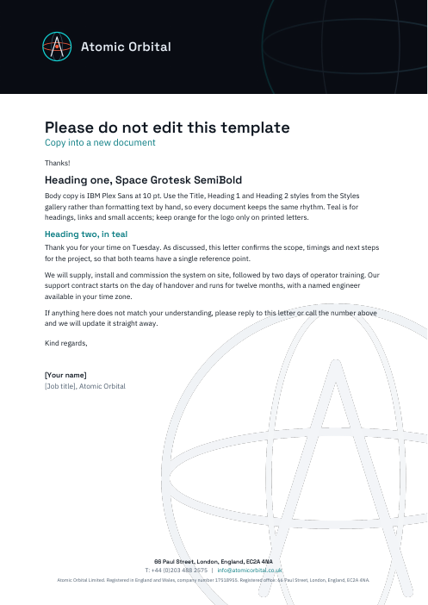
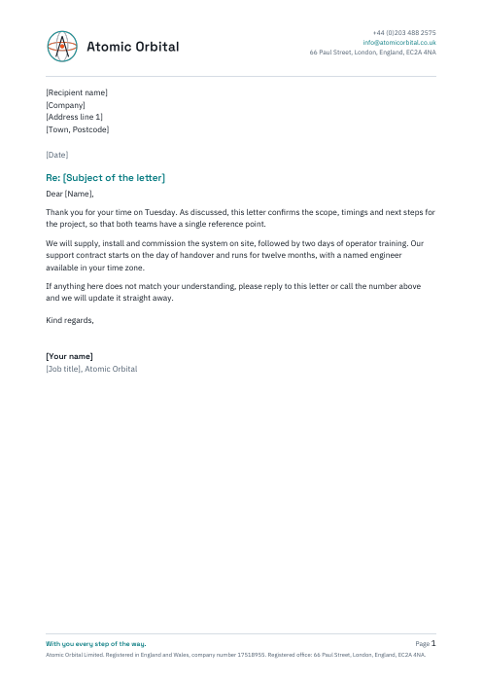
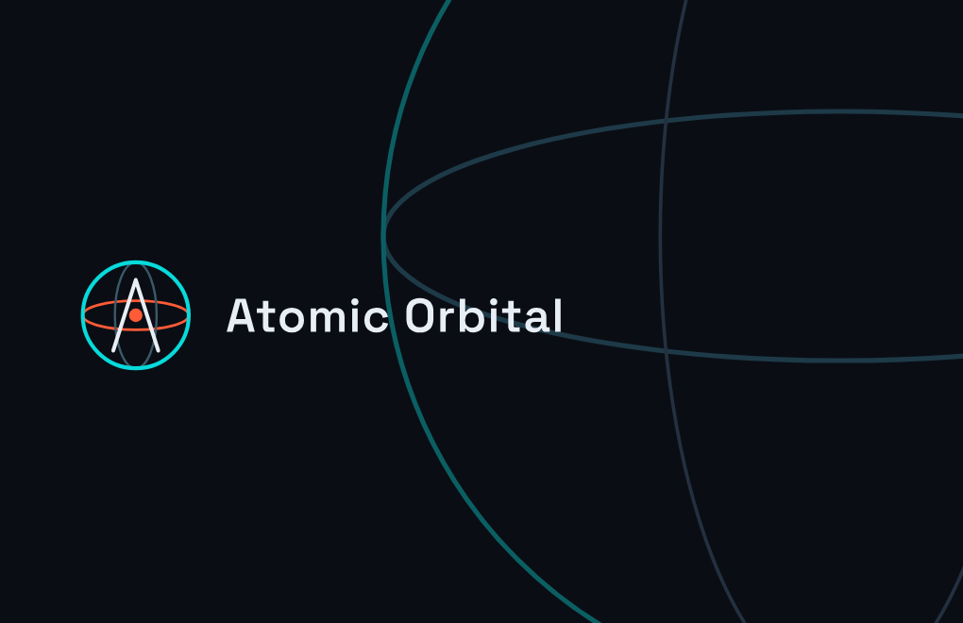
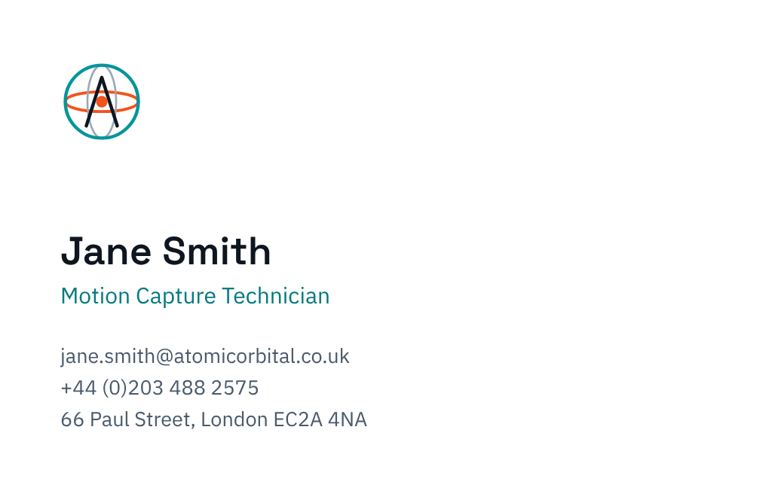
Letterheads and business cards
Brand application · print
Print letterhead (A4)
Digital letterhead (A4)
Business card (85 × 55 mm)

Slide 21
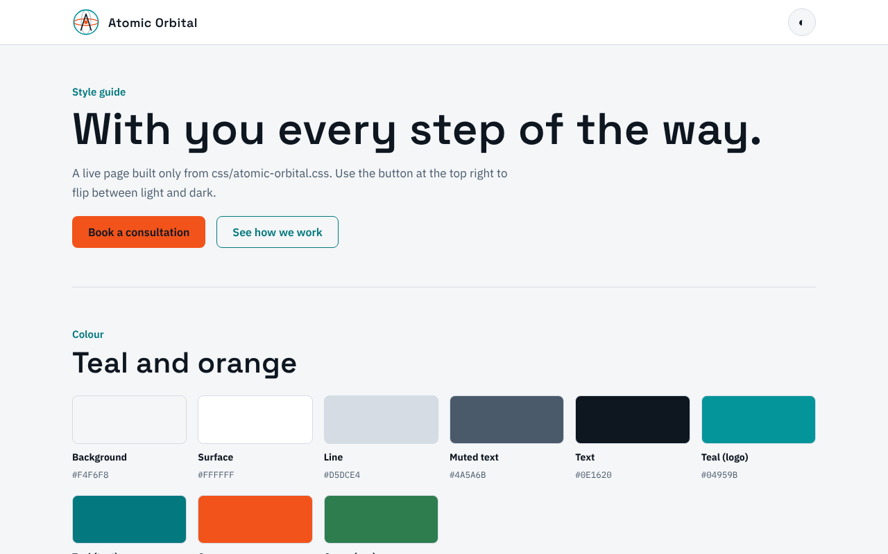
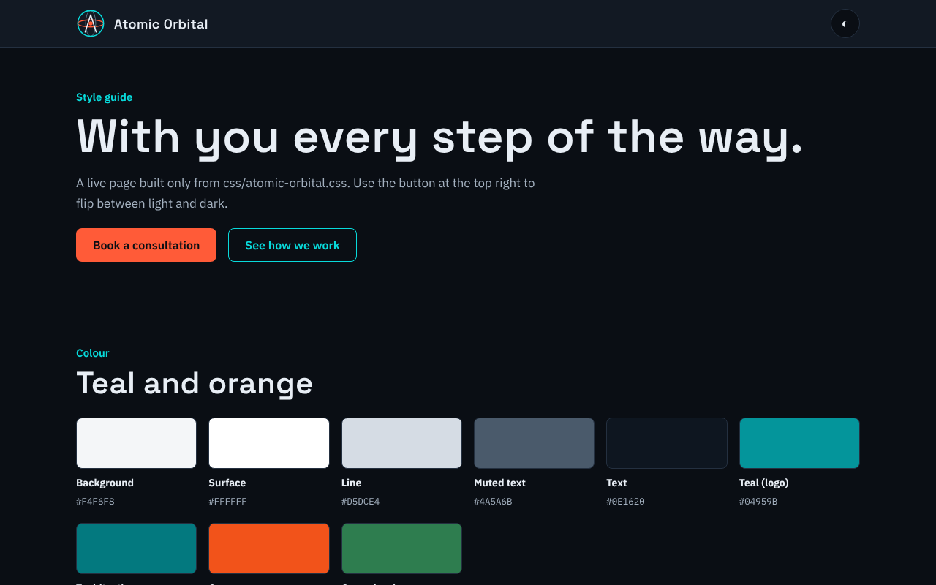
One style sheet, light and dark
Brand application · web
css/atomic-orbital.css drives every page. Light is the default; dark follows the visitor’s device, or set data-theme on the html element. The kit includes the head snippet and legal footer.

Slide 22
Use these exactly
Company details
Website footer links
Legal name
Atomic Orbital Limited
Legal
Privacy Policy · GDPR Policy · Trademarks & Disclaimer · Modern Slavery Statement
Responsibility
Environmental & Sustainability · ESG Policy
Registered in
England and Wales
Company number
17518955
Registered office
66 Paul Street, London, England, EC2A 4NA
Email
info@atomicorbital.co.uk
Every page carries the legal footer: “© Atomic Orbital Limited. Registered in England and Wales, company number 17518955.”
Telephone
+44 (0)203 488 2575

Slide 23
With you every step of the way.
Questions about the brand, or need a file that isn’t in the kit?
info@atomicorbital.co.uk

