Slide 1
QCM: SFPC

Slide 2
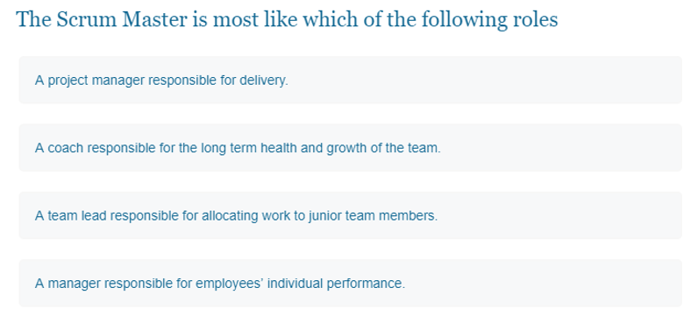
Question 1
C
Notes:
The scrum master's role in the organization in the following aspects: Lead and coach scrum adoption. Plan ...

Slide 3
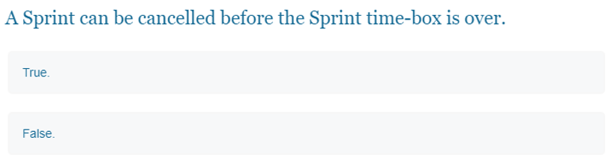
Question 2
True
Notes:
A Sprint can be cancelled before the Sprint time-box is over. Only the Product Owner has the authority to cancel the Sprint, although he or she may do so under influence from the stakeholders, the Development Team, or the Scrum Master. A Sprint would be cancelled if the Sprint Goal becomes obsolete.

Slide 4
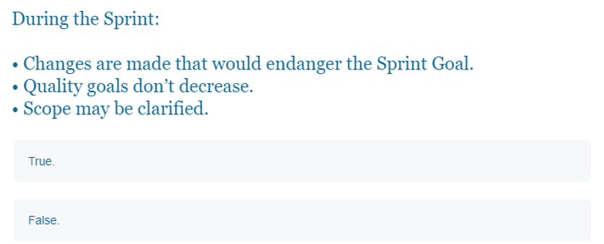
Question 3
False
Notes:
During the Sprint: No changes are made that would endanger the Sprint Goal; Quality goals do not decrease; and, Scope may be clarified and re-negotiated between the Product Owner and Development Team as more is learned.

Slide 5
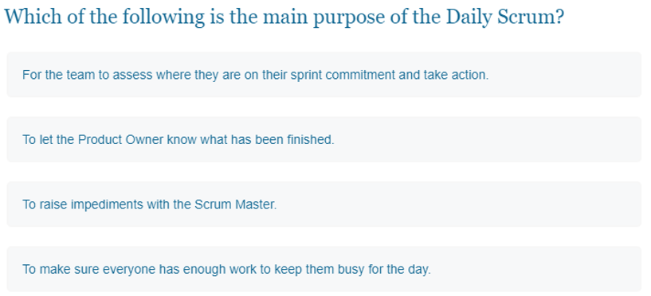
Question 4
A
Notes:
The purpose of the Daily Scrum is to inspect and synchronize the team's progress towards the Sprint Goal, discuss if anything impedes the team and re-plan the team's work to achieve the Sprint Goal. The outcome of the Daily Scrum should be: An updated Sprint Backlog

Slide 6
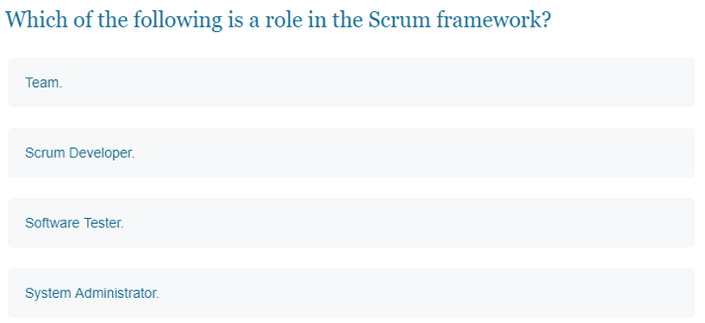
Question 5
B
Notes:
In Scrum, there are three roles: Product Owner, Development Team, and Scrum Master. Together these are known as the Scrum Team.

Slide 7
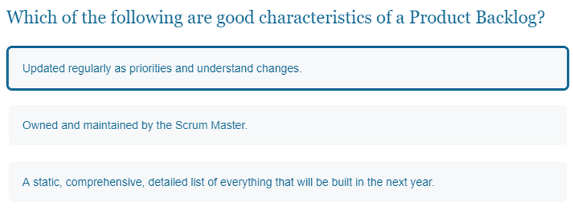
Question 6
A

Slide 8
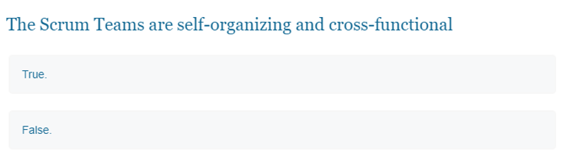
Question 7
True
Notes:
Scrum Teams are self-organizing and cross-functional… Cross-functional teams have all competencies needed to accomplish the work without depending on others not part of the team. ... The team model in Scrum is designed to optimize flexibility, creativity, and productivity.

Slide 9
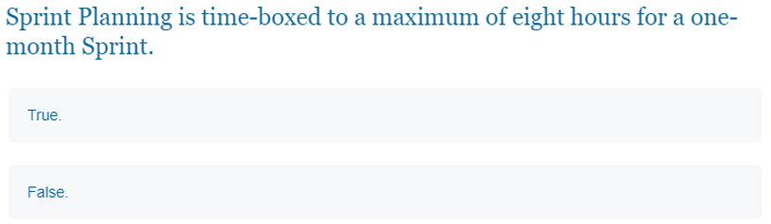
Question 8
True
Notes:
Sprint planning is limited to a maximum of eight hours. The general rule of thumb is to allow two hours of sprint planning for every one week of sprint length. That means teams should timebox sprint planning to four hours for a two-week sprint and eight hours for a one-month sprint.

Slide 10
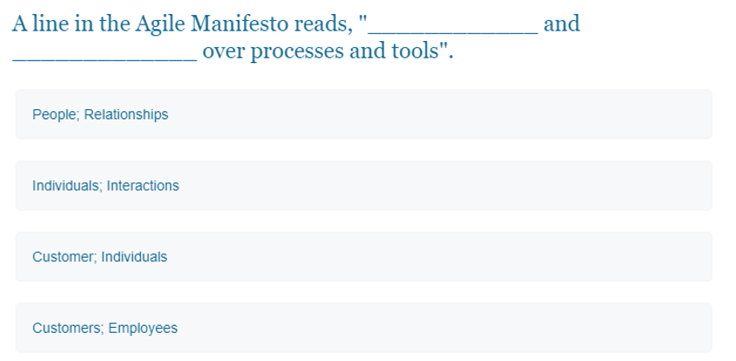
Question 9
B
Notes:
Livre Scrum Institute

Slide 11
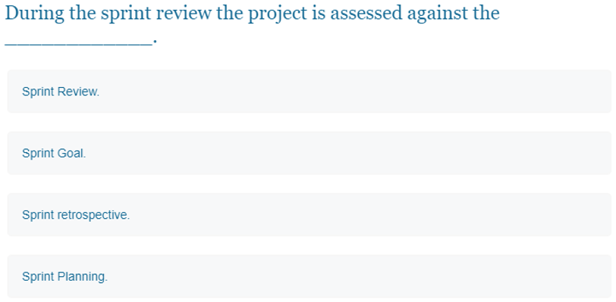
Question 10
B
Notes:
During the sprint review, the project is assessed against the sprint goal determined during the sprint planning meeting. Ideally, the team has completed each product backlog item brought into the sprint, but it's more important that they achieve the overall goal of the sprint.

Slide 12
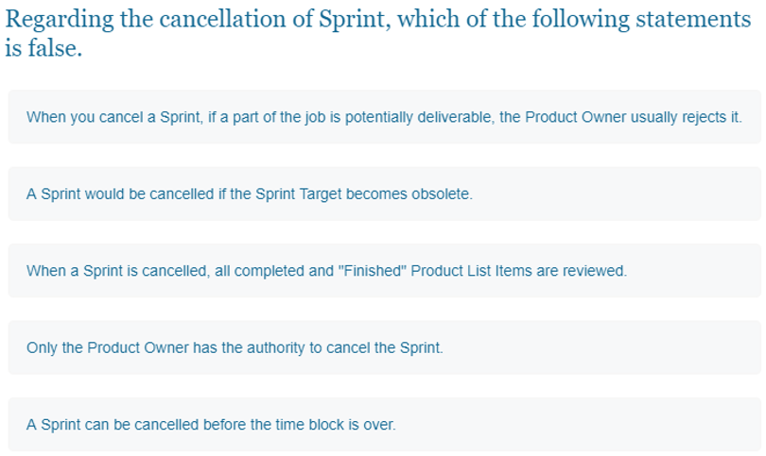
Question 11

Slide 13
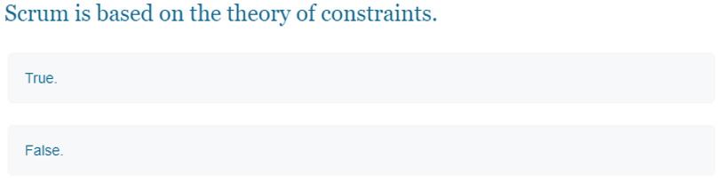
Question 12

Slide 14
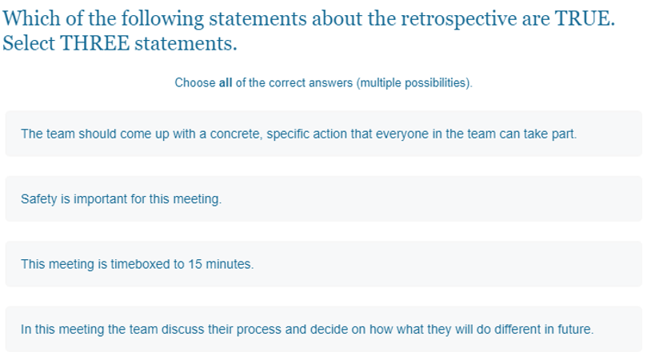
Question 13

Slide 15
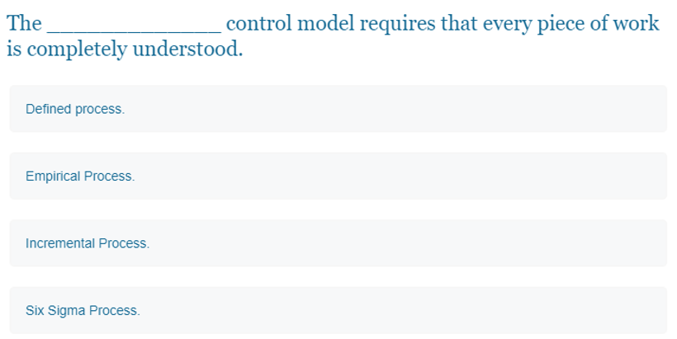
Question 14

Slide 16
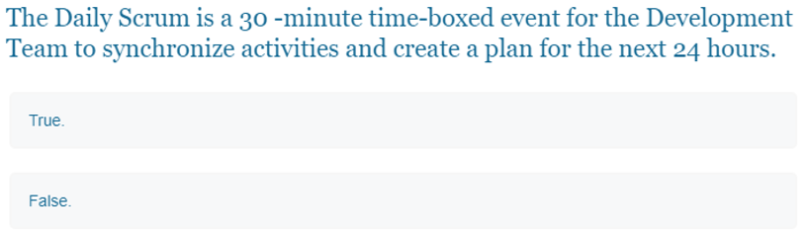
Question 15

Slide 17
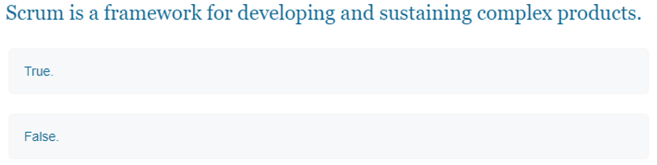
Question 16

Slide 18
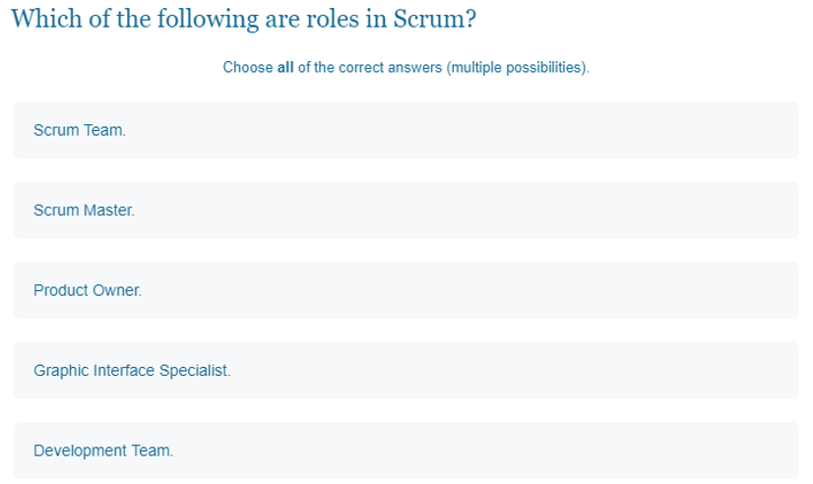
Question 17

Slide 19
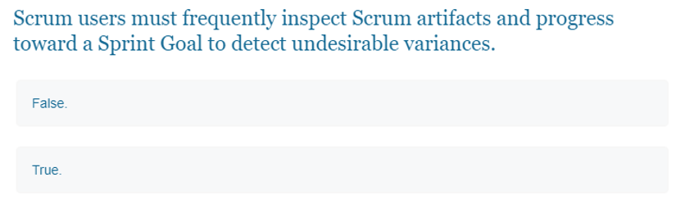
Question 18

Slide 20
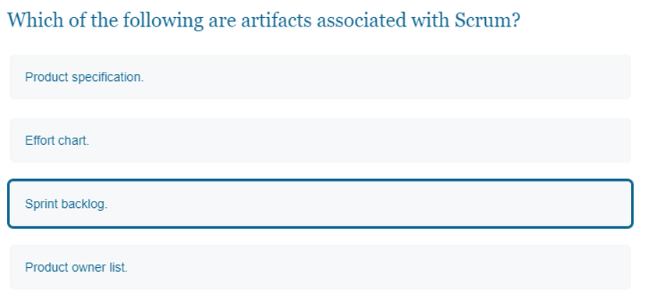
Question 19

Slide 21
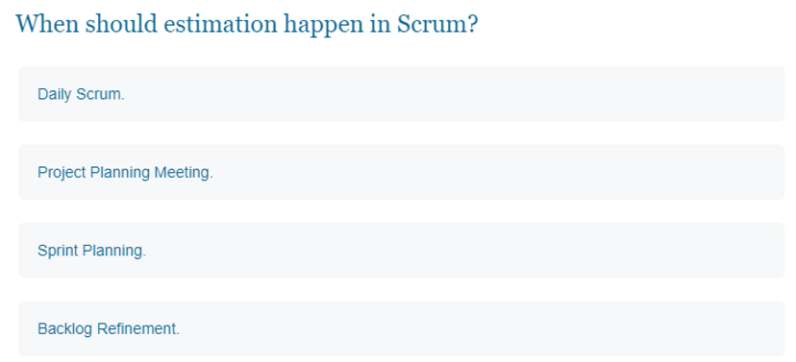
Question 20

