Slide 1
Welcome to The presentation

Slide 2





CASE TITLE
Wideopenwest:
financing
the knology acquisition

Slide 3
ECONOMIC ANALYSIS
Cable industry in growing at a very good rate.
TV produces better contents and is likely to continue enjoying .
Big players continue to invest heavily as net profit is skyrocketing.
Cable industry is positively related with the economic cycle.

Slide 4
Porters 5 force model
Bargaining power of suppliers (High)
For this reason the company had to pay more for its primary raw material.
Bargaining power of Buyers (High)
Individual customer do not have the power over the product and service provider of this industry.
Threat of existing competitors (HIGH)
Compete for the same customers daily and for the retention of the existing customers.
Threat of new entrants (Low)
Higher level of Fixed Costs.
Substitute Product
( High)
Switching cost is significantly lower for the customers.

Slide 5
DU pont analysis
Net profit margin | 0.036813813
Asset turnover | $0.73
Equity multiplier | 0.001855552
Return on Equity | $0.000049645

Slide 6
Risk Analysis (Business Risk)
BUSINESS RISK
Subject | CV
Sales | 0.5
Operating income | 0.53
Degree of operating leverage | 2009 | 2010 | 2011
 | 25.2 | 22.01 | 3.39

Slide 7
Financial Risk
 | 2008 | 2009 | 2010 | 2011
Degree of Financial leverage | -0.17 | -1.95 | -27.66 | 3.48
 | 2008 | 2009 | 2010 | 2011
INTEREST COVERAGE RATIO | 0.14 | 0.66 | 0.96 | 1.40
Higher the degree of debt use, higher the financial risk.

Slide 8
Z SCORE MODEL
Working Capital/Total Asset | -0.0530
Retained Earnings/Total Asset | -329.70
EBIT/Total Asset | 0.09
Market Value of Equity/Book value of debt | -0.49
Sales/Total Asset | 0.59
Z Score | -461.02
Distress Zone
Z = 1.2X1 + 1.4X2 + 3.3X3 + 0.6X4 + 1X5
Value is lower than 1.81. So the company is in Distress zone. According to the category firm has higher bankruptcy cost in near future.

Slide 9
PROBLEM STATEMENT
To be or not to be the issue co-manager of a bond issuing process that may serve the purpose of lifeline for WIDEOPENWEST and may or may not usher a new beginning .

Slide 10
Decision making process
Enterprise Value | 6,402.65
Add:Cash and Marketable Securities | 15.90
Less: Interest Bearing Debt | 2,920.00
Equity Value | 3,498.55
But the most important thing to the Managing Director in the Leveraged Finance group at STRH is the cash flows of the firm (WOW-KNOL combined). So, we ran simulation defining forecast on it.
2013 | 2014 | 2015 | 2016 | 2017
225.68 | 265.70 | 285.21 | 305.00 | 321.81

Slide 11
Simulation analysis
Base case 285.21

Slide 12
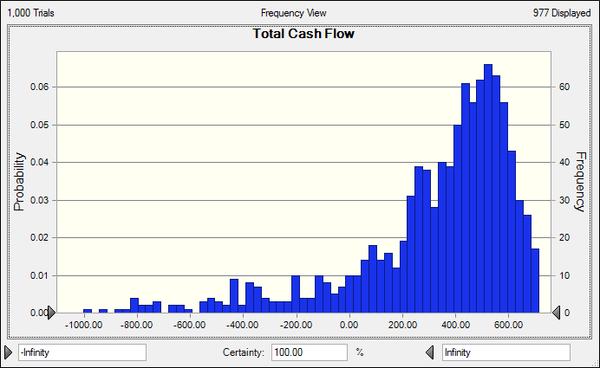

Slide 13
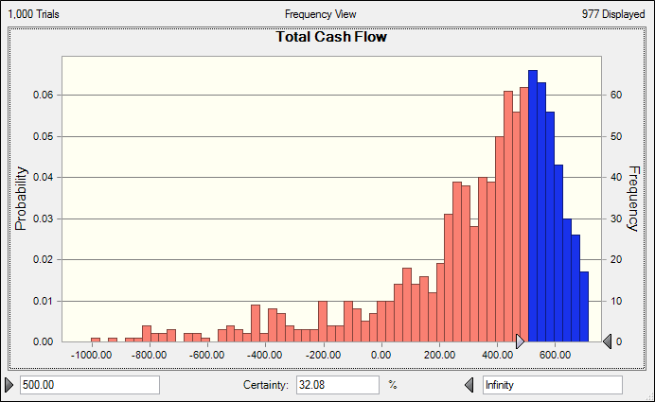

Slide 14
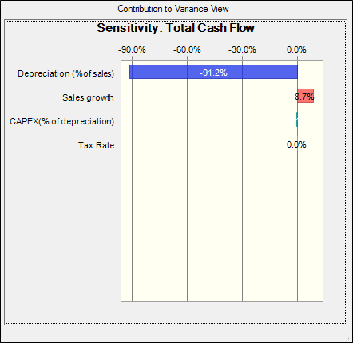

Slide 15
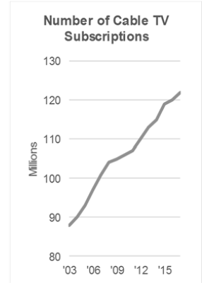
HOPE

Slide 16
Recommendation
The firm has great potential to become a successful business. TV is going to stay for a very long time(may be for another fifty years) in future.
The case of WOW-KNOL looks like a LBO situation and the Job of the investment bank is actually to help projects that mainstream commercial banks can’t and make a supernormal profit in return.
Lot of cord cutting was because of economic downturn, if economy remains strong people will feel the urge to dive in the ocean of quality contents provided by cable TV networks.

Slide 17
People really do not like to ‘work’ in order to entertain themselves.
Risk taking investments are not new in American culture and as part of the bond is secured there may remain incentive to go with the hunch of Morgan Stanley.
Go for it.

Slide 18
QUERIES????

Slide 19
THANK YOU

