Slide 1



WELCOME TO OUR PRESENTATION
CASE-03
FANUC Corporation

Slide 2

We are – Group 63
NAME | BBA ID | MBA ID
Mirza Moidul Islam | 18-022
Sayed Tarif Ishtiaque | 18-260
Md. Abdul Kader Jony | 17-251

Slide 3
Company Profile
Dr. Seiuemon Inaba, FANUC’s visionary founder and father of the current CEO Dr. Y. Inaba, joined Fuji Tsushinki Manufacturing Corporation (later named Fujitsu) in 1946, and developed the first numerical control (NC) system in 1956
The NC business grew quickly and became very profitable as costs came down. In 1972, Fujitsu spun off the NC business into a new company called Fujitsu FANUC Ltd. (FANUC stood for Fuji Automatic NUmerical Control) with Seiuemon Inaba as its president.
His son, Dr. Y. Inaba, became the president in 2003. Despite the change in leadership, Seiuemon Inaba continued to be actively involved with important business decisions. In 2013, he relinquished all control and involvement with the firm leaving his son in full control.
The company was known for being secretive and indifferent to analysts and investors. Email exchanges outside the company were restricted
the Securities Analysts Association of Japan ranked FANUC last out of 251 companies in its annual corporate disclosure index in 2014.

Slide 4
Economic Analysis
Japan’s postwar economy can be divided into three sub-periods: a high-growth period from 1955 to 1972, a stable-growth period from 1973 to 1989, and a no-growth period from 1990 to 2014. During the high-growth period, GDP growth averaged over 9% per year as Japan rebuilt its industrial base and became the second-largest economy in the world. Growth slowed considerably to an average of 3% in the 1970s due in large part to an appreciating yen that hurt the export-driven economy and two oil shocks that slowed growth because of the country’s dependence on foreign oil. Stock prices crashed in 1990 and land prices crashed the following year, ushering in a no-growth period known as the “lost decade.” Over the next 20 years, economic growth stalled, consumer spending declined, unemployment rose, and consumer prices fell. At the end of 2014, the Nikkei 225 Index was still 50% below its all-time high, achieved some 25 years earlier. So, the economic condition is not very healthy at all.

Slide 5
Porters 5 Force Model
Bargaining power of suppliers (Low)
High overall supply
Bargaining power of Buyers (High)
CLow switching costs , High access to product information , High availability of substitutes
Rivalry among existing competitors (High)
High aggressiveness of firms, Low switching cost, High number of firms
Threat of new entrants (Low)
Moderate customer loyalty
Substitute Product
( High)
Switching cost is significantly lower for the customers.
Low forward integration of suppliers
High cost of brand development

Slide 6
SWOT ANALYSIS
Internal Analysis
Strengths
FANUC is unique company with a long history of being the best and fastest to market in everything it does.
It focuses relentlessly on producing only a limited number of technically superior product.
The global market share for industrial robots was expected to grow from $15 billion to $67 billion in 2025.
Long term profitability is the prime concern.
The company had a good record of extra-ordinary performance for more than 30 years.
Weaknesses
Some potential investors believe that FANUC had illogical capital structure.
Low ranking in terms of disclosing financial information.
Long term growth expectation of 100 to 200 years is unrealistic.

Slide 7
SWOT ANALYSIS (Cont’d)
External Analysis
Opportunities
Foreign interest in ownership of Japanese listed shares had increased dramatically.
FANUC secured achieving $2.4 billion of operating profit and 40% of margins in FY 2014 that attract foreign investment in FANUC.
The change in management can play positive impact if the company can effectively utilize its excess capital.
International expansion.
Threats
What should be the effective capital structure to make sure long term growth is the most important question.
Proper management of various changes related to corporate governance and its business.
Slow growth economy of Japan.

Slide 8
Business Risk
Year | 2011 | 2012 | 2013 | 2014 | 2015 | 2016 | 2017 | 2018 | 2019
EBIT | 189.80 | 221.80 | 184.80 | 164.10 | 282.50 | 333.00 | 387.60 | 479.12 | 580.94
Change of EBIT |  | 32.00 | -37.00 | -20.70 | 118.40 | 50.50 | 54.60 | 91.52 | 101.82
Revenue | 446.2 | 538.5 | 498.4 | 451 | 705 | 846 | 1015.2 | 1218.2 | 1461.9
∆ Revenue |  | 92.30 | -40.10 | -47.40 | 254.00 | 141.00 | 169.20 | 203.04 | 243.65
Operating leverage |  | 0.82 | 2.24 | 1.18 | 1.28 | 0.89 | 0.82 | 1.18 | 1.06
Here for FANUC, we can see that from 2012 to 2019 the degree of operating leverage is positive and it declines to the end.It indicates that the company is in lower level of Business risk.

Slide 9
Interest Coverage Ratio
Interest coverage ratio is calculated by dividing the earnings before interest and tax with the help of interest expense. For FANUC, the highest amount of interest coverage ratio was in 2016.

Slide 10
Profitability ratios

Slide 11
Leverage ratios
Till 2015, the company is a full equity firm. It has no debt outstanding. So debt equity ratio is still 0. And we have make an structure which will give a debt equity ratio of 35%.

Slide 12
Liquidity Ratios

Slide 13
PROBLEM STATEMENT
To increase FANUC Corporation’s return on equity to the level of comparable companies in the developed world through changing its capital structure and proper allocation of its extra cash

Slide 14
ALTERNATIVES
Issuing long term bond
Taking bank loan
Buyback shares
Issuing convertible bond

Slide 15
ASSUMPTIONS
Cost of capital 3.12%
Depreciation (%of sales) 7.60%
Tax Rate 30.00%
COGS(%of sales) 50.00%
CAPEX(% of sales) 20.00%
Sales growth 20.00% for next five years
Terminal growth rate 3.00%

Slide 16
WACC
Bond Issue
Risk Free Rate | 0.005
Market Return | 0.02
Beta | 1.2
Cost of Equity | 0.023
Cost of Debt | 0.005
After Tax cost of debt | 0.0035
Weight ot Debt | 0
Weight of Equity | 1
Total Debt | 0
Total Equity | 1,199.90
Total Value(Debt+ Equity) | 1199.9
Income Tax | 0.3
WACC | 0.023
We have added a 100 bp to compensate for bankruptcy risk. So the final WACC is 3.12%.

Slide 17
ALTERNATIVE-1 (Long term bond)
Equity Value | 106,527.05
No. of shares | 195000000
value per share(Bond) | 546,292.54
WACC is 3.12% and Terminal Growth Rate is 3%

Slide 18
ALTERNATIVE-1 (Long term bond)
The company has to sign covenants that may limit a few policy actions of the company in future. But given the strong prospect and already established track record, it is very unlikely that the company will not have sufficient fund to breakthrough those covenants if needed. But more importantly it will give the company enough funds to lever its capital structure without compromising any key board position to an outsider

Slide 19
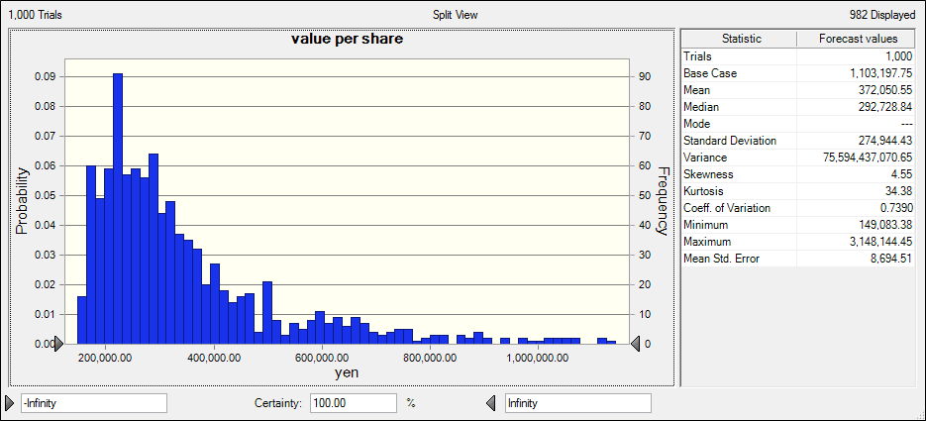
ALTERNATIVE-1 (Long term bond)

Slide 20
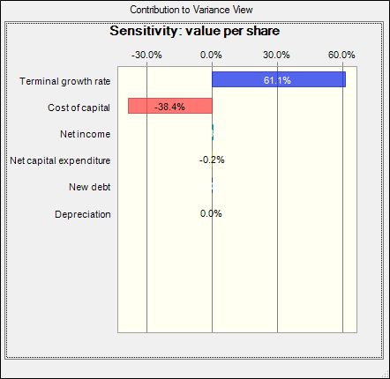
ALTERNATIVE-1 (Long term bond)

Slide 21
Z SCORE MODEL
 | 2015 | 2016 | 2017 | 2018 | 2019
Total score | 808.62 | 8.27 | 4.84 | 3.73 | 3.34
 | Safe Zone | Safe Zone | Safe Zone | Safe Zone | Safe Zone

Slide 22
ALTERNATIVE-2 (Bank Loan)
Bank loan is cheaper than bond given that it gives us less cost of capital. But the corporate governance system of Japan makes it really costly because the lender institution usually takes big role in the corporate governance of the borrower institution. FANUC is a high-tech company. Every piece of information is vital. So, Dr. Y. Inaba’s position on the secrecy of the firm’s strategies seems highly logical. Given this situation, the actual cost of letting outsider’s substantial control in the board can really outweigh the benefits. We have explored the option for further clarity but we do not recommend this though both the value per share and ROE are more favourable in case of bank loan.

Slide 23
ALTERNATIVE-2 (Bank Loan)
Equity Value | 127,044.13
No. of shares | 195000000
value per share(Bank loan) | 651,508.37
WACC is 2.9%, Terminal Growth Rate is 2.8%

Slide 24
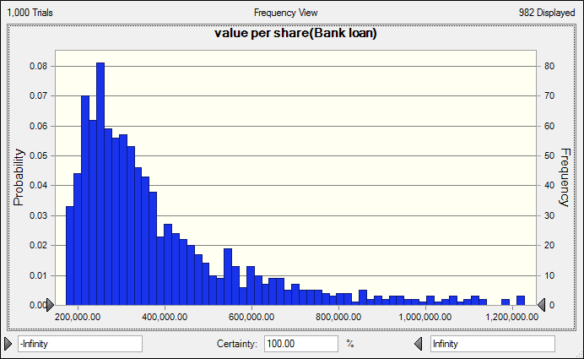
ALTERNATIVE-2 (Bank Loan)

Slide 25
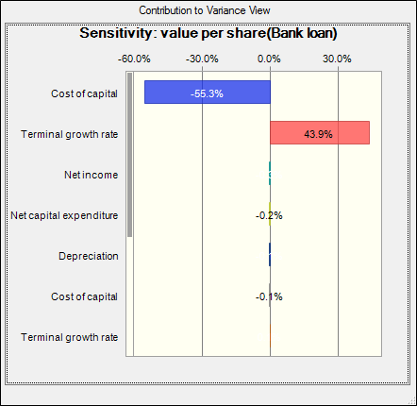
ALTERNATIVE-2 (Bank loan)

Slide 26
ALTERNATIVE-3 (Convertible bond)
Equity Value | 18,988.79
No. of shares | 375000000
value per share | 50,636.76
WACC is 3.12% and terminal growth rate is 3%

Slide 27
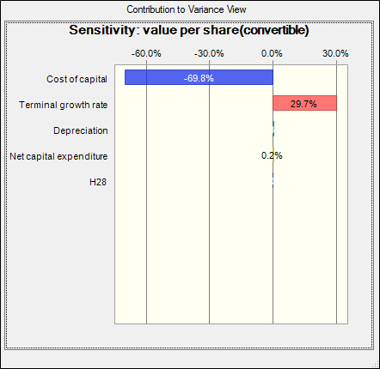
ALTERNATIVE-3 (Convertible bond)

Slide 28
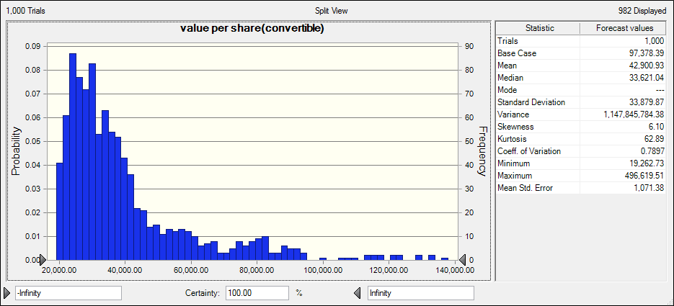
ALTERNATIVE-3 (Convertible bond)

Slide 29
ALTERNATIVE-4 (Buyback of share)
Equity Value | 25,305.97
No. of shares | 183000000
value per share(buyback) | 138,284.00
WACC is 3.00 %, Terminal Growth Rate is 2.90%

Slide 30
ALTERNATIVE-4 (Buyback of share)
Firstly, it is time consuming
Secondly it will take significantly more than book value which will make a capital loss
Thirdly they have to find the shareholders who are willing to sell their share and it is not so easy task given that the share is already undervalued and in the light of the govt. policy its price will increase in future.
And above all buying back shares does not add any value to the bottom line of the company

Slide 31
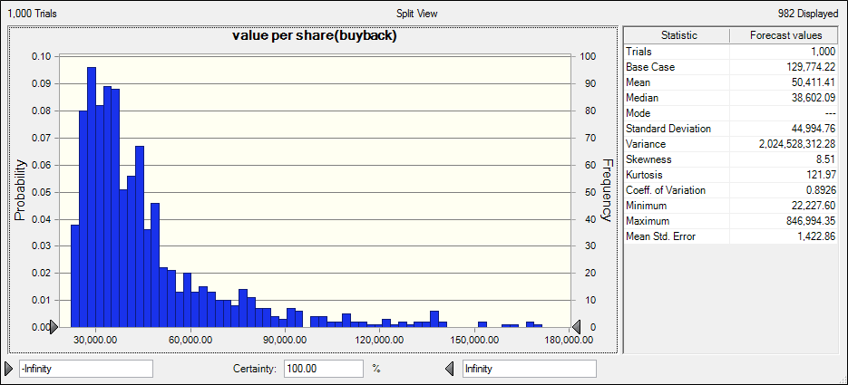
ALTERNATIVE-4 (Buyback of share)

Slide 32
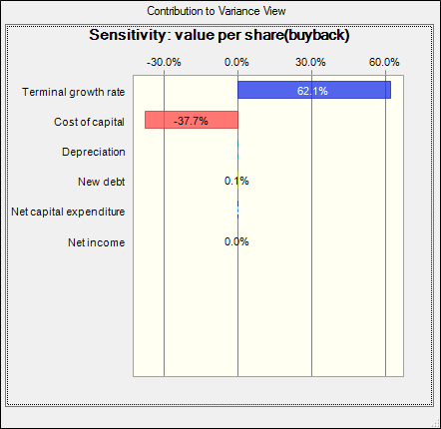
ALTERNATIVE-4 (Buyback of share)

Slide 33
Recommendation
 | ROE | VPS
Bond | 0.252613 | 546292.543
Bank Loan | 0.251394 | 651508.373
Buy back | 0.174338 | 138284.003
Convertible | 0.085263 | 50636.7634
Issuing bond is the most favourable option and obviously we recommend issuing long term bond at least 4 times in next four years which will result in debt-equity ratio of 35% and ROE of more than 25% comfortably placing the company alongside its American and west-European peers.

Slide 34
ANY QUERIES????

Slide 35
THANK YOU

