Slide 1
Welcome to the presentation

Slide 2
CASE-04
FOX’S INITIAL PUBLIC OFFERING:
UNLOCKING SHAREHOLDER VALUE
AT
NEWS CORPORATION

Slide 3



We are group-63
NAME | BBA ID
Md. Abdul Kader Jony | 17-251
Mirza Moidul Islam | 18-022
Sayed Tarif Ishtiaque | 18-260

Slide 4
ECONOMIC ANALYSIS
Global media and entertainment industry is integrating.
Americans prefer domestic stocks to foreign stocks.
Worldwide reach is going to be crucial in days to come.
Though market looks like it is in slump but in true sense it is in the recovery mode.

Slide 5
Porters 5 force model
Bargaining power of suppliers (High)
Suppliers in the media and entertainment industry have a relatively low bargaining power.
Bargaining power of Buyers (High)
The bargaining power of buyers is minimal due to the large number of buyers and the few number of entertainment corporations.
Threat of existing competitors (HIGH)
Compete for the same customers daily and for the retention of the existing customers.
Threat of new entrants (Low)
Higher level of Fixed Costs.
Substitute Product
( High)
Switching cost is significantly lower for the customers.

Slide 6
DU-pont analysis
 | Net Income | Total Revenues | EBIT | Total Assets | Total Equity | Opreating Profit Margin | Total Asset Turnover | Financial Leverage | ROE
1997 | $30 | 5,847 | 320 | $11,697 | 3,767 | 0.51% | 49.99% | 3.11 | 0.80%
1998 | $176 | 7,023 | 663 | $12,630 | 3,941 | 2.51% | 55.61% | 3.20 | 4.47%

Slide 7
PROBLEM STATEMENT
To unlock shareholder value through integration of FOX in the stock market as a domestic company by an IPO which will in turn help the business to grow and ultimately maximize shareholders value.

Slide 8
Risk Analysis (Business Risk)
BUSINESS RISK
Subject | CV
Sales | 0.21
Operating income | 0.35
Degree of operating leverage | 1997 | 1998
 | -1.17 | 5.33

Slide 9
Financial Risk
 | 1996 | 1997 | 1998
Degree of Financial leverage | 0.80704698 | 0.626223092 | 0.709850107
 | 1996 | 1997 | 1998
INTEREST COVERAGE RATIO | -4.1826087 | -1.67539267 | -2.446494465

Slide 10
Z SCORE MODEL
Working Capital/Total Asset | -0.1329
Retained Earnings/Total Asset | 0.0542
EBIT/Total Asset | 0.1627
Market Value of Equity/Book value of debt | 4.4139
Sales/Total Asset | 0.5549
Z Score | 5.05
Safe Zone
Z = 1.2X1 + 1.4X2 + 3.3X3 + 0.6X4 + 1X5
Value is higher than 2.9. So the company is in safe zone. According to the category firm has higher bankruptcy cost in near future.

Slide 11
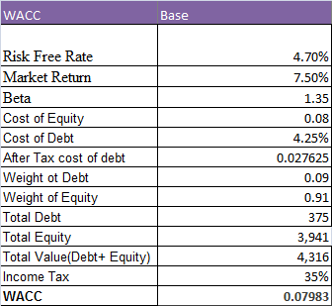
Decision making process
(Base case)
Equity Value(in millions of dollars) | 18,244.89
No. of shares | 548000000
Value per share | 33.29

Slide 12
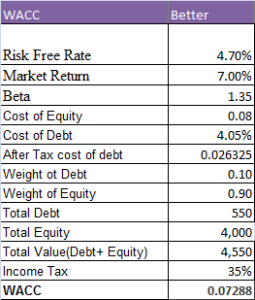
Decision making process (Better case)
Equity Value(in millions of dollars) | 21,789.30
No. of shares | 548000000
Value per share | 39.76

Slide 13
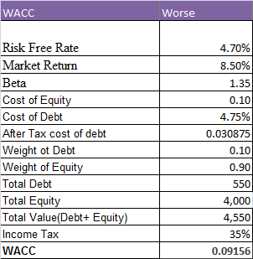
Decision making process (Worse case)
Equity Value(in millions of dollars) | 14,250.75
No. of shares | 548000000
Value per share | 26.01

Slide 14
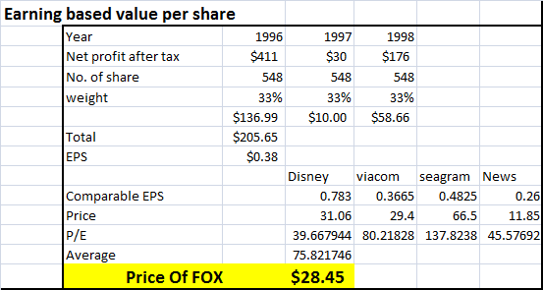
Decision making process
(Multiples)

Slide 15
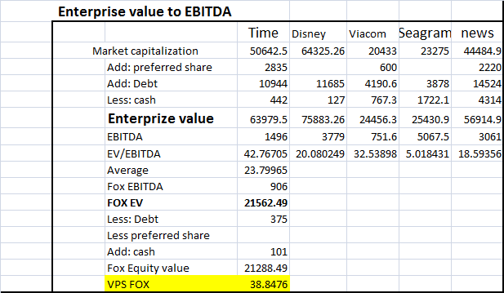
Decision making process
(Multiples)

Slide 16


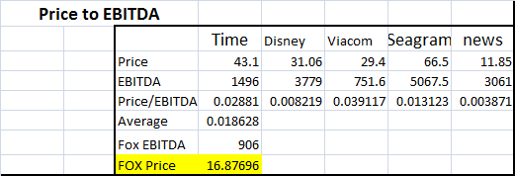
Decision making process (Multiples)

Slide 17
Decision making process
Fox’s Average Price | 32.438
Large part of the equity value is terminal value so we suggest to set the indicative price around 18-20 given that market is expecting high growth from FOX.

Slide 18
Simulation analysis

Slide 19
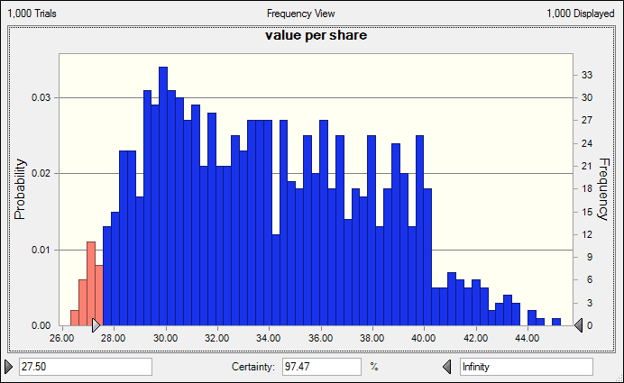
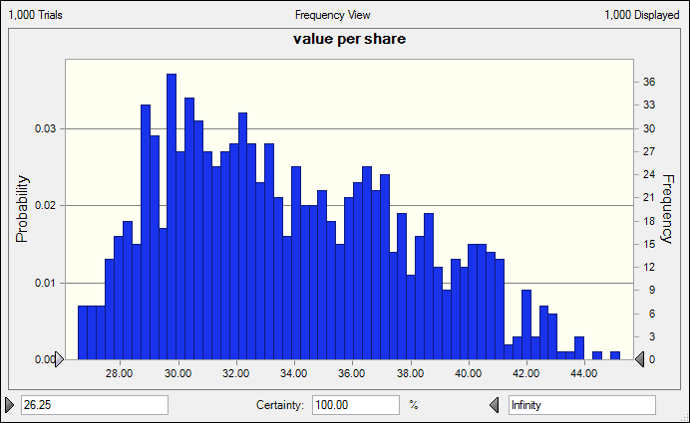

Slide 20
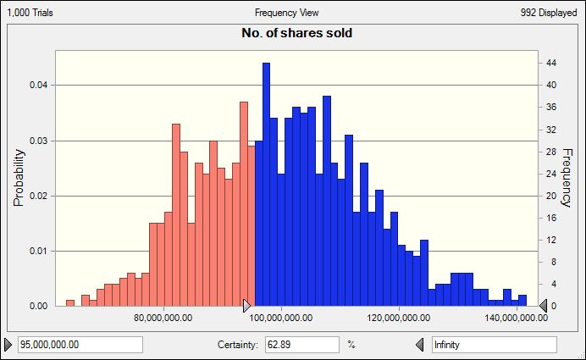

Slide 21
Recommendation
A run through the book building process will be more helpful to unlock true share value.
Indicative price should be set at $20 with a little ‘brave-heart’ range of ±40%.Given the prospect possibility of an upward bias is more likely than a downward one.
If we issue 95000000 shares at $19 per share, simulation shows there is more than 62% possibility that our Target $1.8b will be raised comfortably.

Slide 22
Finally, though market looks like it is in slump but in true sense it is in the recovery mode. The IPO is intended to integrate FOX in the US environment so that people gets to feel as if it is one of their own because US investors bias towards domestic stocks is empirically proved.
News corporation is a big company but not a US one yet. Postponing the IPO is likely to cause more rumors which are not likely to be helpful.
Prompt issue will give the chance to News corporation to benefit from the already created positive attitude towards FOX. It will allow more time for integration too.
Go for it

Slide 23
QUERIES????

Slide 24
THANK YOU

