Slide 1
Welcome to the presentation

Slide 2
CASE-05
VINCOR International inc.
INITIAL PUBLIC OFFERING

Slide 3
ECONOMIC ANALYSIS
Wine industry is synergistic.
Days of generous support from govt. Is coming to an end.
Export market in US is promising but unexplored.
There is enough growth opportunity

Slide 4
Porters 5 force model
Bargaining power of suppliers (High)
Suppliers in the media and entertainment industry have a relatively low bargaining power.
Bargaining power of Buyers (High)
The bargaining power of buyers is minimal due to the large number of buyers and the few number of large corporations.
Threat of existing competitors (HIGH)
Compete for the same customers daily and for the retention of the existing customers.
Threat of new entrants (Low)
Higher level of Fixed Costs.
Substitute Product
( High)
Switching cost is significantly lower for the customers.

Slide 5
DU-pont analysis
 | Net Income | Total Revenues | EBIT | Total Assets | Total Equity | Opreating Profit Margin | Total Asset Turnover | Financial Leverage | ROE
1994 | ($928) | 81,316 | 3835 | $125,576 | 14,995 | -1.14% | 64.75% | 8.37 | -6.19%
1995 | $1,677 | 114,522 | 9046 | $112,370 | 19,202 | 1.46% | 101.92% | 5.85 | 8.73%

Slide 6
PROBLEM STATEMENT
To minimize excessive debt load and raise fund to capture the growth opportunities through an IPO that will ensure profitable business growth as well as provide opportunity to institutional shareholders to realize on there investments.

Slide 7
PROBLEM STATEMENT
There are three general questions regarding an IPO
At what price?
How many shares?
When to issue them?

Slide 8
Risk Analysis (Business Risk)
BUSINESS RISK
Subject | CV
Sales | 0.24
Operating income | 0.57
Degree of operating leverage | 1994 | 1995
 |  | 3.33

Slide 9
Financial Risk
 | 1994 | 1995
Degree of Financial leverage | -6.32838284 | 3.122540559
 | 1994 | 1995
INTEREST COVERAGE RATIO | 0.863544247 | 1.471133518

Slide 10
Z SCORE MODEL
1995 | 1996 | 1997
1.32 | 1.87 | 2.30
Distress Zone | Gray Zone | Gray Zone
Debt-Equity ratio
2.17009 | 0.69845 | 0.47336

Slide 11
Decision making process
Equity Value | 93,503,615.48
No. of shares | 16770000
value per share | 5.58
WACC
Risk Free Rate | 7.14%
Market Return | 7.00%
Beta | 0.95
Cost of Equity | 0.07
Cost of Debt | 8.40%
After Tax cost of debt | 0.0546
Weight ot Debt | 0.68
Weight of Equity | 0.32
Total Debt | 41,670
Total Equity | 19,202
Total Value(Debt+ Equity) | 60,872
Income Tax | 30%
WACC | 0.05948

Slide 12
Decision making process
(Multiples)
Earning based value per share
 | Year | 1994 | 1995
 | Net profit after tax | ($928) | $1,677
 | No. of share | $16,770.00 | $16,770.00
 | weight | 50% | 50%
 |  | ($464.00) | $838.50
 | Total | $374.50
 | EPS | $0.02
 |  |  | Canandaigua | Mondavi | Magnotta | Andres
 | Comparable P/E |  | 13.3 | 16.74 |  | 14.02
 | Average |  | 14.68666667
 | Price Of Vincor |  | $0.33

Slide 13
Decision making process (Multiples)
Projected
 | EPS | $0.28
 | P/E | 14.68666667
Price Of Vincor |  | $4.09
 |  | NAV | 1.145
Price to EBITDA
 |  |  | Canandaigua | Mondavi | Magnotta | Andres
 |  | Price/EBITDA | 7.3 | 7.26 | 7.25 | 5.64
 |  | Average | 6.8625
 |  | Vincor EBITDA | 12,429 | $0.74
 |  | Vincor Price | $5.09

Slide 14
Decision making process
Vincor’s Average Price | 6.84
Large part of the equity value is terminal value so we suggest to set the indicative price around $3 given that market is expecting high growth from Vincor.

Slide 15
Recommendation
Price | 3
Amount | 33000000
No. of shares | 11000000
Flotation cost
5% | 1650000
Net proceed | 31350000
Debt repayment | 19800000
Expansion | 11550000

Slide 16
Simulation analysis

Slide 17
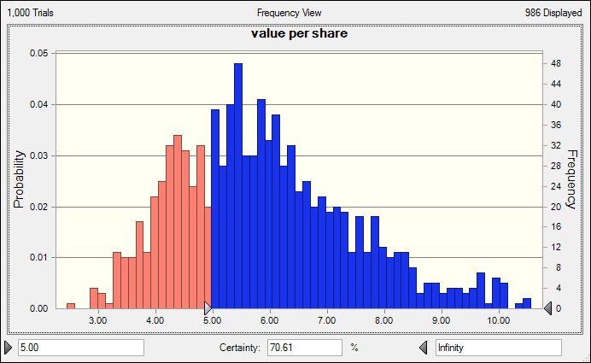

Slide 18
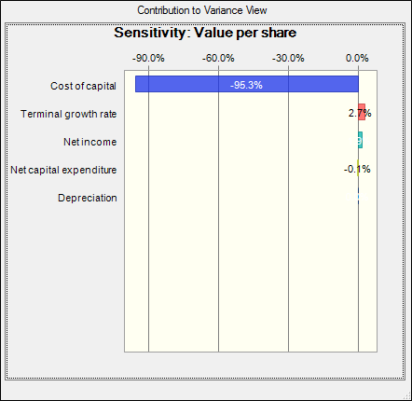
Sensitivity

Slide 19
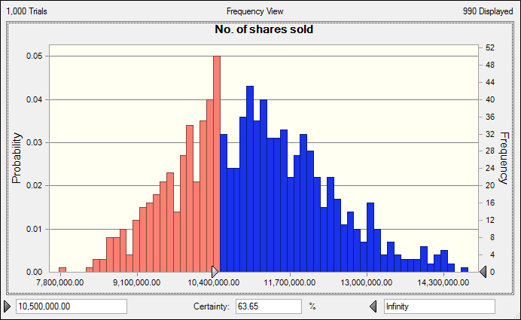

Slide 20
Recommendation
A run through the book building process will be more helpful to unlock true share value.
Indicative price should be set at $4 with a little ‘brave-heart’ range of ±25%.Given the prospect possibility of an upward bias is more likely than a downward one.
If we issue 105000000 shares at $3 per share, simulation shows there is more than 63% possibility that $31500000 will be raised comfortably.
Given FC of 5% we are left with net proceeds of $29925000.
We can use the $19800000 to repay debt which will bring down the debt load considerably by 1997. (D/E of .47).

Slide 21
Finally, though market is in slow growth
By using the excess fund raised trough IPO, we can man go for both vertical and horizontal expansion.
Vincor can start producing glass bottles itself. It can also invest in grape production to secure less costly supply of raw materials.
Production of Inniskillin icewine can also be financed.
Al ready proven successful method of acquiring promising small wineries can also be carried out

Slide 22
QUERIES????

Slide 23
THANK YOU

