Slide 1
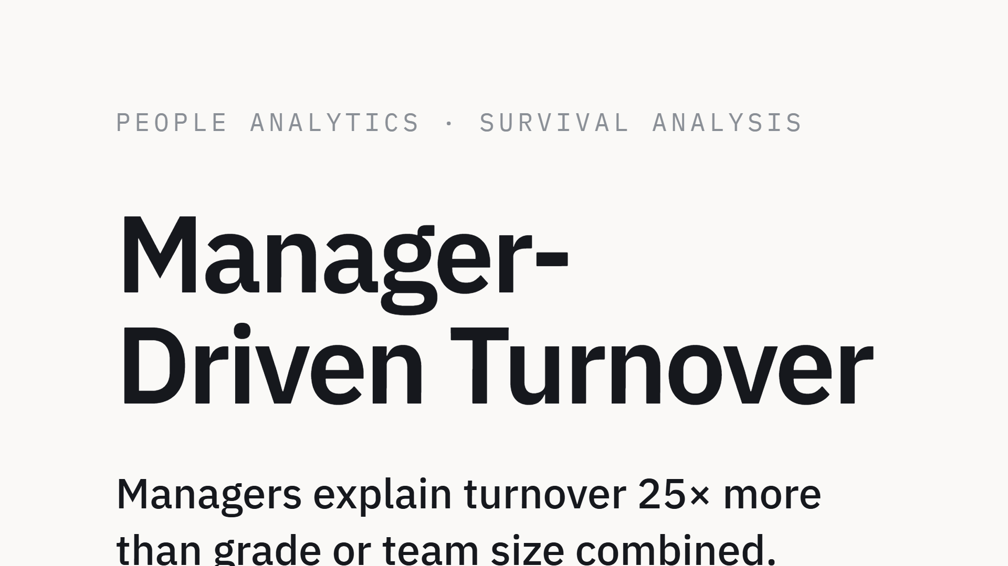

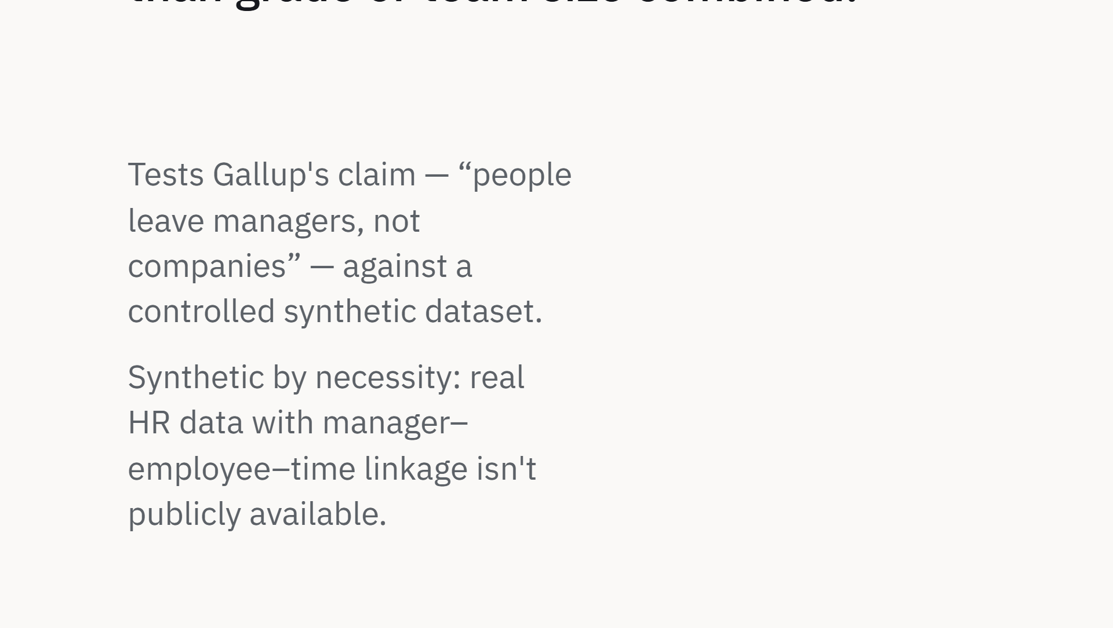
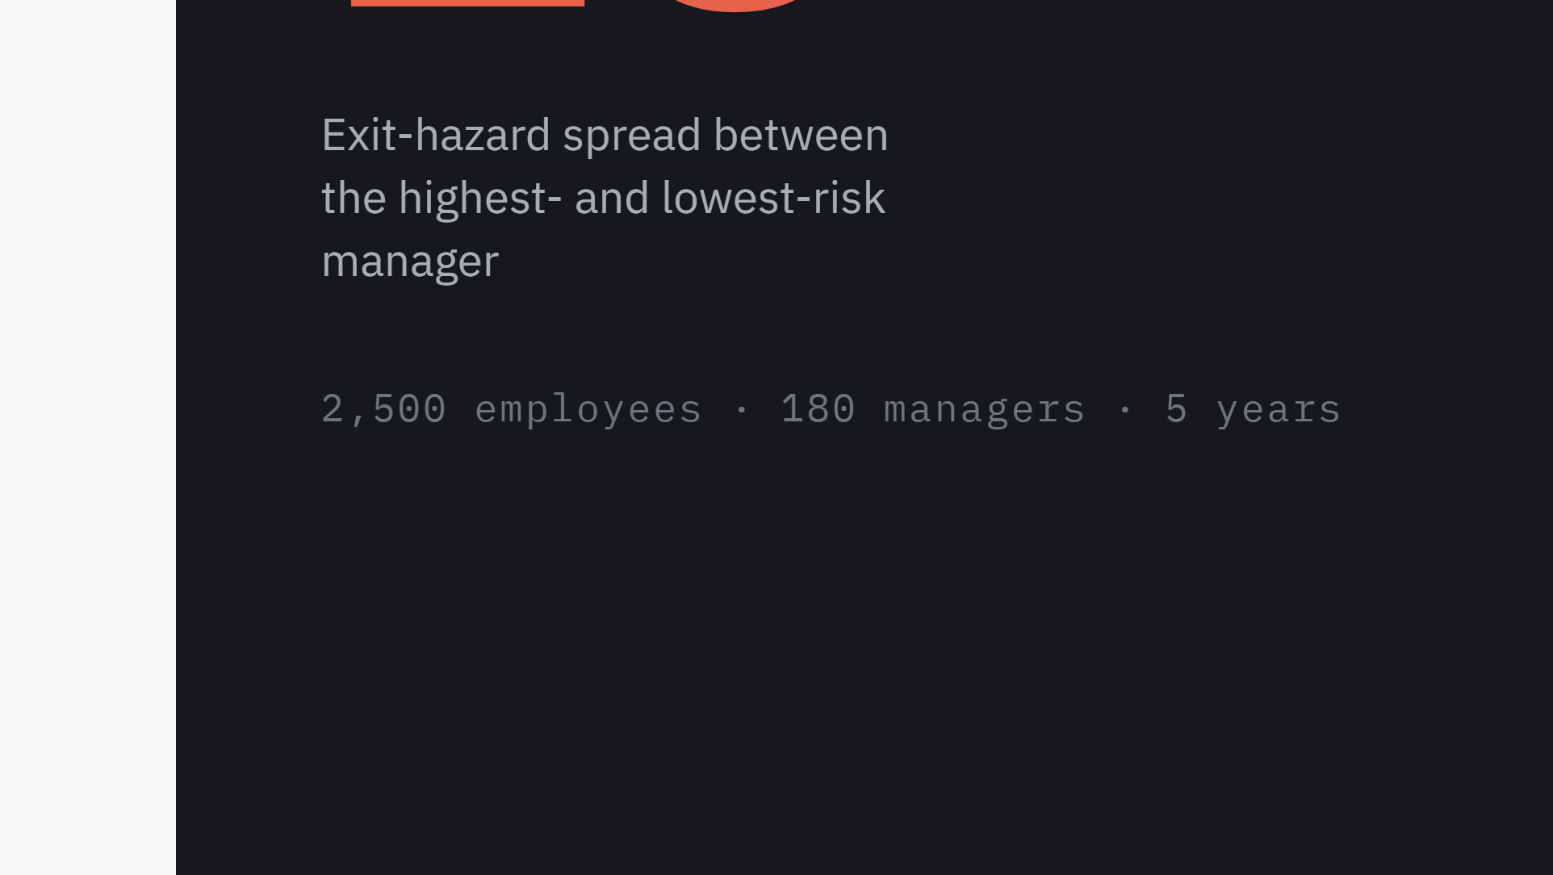
Notes:
Synthetic-data survival analysis project. The hook is the 25x spread; the credibility comes from the sealed-parameter validation on slide 5.

Slide 2
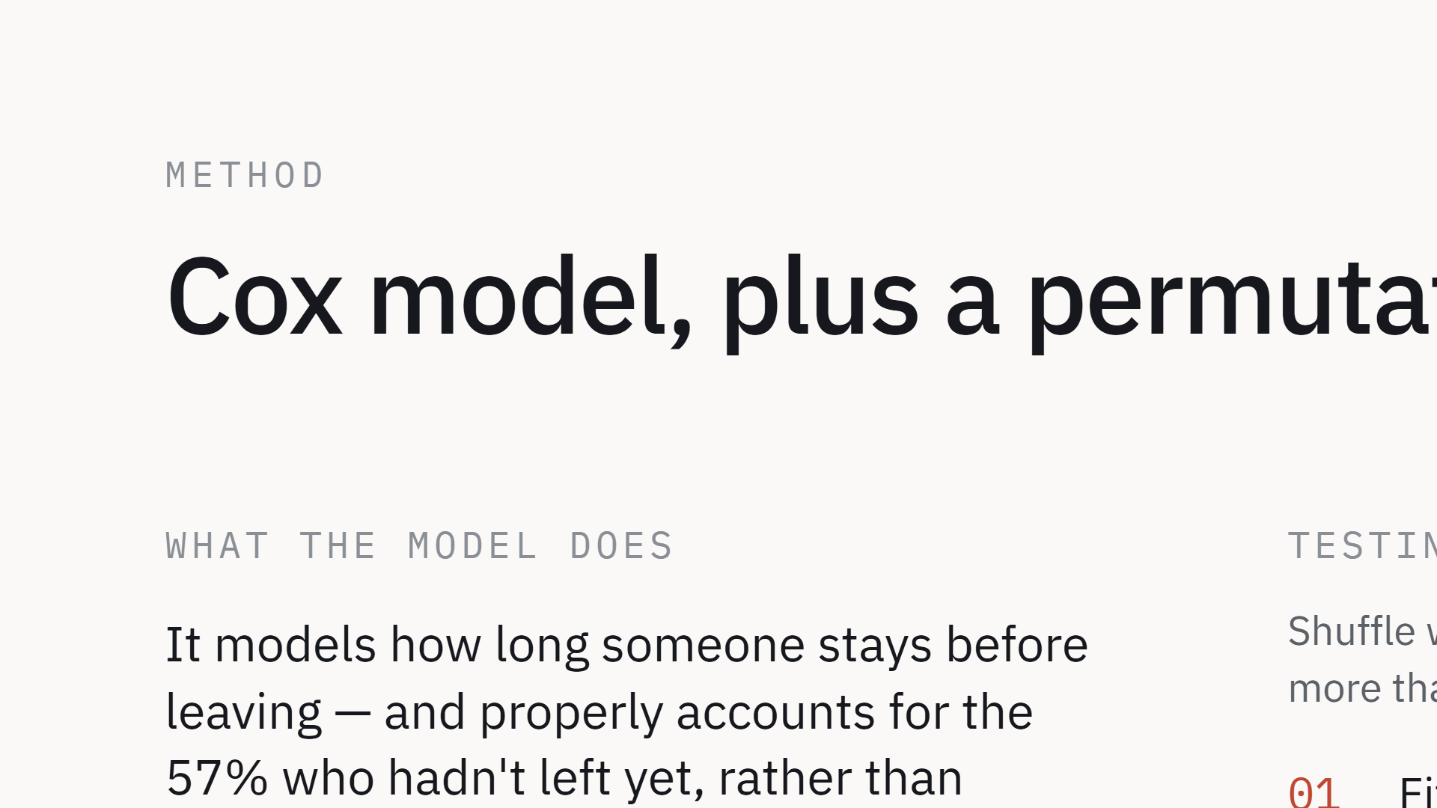
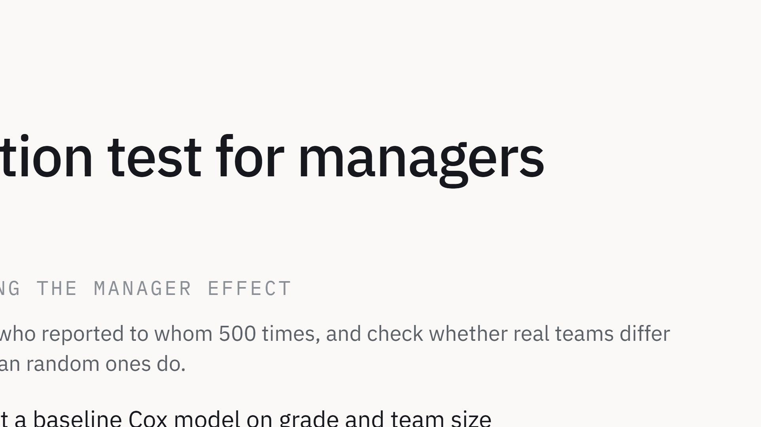
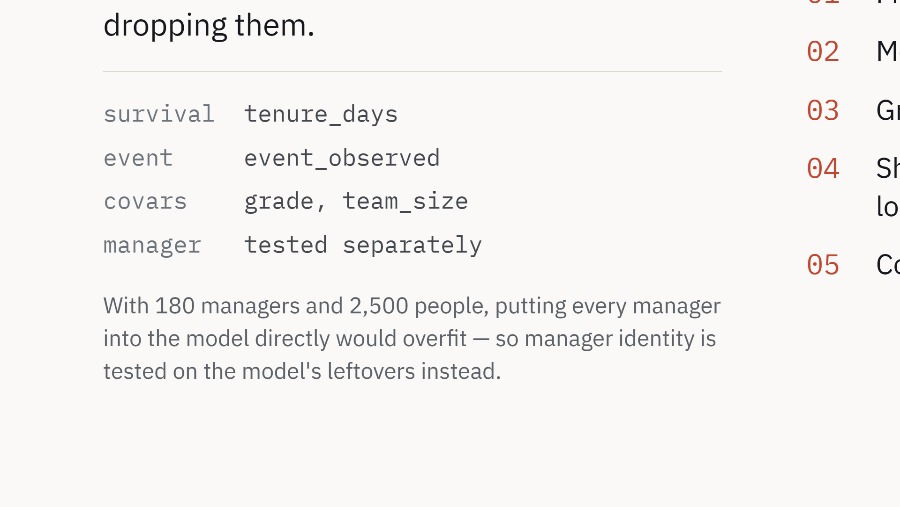
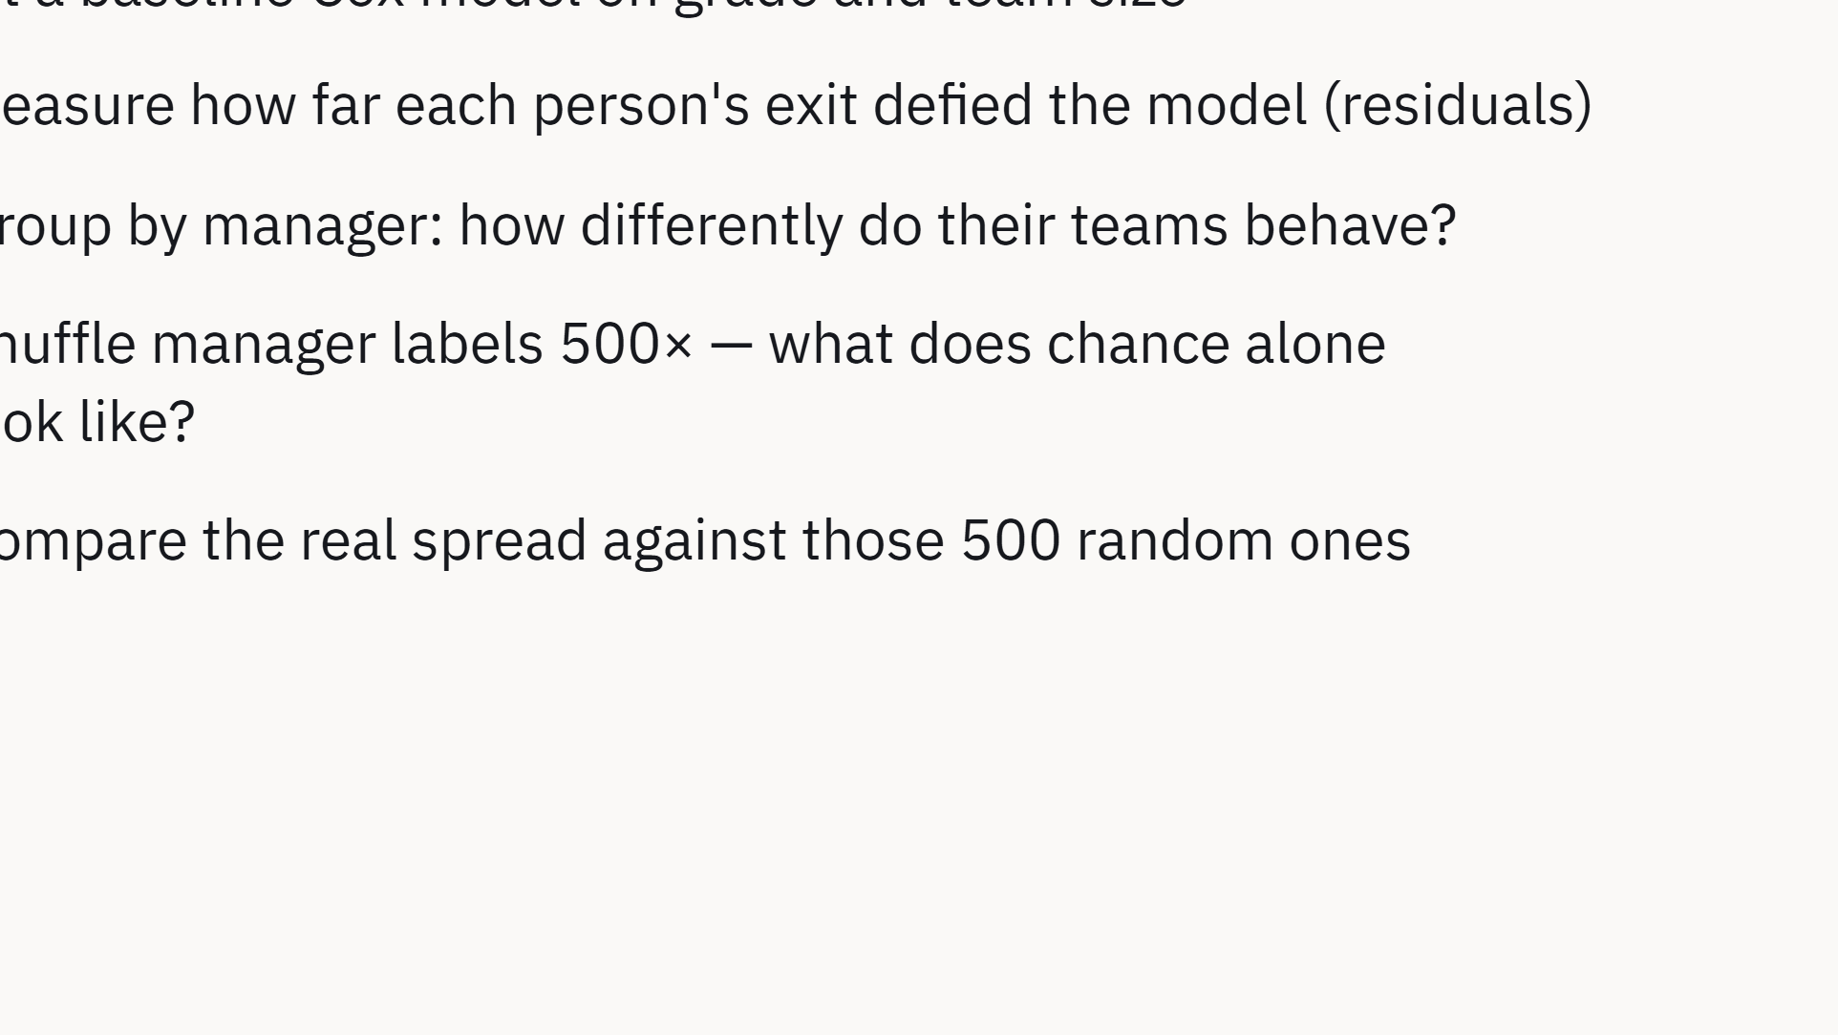
Notes:
Tenure is the survival clock, not a covariate — that handles managers with many new hires. The permutation test exists because 180 manager dummies would overfit 2,500 rows.

Slide 3
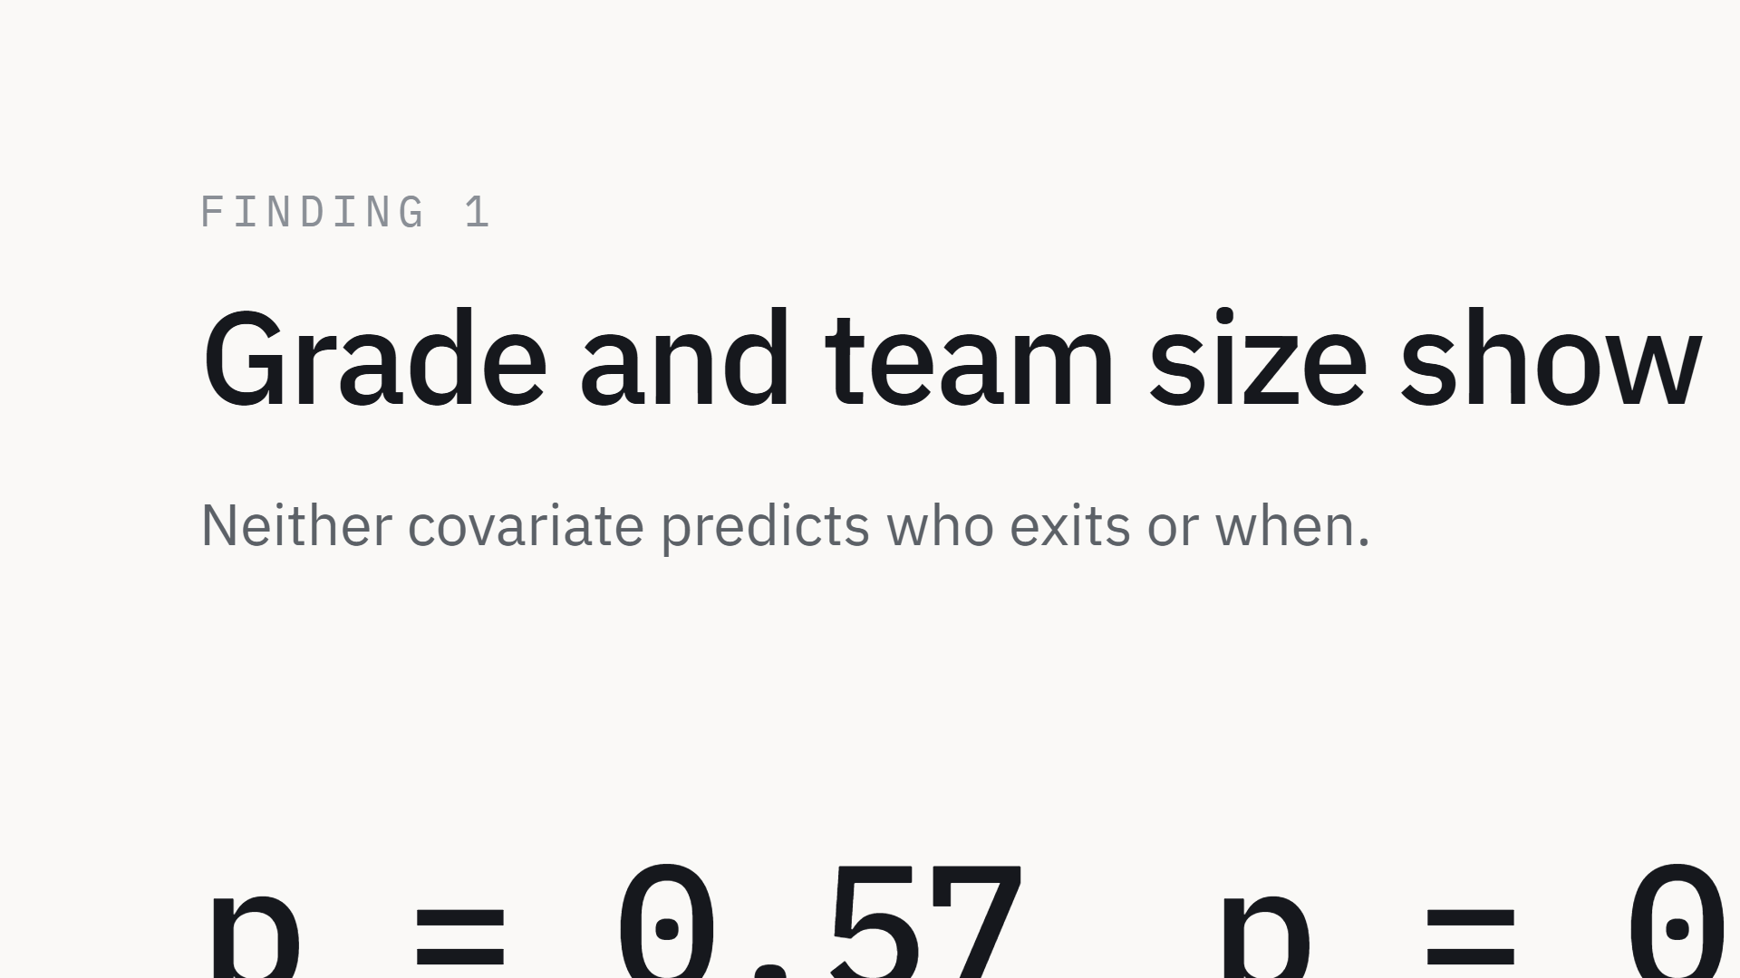
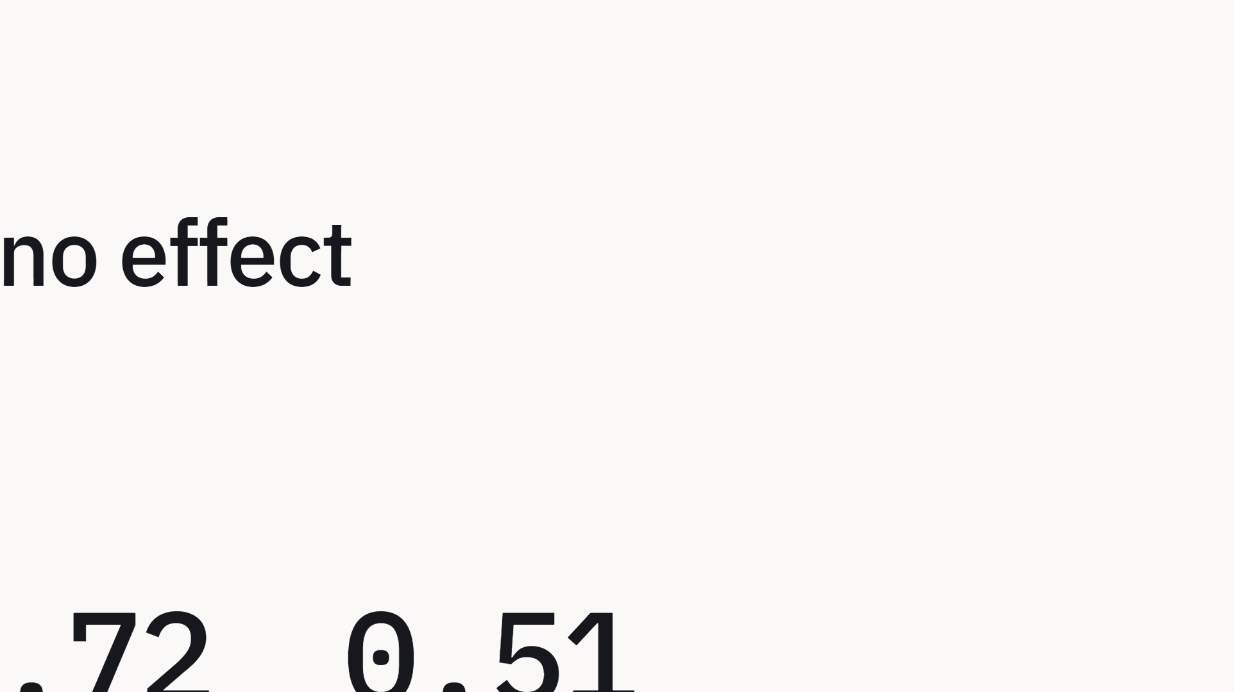
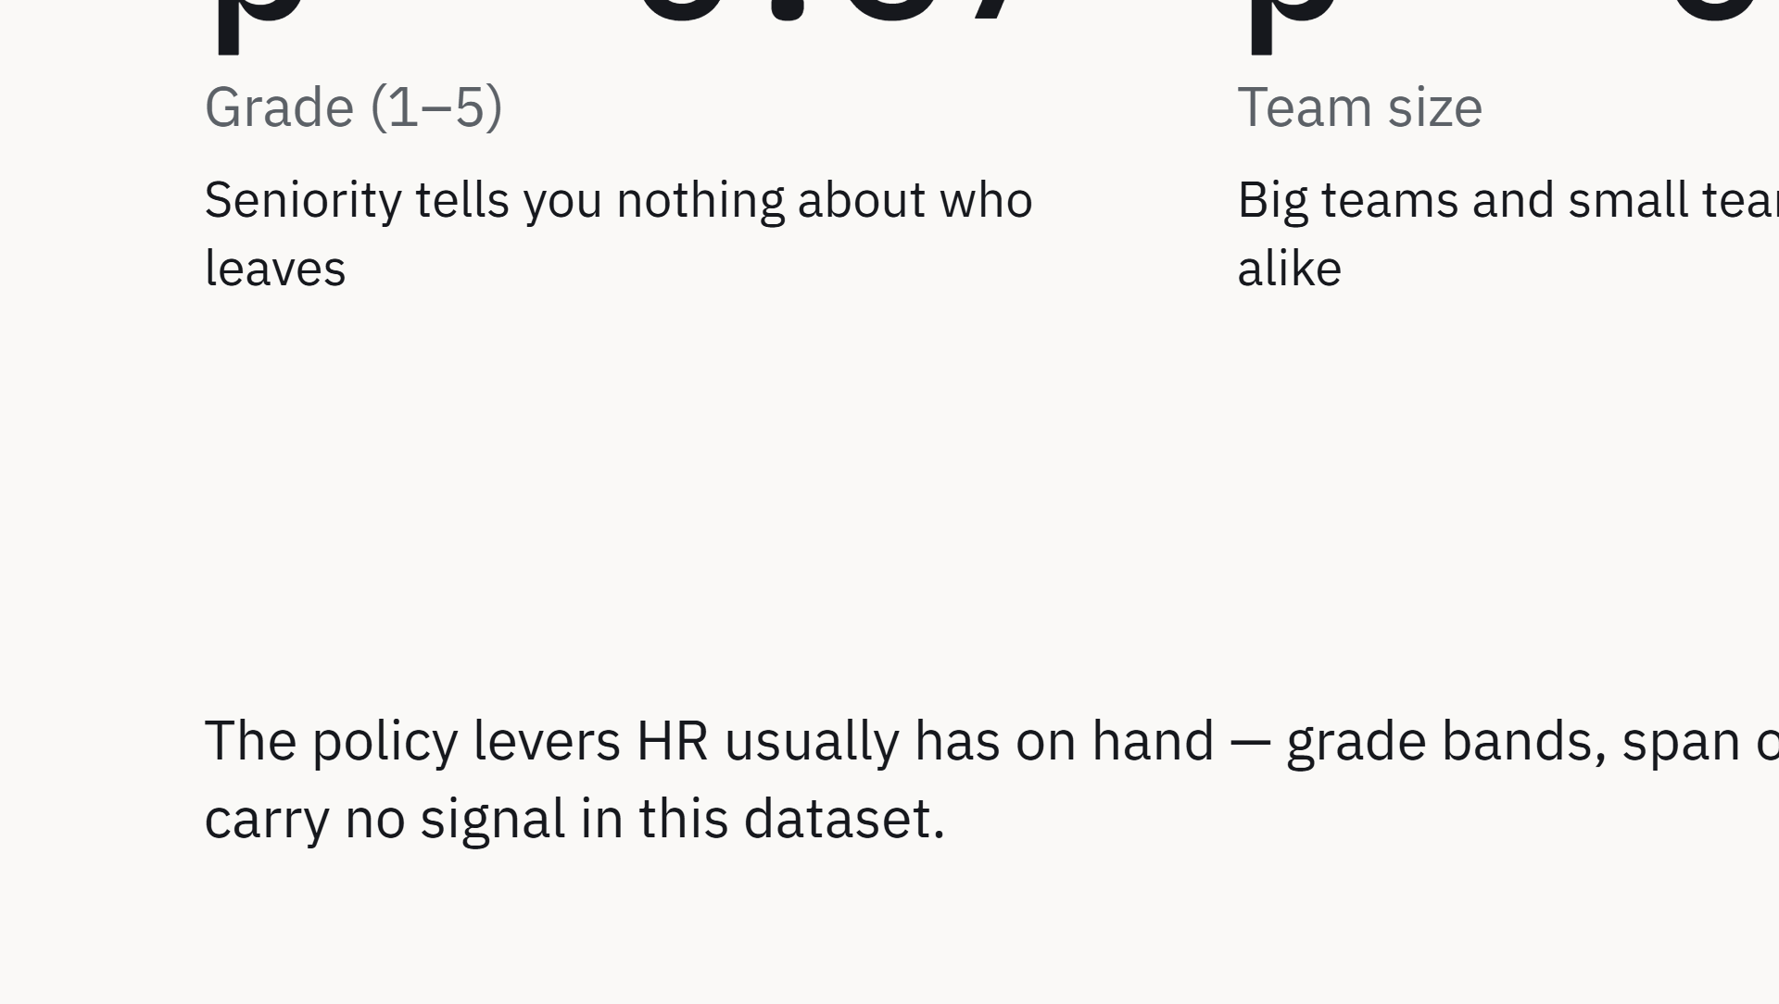
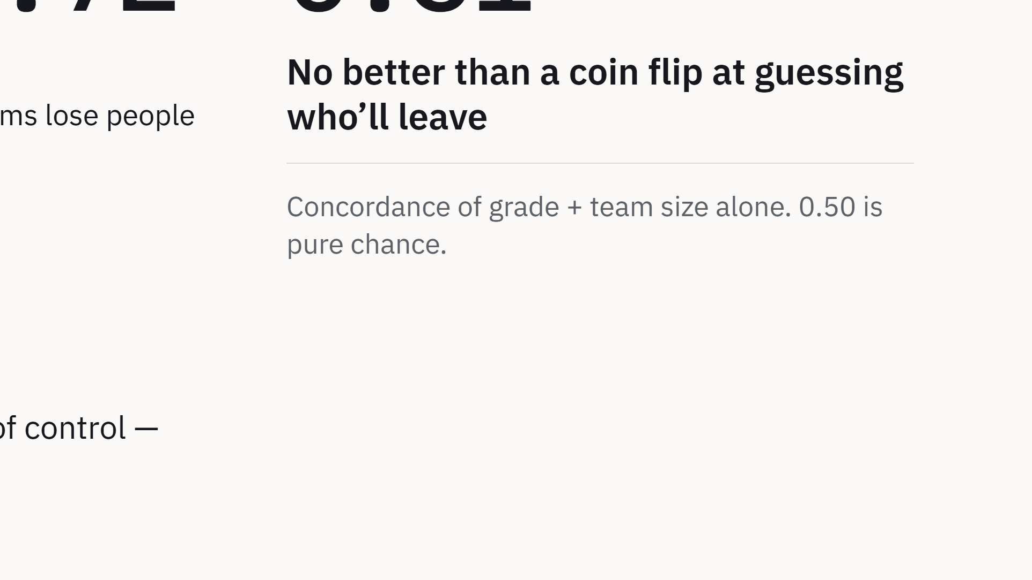
Notes:
Lead with the null result. Concordance 0.51 means the structural covariates are effectively a coin flip.

Slide 4

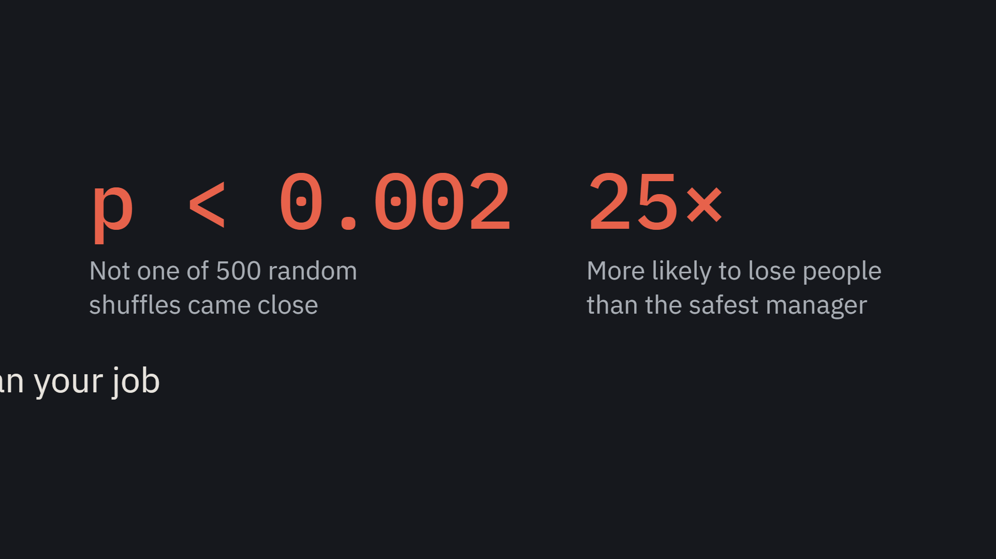
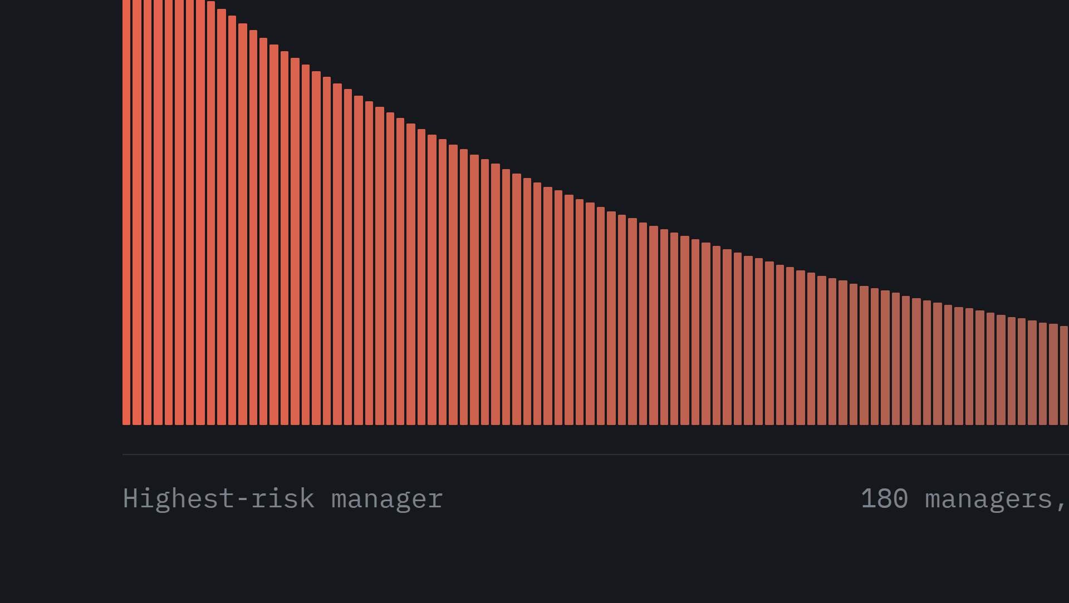
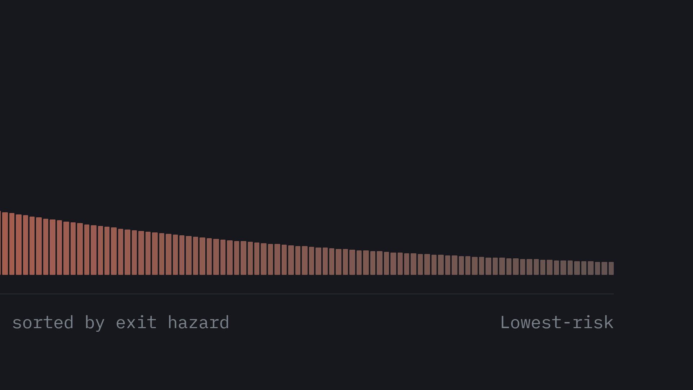
Notes:
Centerpiece. Each bar is one manager, sorted by exit hazard. Zero of 500 permutations reached the observed variance.

Slide 5
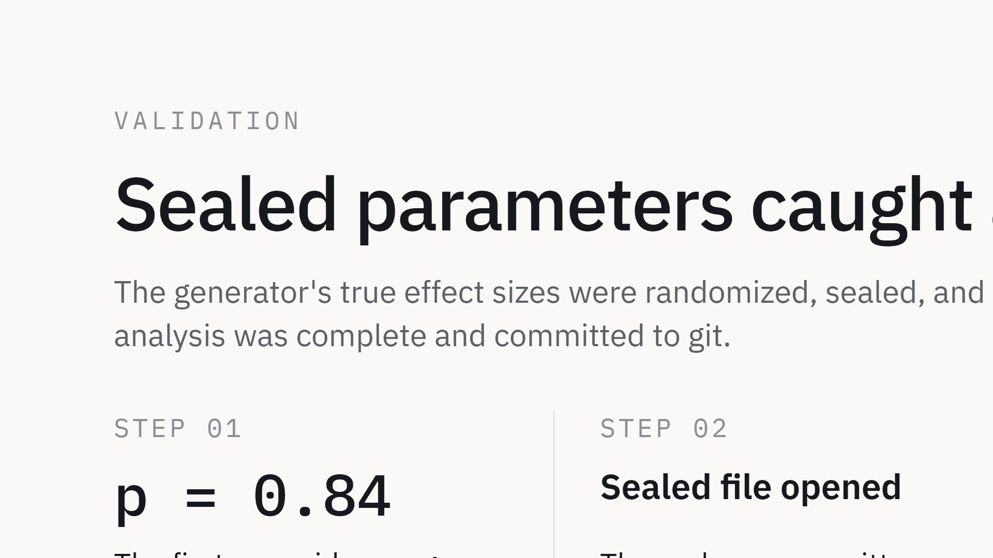
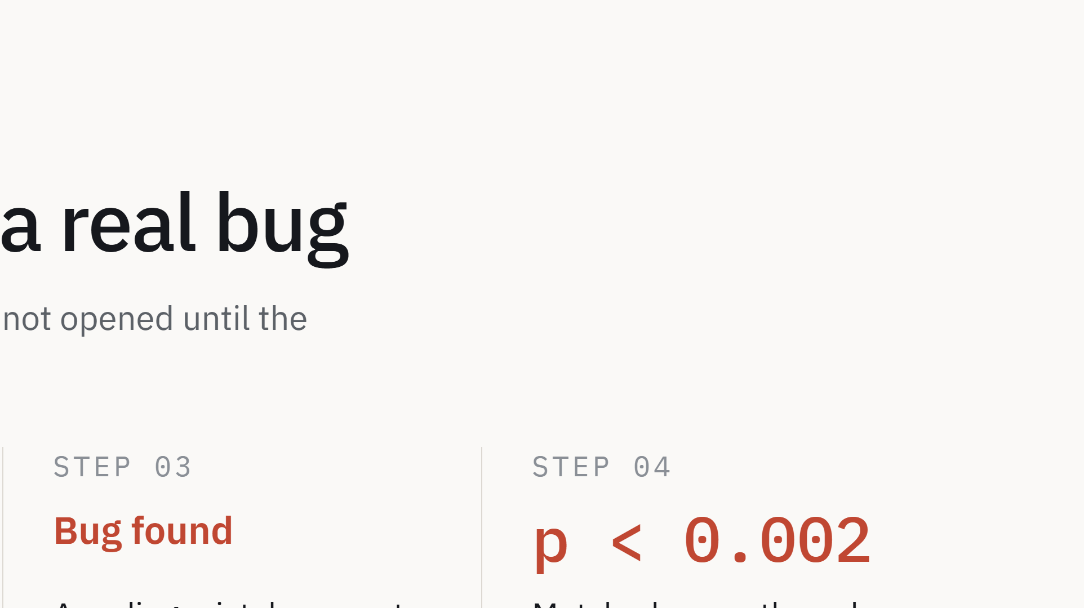
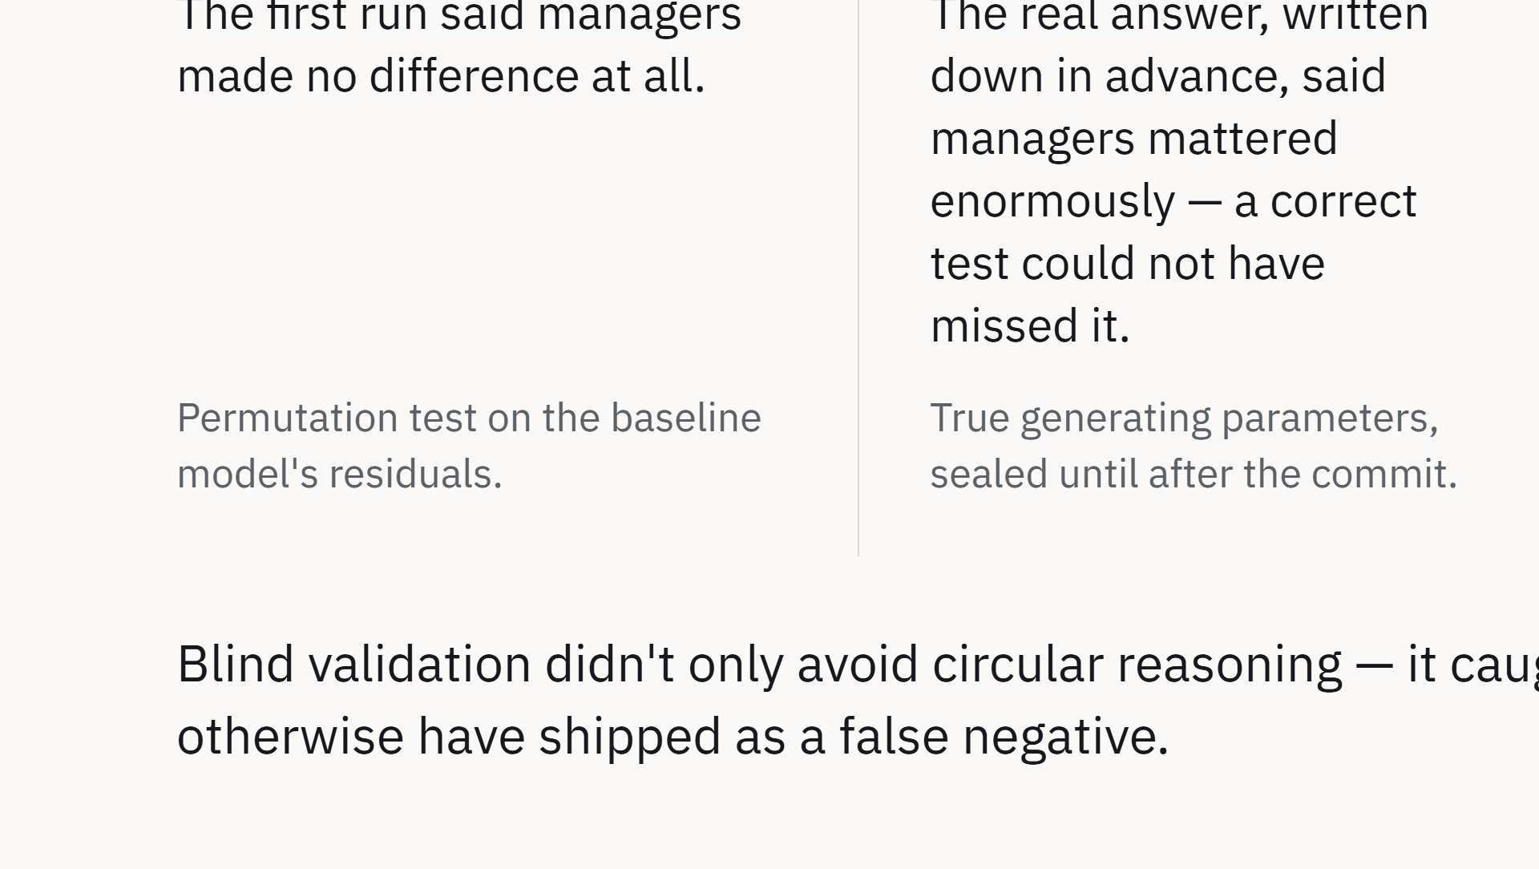
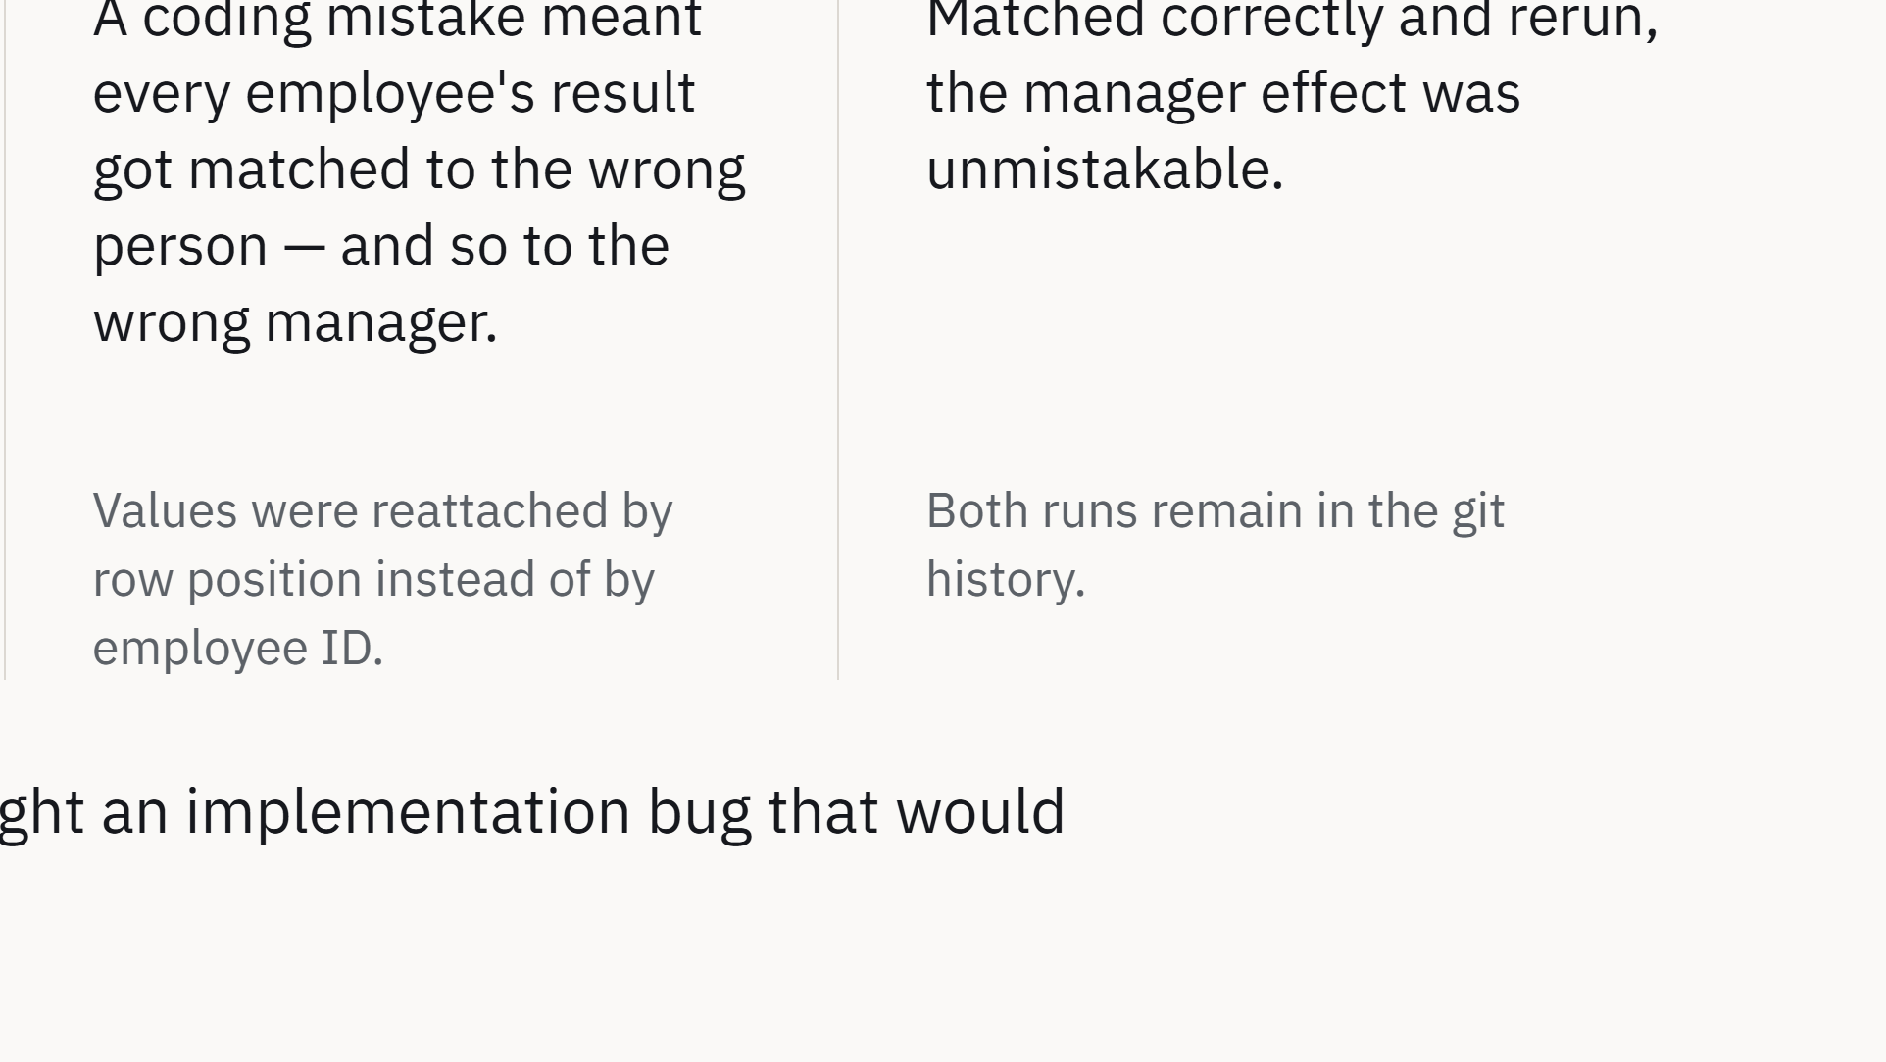
Notes:
The differentiator. Blind validation wasn't just anti-circularity hygiene — it caught a positional-alignment bug that would have shipped as a false negative.

Slide 6
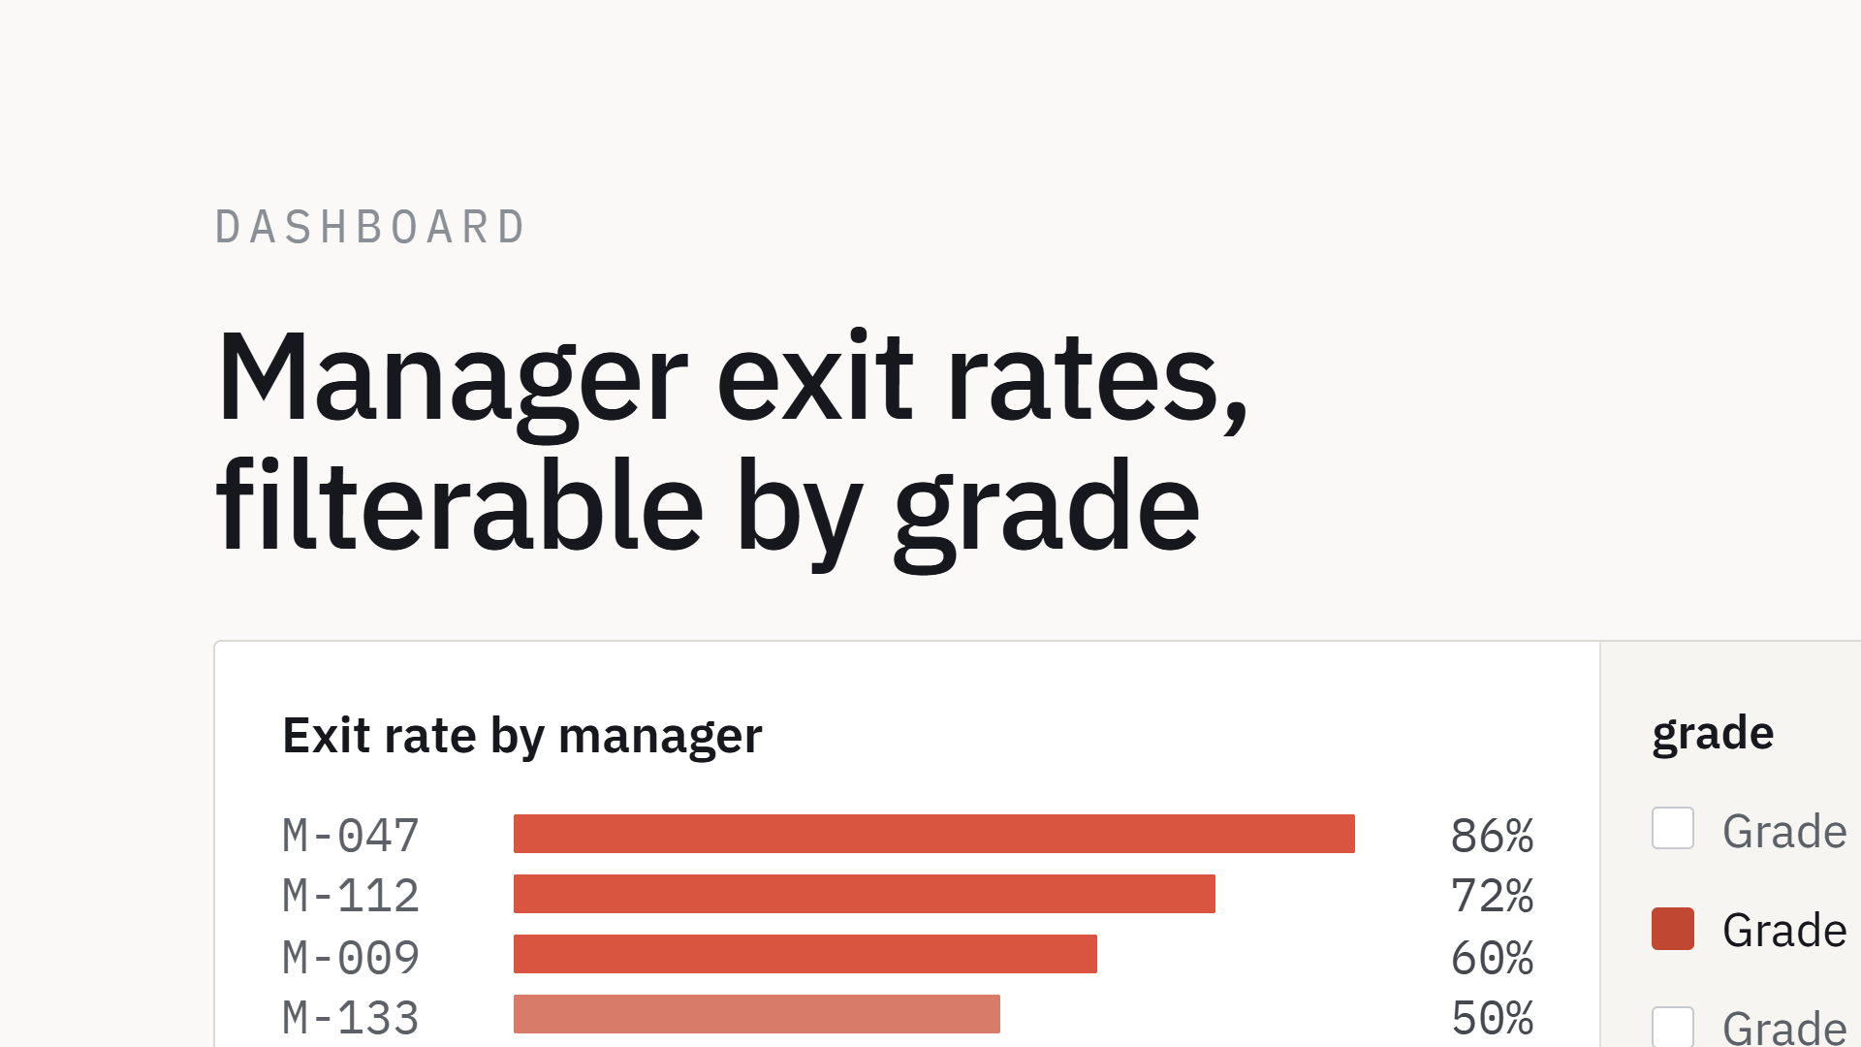
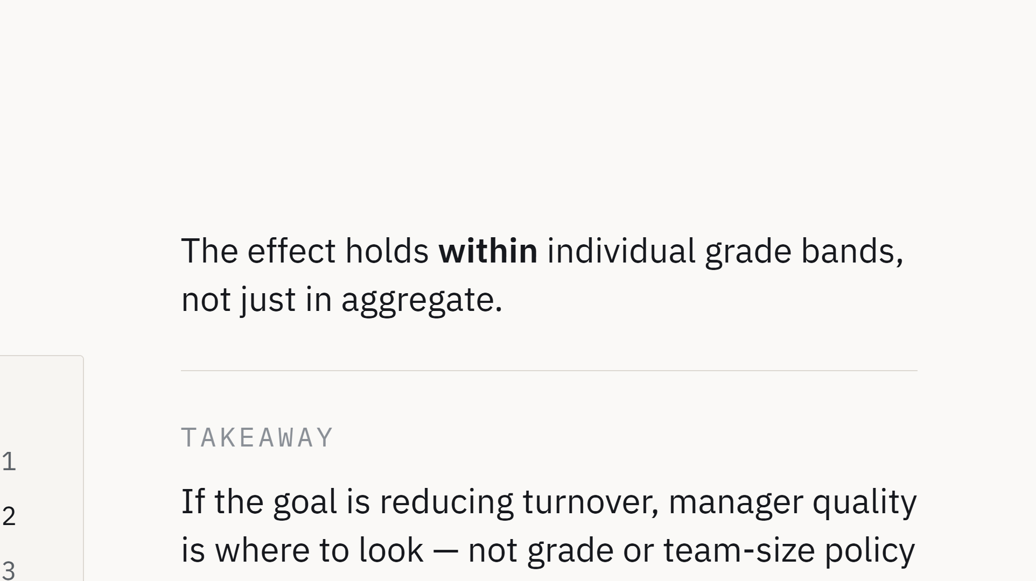
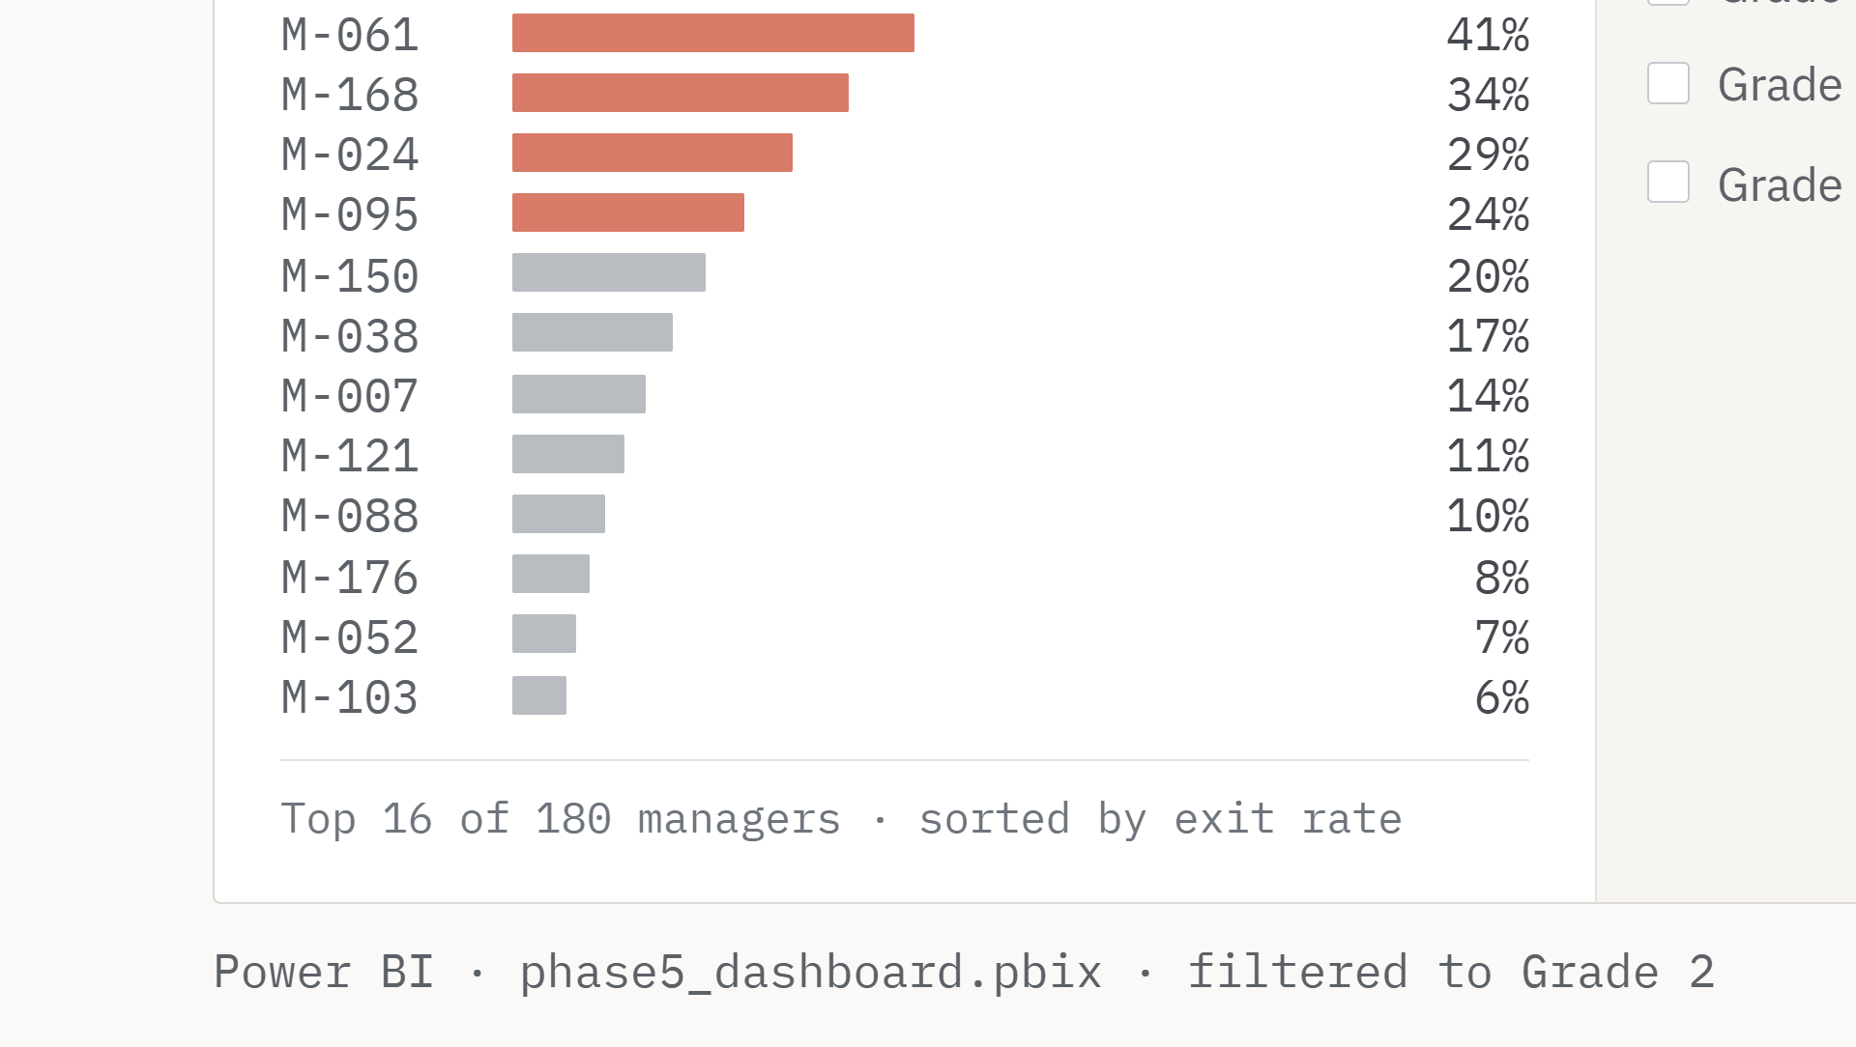
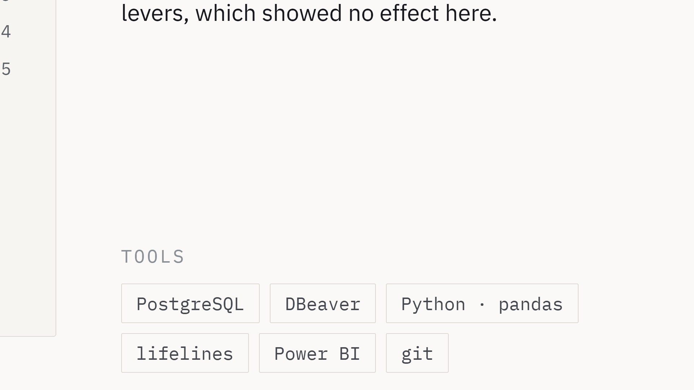
Notes:
Power BI is new in this portfolio. The grade filter is the point: the manager effect holds inside individual grade bands, not only in aggregate.

