Slide 1
Deep Learning Based Fear & Greed Index Prediction
CENG 476 - Introduction to Deep Learning
Tarık Kızıltan-200444020
Kasım Berke Ünver -200444021

Slide 2
Predicting synthetic "Crypto Fear & Greed Index" using historical market data.
Financial markets are non-linear and volatile.
Accurate sentiment prediction aids in risk management.
Time-Series Regression (Predicting a score between 0-100).

Slide 3
Bitcoin & Gold Daily Closing Prices
Input Features (13 Total):
Price Momentum (1-day, 7-day returns)
Volatility (Rolling standard deviation)
Cross-Asset Ratios (BTC/Gold ratio)

Slide 4
Synthetic Target
Instead of using pre-labeled data, we engineered a custom target variable based on momentum divergence between assets.

Slide 5
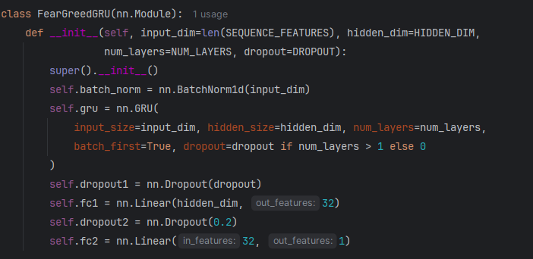
Model Architecture
Core Model: GRU (Gated Recurrent Unit)
Why GRU? Computational efficiency over LSTM, better at capturing long-term dependencies than simple RNNs.

Slide 6
Architecture Flow
Input Normalization: Batch Normalization (Stability)
Recurrent Layer: GRU (Hidden Dim: 64)
Regularization: Dropout (0.3)
Hidden Layer: Linear (32) + ReLU
Output: Linear (Regression)

Slide 7
Training Strategy
Data Splitting: Chronological Split (70% Train / 15% Val / 15% Test).
Reason: Preventing Data Leakage
Optimizer: AdamW.
Scheduler: ReduceLROnPlateau (Reduces LR by 0.5 if loss stalls).
Early Stopping: Patience = 30 epochs.

Slide 8
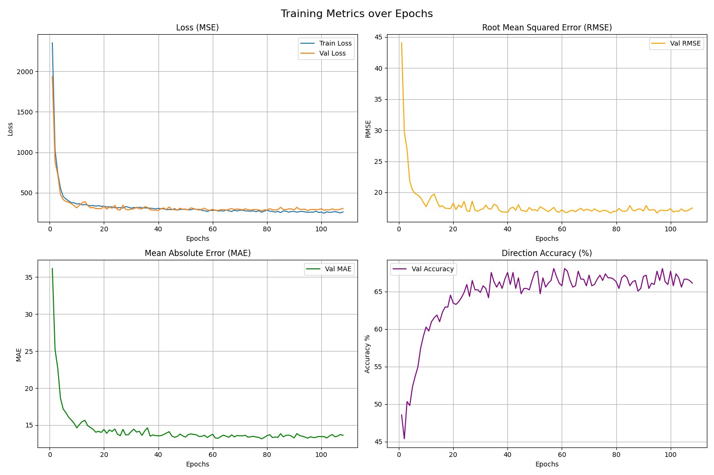
Results
Key Metrics (Test Set):
R² Score: 0.65 (Beats Baseline significantly).
Direction Accuracy: 67.79% (Predicts Up/Down correctly).
RMSE: 17.04a
Observation:
Training and Validation loss converge together (No Overfitting).
Direction accuracy improves consistently over epochs.

Slide 9
Creativity & Originality
Synthetic Target Engineering: Creating a domain-specific target variable rather than using raw prices.
Custom Metric: Implementing "Direction Accuracy" to measure financial utility beyond standard regression errors.

Slide 10
Conclusion
Summary: Successfully implemented a GRU model with 0.65 R² score.
Key Takeaway: Deep Learning (GRU) outperforms statistical baselines in capturing market sentiment.

Slide 11
Thank you for listening.
Tarık Kızıltan-200444020
Kasım Berke Ünver-200444021

