Slide 1

COURSE
MENG442 — Solar Energy Engineering
PV System Design for a Workshop Building
STUDENTS
Tariq Tarik Daniel Adebayo
INSTITUTION
Eastern Mediterranean University
TERM
Spring 2025–2026
Department of Mechanical Engineering · Project Presentation
01

Slide 2

PROJECT OVERVIEW
Design a rooftop PV system that can satisfy the workshop’s annual electricity demand.
Engineering objective
Solar context
The project models a three-story workshop building in DesignBuilder, estimates its annual electrical load, sizes a photovoltaic array, and checks whether the selected inverter can safely support the final PV configuration.
Famagusta, North Cyprus offers favorable conditions for solar integration because of strong solar availability and extended sunshine duration. Local weather data was therefore used to represent realistic annual performance.
150,000
3
19°
kWh/year project demand target
building levels: basement, ground floor, first floor
building orientation west of true north
02

Slide 3

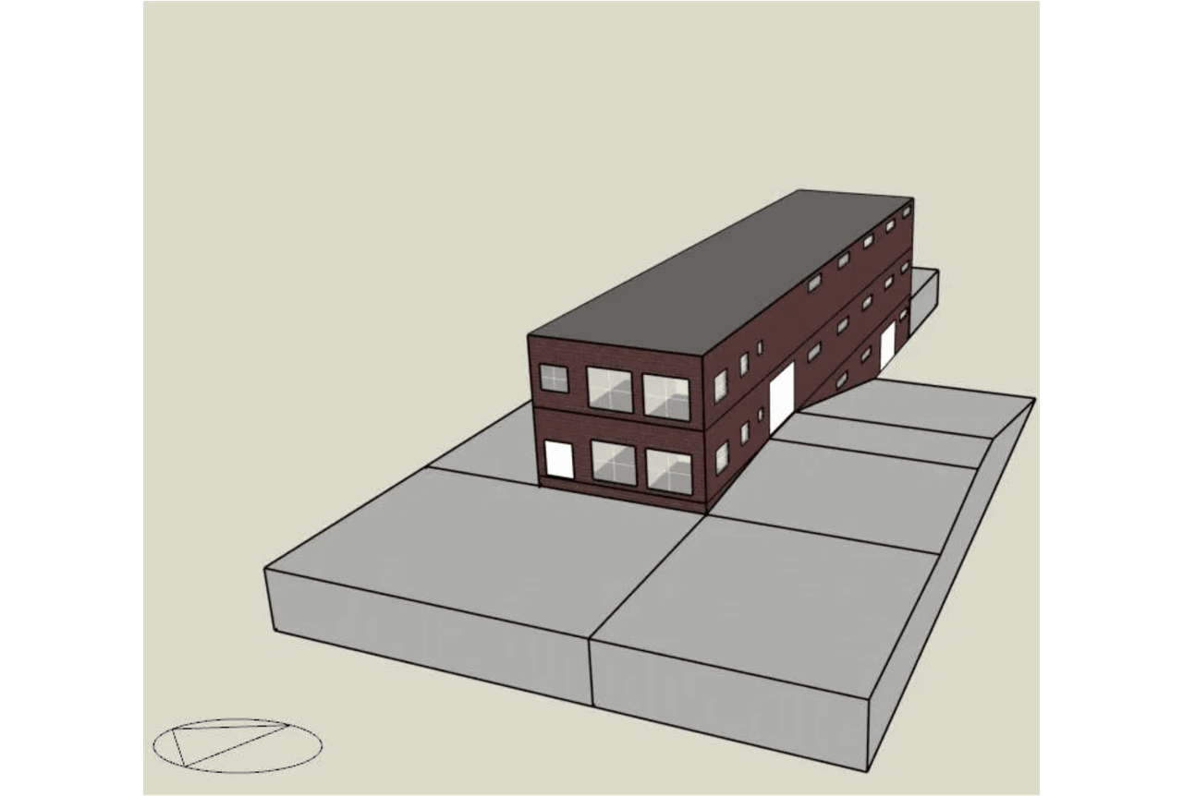
BUILDING MODEL
DesignBuilder model captures the workshop geometry and operating zones.
Model workflow
AutoCAD drawings were converted to DXF and imported into DesignBuilder.
Zone count
9 basement zones, 14 ground-floor zones, and 14 first-floor zones.
03

Slide 4
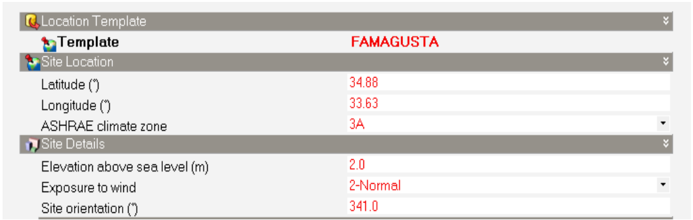
LOCATION TEMPLATE
Famagusta location details on DB
04

Slide 5

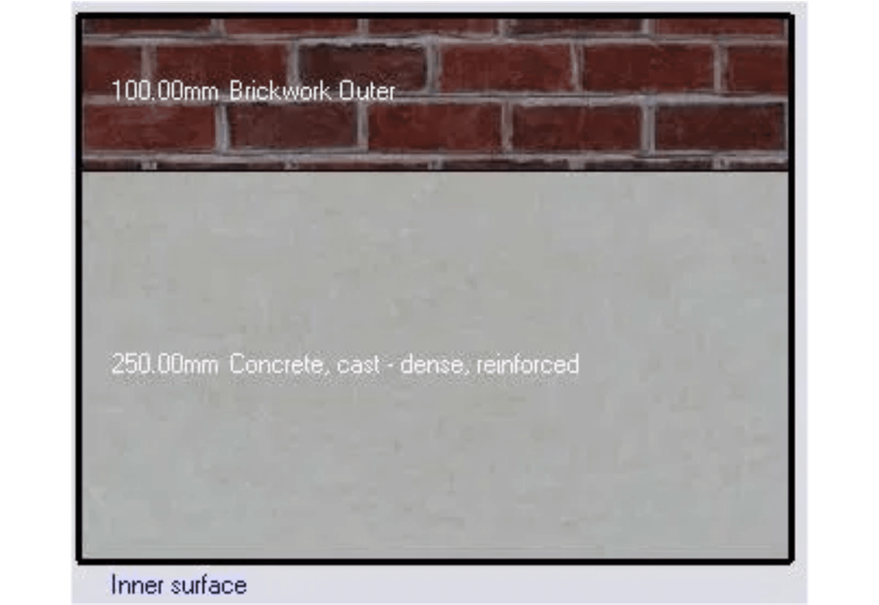
SIMULATION PARAMETERS (1/2)
Building Activity and Construction Materials
Construction
Reinforced concrete frame (0.25m) and brickwork outer walls (0.1m) provide the necessary thermal mass for accurate energy simulation.
05

Slide 6

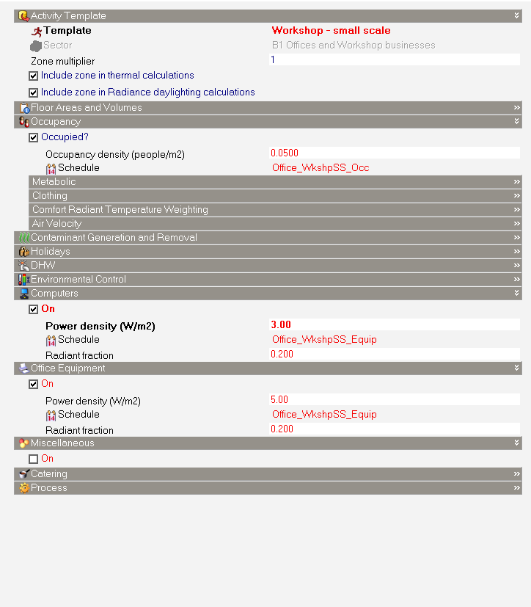
SIMULATION PARAMETERS (2/2)
Activity Tab
Activity template
– Workshop – small scale
Computers & office equipment
Power density of the office equipment was 5w/m² and computers power density was selected as 3w/m² . Some assumptions were made, that office computers are of 100W rated power and the area of each computer occupies was assumed
06

Slide 7
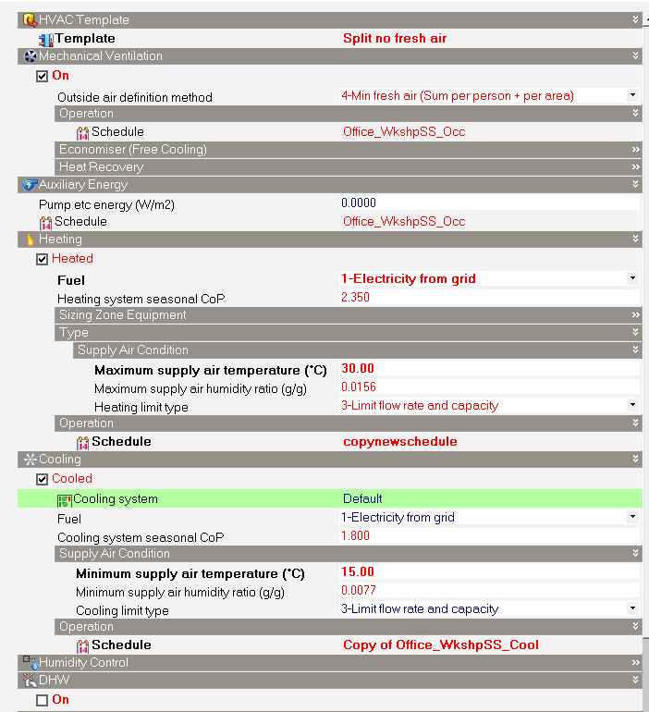
SIMULATION PARAMETERS (2/2)
Lighting and HVAC System Settings
HVAC Template
Split no fresh air
HVAC & Ventilation
Split system (no fresh air) with mechanical ventilation. Heating and cooling schedules are set to maintain 15°C to 30°C range.
07

Slide 8

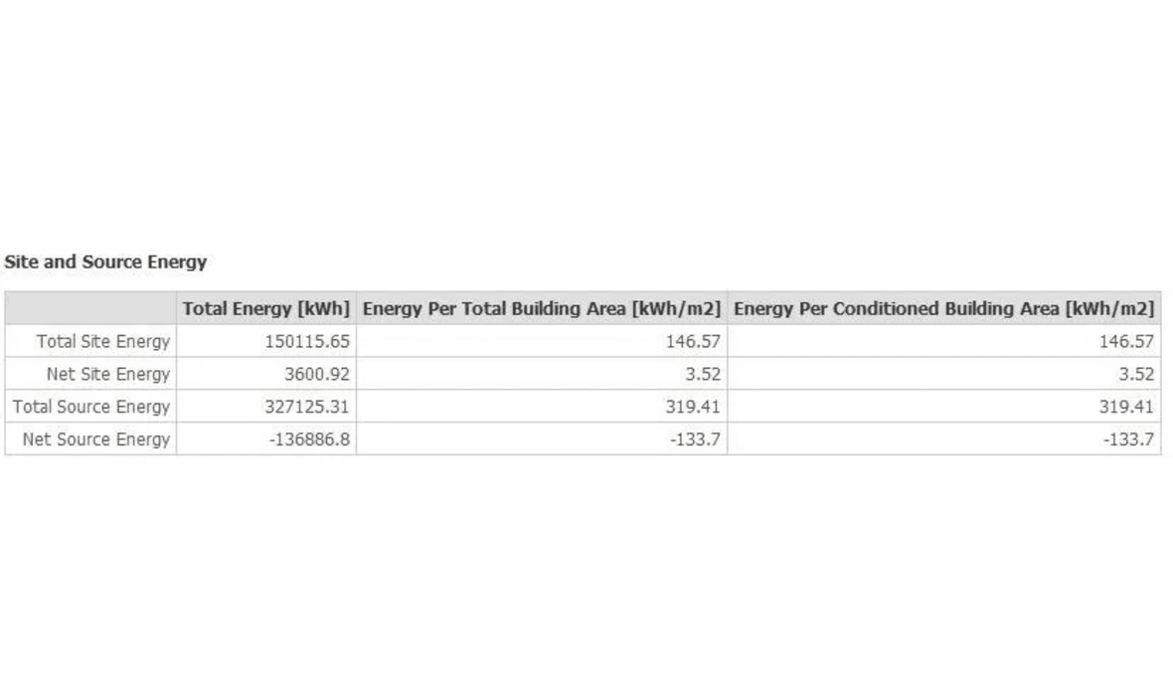
BASELINE ENERGY DEMAND
DesignBuilder simulation confirms building meets the project target.
ANNUAL ELECTRICITY CONSUMPTION
150,115kWh/year
Requirement Alignment: The result is within 0.1% of the 150,000-kWh project target.
Seasonal Variation: Cooling demand peaks in August; heating demand dominates from October to April.
Base Load: Lighting and equipment power remain consistent throughout the operating year.
08

Slide 9

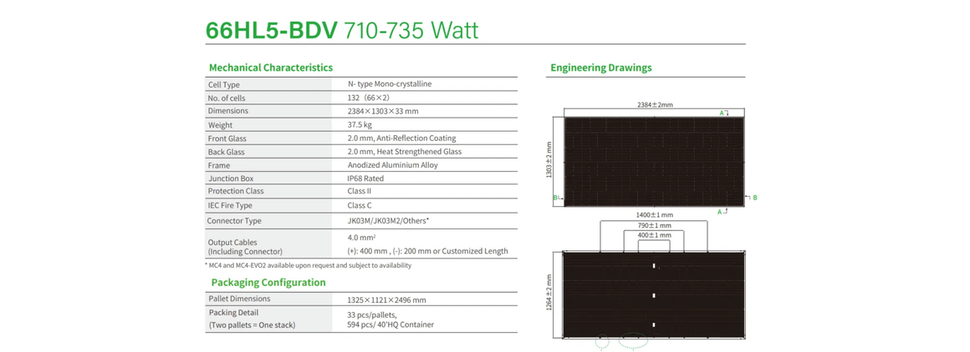
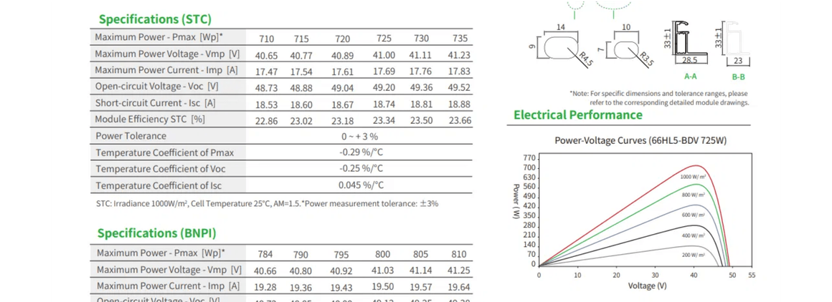
Module selection
MANUFACTURER
JinkoSolar
MODEL
TigerNeo 66HL5-BDV
RATED OUTPUT
735 W (at STC)
EFFICIENCY
23.66%
CELL TYPE
N-type Mono-crystalline
WEIGHT
37.5 kg
The selected module features bifacial technology with dual glass, providing superior durability and performance in the high-irradiance Mediterranean environment of Famagusta.
09

Slide 10

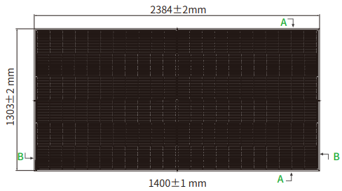
MODELING METHODOLOGY
DesignBuilder: Equivalent One-Diode Configuration
PERFORMANCE TYPE
Equivalent One-Diode
Simulation Strategy
RATED ELECTRIC POWER (PMAX)
735 W
The Equivalent One-Diode model was chosen for its high accuracy in simulating N-type bifacial modules under real-world Cyprus weather conditions.
CELLS IN SERIES
132 (66×2)
ACTIVE AREA (PER MODULE)
2.8 m²
SHORT CIRCUIT CURRENT (ISC)
18.88 A
Active area
OPEN CIRCUIT VOLTAGE (VOC)
49.52 V
Active area was assumed to be 90% of the area of a single panel.
CURRENT AT MAX POWER (IMPP)
17.87 A
VOLTAGE AT MAX POWER (VMPP)
41.13 V
TEMP. COEFF. OF ISC
+0.046 %/°C
TEMP. COEFF. OF VOC
-0.25 %/°C
10

Slide 11

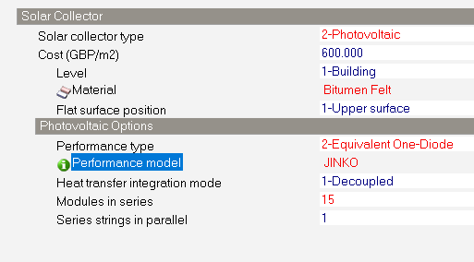
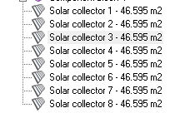
Panel modeling on DB
The system was configured as a single string of 15 in series and modelled accordingly on DB.
Area of one panel = 2.384 x 1.303 = 3.11 m²
Area of 15 panels = 3.11 x 15 = 46.6 m²
11

Slide 12
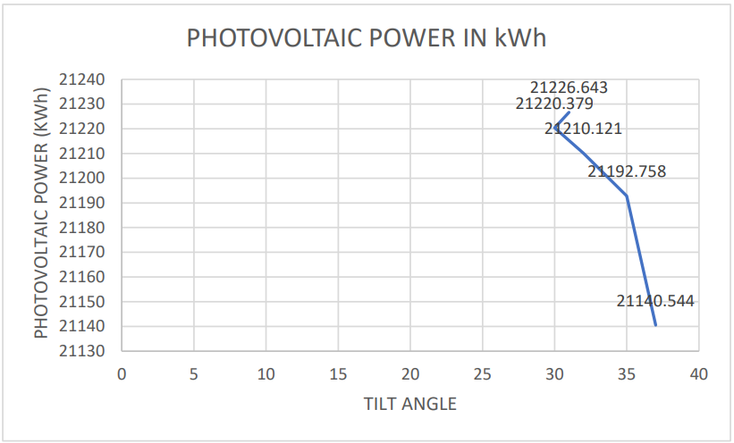
Iterative simulation identifies the optimum tilt angle for Famagusta.
Methodology
Multiple simulations were performed using a single string of 15 panels to evaluate performance across a range of tilt angles.
Comparison
Tilt angles from 30° to 37° were tested, with performance decreasing as the angle deviated from the peak.
31° Tilt
Optimum angle yielding 21,226.6 kWh/year per string
12

Slide 13

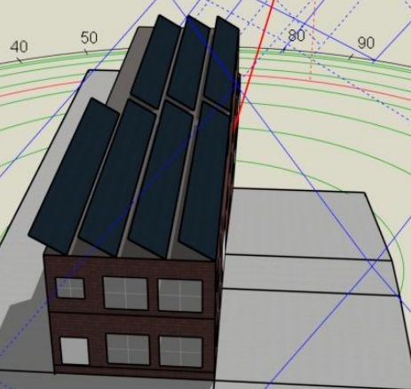
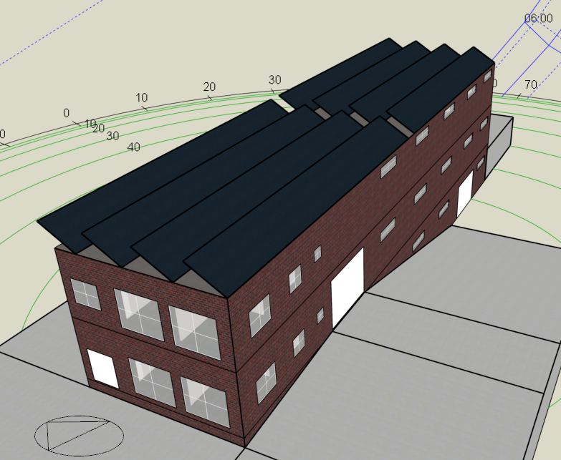
Iterative sizing ensures the PV array meets the building demand.
Case 1: Seven Strings
7 parallel strings generated 135,673 kWh/year, failing to satisfy the workshop's electrical needs.
Case 2: Eight Strings
8 parallel strings generated 154,226 kWh/year, providing a safe margin over the building demand.
120 Panels
Final Array Configuration (15 in series × 8 in parallel)
13

Slide 14

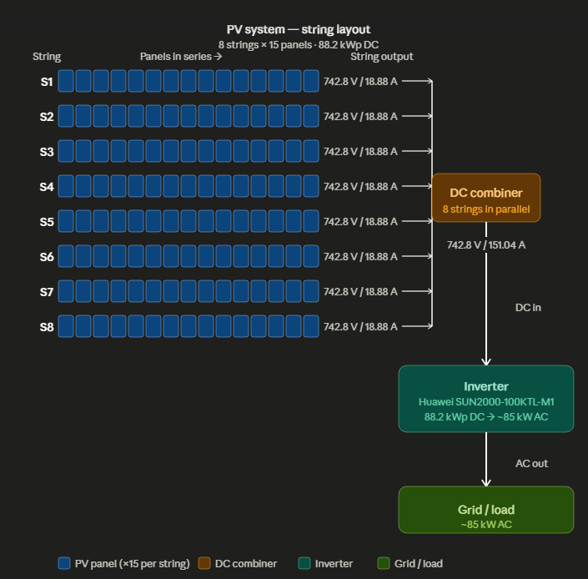
ELECTRICAL CONFIGURATION
System Schematic and Technical Calculations
STRING VOLTAGE (VOC)
15 Panels × 49.52 V = 742.8 V
Total string voltage is well within the 1000V inverter limit.
ARRAY CURRENT (ISC)
8 Strings × 18.88 A = 151.04 A
Total current is distributed across the MPPT trackers.
14

Slide 15


INVERTER COMPATIBILITY
Huawei Smart PV Controller supports the calculated array load.
Voltage Range Check
Array Voc of 742.8 V is well within the inverter's MPPT operating range of 200 V – 1000 V.
Current Limit Check
Max Isc per MPPT is 37.76 A (2 strings), staying below the inverter's 40 A limit.
MPPT Utilization
The inverter provides 10 MPPTs; our 8-string design efficiently utilizes 4 trackers.
Efficiency Rating
The Huawei SUN2000-100KTL-M1 offers a maximum efficiency of 98.8%.
15

Slide 16
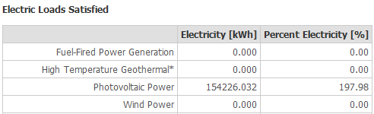
Final results
ANNUAL BUILDING DEMAND
150,115kWh/year
ANNUAL PV GENERATION
154,226kWh/year
102.7%
Annual Electricity Demand Coverage
16

Slide 17

THANK YOU
QUESTIONS & DISCUSSION
PRESENTERS
DEPARTMENT
Tariq Tarik & Daniel Adebayo
Mechanical Engineering, EMU
17

