Slide 1
Exploration, Visualisation and Functional Interpretation
Day 3 — Transcriptomics Summer School, Sarajevo

Slide 2
Block 1 — Exploratory analysis is quality control

Slide 3
Yesterday you produced a table. Today: is it real?
You have 4,000 genes at FDR < 0.05. Three questions, in this order:
Do the samples group the way the design says they should?
Is there structure in the data that is not in my model?
What is the biology?
Most people skip to 3. Questions 1 and 2 are where the retractions live.

Slide 4
Never test before you look
The order of operations that avoids most disasters:
count matrix
↓
transform for visualisation (vst / rlog)
↓
PCA, sample-distance heatmap, clustering ← LOOK HERE FIRST
↓
decide the model (do I need a batch term?)
↓
fit, test, extract results
↓
figures and functional interpretation
Yesterday we went straight to the model because you needed to see DESeq2 work. In your own projects, exploratory analysis comes first.

Slide 5
Transform first — but not for the test
Raw and normalised counts have variance that depends on the mean, so distance-based methods (PCA, clustering, correlation) would be dominated by the few most-expressed genes.
vsd <- vst(dds, blind = FALSE) # fast, good for n > 10
rld <- rlog(dds, blind = FALSE) # better for small n, slower
blind = FALSE means “use the design when estimating the trend”. Use blind = TRUE only for an unsupervised QC look where you want the transformation to know nothing about your groups.
Never feed vsd/rld back into DESeq().

Slide 6
PCA: what it does
You have 16,000 genes × 8 samples. PCA finds new axes — linear combinations of genes — ordered so that:
PC1 captures the largest share of variance across samples
PC2 the largest share of what remains, and is uncorrelated with PC1
and so on
Each sample gets a coordinate on each PC. Plotting PC1 vs PC2 shows you the dominant structure in the data in two dimensions.
In practice: use the top ~500 most variable genes, on the transformed scale.
plotPCA(vsd, intgroup = c("condition", "batch"))

Slide 7
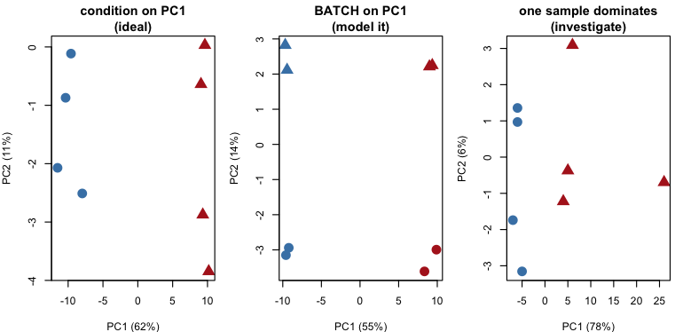
PCA: what to look for

Slide 8
PCA: what it is not
PC1 is not “the treatment effect”. PCA is unsupervised. It finds the biggest variance, whatever that is — often RNA quality, dissection depth, or sex.
Small percentages are not “no effect”. A real 500-gene response can sit on PC3 at 4% while PC1 is donor identity at 50%.
Distances on the plot are only meaningful in the plotted plane. Two samples that look close may be far apart on PC3.
Adding more genes does not make it more accurate. The top-variance gene subset is a deliberate denoising step.
Always check: how much variance do PC1 and PC2 actually explain? And plot PC3/PC4 as well.

Slide 9
Sample-distance heatmap
Compute pairwise Euclidean distance between samples on the transformed scale, cluster, and plot.
This catches things PCA hides:
swapped labels — a “control” sitting inside the treated block
a pair of samples that are suspiciously identical — the same library sequenced twice by mistake
nested structure — samples clustering by donor first, condition second (which tells you the paired design is the right one)
Use this and PCA together. They fail differently.

Slide 10
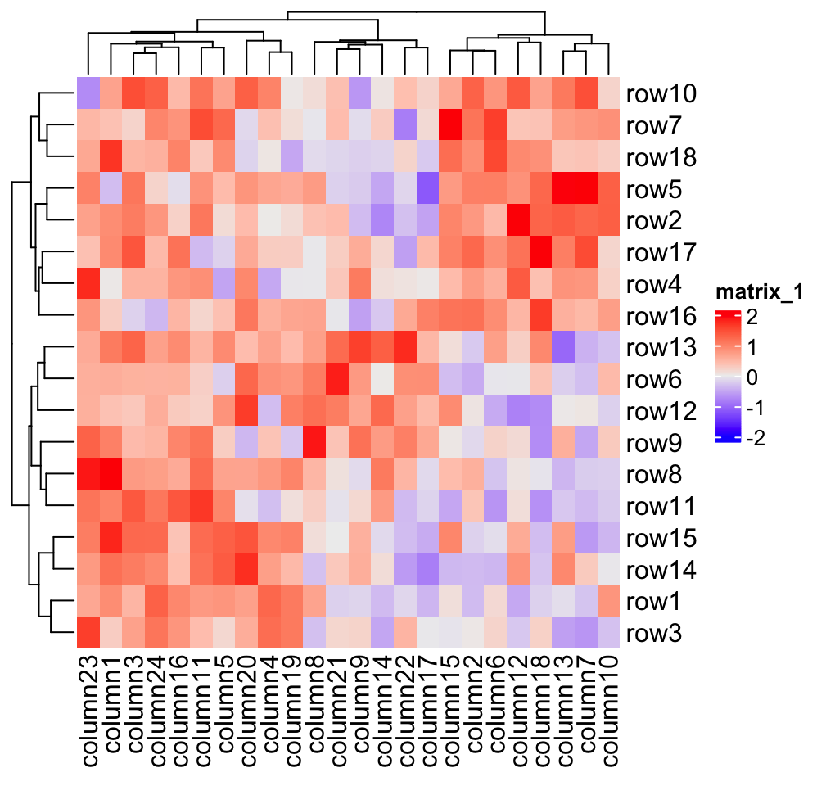
Sample-distance heatmap

Slide 11
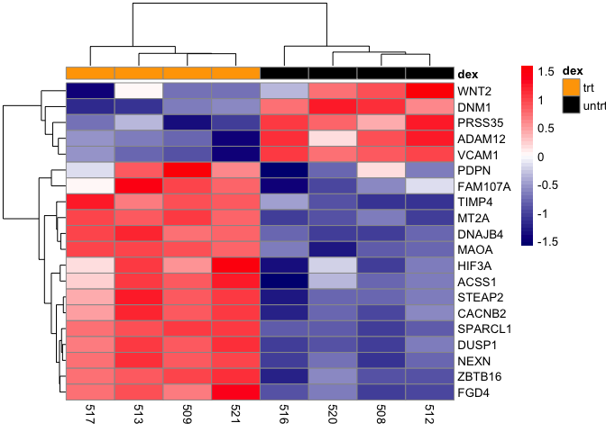
Sample-distance heatmap

Slide 12
Heatmaps
Use a diverging palette centred on zero for scaled data (blue–white–red). Use a sequential palette for unscaled data. A rainbow palette creates boundaries that are not in the data.
Cluster genes and think before clustering samples. Clustering samples on selected genes is circular (previous slide).
Annotate the columns with condition and batch. An annotation bar showing that your clusters are batches saves you months.

Slide 13
Heatmaps - One of the more misleading figures
A heatmap of the significant genes, rows scaled, samples clustered, showing a beautiful split between your groups.
It always looks like that. You selected those genes because they differ between the groups. The heatmap is a picture of your selection criterion, not evidence.
It is fine as an illustration. It is not evidence of anything, and it cannot be used to argue that a cluster of samples is “real”.
If you want a heatmap that carries evidence, use the top variable genes (selected without reference to the groups), not the top significant genes.

Slide 14
Block 2 — Figures that survive review

Slide 15
Volcano plots
Plot −log₁₀(raw p) on the y axis but set the significance colour by padj. Mixing the two silently is common and misleading.
Label 5–20 genes, not 200. A labelled volcano with 200 genes communicates nothing.
Draw the thresholds you actually used and state them in the legend.
Do not truncate the axes without saying so — a gene at p = 10⁻³⁰⁰ pushed to the top of the plot looks like an artefact because it often is one (usually a single-sample outlier).
If you used lfcThreshold, say so: the vertical lines then mean something statistical rather than decorative.

Slide 16
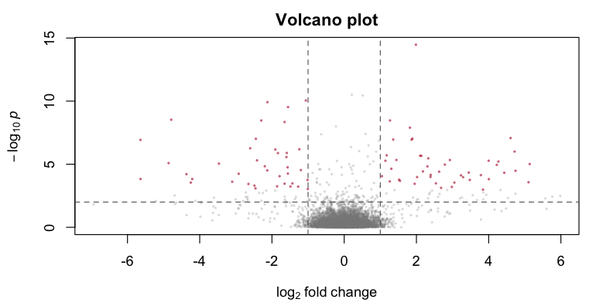
Volcano plots
x = log2 fold change, y = −log₁₀(p).

Slide 17
MA plot
x = mean expression, y = log2 fold change, colour = significance.
Answers: is the cloud centred on zero (normalisation sane)? Is the fold-change range plausible? Are hits spread across the expression range or only at high expression (a power issue)?
Use shrunken fold changes. Unshrunk MA plots have a noise fan at the left that hides everything else.

Slide 18
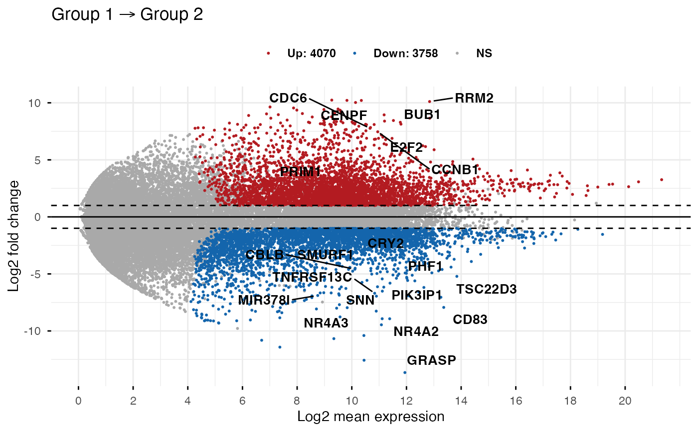
MA plot

Slide 19
Counts plots for individual genes
The least fashionable and most useful figure in the set.
For any gene you plan to discuss in the text: plot its normalised counts for every sample, grouped by condition, on a log scale, with each replicate visible as a point.
What it catches:
one outlier sample driving a “significant” gene
a gene where all counts are 5–30, so the fold change is real but the biology is probably irrelevant
a paired design where every donor moves in the same direction (very convincing) versus two up and two down (not)
Reviewers ask for these. Make them first.

Slide 20
Figure hygiene checklist
Axis labels with units and the transformation stated (log2, vst)
Sample size in the caption or the panel
The statistical test and the threshold, in the caption
Colour-blind-safe palette (viridis, or RColorBrewer::brewer.pal with colorblindFriendly = TRUE)
Vector format (PDF/SVG) for line art; 300+ dpi PNG otherwise
Readable at the size it will be printed — check by printing it
Every figure generated by a script, never edited by hand

Slide 21
Block 3 — Functional interpretation

Slide 22
The problem
You have 800 significant genes. Nobody can read 800 gene names and form a hypothesis.
You want to say: “genes involved in the inflammatory response are coordinately upregulated”. That requires
a vocabulary of gene functions, and
a statistical test for whether your list is unusually full of some category.

Slide 23
Gene Ontology: the vocabulary
Three separate ontologies:
BP — Biological Process: inflammatory response, mitosis
MF — Molecular Function: ATP binding, kinase activity
CC — Cellular Component: mitochondrial matrix, nucleolus
Structure: a directed acyclic graph, not a tree. Terms have parents and children; a term can have several parents. Regulation of T cell activation is a child of both regulation of lymphocyte activation and T cell activation.
The true-path rule: a gene annotated to a term is implicitly annotated to all its ancestors. This is why enrichment results are so redundant.

Slide 24
GO evidence codes — annotations are not equal
Every GO annotation carries a code saying where it came from:
EXP, IDA, IPI, IMP, IGI — experimental. Reliable.
ISS, ISO, ISA, IBA — inferred from sequence similarity.
IEA — Inferred from Electronic Annotation. No human ever checked this. The large majority of annotations for most species.
ND — no data.
Consequences: well-studied genes have many more annotations than obscure ones, and the ontology’s structure reflects what has been studied, not what exists. Immune and cancer terms are dense; almost everything else is sparse.

Slide 25
Other databases
KEGG — curated pathway maps. Fewer, larger, more mechanistic terms. Good for metabolism and signalling. Licence restrictions on bulk download.
Reactome — curated, hierarchical, well-maintained, human-centred but with orthology projections. Often more interpretable than KEGG.
MSigDB — collections rather than one ontology: H hallmark (50 well-curated, non-redundant sets — start here), C2:CP canonical pathways, C5 GO, C7 immunologic, C8 cell types.
WikiPathways, Gene Ontology slims, CORUM (complexes), TF target sets (ChEA, DoRothEA).
Different databases give different answers. Report which you used and its version.

Slide 26
Over-representation analysis (ORA)
The question: among my 800 significant genes, are there more “inflammatory response” genes than I would expect by chance?
A 2 × 2 table:
 | in GO term | not in term
in my list | k = 25 | 775
not in list | 320 | 14,880
Test with the hypergeometric distribution (= one-sided Fisher’s exact test): given 345 term genes among 16,000, how surprising is 25 in a draw of 800?

Slide 27
ORA: the background set is the analysis
The denominator is not “all genes”. It is all genes that could have been detected in your experiment — i.e. the genes that survived filtering and were actually tested.
Using all ~20,000 annotated genes as background when you tested 14,000 creates enrichment for anything expressed in your tissue at all. In a brain experiment you will “discover” that your gene list is enriched for neuronal terms. It is: so is every gene you could have detected.
enrichGO(gene = sig_genes,
universe = all_tested_genes, # <- NOT NULL, NOT all of GO
...)
This single argument is the most common error in published enrichment analyses.

Slide 28
ORA: other assumptions you are making
Independence between genes. False: genes in a pathway are co-regulated, so the effective number of independent observations is much smaller than k. p-values from ORA are anti-conservative.
Equal detection probability. False: long and highly expressed genes have more power in RNA-seq, and they are not randomly distributed across GO terms (GOseq corrects for length bias).
The threshold is meaningful. A gene at padj = 0.049 is in; one at 0.051 is out. Move the threshold and your enrichment changes.
Terms are independent. False, by construction — the true-path rule guarantees nested terms.

Slide 29
Gene Set Enrichment Analysis (GSEA)
Remove the threshold entirely.
Rank all tested genes by a statistic — shrunken log2FC, or -log10(p) × sign(LFC)
The enrichment score is the maximum deviation from zero
Normalise for set size (NES)
A pathway where every gene moved 1.3-fold — none individually significant — is invisible to ORA and strongly significant in GSEA.

Slide 30
ORA vs GSEA — when to use which
 | ORA | GSEA
Input | a gene list | all genes, ranked
Needs a threshold | yes | no
Detects many small coordinated changes | no | yes
Detects a few huge changes | yes | sometimes not
Direction of change | must split up/down yourself | built in (NES sign)
Interpretability | very high | high
Sensitive to background choice | critically | less so
If you have hundreds of hits: run both. They answer different questions and disagreeing is informative. If you have 12 hits: ORA is underpowered — use GSEA. If you have zero hits: GSEA can still find coordinated shifts.

Slide 31
What enrichment analysis cannot tell you
Direction of causality. An enriched “cell cycle” term does not mean your treatment targets the cell cycle; it may be a downstream consequence of cells dividing less.
Mechanism. Co-regulation is not a pathway.
Anything about unannotated genes. In a non-model organism, a large fraction of your genes have no annotation and are silently discarded. If 60% of your DE genes are unannotated, your enrichment result describes the annotated 40% only — say so.
Novelty. Well-studied terms win because they have more annotations.

Slide 32
This afternoon
Day3_BulkRNAseq_Downstream/scripts/03_visualization_pathways.R
VST transform; PCA (PC1–PC4); sample-distance heatmap
Volcano plot with labelled genes
Heatmap of top variable genes and top significant genes — compare, and discuss why one is evidence and the other is not
GO over-representation, up and down separately, with the correct background
Redundancy reduction and a term-similarity network
GSEA on the ranked list, with the hallmark collection
Assemble a multi-panel figure

Slide 33
Useful links
G:Profiler - https://biit.cs.ut.ee/gprofiler/gost - Gene ontology analysis quick and dirty
Ensembl - https://www.ensembl.org - Database for genomes and genes
NCBI - https://www.ncbi.nlm.nih.gov – US equivalent to Ensembl
string - https://string-db.org/cgi/input?sessionId=bCx7XL107mj8&input_page_show_search=on – database for protein interactions

