Slide 1
Single-Cell RNA-seq: Technology and Preprocessing
Day 4 — Transcriptomics Summer School, Sarajevo

Slide 2
Block 1 — Why single cell, and what it costs

Slide 3
What bulk cannot tell you
You measure a tissue and find Gene X up 2-fold. Four explanations, indistinguishable in bulk:
Every cell increased Gene X 2-fold
Half the cells increased it 4-fold, half did nothing
A cell type that expresses Gene X highly doubled in abundance
A new cell state appeared that did not exist before
Explanation 3 is the most common, and it is a composition change, not a regulation change. Bulk cannot distinguish regulation from composition. Single cell can.

Slide 4
The three questions single cell answers well
What cell types/states are here, and in what proportions? This is what scRNA-seq is genuinely best at.
What is happening inside one specific population? Especially a rare one — 2% of cells is invisible in bulk and is 1,000 cells in a 50,000-cell experiment.
What is the structure of a continuous process? Differentiation, activation, cell cycle. Cells caught at different points along a trajectory, which you can then order.

Slide 5
What it costs you
Statistical power per sample. You have 5,000 cells from one mouse. Your n is one. Cells are pseudo-replicates.
Sensitivity. 1,000–5,000 genes detected per cell versus ~20,000 in bulk. Transcription factors — low-expressed and interesting — are frequently undetected.
Money. Roughly 10–50× bulk per biological sample.
Live cells. No FFPE, no frozen tissue (though fixed and single-nucleus protocols exist and are improving fast).
The dissociation. You measure the cells that survived.

Slide 6
The design principle that gets violated most
Cells are not replicates. Donors are.
If you want to say “treatment changes expression in macrophages”, you need several independent animals per group and you should analyse them as pseudobulk — sum counts per cell type per animal, then run DESeq2 on that. (Friday morning.)
Treating 3,000 cells as n = 3,000 gives p-values around 10⁻⁵⁰ for essentially anything. Those numbers are not small; they are wrong. The technical term is pseudoreplication, and it is endemic in the published single-cell literature.

Slide 7
Minimum viable single-cell design
Goal | What you need
Describe cell types in a tissue | 1–2 samples is defensible
Compare proportions between conditions | ≥ 4–5 donors per group
DE within a cell type between conditions | ≥ 4–5 donors per group, pseudobulk
Find a rare population | depth of cells, not of donors
Trajectory within one sample | 1 sample, many cells
Multiplex if you possibly can. Cell hashing or genetic demultiplexing lets you load several donors in one lane, which removes the batch–condition confounding that otherwise ruins these experiments.

Slide 8
Block 2 — How the data are made

Slide 9
The three platform families
Droplet-based (10x Chromium, Drop-seq) Thousands–millions of cells, 3’ (or 5’) end only, UMI-based, ~1,000–3,000 genes/cell. The default for atlas and census work.
Plate-based (Smart-seq2/3, CEL-seq2) Hundreds of cells, full-length transcripts, higher sensitivity (5,000–10,000 genes/cell), isoform and allele information possible. Expensive per cell. Use when you need depth on few, selected cells.
Combinatorial indexing (sci-RNA-seq, Parse Evercode, 10x Flex) No droplets: cells are split and pooled through rounds of barcoding. Very high cell numbers, cheap per cell, works on fixed material.

Slide 10
10x Chromium, mechanically
Cell suspension, barcoded gel beads and oil meet in a microfluidic chip → GEMs (gel bead-in-emulsion droplets)
Loading is deliberately dilute: most droplets get zero cells. This is what keeps doublets rare.
Inside a droplet: the cell lyses, the bead dissolves, and poly-dT oligos capture mRNA
Reverse transcription attaches, to every cDNA molecule: cell barcode (16 bp, same across the bead) + UMI (12 bp, unique per molecule) + partial read-1 sequence
Emulsion broken, cDNA amplified, fragmented, sequenced
Read 1 = barcode + UMI; read 2 = the transcript’s 3’ end

Slide 11
Poisson loading and the doublet rate
Loading is a Poisson process. If $λ$ cells per droplet on average:
$$P(\text{2 or more cells})≈λ^{2}/2 \text{for small }λ$$
so the doublet rate scales roughly with the number of cells recovered:
Cells recovered | Doublet rate
1,000 | ~0.8%
5,000 | ~4%
10,000 | ~8%
20,000 | ~16%
Load more cells and you buy cells at the price of doublets. At 20,000 recovered cells, one in six “cells” is not a cell.

Slide 12
UMIs: counting molecules, not reads
PCR amplifies unevenly, by orders of magnitude. Without UMIs you cannot distinguish 10 molecules from 1 molecule amplified 10-fold.
With UMIs: collapse all reads sharing (cell barcode, UMI, gene) into one count. The matrix holds approximate molecule counts.
Practical consequences:
counts saturate: a gene cannot exceed the number of distinct UMIs
sequencing deeper stops adding information once UMIs are saturated (~20,000–50,000 reads/cell for 10x 3’)
the data are 3’-biased: no isoform information, and 3’ UTR annotation quality directly affects your counts

Slide 13
From FASTQ to matrix: Cell Ranger
FASTQ (R1 = barcode+UMI, R2 = cDNA)
↓ extract and correct cell barcodes against the known whitelist
↓ align R2 to the transcriptome (STAR)
↓ deduplicate UMIs per cell per gene
raw matrix — ~500,000 barcodes × 30,000 genes (mostly empty droplets)
↓ call cells (EmptyDrops / knee on the barcode-rank curve)
filtered matrix — ~3,000 cells × 30,000 genes ← where you start
Alternatives: STARsolo, alevin-fry, kallisto|bustools — faster, open, and give equivalent results.

Slide 14
Where do artefacts come from — 1: ambient RNA
Cells that lysed before encapsulation release mRNA into the suspension. Every droplet is filled with that soup.
Consequences:
empty droplets have non-zero counts (which is how EmptyDrops works: it tests against the ambient profile)
real cells get a background of transcripts they never expressed
you see haemoglobin in T cells, insulin in every pancreatic cell type, and the tissue’s dominant transcript everywhere
Correction: SoupX, CellBender, DecontX. Worth doing when one cell type dominates the tissue — always check for implausible markers before you believe them.

Slide 15
Where the artefacts come from — 2: doublets
Two cells, one barcode, one chimeric profile. A T-cell/monocyte doublet looks like a novel cell type expressing both programmes, and it will form its own cluster.
Detection: simulate artificial doublets from your own data and find cells that resemble them. DoubletFinder, scDblFinder, Scrublet.
Heuristics that help: doublets have high UMI counts and high gene counts, and co-express markers of two lineages.
A cluster co-expressing two lineage programmes is a doublet cluster until proven otherwise. This is the single most common false “novel cell type” in the literature.

Slide 16
Where the artefacts come from — 3: dying cells
Apoptotic and damaged cells leak cytoplasmic RNA. Mitochondrial transcripts are retained longer, so the mitochondrial fraction rises.
Typical thresholds — and they are organism- and tissue-dependent:
< 5% MT: common cut for cell lines and PBMCs
< 10–20%: tissues; heart and muscle are genuinely mito-rich
cardiomyocytes can be 30–40% mitochondrial while perfectly healthy
Never copy a threshold from a tutorial. Plot your distribution and choose from it.

Slide 17
Where the artefacts come from — 4: the dissociation itself
Enzymatic digestion at 37 °C for 30–60 minutes is a stress experiment.
Cells induce FOS, JUN, JUNB, EGR1, HSPA1A, HSPA1B, SOCS3 — a stress signature that is not in the tissue you sampled.
Mitigations:
cold-active protease (Bacillus licheniformis) at 6 °C
transcription inhibitors (actinomycin D) during digestion
single-nucleus RNA-seq: nuclei are isolated mechanically, no incubation, and works on frozen tissue
computationally: score the stress signature and regress it out, or at minimum report it

Slide 18
Composition bias: you measure the survivors
Different cell types survive dissociation at very different rates.
Neurons, adipocytes and cardiomyocytes are large and fragile → lost
Immune cells are small and robust → over-represented
In a solid tumour, the immune fraction in scRNA-seq routinely exceeds the histological fraction several-fold
Therefore: cell-type proportions from scRNA-seq are not tissue proportions. Treat them as relative, compare like with like (same protocol), and validate with imaging or flow cytometry before making a quantitative claim.

Slide 19
Block 3 — The count matrix

Slide 20
What it looks like
Cell_1 Cell_2 Cell_3 ... Cell_2700
GAPDH 12 8 21 15
CD3D . 4 . 3
MS4A1 . . 7 .
LYZ 45 . . 88
...
~20,000–30,000 genes × 500–500,000 cells
90–95% of entries are zero
values are small integers: most non-zero entries are 1, 2 or 3
stored sparse (only non-zeros): a 3,000-cell matrix is ~10 MB dense but ~3 MB sparse; a 500,000-cell matrix is impossible dense

Slide 21
What a zero means
Three different causes, and the distinction matters:
Biological zero — the gene is genuinely off in this cell
Sampling zero — the gene is expressed, but you captured ~10% of the cell’s mRNA and missed it. Purely a depth problem.
Technical failure — capture bias, unmappable, missing from annotation
Type 2 dominates and is well described by simple multinomial / Poisson sampling from the cell’s true composition.

Slide 22
The “dropout” debate, settled enough for practice
Early single-cell papers assumed a zero-inflated process: extra zeros beyond what sampling predicts, needing imputation.
For UMI-based droplet data the current view is that there is little or no zero inflation beyond Poisson/negative-binomial sampling (Svensson 2020; Townes 2019; Choudhary & Satija 2022). The zeros are mostly just low depth.
Practical consequences:
you do not need imputation for standard analysis; imputation invents correlations and inflates significance
zero-inflated models (ZINB) are usually unnecessary for UMI data
plate-based, non-UMI data are a different story

Slide 23
Normalisation problem 1: depth varies enormously
Total UMIs per cell vary 10–100× within one sample — because of cell size, RNA content, capture efficiency, and cell-cycle stage.
The standard fix — log-normalisation:
$${\tilde{x}}_{gc}=log​\left(1+\frac{x_{gc}}{\sum_{g}^{​}{x_{gc}}}×{10}^{4}\right)$$
i.e. counts per 10,000, then log1p. NormalizeData() in Seurat.
Simple, fast, and adequate for clustering and annotation, which is what you will do this afternoon.

Slide 24
Why log10 is imperfect
The log transform does not fully stabilise variance for small counts, and the pseudocount interacts with depth: cells with few UMIs get systematically different values, so residual depth structure survives into the PCA.
SCTransform instead fits a regularised negative-binomial regression per gene with sequencing depth as a covariate, and uses the Pearson residuals as the normalised values.
better variance stabilisation; depth structure largely removed
feature selection comes free (residual variance ranks genes)
slower, more memory, and the residuals are harder to interpret

Slide 25
Which to use
Use NormalizeData (log-CP10K) when: you are learning, the data are one clean sample, you need speed, or you want values you can interpret as “log expression”.
Use SCTransform when: depth varies a lot between cells, you are integrating datasets, or the standard pipeline leaves obvious depth-driven structure in the UMAP.
They rarely change the biological conclusion. They do change cluster boundaries, so do not mix them within a project.

Slide 26
Feature selection: highly variable genes
20,000 genes; most carry no information about which cell is which. Using all of them adds noise and cost.
Find genes whose variance exceeds what their mean predicts:
FindVariableFeatures(obj, selection.method = "vst", nfeatures = 2000)
2,000 is the conventional number. It is a tuning parameter, not a law: try 1,000 and 3,000 and see whether your clusters change. If they change a lot, say so.

Slide 27
Block 4 — Dimensionality reduction

Slide 28
PCA first, always
Same mathematics as Tuesday, applied to scaled HVGs.
Its role here is denoising: each PC averages over many genes, so the top PCs carry coordinated biological variation while the tail carries mostly per-cell sampling noise.
Everything downstream — the neighbour graph, clustering, UMAP — is computed on the top PCs, not on genes. So the number of PCs you keep is one of the most consequential choices in the whole pipeline.

Slide 29
The HVG trap
Highly variable genes are variable across all cells, so they are dominated by whatever distinguishes your largest cell populations.
Consequences:
a rare population differing in a few genes may not contribute any HVGs, and will not separate
immunoglobulin, mitochondrial and ribosomal genes often top the list and carry mostly technical signal
cell-cycle genes are highly variable, and if you do not want proliferation to drive your clusters you must handle it (CellCycleScoring then regress, or exclude those genes)
If a population you know exists does not appear, HVG selection is the first thing to interrogate.

Slide 30
Scaling
ScaleData(obj)
PCA is variance-driven, so without scaling the highest-expressed genes dominate. Scaling gives every selected gene equal influence.
vars.to.regress = c("percent.mt", "nCount_RNA") regresses out unwanted covariates at this step. Use sparingly: every regression removes real biology along with the artefact, and mitochondrial content is sometimes genuinely biological.

Slide 31
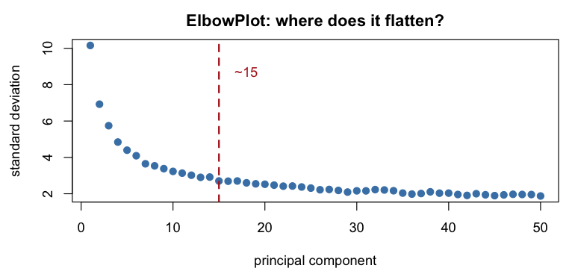
How many PCs?

Slide 32
Methods: the elbow plot (visual, fine in practice), JackStraw (permutation, slow), or the Molecular Cross-Validation / Horn’s parallel analysis family.
Erring high is safer than erring low. Too few PCs merges distinct populations — an error you cannot detect. Too many adds noise, which mostly makes clusters slightly fuzzier.

Slide 33
t-SNE and UMAP: what they are for
Both take your 15–30 dimensional PCA space and produce 2D coordinates that preserve local neighbourhoods.
Both are non-linear and stochastic. Both exist so you can look at your data. Neither is a measurement.
UMAP is now standard: faster, more reproducible, preserves somewhat more global structure, and can project new data onto an existing embedding.

Slide 34
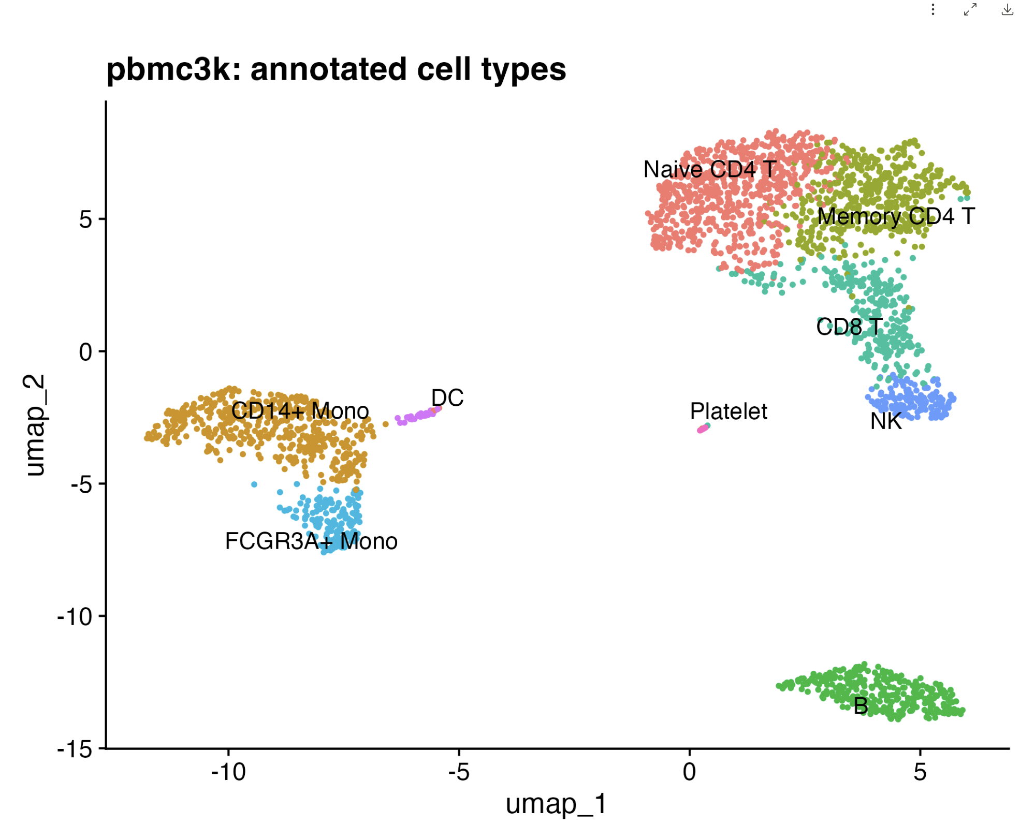
t-SNE and UMAP: what they are for

Slide 35
The UMAP algorithm, conceptually
Build a kNN graph in PCA space (n_neighbors, default 30)
Convert distances to edge weights — a fuzzy topological representation of the data
Lay out a low-dimensional graph whose weights match, by minimising a cross-entropy with min_dist controlling how tightly points can pack
Key parameters:
n_neighbors small (5–10) → local detail, fragmented; large (50+) → global structure, merged detail
min_dist small → tight clumps; large → diffuse

Slide 36
What you may and may not conclude from a UMAP
May:
there appear to be distinct groups of cells (then verify with markers)
these cells are neighbours in high-dimensional space
a continuum may exist here (then test it properly)
May not:
distances between clusters are meaningful — they are not
the sizes of clusters reflect anything — they do not
a cluster appearing between two others is intermediate — it may not be
the branching structure is a lineage — it may be an artefact of min_dist
A published finding that rests on a UMAP’s geometry rests on nothing.

Slide 37
UMAP is stochastic — demonstrate it to yourself
obj <- RunUMAP(obj, dims = 1:15, seed.use = 42)
obj <- RunUMAP(obj, dims = 1:15, seed.use = 1)
Different seeds: same clusters, different positions, sometimes different apparent adjacencies. Always set seed.use and report it.
Then change dims = 1:10 vs 1:30 and look again. If your conclusion changes, it was never a conclusion.

Slide 38
The scRNA-seq pipeline, one slide
filtered count matrix
↓ QC: nFeature, nCount, %MT → filter cells and genes
↓ NormalizeData / SCTransform
↓ FindVariableFeatures (~2000)
↓ ScaleData
↓ RunPCA → ElbowPlot: choose dims
↓ RunUMAP (visualisation only)
↓ FindNeighbors + FindClusters → clusters [Friday]
↓ FindAllMarkers → marker genes [Friday]
↓ annotation → cell types [Friday]
Today: down to RunUMAP. Tomorrow: the rest.

Slide 39
The Seurat object
obj[["RNA"]] # an Assay: counts, data, scale.data
obj@meta.data # one ROW PER CELL — QC metrics, clusters, labels
obj@reductions$pca # cell embeddings and gene loadings
obj@reductions$umap
Idents(obj) # the "current" cell labels
DefaultAssay(obj) # which assay functions act on
Access patterns you will use constantly:
obj$percent.mt # a meta.data column
obj@meta.data$seurat_clusters
GetAssayData(obj, layer = "data") # normalised matrix (Seurat v5)
Cells(obj); nrow(obj); ncol(obj) # cells are COLUMNS
Note the transposition: genes are rows, cells are columns in the assay; but meta.data has one row per cell.

Slide 40
This afternoon
Day4_scRNAseq_Intro/scripts/04_seurat_qc_dimred.R
Read 10x output; build a Seurat object; understand its structure
Compute QC metrics; plot their joint distributions
Choose thresholds from your own data and justify them in writing
Normalise (log-CP10K, and compare with SCTransform)
HVGs; inspect the top 20 and ask whether they are biology
Scale, PCA, examine the loadings of PC1–PC4
Elbow plot; choose dims; UMAP

