Slide 1
From Biology to a Count Table
Day 1 — Transcriptomics Summer School, Sarajevo
Instructor

Slide 2
The week in one slide
Day | Morning (theory) | Afternoon (hands-on)
1 | Biology → count table | R from zero
2 | Counts, models, DE | DESeq2
3 | Visualisation, pathways | PCA, volcano, GO, GSEA
4 | Single-cell technology | Seurat QC → UMAP
5 | Clustering, annotation | Clusters → cell types
You start each afternoon with a count matrix. Everything upstream of that is explained but not executed by you.

Slide 3
Block 1 — What are we actually measuring?

Slide 4
Why we measure RNA
The genome is the same in (almost) every cell of your body. The transcriptome is not.
Genome: what the organism could do
Transcriptome: what a cell is doing, right now, in this condition
Proteome: what actually does the work
RNA is the layer that is simultaneously dynamic, informative, and "cheap" to measure genome-wide. That combination is why RNA-seq became the default assay in functional genomics.

Slide 5
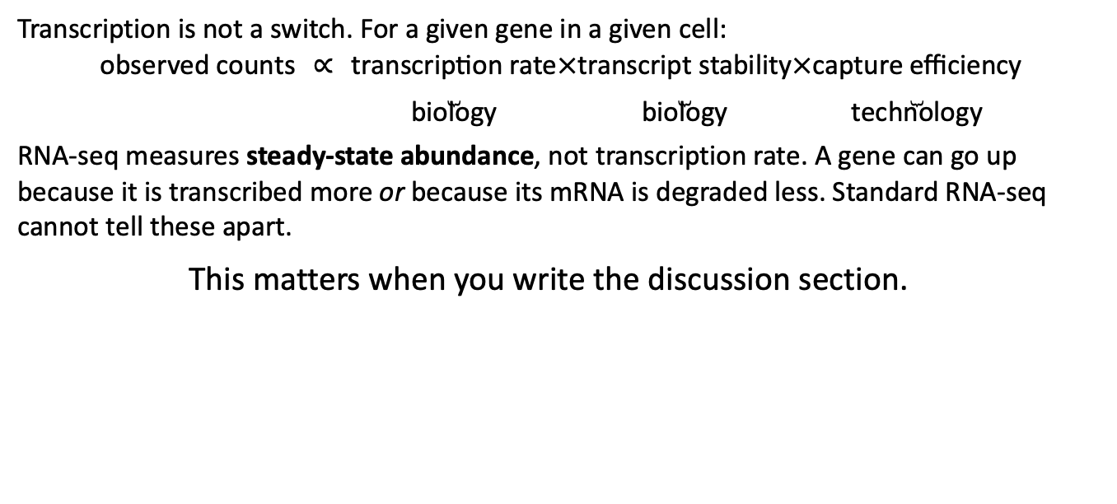
What “gene expression” means operationally
Transcription is not a switch. For a given gene in a given cell:
$$\text{observed counts} ∝ \underset{\text{biology}}{\underset{⏟}{\text{transcription rate}}}×\underset{\text{biology}}{\underset{⏟}{\text{transcript stability}}}×\underset{\text{technology}}{\underset{⏟}{\text{capture efficiency}}}$$
RNA-seq measures steady-state abundance, not transcription rate. A gene can go up because it is transcribed more or because its mRNA is degraded less. Standard RNA-seq cannot tell these apart.
This matters when you write the discussion section.

Slide 6
The questions RNA-seq can answer
Differential expression — which genes differ between conditions, genotypes, tissues, time points?
Co-expression and modules — which genes move together, implying shared regulation?
Annotation and discovery — which transcripts and isoforms exist in this species at all? (de novo assembly, non-model organisms)
Composition — which cell types are present and in what proportions? (single cell, or deconvolution of bulk)
Allele-specific expression, splicing, editing, fusions — all possible, all require specific designs.

Slide 7
The questions RNA-seq cannot answer
Protein abundance. mRNA–protein correlation is typically r ≈ 0.4–0.6 across genes. You did not measure the proteome.
Causality. A gene going up 4-fold is not evidence it drives the phenotype.
Absolute molecule counts. Without spike-ins, RNA-seq is compositional: it measures proportions, not amounts.
Anything about the cells you lost during dissection, dissociation, or filtering.

Slide 8
Bulk vs single cell
 | Bulk | Single cell
Unit measured | tissue average | individual cell
Genes/cell detected | ~15–25k (tissue) | ~1–5k
Cost per sample | low | 10–100× higher
Statistical power for DE | high (true replicates) | low (n = donors, not cells)
Cell-type resolution | none (or inferred) | direct
Rare populations | invisible | detectable
Sample input | ~100 ng RNA | live, intact cells

Slide 9
Bulk vs single cell
 | Bulk | Single cell
Unit measured | tissue average | individual cell
Genes/cell detected | ~15–25k (tissue) | ~1–5k
Cost per sample | low | 10–100× higher
Statistical power for DE | high (true replicates) | low (n = donors, not cells)
Cell-type resolution | none (or inferred) | direct
Rare populations | invisible | detectable
Sample input | ~100 ng RNA | live, intact cells

Slide 10
Bulk vs single cell
 | Bulk | Single cell
Unit measured | tissue average | individual cell
Genes/cell detected | ~15–25k (tissue) | ~1–5k
Cost per sample | low | 10–100× higher
Statistical power for DE | high (true replicates) | low (n = donors, not cells)
Cell-type resolution | none (or inferred) | direct
Rare populations | invisible | detectable
Sample input | ~100 ng RNA | live, intact cells

Slide 11
Bulk vs single cell
 | Bulk | Single cell
Unit measured | tissue average | individual cell
Genes/cell detected | ~15–25k (tissue) | ~1–5k
Cost per sample | low | 10–100× higher
Statistical power for DE | high (true replicates) | low (n = donors, not cells)
Cell-type resolution | none (or inferred) | direct
Rare populations | invisible | detectable
Sample input | ~100 ng RNA | live, intact cells

Slide 12
Bulk vs single cell
 | Bulk | Single cell
Unit measured | tissue average | individual cell
Genes/cell detected | ~15–25k (tissue) | ~1–5k
Cost per sample | low | 10–100× higher
Statistical power for DE | high (true replicates) | low (n = donors, not cells)
Cell-type resolution | none (or inferred) | direct
Rare populations | invisible | detectable
Sample input | ~100 ng RNA | live, intact cells

Slide 13
Bulk vs single cell
 | Bulk | Single cell
Unit measured | tissue average | individual cell
Genes/cell detected | ~15–25k (tissue) | ~1–5k
Cost per sample | low | 10–100× higher
Statistical power for DE | high (true replicates) | low (n = donors, not cells)
Cell-type resolution | none (or inferred) | direct
Rare populations | invisible | detectable
Sample input | ~100 ng RNA | live, intact cells

Slide 14
Bulk vs single cell
 | Bulk | Single cell
Unit measured | tissue average | individual cell
Genes/cell detected | ~15–25k (tissue) | ~1–5k
Cost per sample | low | 10–100× higher
Statistical power for DE | high (true replicates) | low (n = donors, not cells)
Cell-type resolution | none (or inferred) | direct
Rare populations | invisible | detectable
Sample input | ~100 ng RNA | live, intact cells

Slide 15
Bulk vs single cell
 | Bulk | Single cell
Unit measured | tissue average | individual cell
Genes/cell detected | ~15–25k (tissue) | ~1–5k
Cost per sample | low | 10–100× higher
Statistical power for DE | high (true replicates) | low (n = donors, not cells)
Cell-type resolution | none (or inferred) | direct
Rare populations | invisible | detectable
Sample input | ~100 ng RNA | live, intact cells or fixed cells

Slide 16
Choosing between them
Use bulk when:
Your question is about a condition, not a cell type
The tissue is reasonably homogeneous, or you only care about the average
You need statistical power and many replicates
Your material is frozen, fixed, or degraded (FFPE, archived)
Use single cell when:
Your question is about composition or heterogeneity
You expect the effect to be in a minority population
You want to find new cell states
You can get live, intact, dissociable cells

Slide 17
The most common design mistake
“We’ll do single cell because it’s better.”
Single-cell RNA-seq with n = 1 per condition cannot support any statistical claim about the condition. Thousands of cells from one mouse are thousands of measurements of one mouse.
Cells are pseudo-replicates. The experimental unit is the animal, the donor, the dish.
If your question is “does treatment change expression?”, bulk with n = 6 is better then single cell with n = 1 every single time.

Slide 18
Block 1b — Experimental design

Slide 19
Replication: three kinds
Biological replicates — independent organisms/donors/cultures. These are the only ones that let you generalise. These are what n means.
Technical replicates — the same RNA, sequenced twice. Measure machine noise. Almost never worth the money in modern RNA-seq; Illumina technical variance is small relative to biological variance.
Sequencing depth — more reads from the same library. Not replication at all. Doubling depth does not double power.
Rule of thumb: more biological replicates beat more reads. Given a fixed budget, prefer 8 samples at 20 M reads over 4 samples at 40 M reads.

Slide 20
How many replicates?
For bulk differential expression:
n = 2 — detects nothing reliably. Do not.
n = 3 — the field’s minimum. Detects large, clean effects. Dispersion estimates are poor; you depend entirely on shrinkage.
n = 5–6 — a comfortable design. Meaningful power for 2-fold changes in moderately expressed genes.
n ≥ 10 — needed for subtle effects, human cohorts, or when variance is high (patient samples, wild-caught animals).
Formal answer: run a power analysis with your own pilot dispersion estimates. RNASeqPower, PROPER, or ssizeRNA in R.

Slide 21
How deep?
Depth requirement depends on the question, not the organism.
Goal | Reads/sample (paired-end)
DE of moderately/highly expressed genes | 10–20 M
DE including low-expressed genes / TFs | 30–40 M
Isoform-level quantification / splicing | 50–100 M
de novo transcriptome assembly | 100 M+
Single cell (per cell) | 20–50 k
Saturation is real: past ~40 M reads you are mostly re-sequencing the same highly expressed transcripts.

Slide 22
Confounding — errors you cannot fix later
A confounder is a variable that changes together with your variable of interest.
Bad design:
All control samples extracted on Monday, all treatment samples on Thursday
All wild-types sequenced on lane 1, all mutants on lane 2
All patients from hospital A are cases; all from hospital B, controls
If batch and condition are perfectly correlated, no statistical method can separate them. Not DESeq2, not removeBatchEffect, not ComBat. The information is simply not in the data.

Slide 23
Batch effects — how to fix the design
Randomise what you can: sample order at extraction, plate position, library prep day.
Block what you cannot randomise: make sure every batch contains every condition.
BAD GOOD
Batch 1: C C C C Batch 1: C C T T
Batch 2: T T T T Batch 2: C C T T
Record everything. Extraction date, RIN, operator, plate, lane, kit lot. You cannot model a covariate you did not write down.
Then include batch in the model: ~ batch + condition.

Slide 24
Design checklist
What is the biological question, in one sentence?
What is the experimental unit? (Not “cells”. Usually not “wells”.)
What is the smallest effect worth detecting?
How many independent biological units per group?
What could vary systematically besides my variable of interest?
Is every batch balanced for condition?
What metadata am I recording, and where?
Which statistical comparison will answer the question?
If you cannot answer 8 before collecting data, do not collect data.

Slide 25
Block 2 — From tissue to numbers

Slide 26
The wet-lab path
tissue / cells
↓ extraction (TRIzol, column, magnetic bead)
total RNA ────→ QC: RIN / RQN on Bioanalyzer or TapeStation
↓ enrichment
poly-A selection OR rRNA depletion
↓ fragmentation
↓ reverse transcription → cDNA
↓ adapter ligation, indexing (barcodes)
↓ PCR amplification
sequencing library ──→ QC: size distribution, molarity
↓ pooling, flow cell loading
FASTQ files
Every arrow is a place where bias enters.

Slide 27
RNA quality: RIN
The RNA Integrity Number (1–10) comes from the electrophoretic trace, mostly the 28S:18S ratio and the shape of the baseline.
RIN > 8 — good, use freely
RIN 6–8 — usable; prefer random priming over poly-A
RIN < 6 — 3’ bias with poly-A selection becomes severe
RIN < 4 — consider a degraded-RNA protocol or abandon the sample
Critical: if RIN correlates with condition, RIN is a confounder. Report it, plot it, and put it in the model if needed.

Slide 28
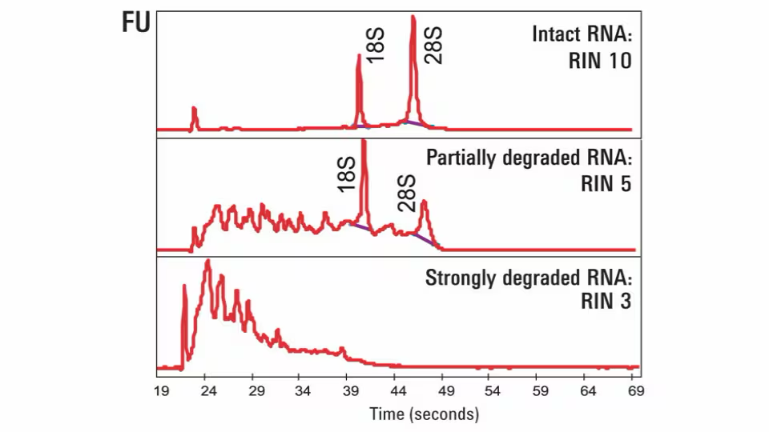
RNA quality: RIN

Slide 29
Poly-A selection vs rRNA depletion
 | Poly-A | rRNA depletion
Captures | polyadenylated mRNA | mRNA + lncRNA + pre-mRNA + circRNA
Needs intact RNA | yes | no
Reads wasted on rRNA | very few | some (2–10%)
Intronic signal | little | substantial
Bacteria / non-poly-A RNA | no | yes
Cost | lower | higher
Reads needed for same mRNA depth | fewer | more
Default for a standard eukaryotic DE experiment: poly-A. For degraded samples, non-coding RNA, or prokaryotes: ribo-depletion.

Slide 30
Strandedness
Unstranded libraries lose the information about which DNA strand the transcript came from.
Why it matters: overlapping genes on opposite strands, antisense transcription, and correct assignment of reads in gene-dense genomes. Typically 5–15% of reads are ambiguous in an unstranded library.
Modern kits are usually reverse-stranded (dUTP method): read 2 matches the transcript. In practice: get the setting right in featureCounts/HTSeq or you will silently lose most of your counts.
If your counts look catastrophically low, check strandedness first.

Slide 31
Single-end vs paired-end
Single-end (SE) — one read per fragment. Cheaper. Adequate for straightforward gene-level DE in a well-annotated genome.
Paired-end (PE) — both fragment ends. More expensive. Required (or strongly preferred) for: isoform quantification, splicing, fusion detection, de novo assembly, repetitive genomes, and any non-model organism.
Read length: 50–75 bp is fine for gene-level DE; 100–150 bp for isoforms.

Slide 32
Single-cell specifics: dissociation
For scRNA-seq you must convert tissue into a suspension of live, intact, single cells. This is the hardest and least reproducible step in the entire protocol.
What goes wrong:
Cell-type bias — neurons, adipocytes, and large or fragile cells die preferentially. Your “composition” is partly a survival ranking.
Stress response — enzymatic digestion at 37 °C induces Fos, Jun, Hspa1a, heat-shock genes. Cold-active protease (Bacillus licheniformis) at 6 °C reduces this.
Ambient RNA — lysed cells release mRNA that is captured by every droplet.
Doublets — two cells in one droplet, reported as one “cell” with a chimeric profile.

Slide 33
Library prep: 10x Chromium in one slide
Cells + barcoded gel beads + oil → GEMs (one cell per droplet, ideally)
Cell lyses inside the droplet
mRNA is reverse transcribed onto the bead’s oligo, which carries:
  a cell barcode (identical on all oligos of one bead)
  a UMI (unique per molecule)
  a poly-dT capture sequence
Emulsion is broken, cDNA pooled, amplified, fragmented
Sequence: read 1 = barcode + UMI, read 2 = transcript (3’ end)
So each read carries: which cell, which original molecule, which gene.

Slide 34
What a UMI buys you
PCR amplifies molecules unevenly. Without UMIs you cannot tell “10 copies of this transcript” from “1 copy amplified 10×”.
With UMIs you collapse duplicates: count unique UMIs per gene per cell, not reads. This turns a noisy amplification-dependent measurement into an approximate molecule count.
Consequence: 10x data are 3’-biased — you only sequence near the poly-A tail. You get gene-level counts, essentially no isoform information.

Slide 35
Computational pre-processing (demonstrated, not run by you)
FASTQ
↓ FastQC + MultiQC quality, adapters, duplication, GC
↓ trimming (fastp/Trim Galore) adapters, low-quality tails
↓ alignment
genome: STAR, HISAT2 (splice-aware, gives BAM)
transcriptome: Salmon, kallisto (pseudo-alignment, gives counts)
↓ quantification
featureCounts / HTSeq (from BAM)
tximport (from Salmon/kallisto)
COUNT MATRIX ← your afternoon starts here

Slide 36
FastQC: what to act on
Per-base quality dropping at the 3’ end → trim
Adapter content → trim
Over-represented sequences → rRNA contamination, or a highly expressed gene (often fine in RNA-seq)
Unexpected GC distribution → contamination, or a different organism than you think
Very high duplication → low-complexity library, over-amplification

Slide 37
FastQC: what looks alarming but is not
Failed “per-base sequence content” in the first ~12 bases. Random-primer bias. Universal in RNA-seq, not fixable, harmless, trimmed.
High duplication for highly expressed transcripts. In RNA-seq, duplicate reads are mostly real molecules from an abundant gene — not a PCR artefact. Do not deduplicate RNA-seq reads.
A red cross in FastQC is a flag, not a verdict. The tool does not know it is looking at RNA.

Slide 38
Alignment vs pseudo-alignment
Genome alignment (STAR, HISAT2) Finds the actual coordinates of each read, spanning splice junctions. Slow, memory-hungry (STAR: ~32 GB for human), gives a BAM you can look at in IGV. Required for novel transcript discovery, variant calling, or anything positional.
Pseudo-alignment (Salmon, kallisto) Asks only which transcripts is this read compatible with, then resolves multi-mapping with an EM algorithm. ~20× faster, runs on a laptop, handles isoform-level quantification well. Cannot find anything that is not already in the annotation.
For gene-level DE in a well-annotated organism, they agree closely. Salmon/kallisto is the pragmatic default.

Slide 39
How a read becomes a count
featureCounts / HTSeq assign each alignment to a gene using a GTF:
Read entirely inside one gene’s exons → count it
Read overlapping two genes → ambiguous, discarded by default
Read in an intron or intergenic → no feature, discarded
Read mapping to many locations → multi-mapping, discarded by default
You should always look at the assignment summary. If 60% of reads are “no feature”, something is wrong — wrong GTF, wrong strandedness, or DNA contamination.

Slide 40
What the count matrix actually is
sample1 sample2 sample3 sample4
ENSG0001 712 690 1204 1188
ENSG0002 0 3 1 0
ENSG0003 13402 12880 13115 14002
...
Rows = genes (or transcripts)
Columns = samples
Values = number of reads/fragments assigned. Integers. Not normalised. Not log-transformed.
Plus a sample sheet (colData) with one row per column of the matrix, in the same order. Always check the order.

Slide 41
Three things to check before analysing any count matrix
Are the values integers? If they are decimals, someone already normalised them, and DESeq2 will refuse (or mislead you). tximport output is the legitimate exception.
Do colnames(counts) and rownames(metadata) match, in order? A silent mismatch here has produced published papers with swapped groups.
What are the library sizes? colSums(counts). A sample at 10% of the others’ depth is a problem to discuss, not to ignore.

Slide 42
Preview: why you cannot just do a t-test
Counts are discrete and non-negative
Variance increases with the mean (not constant)
With n = 3 the per-gene variance estimate is nearly worthless
You test ~20,000 genes at once
Total counts differ between samples, so raw counts are not comparable
Tomorrow: the negative binomial model, shrinkage, and DESeq2.

Slide 43
Block 3 — R for research

Slide 44
Why R, and why we spend a whole afternoon on it
Bioconductor is where methods development in genomics happens. DESeq2, edgeR, limma, clusterProfiler, and (via Seurat) most of the single-cell ecosystem are R.
You do not need to become a programmer. You need to stop losing hours to syntax errors while trying to think about biology.
This afternoon is deliberately not RNA-seq. Small, clean data; every concept you will need this week; nothing else.

Slide 45
The five things that actually matter
Assignment and objects — x <- 5. Everything is an object.
Vectors and data frames — the shapes your data come in.
Subsetting — [ ], $, and logical conditions. This is 60% of practical data work.
Functions — f(arg1, arg2). Read the help page: ?mean.
Packages — install.packages() from CRAN, BiocManager::install() from Bioconductor, then library().

Slide 46
Data structures you will meet this week
Structure | What it holds | Example
vector | one type, 1-D | c(1, 5, 9)
factor | categorical with levels | factor(c("ctrl","trt"))
matrix | one type, 2-D | the count matrix
data.frame | mixed types, 2-D | the sample sheet
list | anything, nested | model output
S4 object | slots, formal class | DESeqDataSet, Seurat
Sparse matrix | Count data for single cells | seurat
Factors matter: the first level is the reference level in every model you fit. relevel() is your friend.

Slide 47
The two dialects
Base R — df[df$gene == "TP53", ] Always available, no dependencies, used throughout Bioconductor.
Tidyverse — df |> filter(gene == "TP53") More readable for data wrangling; ggplot2 for figures.
You need both. Bioconductor objects are base-R/S4; your figures and tables will be tidyverse. We teach both and switch between them explicitly.

Slide 48
ggplot2 in one slide
ggplot(data = df, aes(x = logFC, y = -log10(pvalue))) +
geom_point(aes(colour = significant), alpha = 0.6) +
scale_colour_manual(values = c("grey70", "firebrick")) +
labs(x = "log2 fold change", y = "-log10 p") +
theme_bw()
ggplot() — the data and the canvas
aes() — which variable maps to which visual property
geom_*() — what to draw
scale_*() — how to translate values to colours/sizes/positions
labs(), theme_*() — text and appearance
+ — add layers
Every figure this week is built from these pieces.

Slide 49
Working practices we will insist on
Use RStudio Projects. One folder per analysis. No setwd().
Write scripts, never console-only work. If it is not in a script, it did not happen reproducibly.
Comment why, not what. # filter low-expressed genes to reduce multiple-testing burden is useful. # filter rows is not.
Print sessionInfo() at the end of every analysis. Package versions change results.
Never overwrite raw data. Read it, transform it, write the result somewhere else.

Slide 50
Getting unstuck
Read the error message. Genuinely read it. The line number and the object name are usually enough.
?function_name — every R function has a help page with examples.
str(object) — what is this thing? Use constantly.
dim(), head(), class(), summary() — cheap sanity checks.
Bioconductor package vignettes: browseVignettes("DESeq2"). These are written by the method authors and are excellent.
Search the error text verbatim. Bioconductor Support, Biostars.

Slide 51
This afternoon — nine sections
Open Day1_Intro_and_R_Basics/scripts/01_R_basics.R.
R as a calculator; assignment
Vectors and vectorised operations
Data frames; reading and writing files
Subsetting and logical indexing
Factors (and why they bite)
Writing functions
apply family and iteration
dplyr verbs
ggplot2, layer by layer

Slide 52
How to work through it
Each section has worked examples and an exercise. Do the exercises. Reading code and writing code are different skills, and only one of them transfers to tomorrow.
Run it line by line — Ctrl/Cmd + Enter — and read the output before moving on. If you do not understand an output, that is the moment to ask, not three sections later.
We stop at 15:15 wherever we have got to; finish the rest in the group block. Sections 4, 5 and 8 are the ones you will use immediately tomorrow, so prioritise those if you fall behind.

Slide 53
Tomorrow
Morning: the statistics of count data. Normalisation done properly, the negative binomial, dispersion shrinkage, hypothesis testing, and how to write a design formula for a real experiment.
Afternoon: your group’s first complete differential expression analysis in DESeq2.
Please have 00_check_installation.R passing before tomorrow 13:00.

