Slide 1
How an RNA-seq Experiment Works
From extraction to FASTQ — Transcriptomics Summer School, Sarajevo
Instructor

Slide 2
From Biology to a Count Table
Day 1 — Transcriptomics Summer School, Sarajevo
Instructor

Slide 3
The week in one slide
Day | Morning (theory) | Afternoon (hands-on)
1 | Biology → count table | R from zero
2 | Counts, models, DE | DESeq2
3 | Visualisation, pathways | PCA, volcano, GO, GSEA
4 | Single-cell technology | Seurat QC → UMAP
5 | Clustering, annotation | Clusters → cell types
You start each afternoon with a count matrix. Everything upstream of that is explained but not executed by you.

Slide 4
Block 1 — What are we actually measuring?

Slide 5
Why we measure RNA
The genome is the same in (almost) every cell of your body. The transcriptome is not.
Genome: what the organism could do
Transcriptome: what a cell is doing, right now, in this condition
Proteome: what actually does the work
RNA is the layer that is simultaneously dynamic, informative, and "cheap" to measure genome-wide. That combination is why RNA-seq became the default assay in functional genomics.

Slide 6
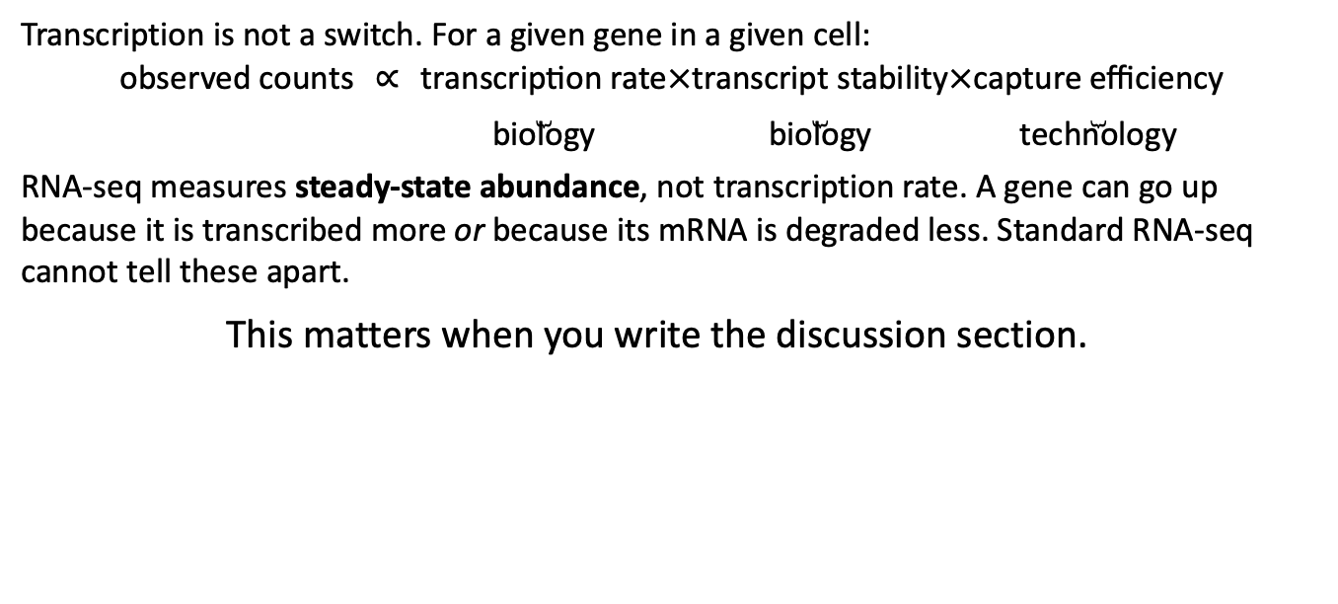
What “gene expression” means operationally
Transcription is not a switch. For a given gene in a given cell:
$$\text{observed counts} ∝ \underset{\text{biology}}{\underset{⏟}{\text{transcription rate}}}×\underset{\text{biology}}{\underset{⏟}{\text{transcript stability}}}×\underset{\text{technology}}{\underset{⏟}{\text{capture efficiency}}}$$
RNA-seq measures steady-state abundance, not transcription rate. A gene can go up because it is transcribed more or because its mRNA is degraded less. Standard RNA-seq cannot tell these apart.
This matters when you write the discussion section.

Slide 7
The questions RNA-seq can answer
Differential expression — which genes differ between conditions, genotypes, tissues, time points?
Co-expression and modules — which genes move together, implying shared regulation?
Annotation and discovery — which transcripts and isoforms exist in this species at all? (de novo assembly, non-model organisms)
Composition — which cell types are present and in what proportions? (single cell, or deconvolution of bulk)
Allele-specific expression, splicing, editing, fusions — all possible, all require specific designs.

Slide 8
The questions RNA-seq cannot answer
Protein abundance. mRNA–protein correlation is typically r ≈ 0.4–0.6 across genes. You did not measure the proteome.
Causality. A gene going up 4-fold is not evidence it drives the phenotype.
Absolute molecule counts. Without spike-ins, RNA-seq is compositional: it measures proportions, not amounts.
Anything about the cells you lost during dissection, dissociation, or filtering.

Slide 9
Why spend a morning on the wet lab
You will never run a library prep in this workshop. Every afternoon hands you a count matrix and asks you to analyse it.
So why does this matter?
Because a count matrix is not a measurement. It is the end of a long chain of decisions, and almost every way an RNA-seq analysis can fail is a decision made before any code was written.
By the end of this, you should be able to look at a count matrix and ask the four or five questions that decide whether it is worth analysing.

Slide 10
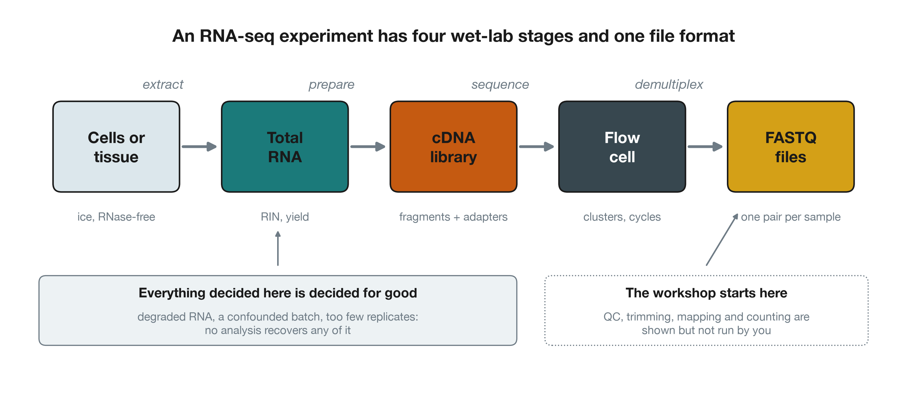
The whole thing on one slide
Overview of an RNA-seq experiment, from cells to FASTQ files

Slide 11
Stage 1 — Extraction

Slide 12
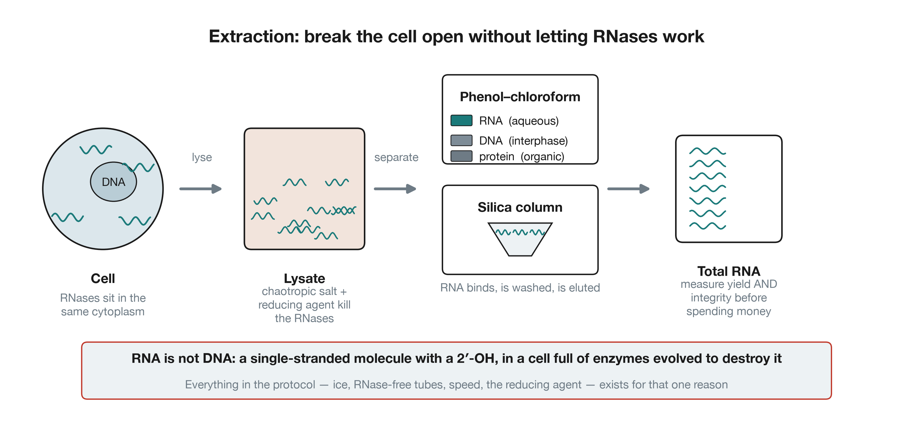
Getting RNA out of a cell, intact
RNA extraction: lysis, then phase separation or a silica column

Slide 13
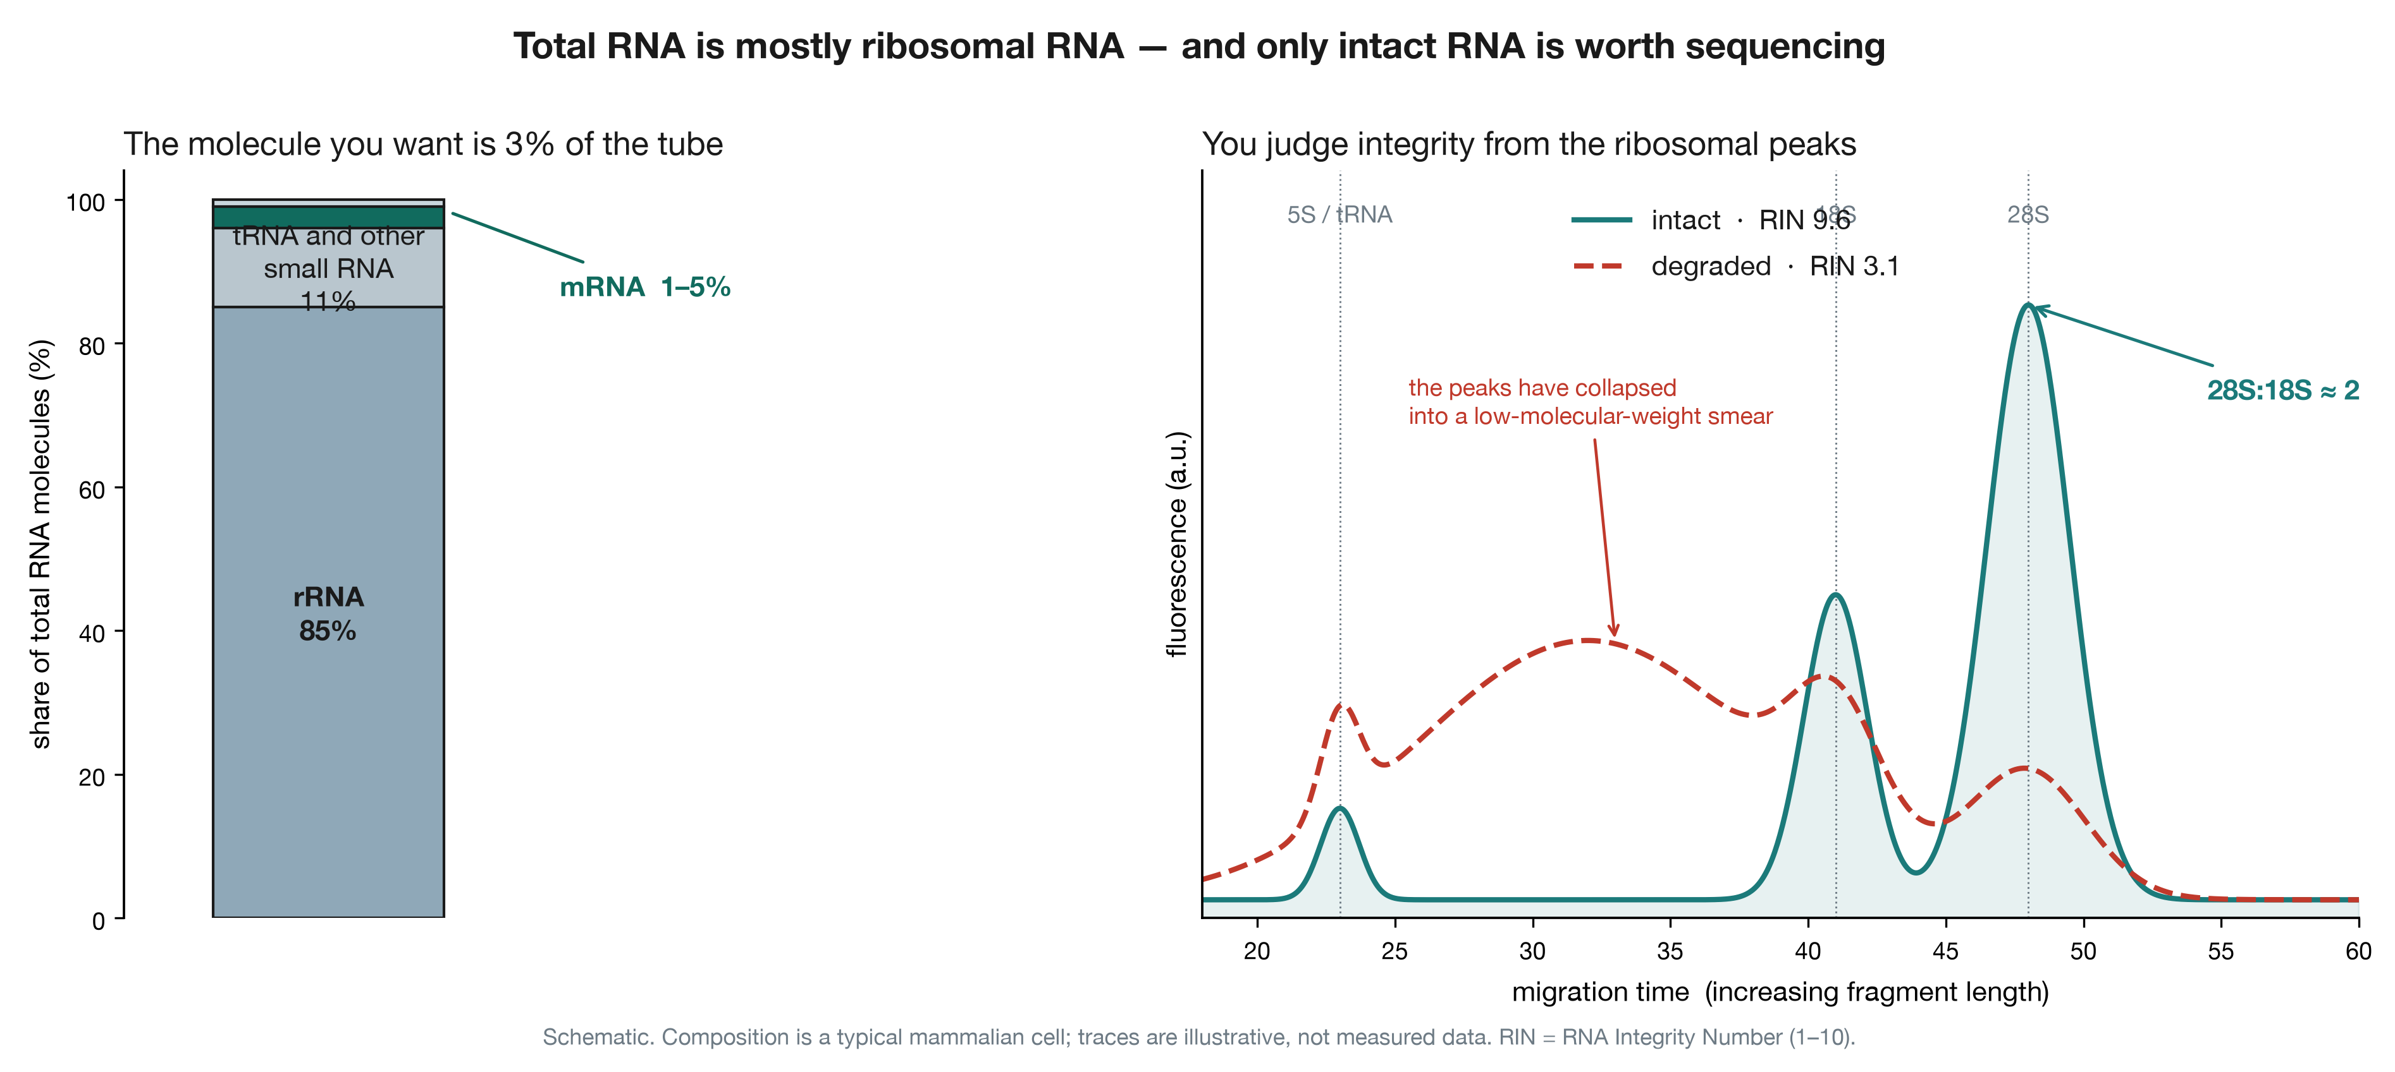
What is actually in the tube
Composition of total RNA, and integrity assessed from the ribosomal peaks

Slide 14
Two numbers to demand, every time
Yield — ng/µL, by fluorometry (Qubit), not by absorbance. A NanoDrop cannot tell RNA from free nucleotides and will cheerfully over-report by twofold.
Integrity — the RIN, from a Bioanalyzer or TapeStation trace.
RIN above 8 is good. Between 6 and 8, usable with care. Below 6, the 3′ ends are over-represented and your gene-level counts are biased in a way that correlates with transcript length.
And record the RIN per sample. If your treated samples happen to have lower RIN than your controls, degradation is confounded with treatment and no model can separate them.

Slide 15
Stage 2 — Library preparation

Slide 16
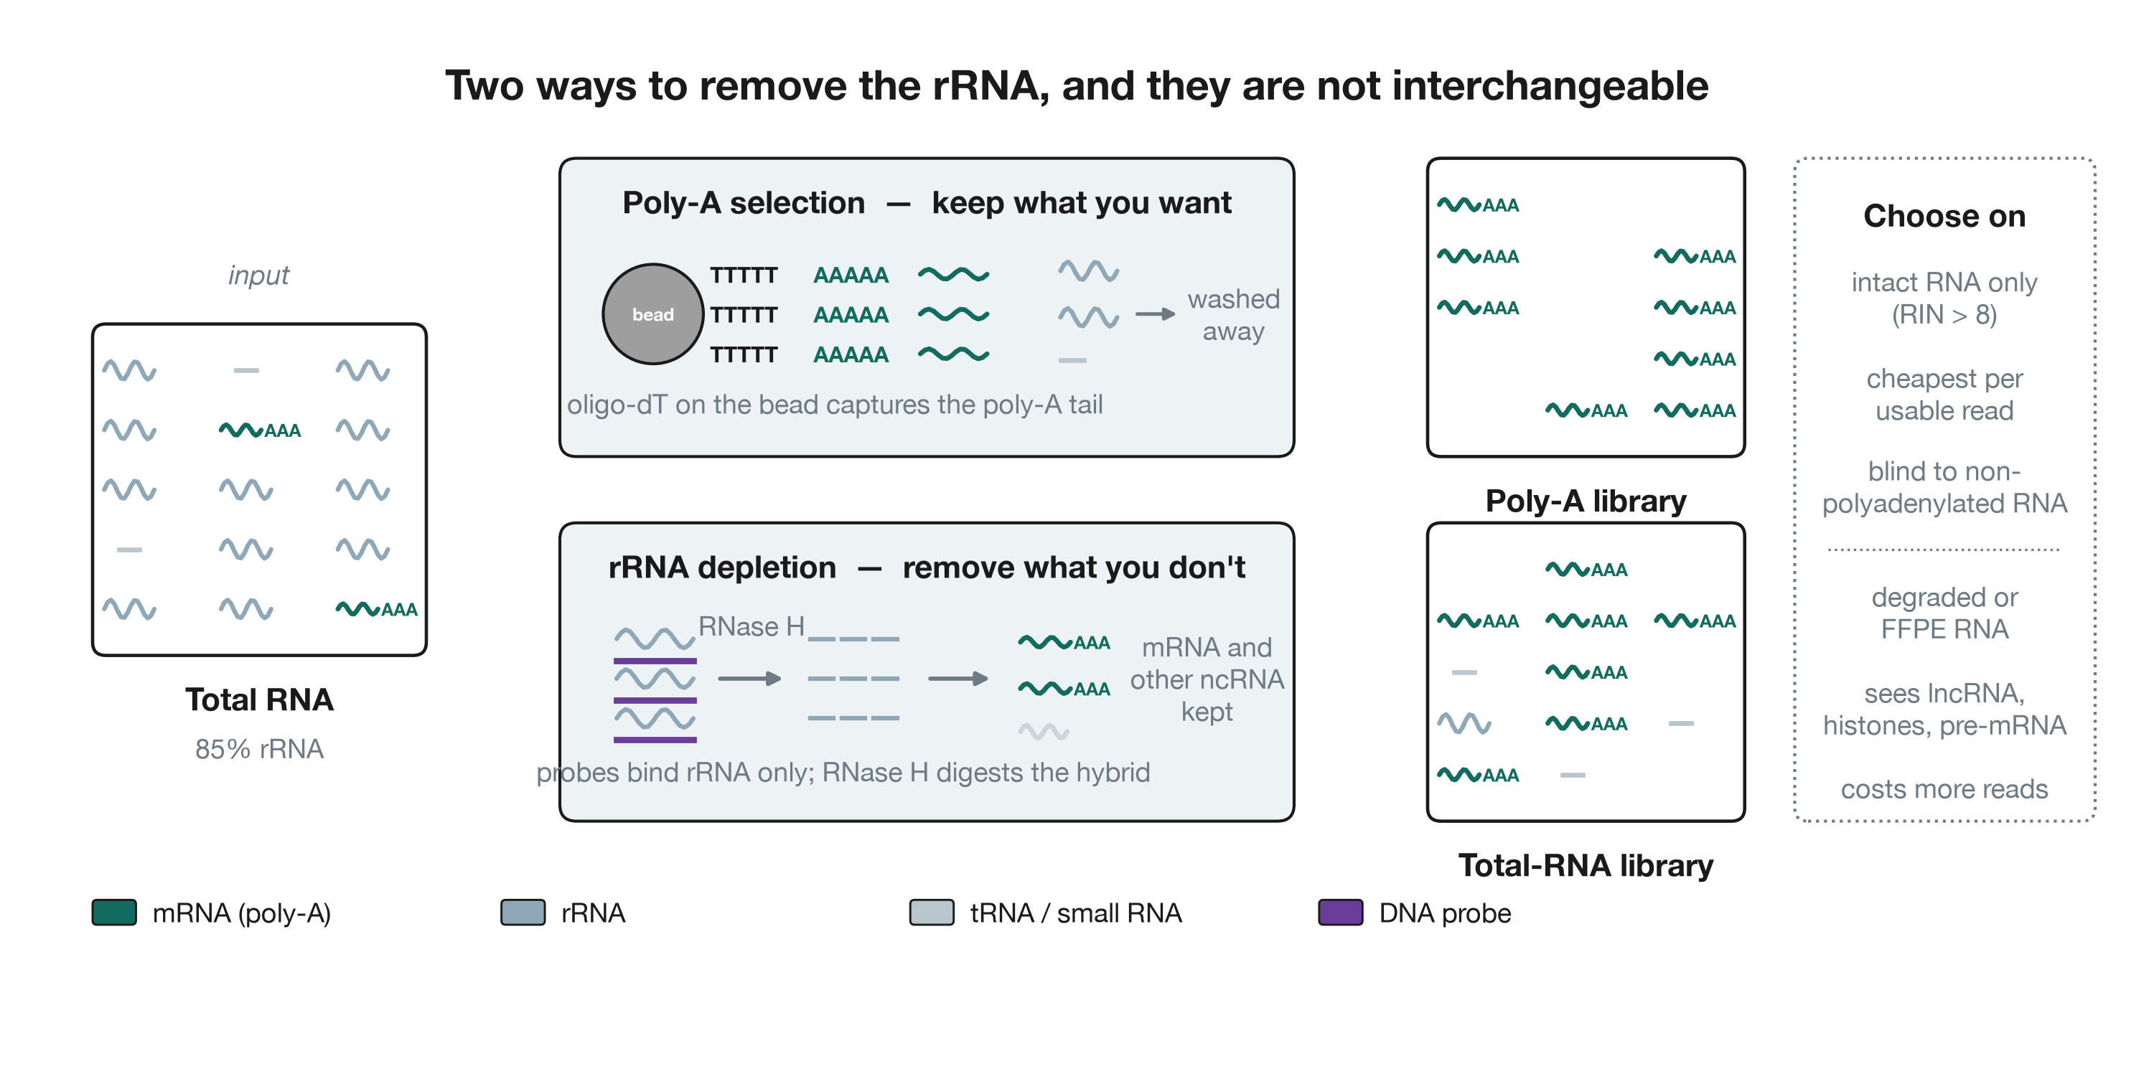
Removing the 85%
Poly-A selection versus rRNA depletion

Slide 17
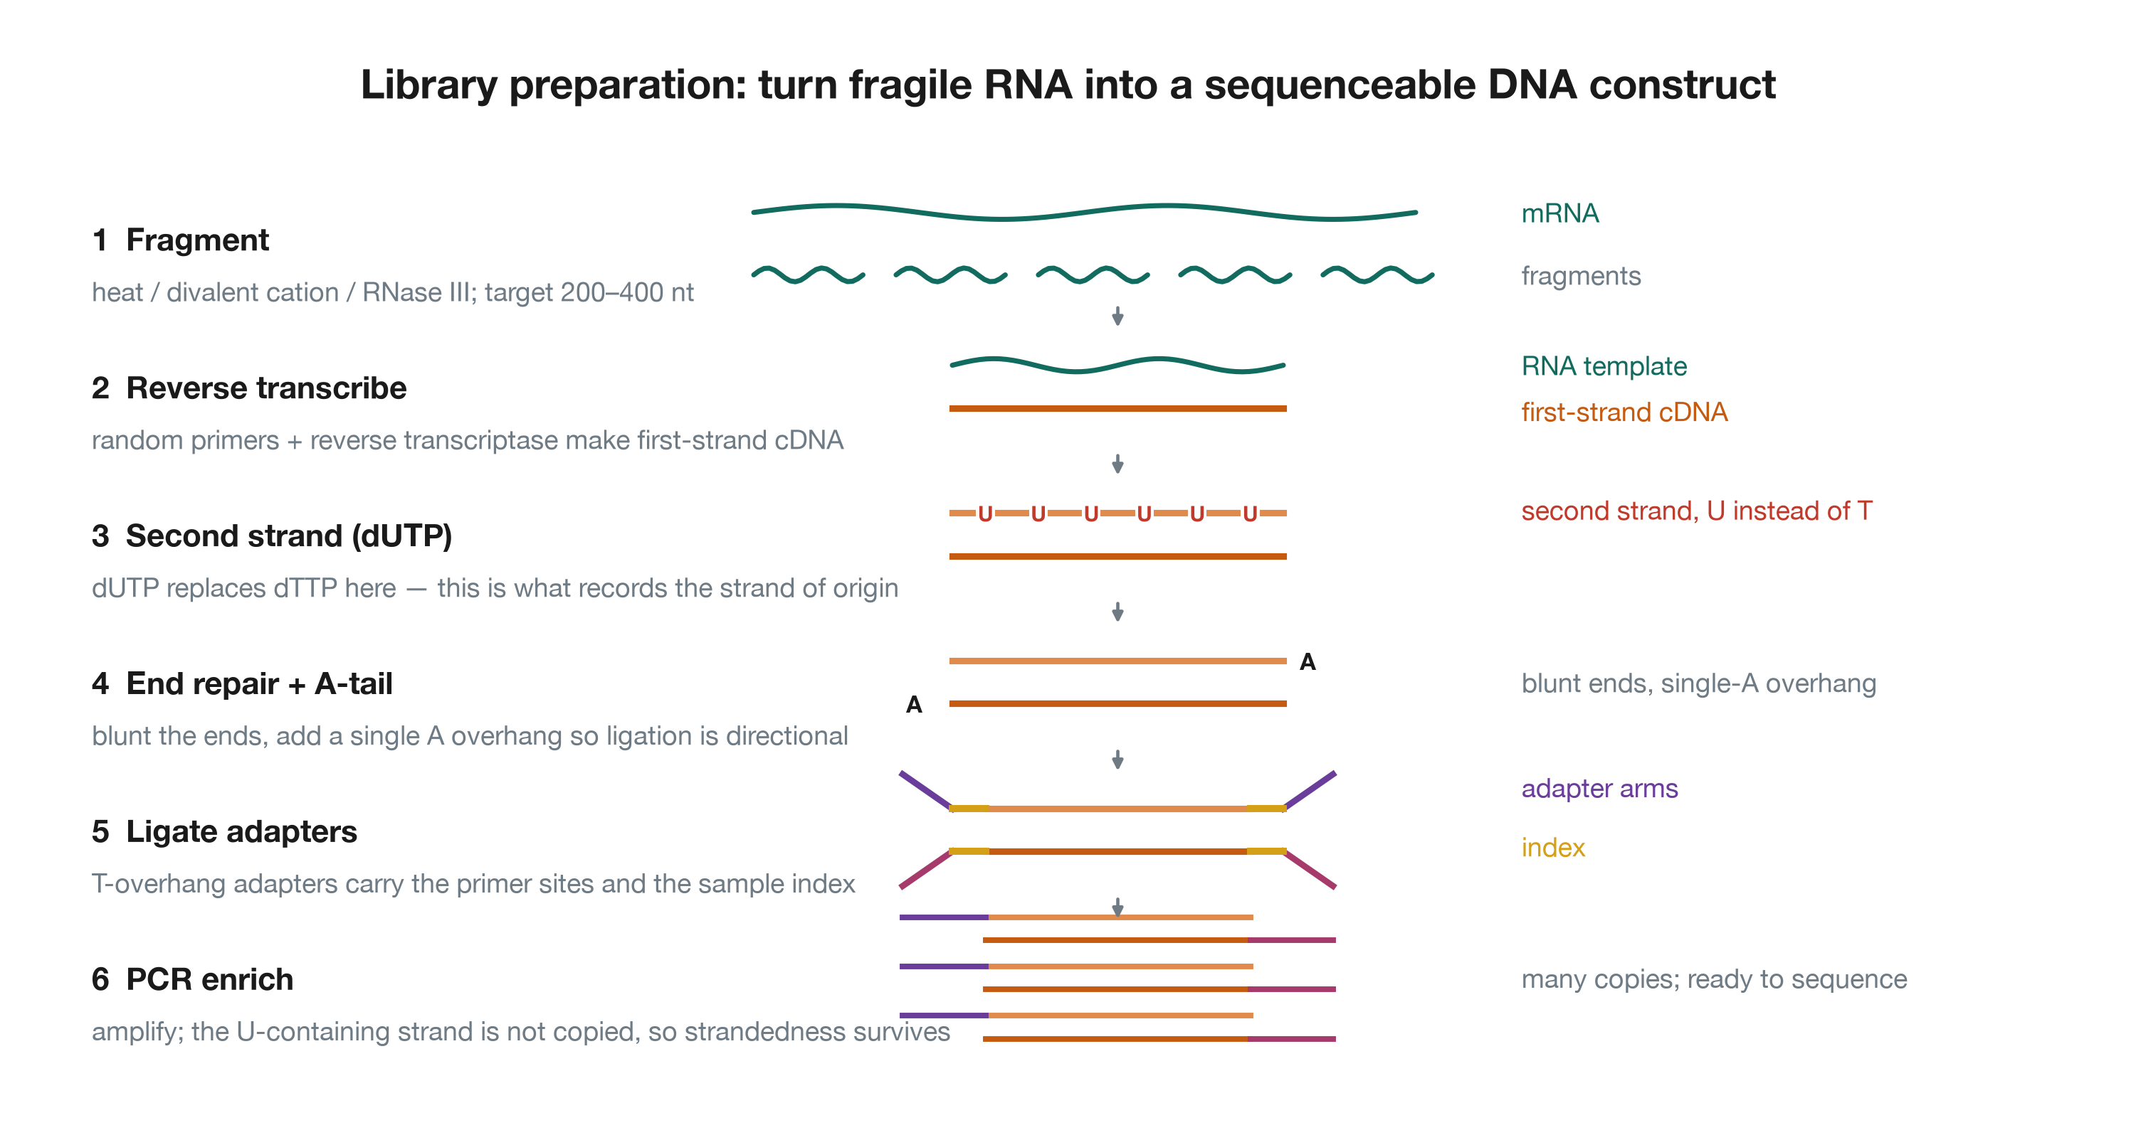
Turning RNA into a sequenceable construct
The six steps of library preparation

Slide 18
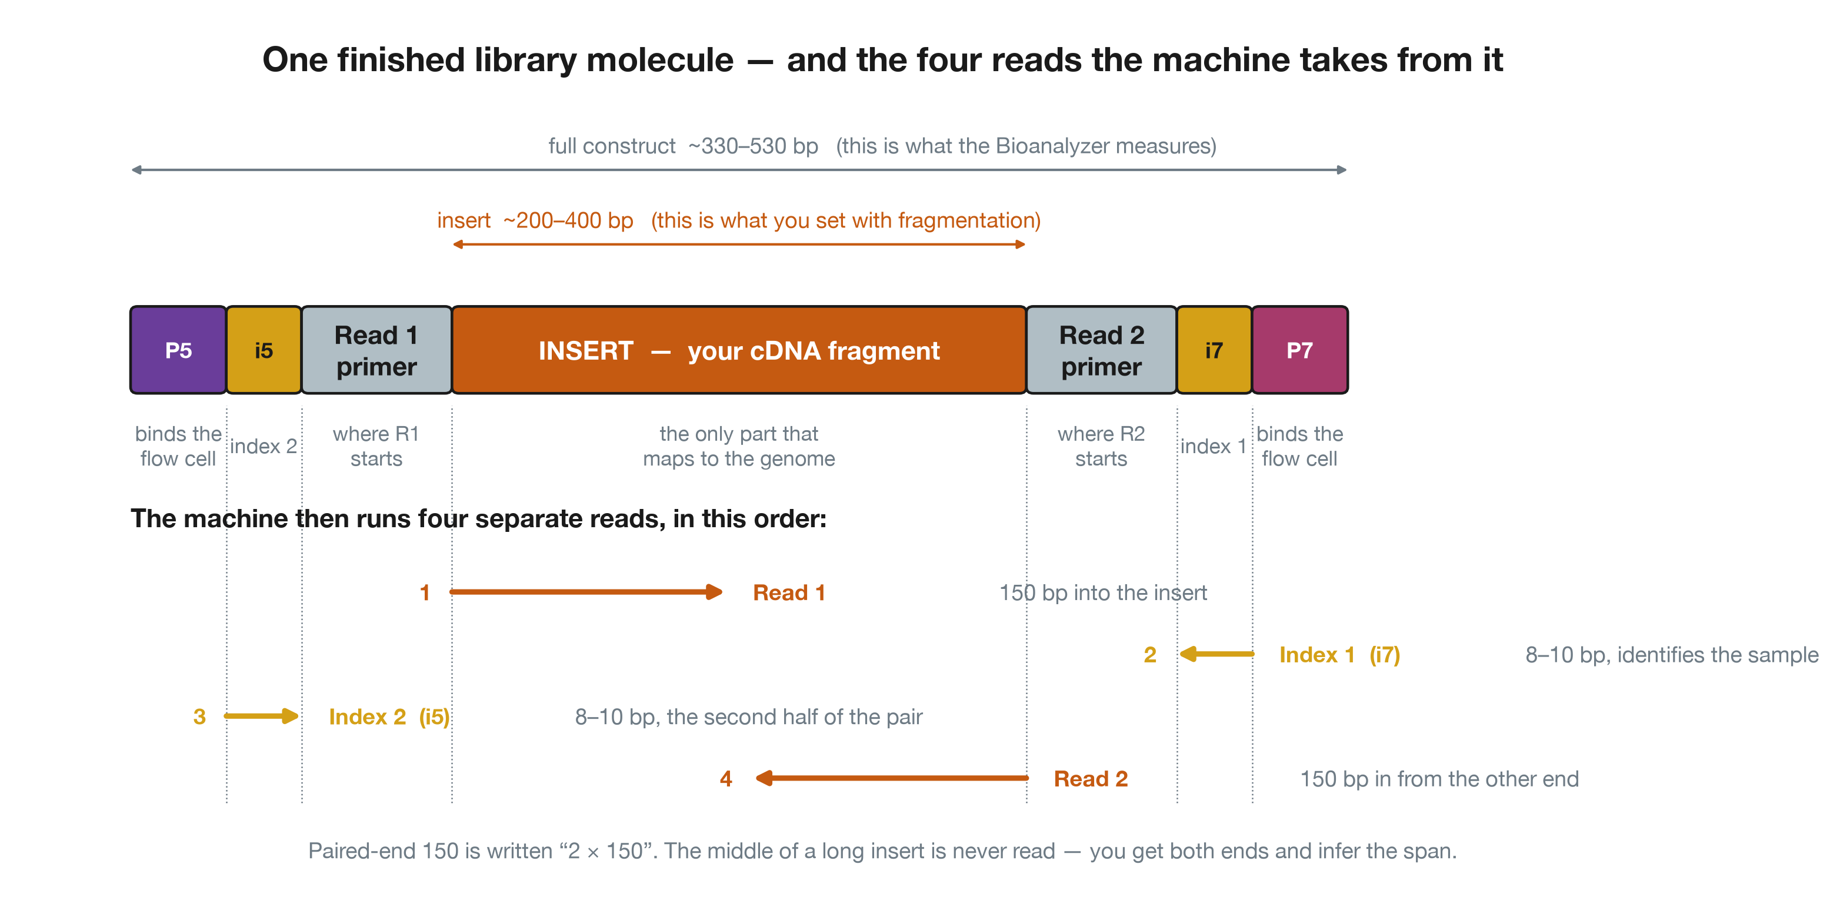
Anatomy of one library molecule
The finished construct and the four reads taken from it

Slide 19
Why the dUTP step earns its place
Without it, you know a read came from a locus. You do not know which strand it came from.
That matters more often than people expect:
overlapping genes on opposite strands — common in compact genomes, and in bacteria
antisense transcripts, which are regulatory, not noise
distinguishing a real transcript from pervasive background transcription
A stranded library costs nothing extra and answers a question an unstranded one cannot. There is no good reason to prepare an unstranded RNA-seq library today, and you will still meet them in public data — check before you reuse someone else’s counts.

Slide 20
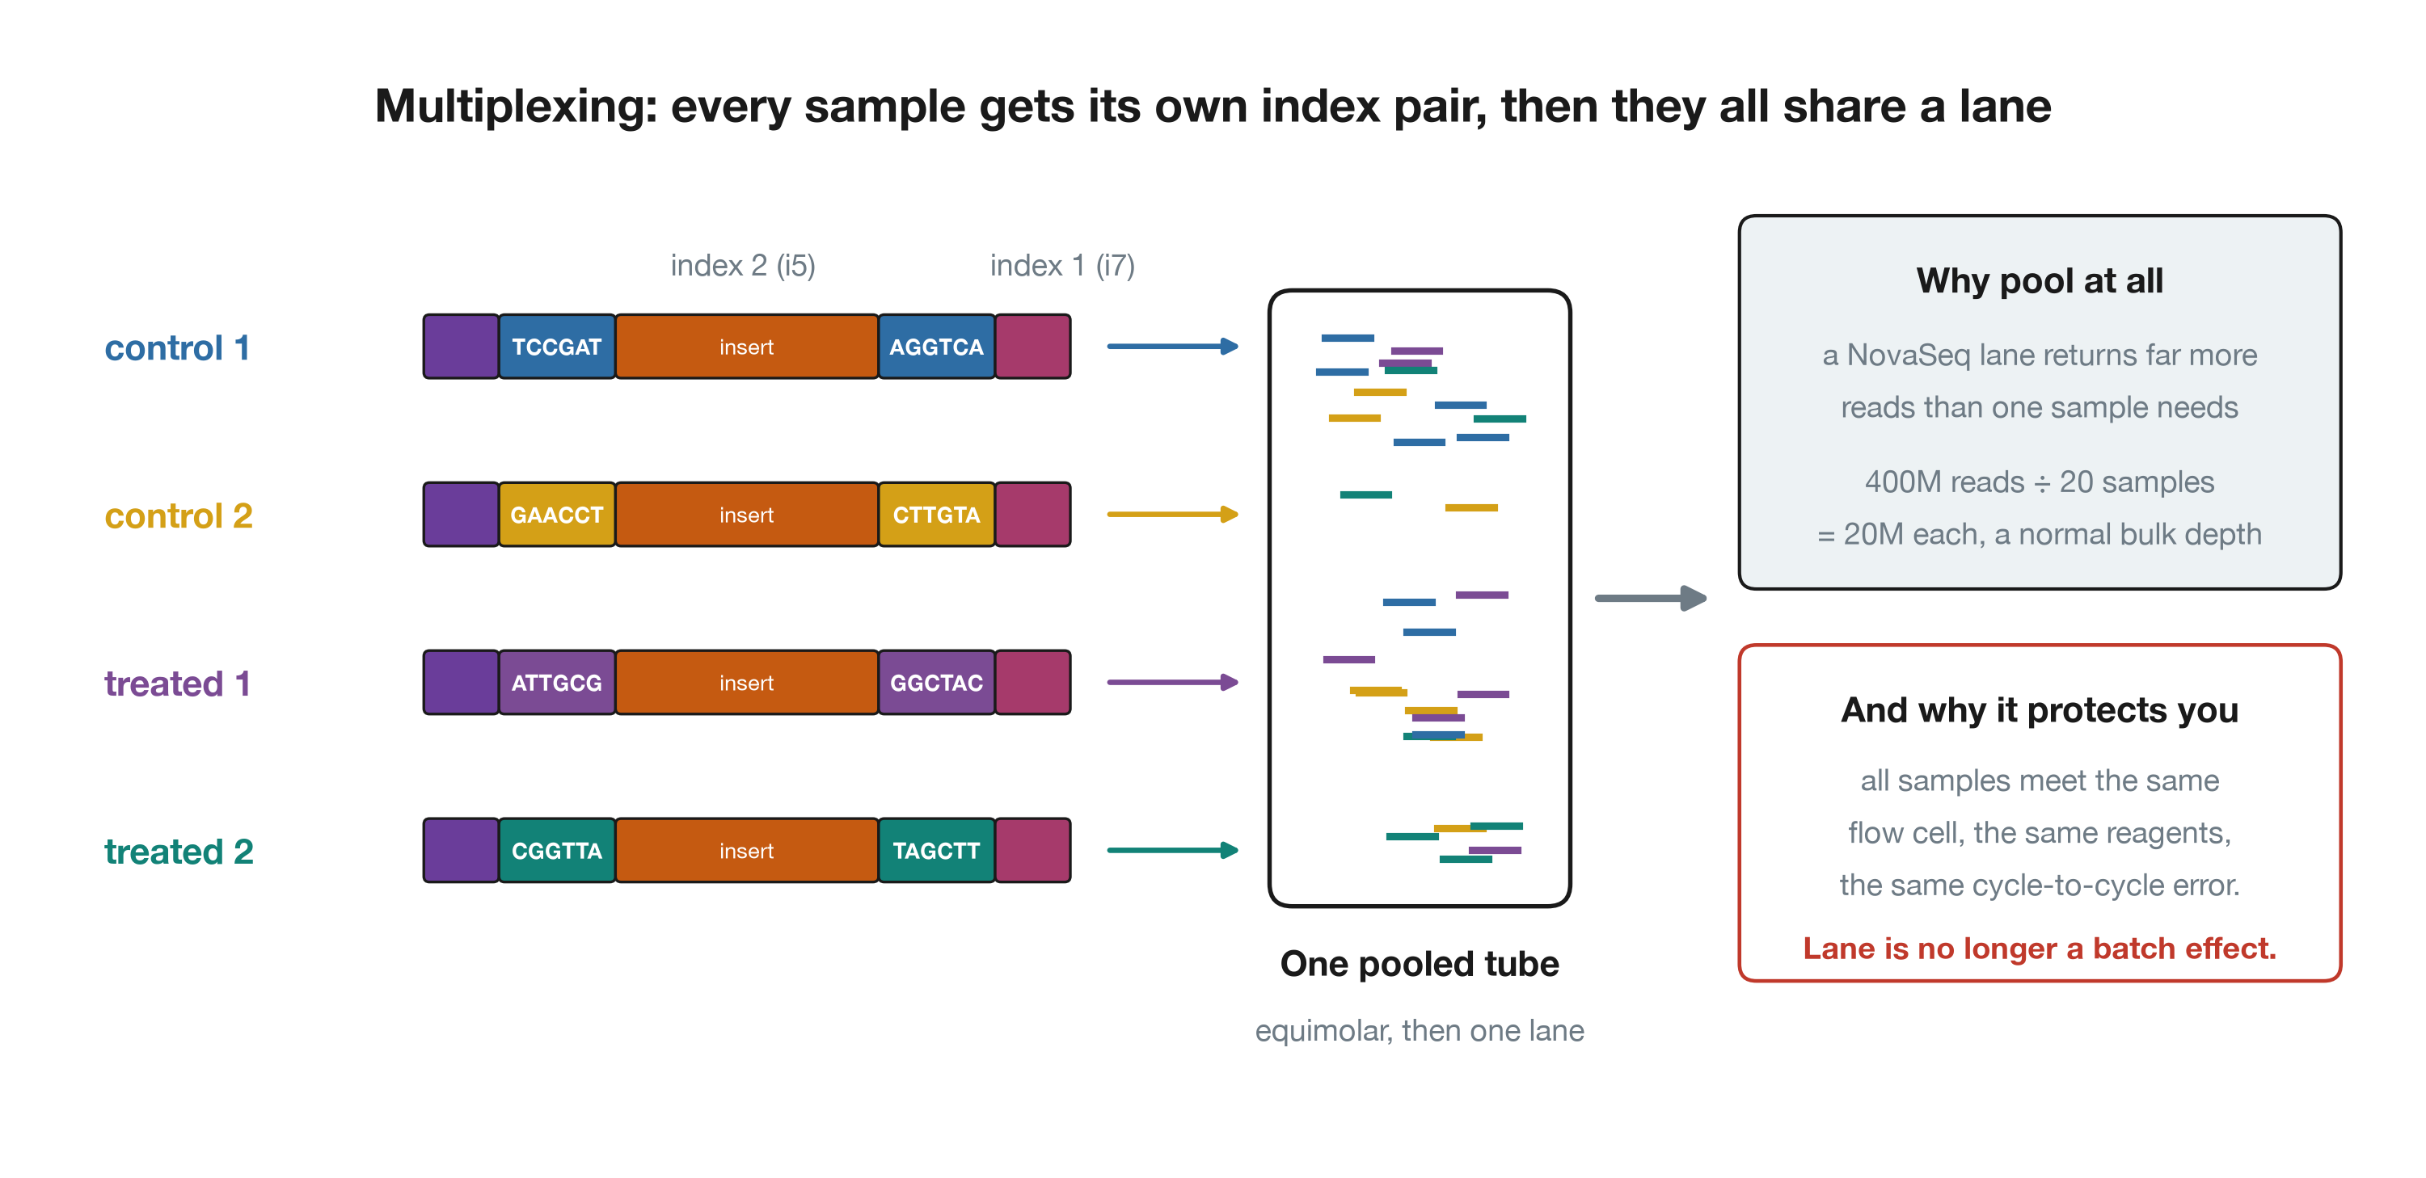
Every sample gets a barcode
Multiplexing: index pairs, then one pooled lane

Slide 21
Stage 3 — Sequencing

Slide 22
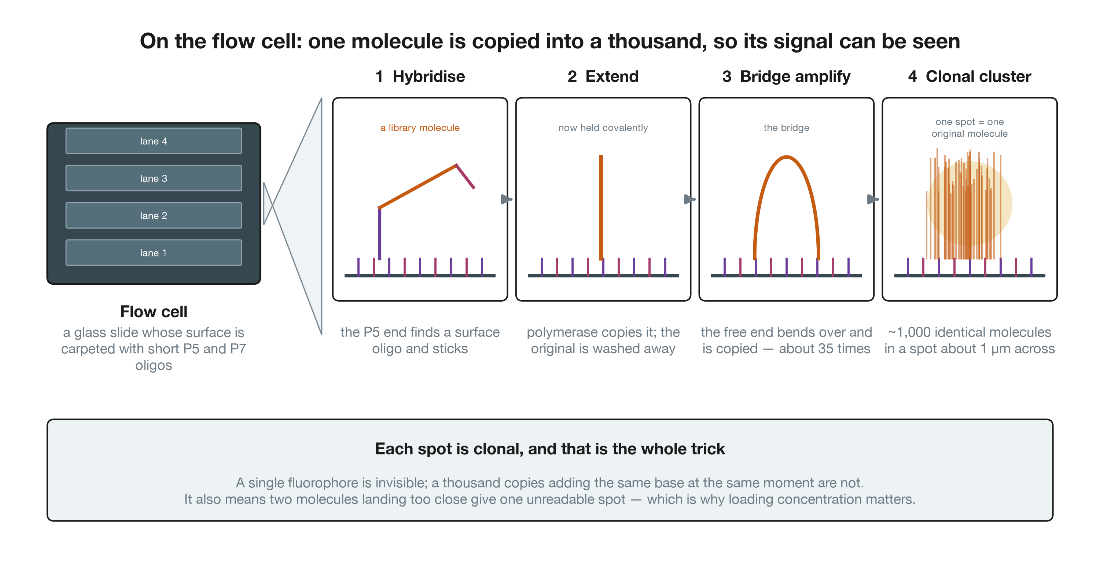
Making one molecule visible
Flow cell and cluster generation by bridge amplification

Slide 23
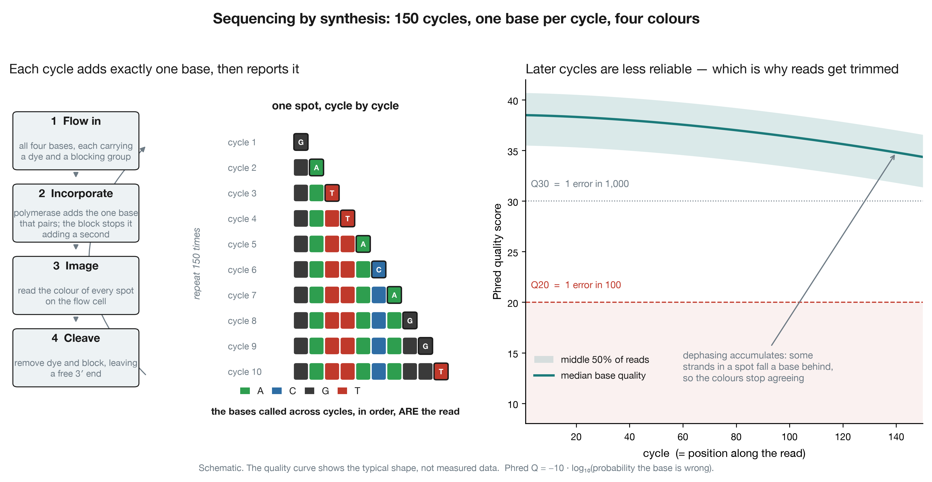
One base per cycle, 150 times
Sequencing by synthesis, and the decline in base quality along the read

Slide 24
What “depth” buys you
Depth is reads per sample, and it trades against sample number at fixed cost. The trade is not symmetric.
Question | Depth per sample
Differential expression, well-expressed genes | 10–20 M
Low-expressed genes, or subtle fold changes | 30–40 M
Novel transcript or isoform discovery | 60–100 M
Allele-specific or splicing analysis | 60 M+, paired-end essential
Beyond about 20 M reads, another biological replicate buys more statistical power than another 10 M reads. Sequencing deeper reduces technical noise, which was never your limiting factor; more replicates reduce biological variance, which is.

Slide 25
Stage 4 — Demultiplexing

Slide 26
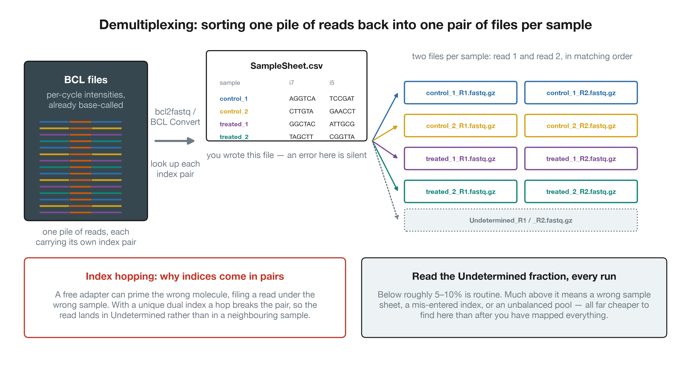
Sorting the pile back into samples
Demultiplexing pooled reads into per-sample FASTQ files

Slide 27
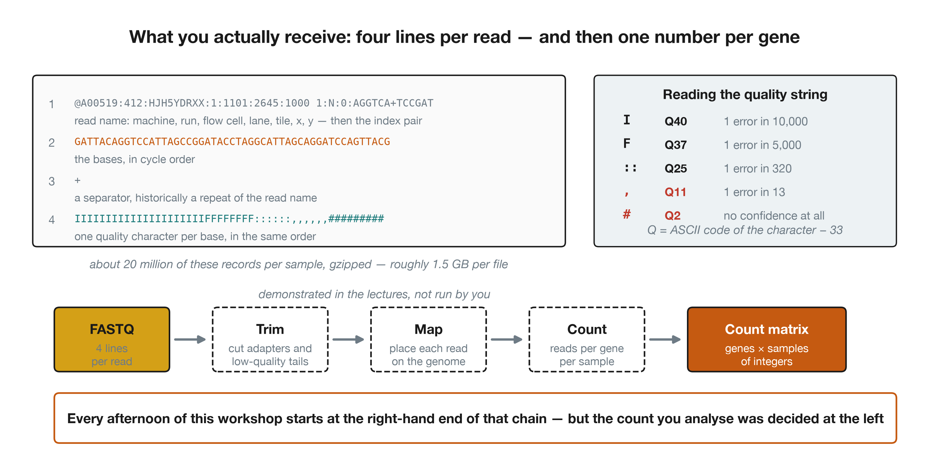
And this is what lands in your folder
The FASTQ record, and the path from reads to a count matrix

Slide 28
What to take away

Slide 29
Where each stage can betray you
Stage | The failure | Can you fix it later?
Extraction | degraded RNA, 3′ bias | no
Extraction | RIN confounded with condition | no
Enrichment | wrong chemistry for the RNA class | no
Library prep | unstranded library | no
Library prep | low-complexity, over-amplified | partly (deduplication)
Pooling | one condition per lane | no
Sequencing | too shallow | yes, by resequencing
Sequencing | low-quality read tails | yes, by trimming
Demultiplex | wrong sample sheet | yes, by re-running it
Seven of these ten are decided before the machine starts.

Slide 30
The five questions to ask about any count matrix
What was the RIN, per sample, and does it correlate with condition?
Poly-A or rRNA-depleted, and does that match the RNA class I care about?
Stranded or unstranded, and in which orientation?
How many reads per sample, and were they all on the same flow cell?
Which reference and annotation were the counts produced against?
Ask these of your collaborators, and of every public dataset you reuse. If a dataset’s authors cannot answer question 1 or 3, treat their count matrix with suspicion rather than gratitude.

Slide 31
What we do for the rest of the week
Everything from here on lives in the last box of that chain.
The counts you will analyse this afternoon were produced by exactly the process you have just seen — by someone else, some time ago, with decisions you did not make and mostly cannot inspect.
That is the normal situation for a computational biologist. Knowing what those decisions were is the difference between analysing data and processing numbers.

