Slide 1
Counts, Models and Differential Expression
Day 2 — Transcriptomics Summer School, Sarajevo
Instructor

Slide 2
Block 1 — What is in a count matrix?

Slide 3
Where we are
Yesterday: biology → library → reads → count matrix.
Today: the count matrix → a list of genes with fold changes and FDR-adjusted p-values.
This is the single most common analysis in functional genomics, and the single most commonly botched one. The botching is almost always statistical, not computational.

Slide 4
The object
SRR1039508 SRR1039509 SRR1039512 SRR1039513
ENSG00000000003 679 448 873 408
ENSG00000000005 0 0 0 0
ENSG00000000419 467 515 621 365
ENSG00000000457 260 211 263 164
ENSG00000000460 60 55 40 35
integers; one row per gene; one column per library
~20,000 rows × 4–100 columns for a typical experiment
most of the information is in a minority of the rows

Slide 5
Two structural facts that drive everything
1. Counts are compositional. A library has a fixed number of reads. If one gene takes a bigger share, every other gene’s share must fall — even if its absolute expression did not change. You measured proportions, not amounts.
2. Variance grows with the mean. A gene with mean count 10 might range 5–20. A gene with mean count 10,000 will range ~9,000–11,000 in relative terms but ±1,000 in absolute terms. Any model assuming constant variance is wrong.

Slide 6
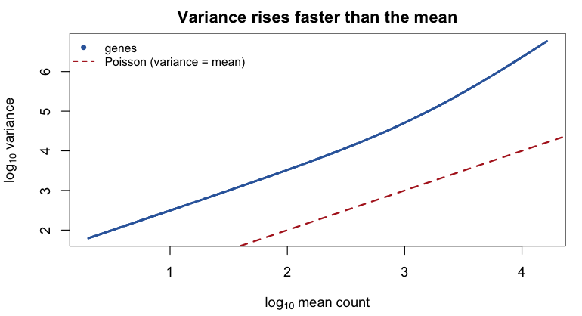
Mean–variance relationship in real data
Points lie above the Poisson line: there is extra (“over-”) dispersion from biological variability between replicates.

Slide 7
Zeros
A zero in a count matrix means “no read was assigned”. That has several possible causes:
the gene is genuinely not expressed in this tissue
the gene is expressed at a level below the detection limit at this depth
the gene is expressed but unmappable (repetitive, missing from annotation)
the sample failed
Bulk RNA-seq zeros are mostly real biological absence — a moderately expressed gene at 20 M reads will essentially never be zero. (Single-cell zeros are a completely different problem. Thursday.)

Slide 8
Filtering low counts
Genes with almost no reads carry no information but cost you multiple-testing power. Remove them before testing.
A standard, defensible rule:
keep <- rowSums(counts(dds) >= 10) >= smallest_group_size
dds <- dds[keep, ]
“At least 10 counts in at least as many samples as the smallest group.”
Notes:
filter on raw counts, and independently of condition — never “keep genes that differ between groups”
DESeq2 additionally does automatic independent filtering at the results stage; the manual filter mostly speeds things up
filtering on the outcome invalidates the p-values

Slide 9
Block 2 — Normalisation

Slide 10
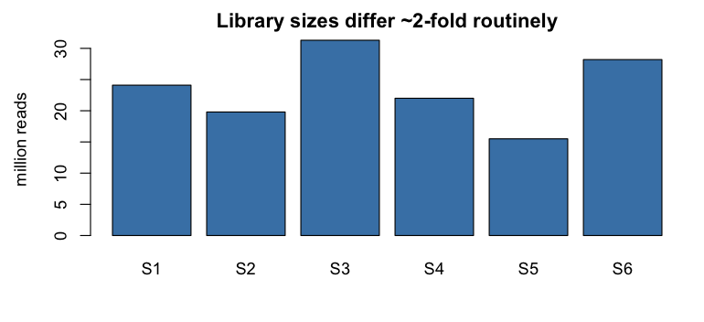
Why raw counts are not comparable

Slide 11
A gene with 200 counts in Sample 3 and 200 counts in Sample 5 is not equally expressed:
S5 was sequenced at half the depth.

Slide 12
Three different normalisation problems
Problem | Symptom | Needs
Library size | deeper sample looks “higher” for all genes | scaling per sample
Gene length | long genes get more reads | scaling per gene
Composition | a few dominant genes suppress everything else | robust scaling per sample
Which ones you must fix depends on the comparison you are making.

Slide 13
Within-sample vs between-sample
Comparing gene A to gene B in the same sample → you must correct for gene length. Use TPM.
Comparing gene A across samples → gene length is identical in both, so it cancels. You must correct for library size and composition. Use median-of-ratios / TMM.
Differential expression is a between-sample, within-gene comparison. Gene length is irrelevant. Composition is critical.

Slide 14
CPM, TPM, RPKM/FPKM
CPM = counts / library size × 10⁶ Corrects depth only. Fine for exploratory plots.
RPKM/FPKM = CPM / gene length in kb Corrects depth then length. Not comparable across samples — the denominator is a per-sample read total, so the units differ between samples.
TPM = (counts / length) normalised so the column sums to 10⁶ Corrects length then depth. Comparable within a sample; the standard unit for “how expressed is this gene here”.

Slide 15
Why you must not use TPM for differential expression
TPM columns sum to a constant by construction. So TPM is strictly compositional: if one gene truly triples, every other gene’s TPM falls.
Worse: TPM normalises by total signal, which is dominated by the few most-expressed genes. In a liver sample, albumin alone can take 10% of reads. A change in albumin shifts the apparent expression of everything.
Concrete failure: comparing a tissue with one massively dominant transcript to one without produces thousands of false “downregulated” genes.

Slide 16
Median-of-ratios (DESeq2’s size factors)
The idea: most genes are not differentially expressed, so the typical ratio between two samples should be 1.
For each gene, compute the geometric mean across all samples (the “reference pseudo-sample”)
For each sample, take the ratio of each gene’s count to its reference value
The sample’s size factor is the median of those ratios
Divide counts by the size factor
The median makes it robust: a handful of wildly changing genes cannot move it. This is what makes it composition-aware, unlike CPM/TPM.

Slide 17
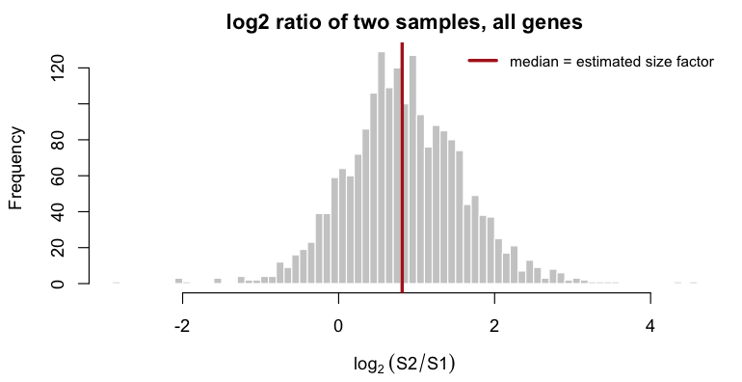
Size factors, illustrated
The bulk of genes pile up at the depth difference. The median finds it.

Slide 18
TMM (edgeR) — the same philosophy
Trimmed Mean of M-values:
Pick a reference sample
Compute log ratios (M) and mean abundances (A) for all genes
Trim the extremes: drop the top/bottom 30% by M and 5% by A
Take a weighted mean of what remains
Different arithmetic, same assumption: most genes are unchanged, so trim away the ones that are not.
In practice, DESeq2 and edgeR normalisation agree closely. Choose one and use it consistently; do not mix.

Slide 19
When the core assumption fails
Median-of-ratios and TMM both assume most genes do not change. That fails when:
you compare very different tissues or species
global transcriptional amplification occurs (e.g. MYC overexpression)
you deplete or add a large RNA fraction
most of the transcriptome genuinely shifts (some stress responses)
In those cases you need spike-ins (ERCC) or an orthogonal anchor (cell number per sample). Otherwise you cannot distinguish “everything went down” from “one thing went up”.

Slide 20
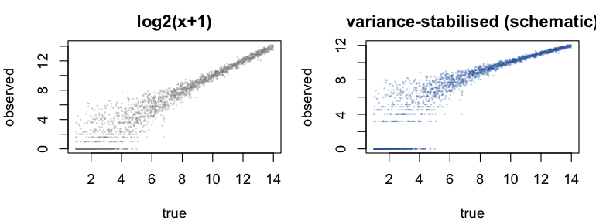
Transformations for visualisation ≠ normalisation for testing
For testing: DESeq2/edgeR use raw counts plus size factors as offsets in the model. Never feed them transformed data.
For plotting, PCA, clustering, heatmaps: you need roughly constant variance across the expression range.
log2(counts + 1) — simple, but low-count genes become the noisiest
vst() — variance-stabilising transformation; fast, recommended
rlog() — regularised log; better for small n (< 30), slower

Slide 21
Block 3 — The statistical model

Slide 22
Why not a t-test on log counts?
Counts are discrete, bounded below at zero, often small
Variance depends on the mean → the t-test’s assumption is violated
With n = 3 per group, the per-gene variance estimate has 4 degrees of freedom. It is wildly unstable: by chance some genes get a tiny variance and produce spectacular false positives
Log-transforming zeros is undefined
You are doing 20,000 tests

Slide 23
The Poisson model, and why it is not enough
If you sequenced the same library twice, read sampling is well described by a Poisson process:
$$K_{ij}∼\text{Poisson}(μ_{ij}), \text{Var}=\text{mean}$$
Technical replicates really do look Poisson.
But biological replicates are more variable than that. Two mice differ genuinely. Observed variance exceeds the mean — overdispersion. Using Poisson on biological replicates produces enormous numbers of false positives.

Slide 24
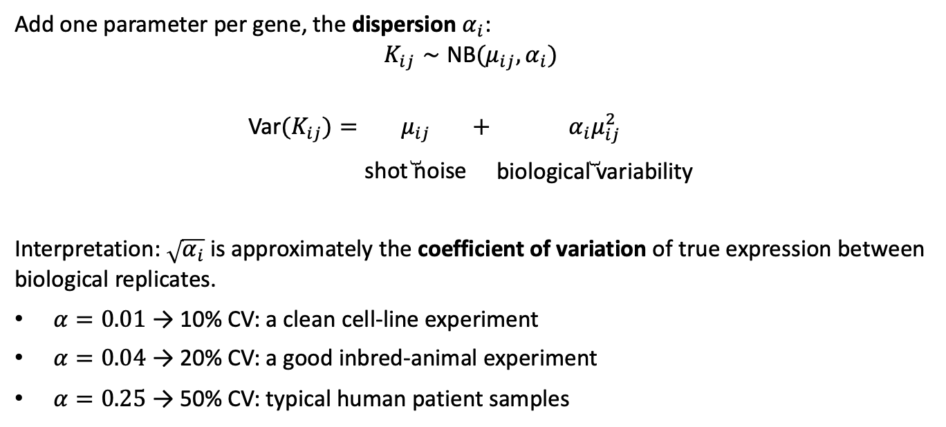
The negative binomial
Add one parameter per gene, the dispersion $α_{i}$:
$$K_{ij}∼\text{NB}(μ_{ij},α_{i})$$
$$\text{Var}(K_{ij})=\underset{\text{shot noise}}{\underset{⏟}{μ_{ij}}}+\underset{\text{biological variability}}{\underset{⏟}{α_{i}μ_{ij}^{2}}}$$
Interpretation: $\sqrt{α_{i}}$ is approximately the coefficient of variation of true expression between biological replicates.
$α=0.01$ → 10% CV: a clean cell-line experiment
$α=0.04$ → 20% CV: a good inbred-animal experiment
$α=0.25$ → 50% CV: typical human patient samples

Slide 25
The generalised linear model
For each gene $i$ and sample $j$:
$$\log_{2}(μ_{ij})=\log_{2}(s_{j})+\sum_{k}^{​}{x_{jk}} β_{ik}$$
$s_{j}$ — the size factor: a fixed offset, not a fitted parameter. This is how normalisation enters the model instead of being applied to the data.
$x_{jk}$ — the design matrix, from your design formula
$β_{ik}$ — the fitted log2 fold changes
For ~ condition with two levels, $β_{1}$ is exactly the log2 fold change you report.

Slide 26
Dispersion estimation
With n = 3 you cannot estimate a per-gene dispersion reliably. DESeq2 therefore shrinks gene-wise estimates towards a fitted trend:
Estimate a rough dispersion for each gene
Fit a smooth curve: dispersion as a function of mean expression (the trend — genes of similar expression have similar dispersion)
Shrink each gene’s estimate towards the trend, by an amount depending on how much data supports it (empirical Bayes)
Genes far above the trend are treated as outliers and not shrunk — protecting you from missing genuinely erratic genes
This borrowing of information across ~20,000 genes is what makes n = 3 workable at all.

Slide 27
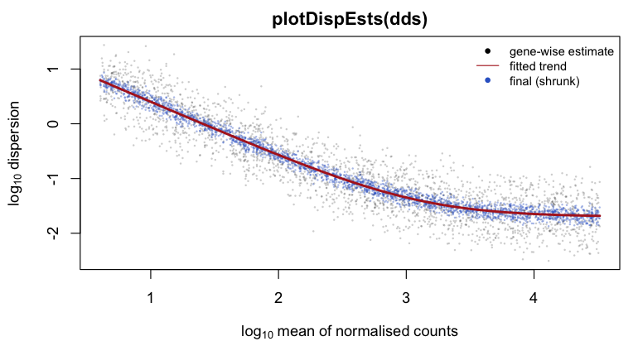
The dispersion plot
Look at this plot every time. A cloud around a decreasing red trend = healthy. No trend, or a trend that rises, means something is wrong with the design or the data.

Slide 28
Hypothesis testing: Wald
For a single coefficient, test $H_{0}:β_{ik}=0$:
$$z=\frac{{\hat{β}}_{ik}}{\text{SE}({\hat{β}}_{ik})}$$
compared to a standard normal. This is what results() returns by default.
Use for: one specific contrast — treated vs control, mutant vs wild-type, a single coefficient in a larger model.

Slide 29
Hypothesis testing: likelihood-ratio
Compare a full model to a reduced model:
dds <- DESeq(dds, test = "LRT", reduced = ~ batch)
with design = ~ batch + timepoint, this asks: does timepoint explain anything at all, over and above batch?
Use for: a factor with more than two levels, time courses, or “is this variable relevant in any way” questions. One p-value for the whole factor, instead of one per pairwise contrast.

Slide 30
log2 fold change shrinkage
A gene with 3 counts in one group and 12 in the other has a log2FC of +2 — and essentially no evidence. Raw fold changes for low-count genes are noisy and dominate any ranking by effect size.
res <- lfcShrink(dds, coef = "condition_treated_vs_untreated",
type = "apeglm")
Shrinks low-information fold changes towards zero while leaving well-measured ones alone. p-values are unchanged — only the estimates and their intervals.
Use shrunken LFCs for: ranking genes, volcano plots, heatmap ordering.

Slide 31
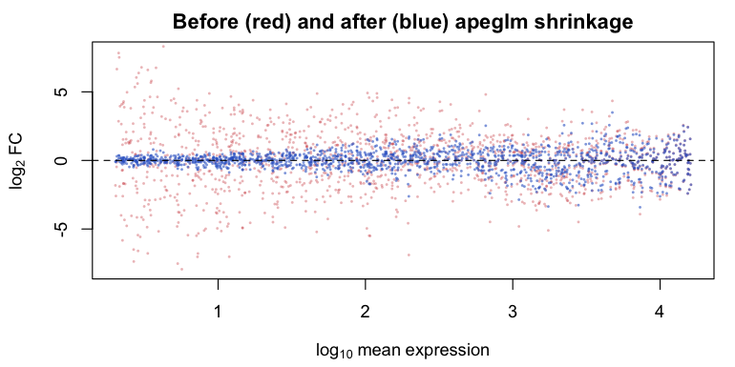
Shrinkage, illustrated
Exp= ~0
but
logFC= ~6

Slide 32
Shrinkage, illustrated
The noisy fan at low expression collapses; high-expression estimates are untouched.

Slide 33
Multiple testing
20,000 tests at $α=0.05$ → 1,000 false positives expected even if nothing is differentially expressed.
Bonferroni: $p×m$. Controls the probability of any false positive. Far too conservative here — you would find almost nothing.
Benjamini–Hochberg (FDR): controls the expected proportion of false positives among the genes you call significant.
“padj < 0.05, 400 genes” means: of those 400, about 20 are expected to be false. That is the right trade-off for a discovery experiment whose hits you will follow up.
Report padj. Never pvalue.

Slide 34
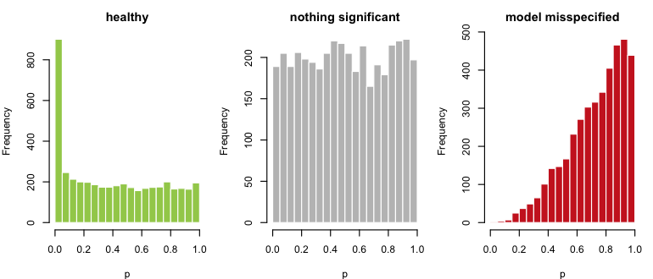
The p-value histogram — your best diagnostic

Slide 35
Flat + spike near 0 = good. Flat = no signal (which can be the correct answer). Hill at the right, or a U shape = your model is wrong (usually an unmodelled batch, or a wrong reference level).

Slide 36
NA values in the results table
DESeq2 returns NA deliberately, in three situations:
all three columns NA — the gene had zero counts everywhere
pvalue and padj NA — a count outlier was detected (Cook’s distance) in a design with replicates
padj only NA — the gene was removed by independent filtering: its mean expression was too low for the test to have useful power, so excluding it increases the number of discoveries overall
NA in padj is not “missing data”. Do not impute it, do not na.omit() before counting your hits without understanding why.

Slide 37
Block 4 — Design formulae

Slide 38
Reading a design formula
~ condition # one factor
~ batch + condition # condition, controlling for batch
~ genotype + treatment # main effects only, additive
~ genotype * treatment # = genotype + treatment + genotype:treatment
~ patient + treatment # paired design
Rules:
the last term is what results() reports by default
terms before it are covariates you adjust for
: is an interaction; * expands to main effects plus interaction
the first level of a factor is the reference

Slide 39
Setting the reference level — do this every time
dds$condition <- relevel(dds$condition, ref = "untreated")
If you forget, R orders levels alphabetically and your fold changes may be inverted relative to how you describe them in the text. This is a silent error: nothing fails, the sign is just wrong.
Check before you interpret:
levels(dds$condition)
resultsNames(dds)

Slide 40
Paired and blocked designs
Paired samples (same patient before/after, littermates, batches of cells) are more powerful if you model the pairing:
design(dds) <- ~ patient + treatment
Each patient gets their own intercept, so between-patient variation is absorbed rather than inflating the residual. This is the regression equivalent of a paired t-test.
Caveat: patient costs one parameter per patient. With n = 3 pairs the design is already tight; you cannot also add three other covariates.

Slide 41
Interactions — the question they answer
design(dds) <- ~ genotype + treatment + genotype:treatment
The interaction term does not ask “is the gene affected by treatment”. It asks:
Is the treatment effect different in the mutant than in the wild type?
That is a different — and usually harder — question. Interactions have lower power than main effects and need more replicates. Do not add one unless the interaction is your hypothesis.

Slide 42
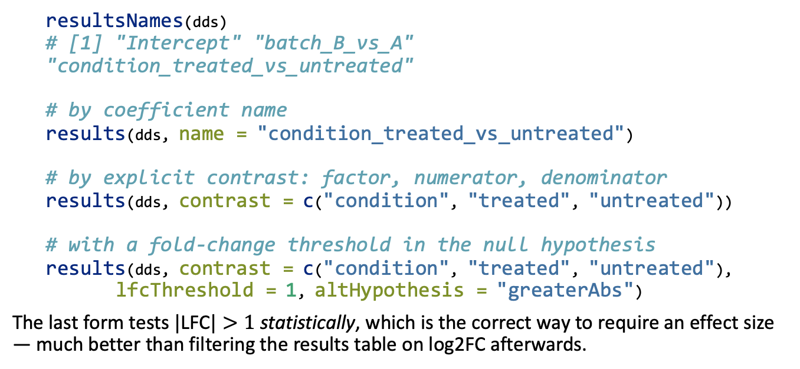
Extracting the contrast you want
resultsNames(dds)
# [1] "Intercept" "batch_B_vs_A" "condition_treated_vs_untreated"
# by coefficient name
results(dds, name = "condition_treated_vs_untreated")
# by explicit contrast: factor, numerator, denominator
results(dds, contrast = c("condition", "treated", "untreated"))
# with a fold-change threshold in the null hypothesis
results(dds, contrast = c("condition", "treated", "untreated"),
lfcThreshold = 1, altHypothesis = "greaterAbs")
The last form tests $|\text{LFC}|>1$ statistically, which is the correct way to require an effect size — much better than filtering the results table on log2FC afterwards.

Slide 43
DESeq2 vs edgeR vs limma-voom
 | DESeq2 | edgeR | limma-voom
Model | NB GLM | NB GLM | linear model + precision weights
Normalisation | median-of-ratios | TMM | TMM
Dispersion | shrink to trend | shrink to trend (QL) | via voom weights
Small n (2–5) | strong | strong | adequate
Large n (> 30) | slow | fine | fast, flexible
Complex designs | good | good | best (duplicateCorrelation, etc.)
In benchmarks all three perform comparably on well-behaved data. The choice is about design complexity and sample size, not correctness. Pick one a priori — running all three and picking the nicest result is p-hacking.

Slide 44
What to report in a methods section
Reads were quantified with Salmon v1.10 against GENCODE v44 and imported with tximport. Genes with fewer than 10 counts in at least 3 samples were removed (16,412 of 61,852 retained). Differential expression was assessed with DESeq2 v1.42 using the design ~ batch + condition, with condition releveled to untreated as reference. Log2 fold changes were shrunk with apeglm. Genes with Benjamini–Hochberg adjusted p < 0.05 were considered differentially expressed.
Every number and version in that paragraph matters for reproducibility.

Slide 45
Common mistakes, collected
Using TPM/FPKM as input to DESeq2
Forgetting relevel() → inverted fold changes
Reporting pvalue instead of padj
Filtering genes based on the comparison of interest
Confounding batch with condition → unfixable
Treating technical replicates as n
Ranking by fold change without shrinkage
na.omit()-ing the results table without understanding the NAs
Concluding “no change” from a non-significant result at n = 3
Running three DE tools and reporting the nicest

Slide 46
This afternoon
Day2_BulkRNAseq_DE/scripts/02_DESeq2_workflow.R
Your group’s dataset, end to end:
Load counts + metadata; verify the column order
Build the DESeqDataSet; set the reference level
Filter low-count genes
Run DESeq(); inspect size factors and plotDispEsts()
Extract results; look at the p-value histogram
lfcShrink(); MA plot
Export an annotated results table for tomorrow
Stop and interpret at each step. Anyone can run seven functions; the skill is knowing when the output is telling you something is wrong.

Slide 47
Tomorrow
Morning: exploratory analysis and visualisation (PCA, clustering, volcano plots, heatmaps) and functional interpretation (GO over-representation, GSEA, and how both mislead you).
Afternoon: turning today’s results table into figures and biology.

