Slide 1
Brain Tumor Diagnosis Assistant
Group 8
Tarik Bilgin Demirci – Technical Lead (Student 1)
Umut Turklay – Figures, Tables & Presentation (Student 2)
Berk Kahraman – Report & Storytelling (Student 3)
Pattern Recognition | Winter 2025

Slide 2
Problem Statement
● Brain tumors are life-threatening conditions requiring accurate and timely diagnosis
● Manual MRI analysis is time-consuming and prone to inter-observer variability
● Need for automated, reliable, and interpretable diagnostic systems
● Challenge: Achieve high accuracy while maintaining clinical trust
● Goal: Develop a hybrid AI system combining deep learning with clinical knowledge
Pattern Recognition | Group 8 | Brain Tumor Diagnosis
2 / 14

Slide 3
Research Questions
● RQ1: How effectively can CNNs classify brain tumor types from MRI scans?
● RQ2: Can meta-learning with shape descriptors improve classification accuracy?
● RQ3: How can rule-based clinical knowledge enhance diagnostic reliability?
● RQ4: What is the impact of explainability techniques (Grad-CAM) on interpretability?
● RQ5: How do different architectures (ResNet, EfficientNet, DenseNet) compare?
Pattern Recognition | Group 8 | Brain Tumor Diagnosis
3 / 14

Slide 4
Literature Review / Related Work
Author | Year | Method | Dataset | Accuracy | Limitation
Deepak & Ameer | 2019 | GoogleNet + SVM | CE-MRI (3064) | 98.0% | No explainability
Afshar et al. | 2019 | CapsNet | CE-MRI (3064) | 90.9% | Limited tumor types
Badza & Barjaktarovic | 2020 | CNN (Custom) | Figshare (3064) | 96.6% | No clinical integration
Swati et al. | 2019 | VGG-19 Transfer | CE-MRI (3064) | 94.8% | Single architecture
Our Work | 2025 | Xception+Meta+Rules | Kaggle (7023) | 99.5% | Hybrid approach
Our work: Combining CNN with meta-learning and rule-based clinical integration for improved reliability.
Pattern Recognition | Group 8 | Brain Tumor Diagnosis
4 / 14

Slide 5
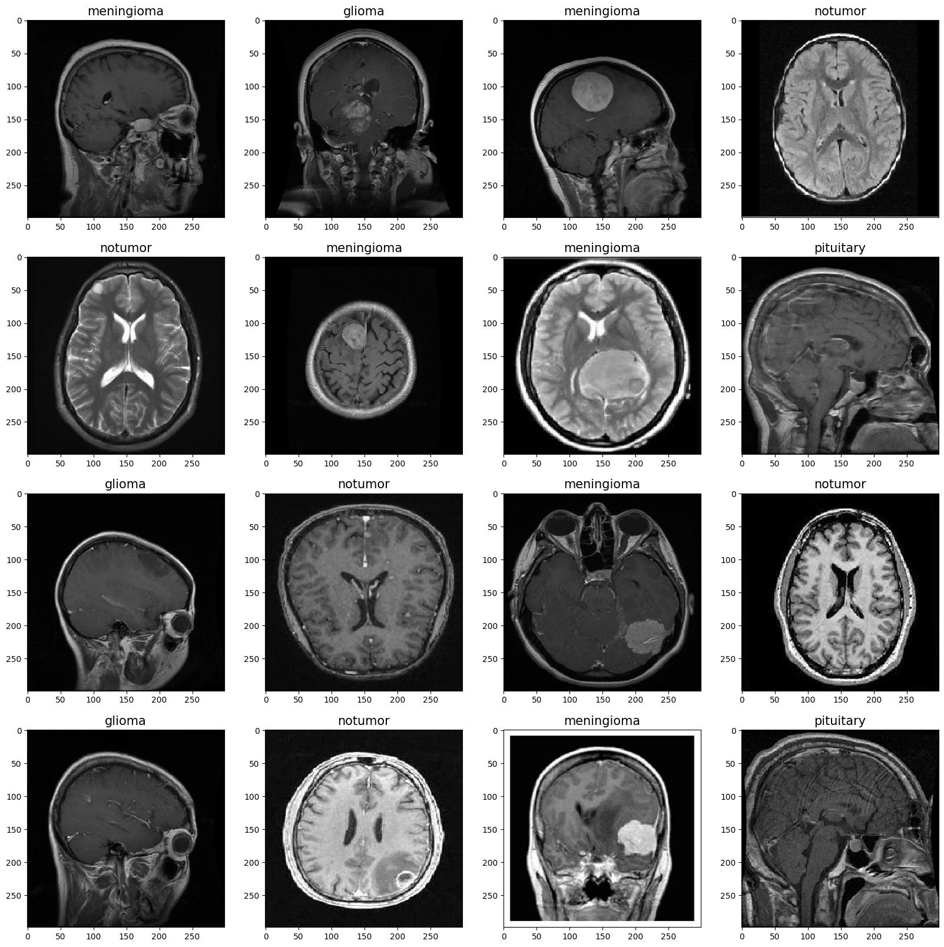
Dataset Overview
● Source: Kaggle Brain Tumor MRI Dataset | 4 Classes: Glioma, Meningioma, Pituitary, No Tumor
● Total: 5,712 training | 655 validation | 656 test images | Size: 299×299 RGB
Pattern Recognition | Group 8 | Brain Tumor Diagnosis
5 / 14

Slide 6
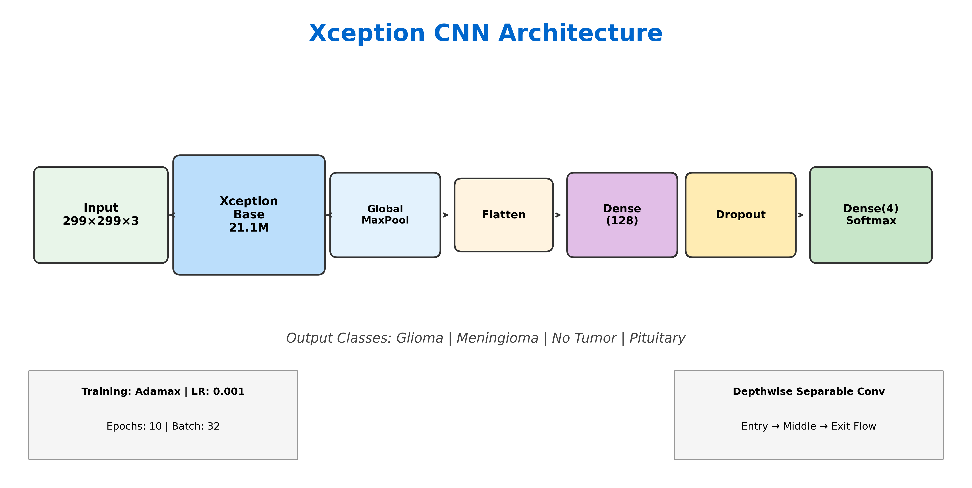
Network Architecture: Xception (Primary Model)
Pattern Recognition | Group 8 | Brain Tumor Diagnosis
6 / 14

Slide 7
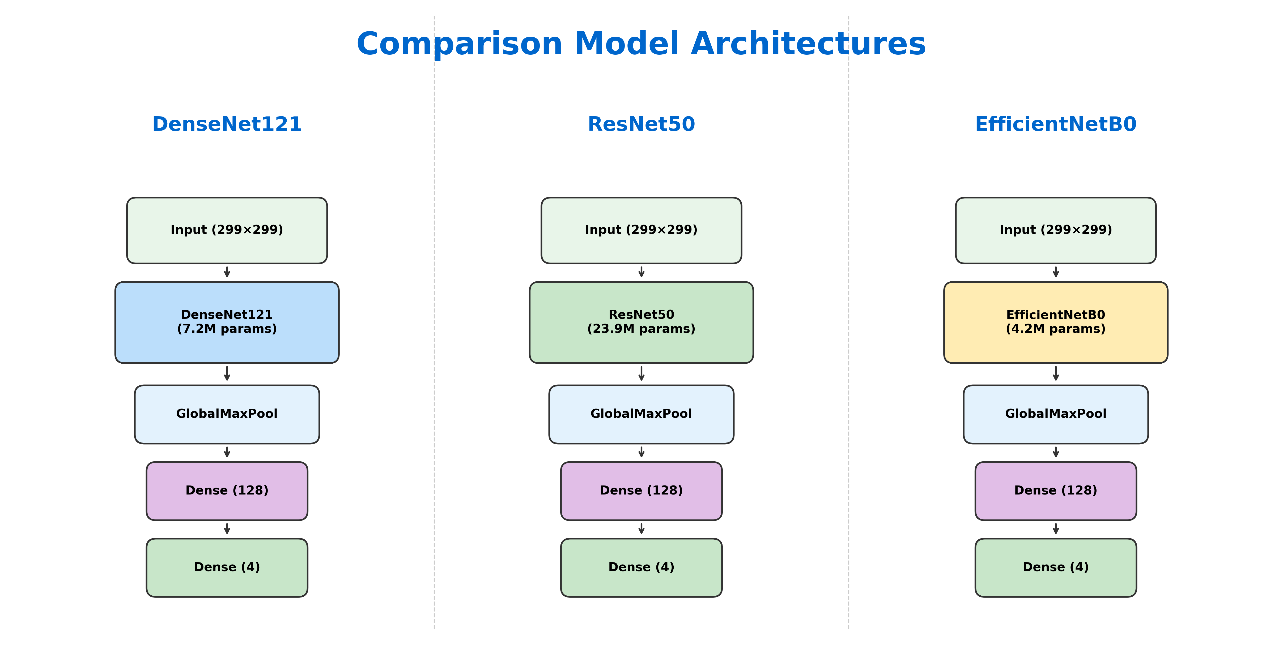
Network Architecture: Comparison Models (RQ5)
Pattern Recognition | Group 8 | Brain Tumor Diagnosis
7 / 14

Slide 8
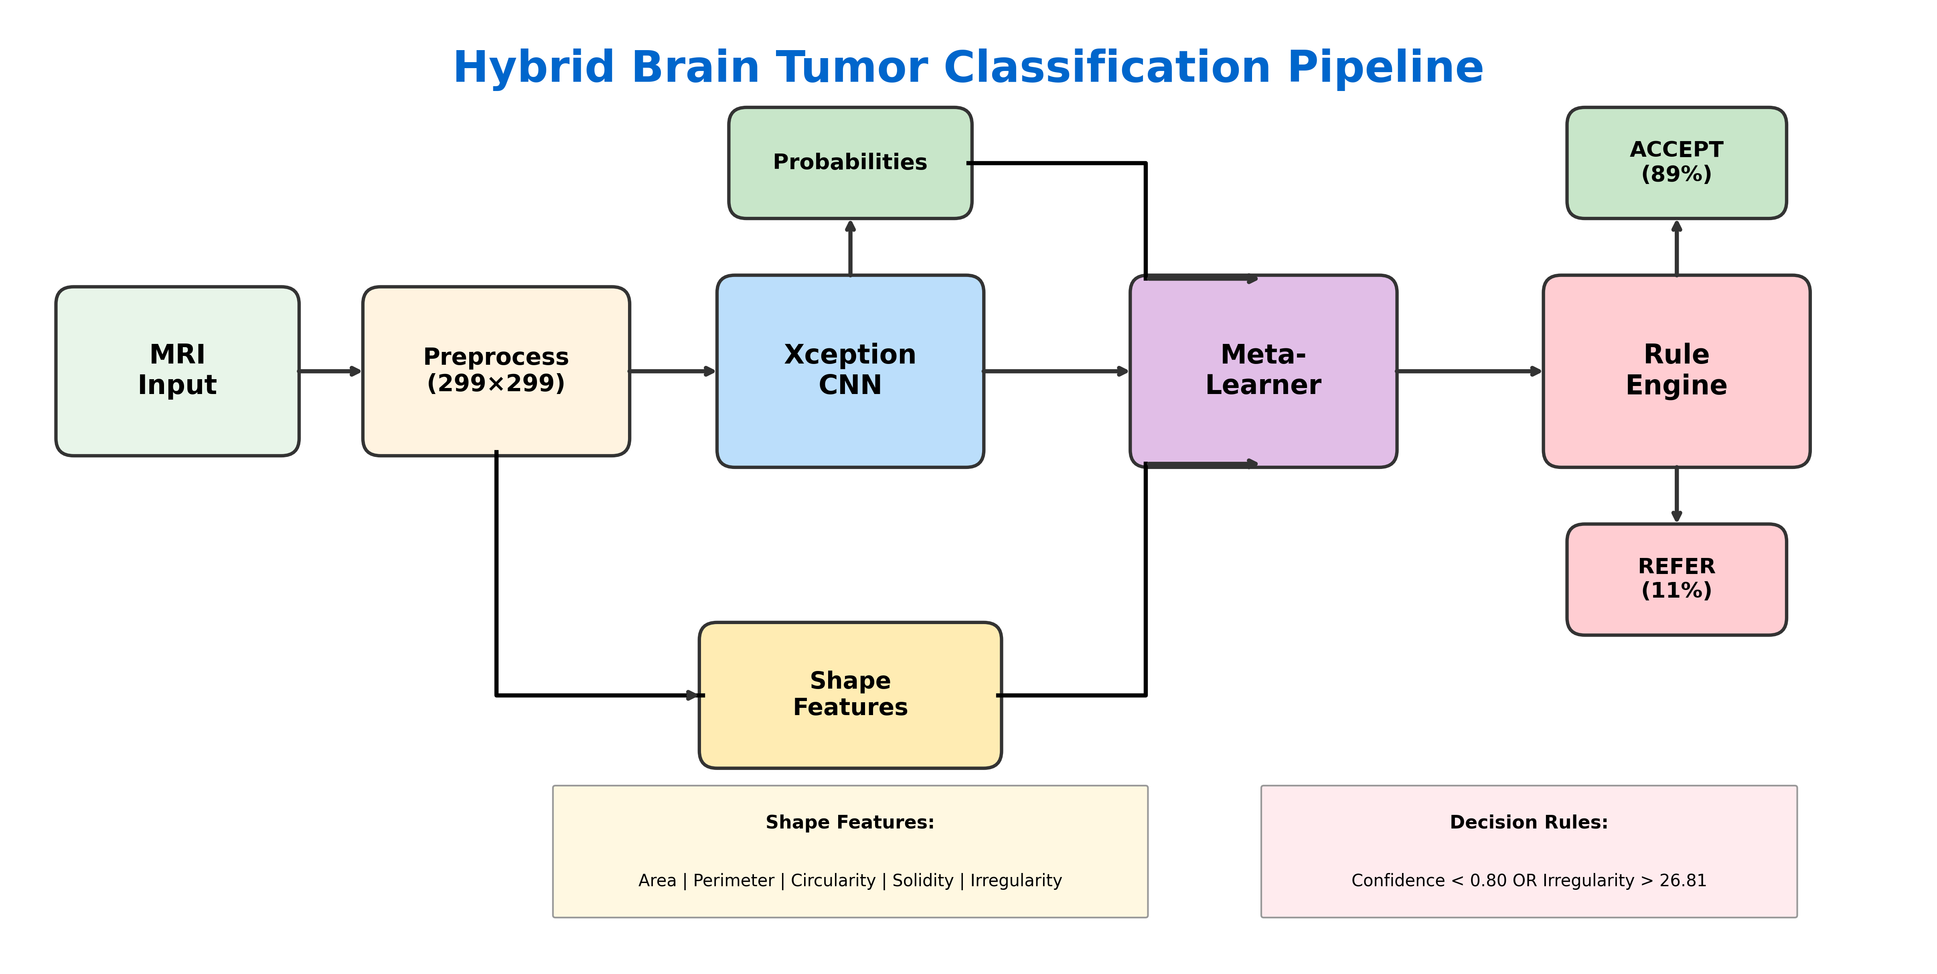
Methodology: Hybrid Classification Pipeline
Pattern Recognition | Group 8 | Brain Tumor Diagnosis
8 / 14

Slide 9
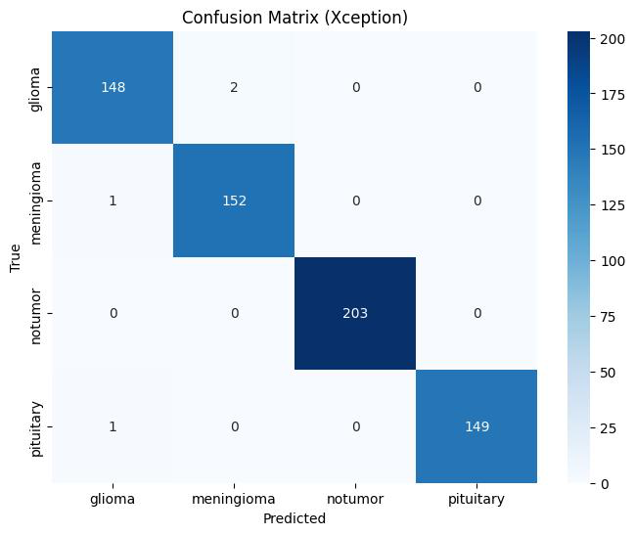
RQ1
CNN Classification Effectiveness
Class | Precision | Recall | F1 | Support
Glioma | 0.99 | 0.99 | 0.99 | 150
Meningioma | 0.99 | 0.99 | 0.99 | 153
No Tumor | 1.00 | 1.00 | 1.00 | 203
Pituitary | 1.00 | 0.99 | 1.00 | 150
Overall | 0.99 | 0.99 | 0.99 | 656
Key Observations
✓ Xception achieves 99.39% test accuracy on 4-class brain tumor classification
✓ Perfect recall (100%) on No Tumor class - critical for avoiding false negatives
✓ Balanced performance across all tumor types with F1 ≥ 0.99
Pattern Recognition | Group 8 | Brain Tumor Diagnosis
9 / 14

Slide 10
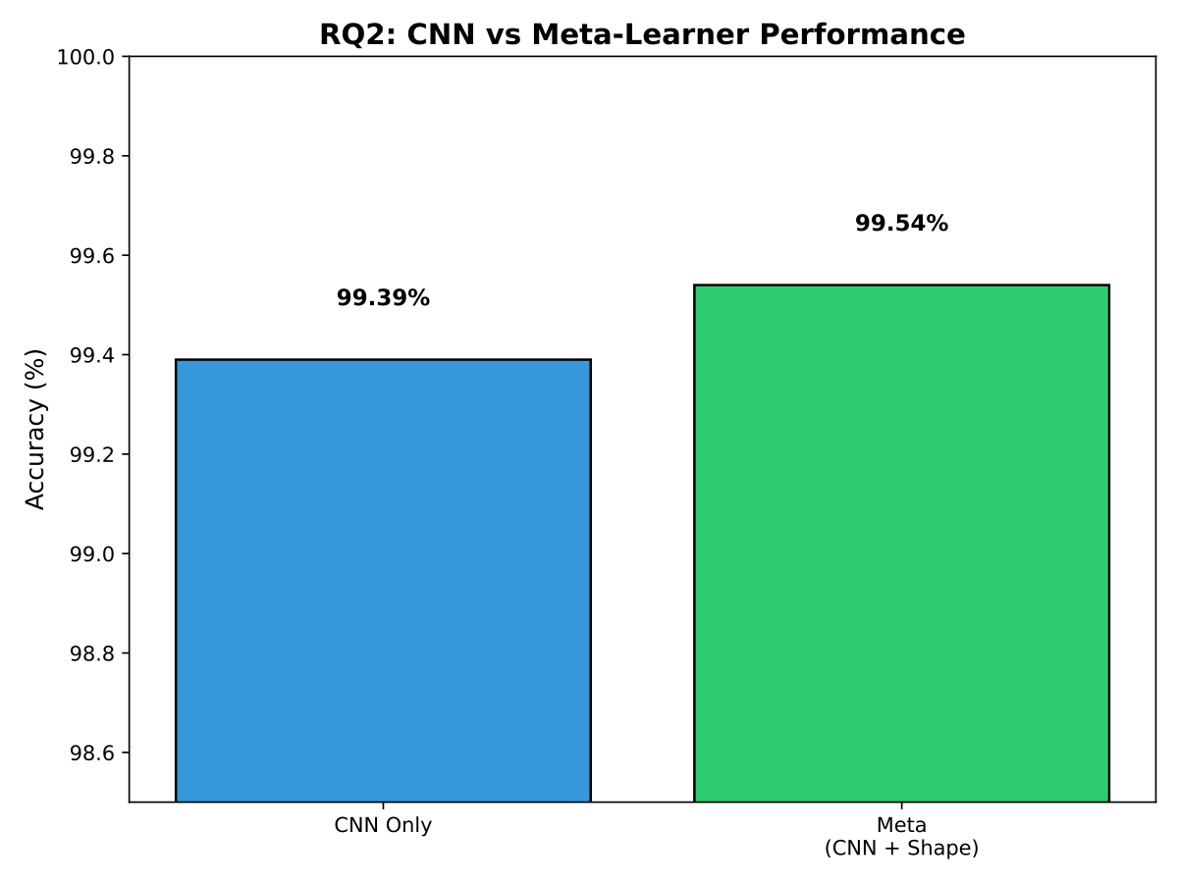
RQ2
Meta-Learning with Shape Features
Model | Accuracy | Improvement
CNN Only (Xception) | 99.39% | Baseline
Meta-Learner (CNN + Shape) | 99.54% | +0.15%
Key Observations
✓ Shape features (area, perimeter, circularity, solidity, irregularity) provide complementary information
✓ Meta-learner (Logistic Regression) successfully combines CNN outputs with shape descriptors
✓ Modest but consistent improvement demonstrates value of hybrid approach
Pattern Recognition | Group 8 | Brain Tumor Diagnosis
10 / 14

Slide 11
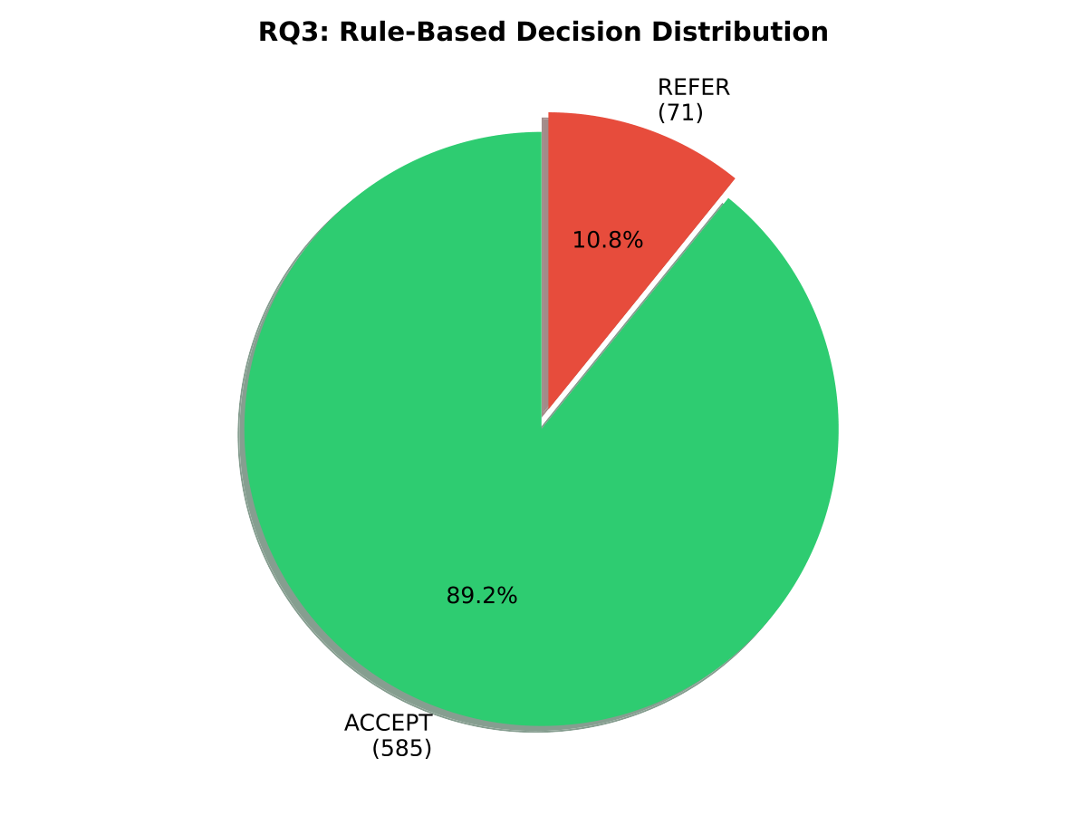
RQ3
Rule-Based Clinical Integration
Metric | Value
Confidence Threshold | 0.80
Irregularity Threshold | 26.81 (90th pctl)
ACCEPT Rate | 89.18% (585)
REFER Rate | 10.82% (71)
Accuracy on ACCEPT | 99.66%
Key Observations
✓ Rule engine flags uncertain cases based on confidence and tumor irregularity
✓ 89% of cases automatically accepted with higher accuracy (99.66%)
✓ Remaining 11% referred to specialists - practical clinical workflow
Pattern Recognition | Group 8 | Brain Tumor Diagnosis
11 / 14

Slide 12
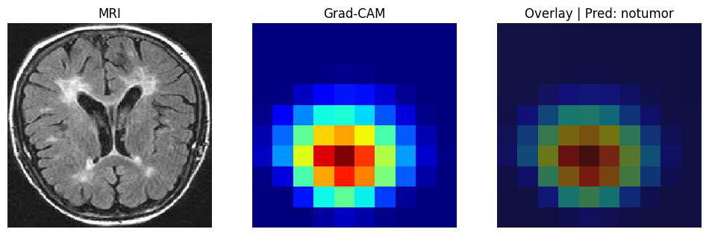
RQ4
Explainability with Grad-CAM
Aspect | Description
Method | Gradient-weighted Class Activation Mapping
Target Layer | block14_sepconv2_act (Xception)
Output | Heatmap highlighting influential regions
Purpose | Enable clinician trust and understanding
Key Observations
✓ Grad-CAM successfully highlights tumor regions that influence predictions
✓ Provides visual explanation for each classification decision
✓ Critical for clinical adoption and regulatory compliance (explainable AI)
Pattern Recognition | Group 8 | Brain Tumor Diagnosis
12 / 14

Slide 13
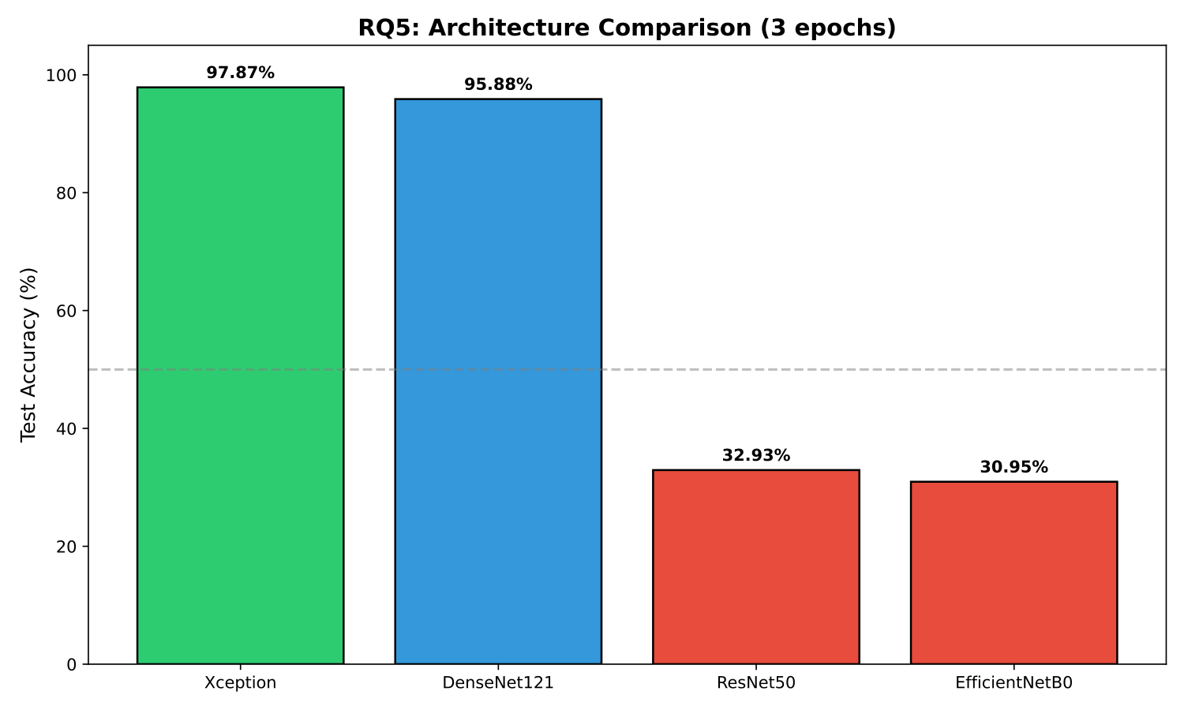
RQ5
Architecture Comparison
Architecture | Accuracy | Params | Time (s)
Xception | 97.87% | 21.1M | 1,390
DenseNet121 | 95.88% | 7.2M | 2,431
ResNet50 | 32.93% | 23.9M | 2,416
EfficientNetB0 | 30.95% | 4.2M | 1,999
Key Observations
✓ Xception significantly outperforms all other architectures for this task
✓ DenseNet121 shows reasonable performance but lower than Xception
✓ ResNet50 and EfficientNetB0 fail to generalize - need different fine-tuning
Pattern Recognition | Group 8 | Brain Tumor Diagnosis
13 / 14

Slide 14
Conclusion
● Key Findings:
• Xception CNN achieves 99.39% accuracy on brain tumor classification
• Meta-learning with shape features improves accuracy to 99.54%
• Rule-based engine enables 99.66% accuracy on 89% auto-accepted cases
• Grad-CAM provides interpretable visualizations for clinical trust
● Limitations:
• Single dataset - needs multi-center validation
• Limited to 4 tumor types
● Future Work:
• Extend to more tumor types and 3D MRI volumes
• Clinical trials for real-world deployment validation
Pattern Recognition | Group 8 | Brain Tumor Diagnosis
14 / 14

