Slide 1
WELCOME TO Angular Store
TARIKH MAHDI
ID: 1207353

Slide 2
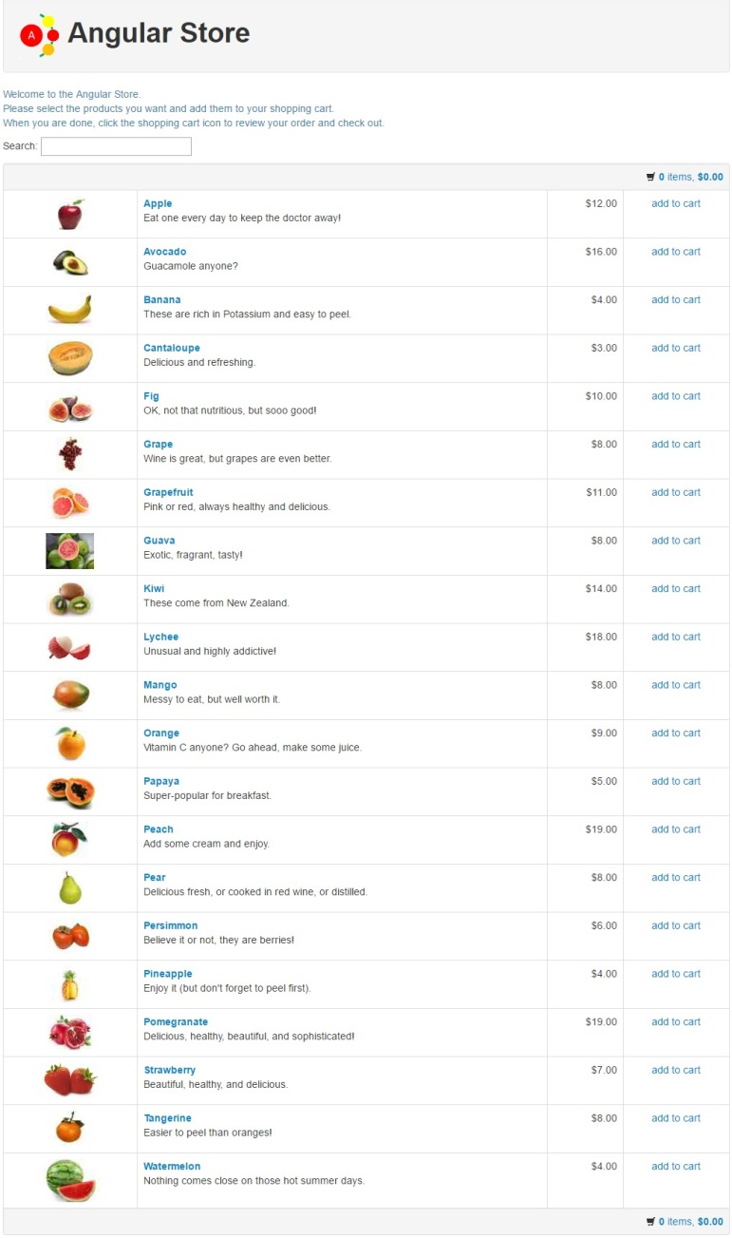
Home Page

Slide 3
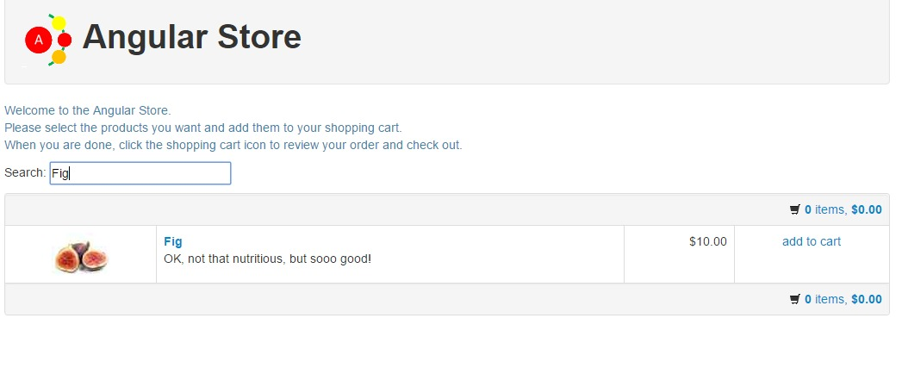

Slide 4
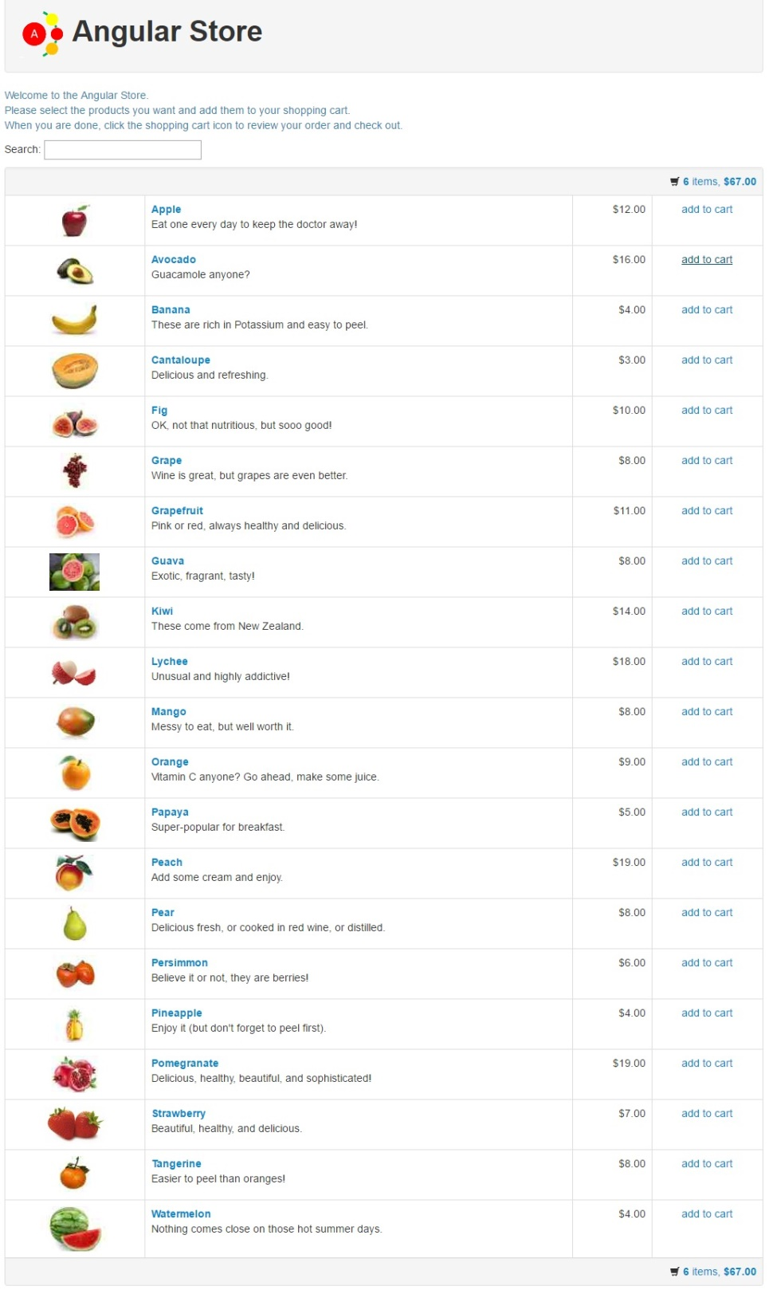

Slide 5
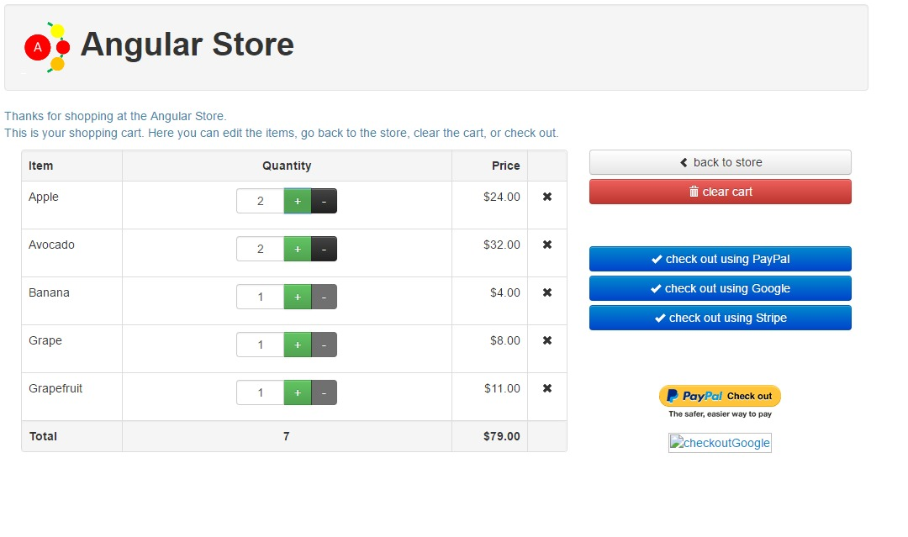

Slide 6
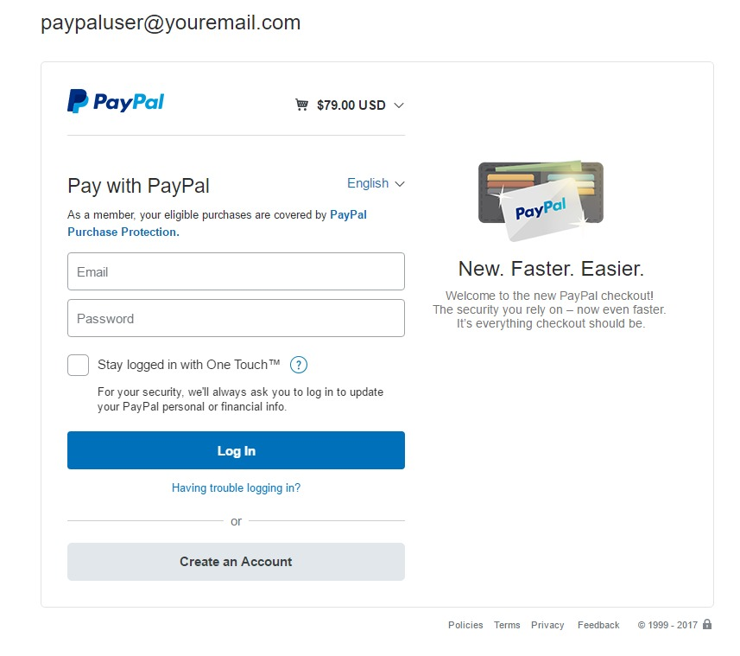

Slide 7
Thank you for watching

