Slide 1

IT 334 – DevOps Engineering on AWS Cloud
Project – Building a Highly Available, Scalable Web Application
Group 1: Tarik Maljanović Melisa Geca
Date 06.06.2024
Teacher: Dzenana Dzevlan

Slide 2
Business scenario overview
The XYZ University has received bad feedback about their web application for managing student records. Report of slow responses and high downtime during peak admissions periods are very common. The goal is to create a functioning, scalable and highly available solution.
The requirements set for this solution are the following:
The website has to be functional, it has to perform all the necessary operations (insert, update, delete records).
It has to be load balanced, meaning that the network load has to be distributed across multiple servers in order to not overwhelm a single server with too many requests.
The solution has to be scalable, meaning that it has to accommodate the growing demand by increasing the amount of computational resources.
The system must be highly available and should have minimal downtime. In cases of server failure, there should always be a backup to maintain the solution.
The solution must be secure in order to prevent any malicious activities (for example accessing the database from unallowed ports).
The solution should also be cost optimised where it should meet a budget with a defined maxim of 100$.
The solution should be high performing, meaning that it should perform the required functionalities with as little delay as possible
Notes:
You can also go more in depth about the design considerations and trade-offs that you made.

Slide 3
Solution overview
The solution of our project was building a web application for a university that will keep track of student records.
The target group in our scenario will be the admissions department of the University, meaning that they will need to store simple records about their students, thus our solution meets the requirements through the following services:
In order to make the website accessible, functional and highly available we created a Virtual Private Cloud (VPC) along with the appropriate subnetworks, internet gateway, network address translation gateway (NAT gateway) and route tables to make our network available to the public. Additionally, we deployed two EC2 instances, that both host this website and allow all HTTP traffic to it (achieved by using Security Groups). In the case of server failure, an additional server will still make the website available, this solution decreases downtime.
To address high demand, our solution implements Auto Scaling. Meaning that new instances will be created to accommodate this requirement. This is achieved by creating an AMI (Amazon Machine Image) from one of our instances, thus a replica can be created without repeated configuring.
The solution is load balanced by creating a Load Balancer that will distribute network traffic across the instances. This is achieved by creating a target group, which is a group of instances that receive traffic from the load balancer. The load balancer provides us with a single DNS record to access the website.
The security need of our solution is addressed by protecting the data within the RDS database by not making it publicly available but only available for our instances. Additionally, the database credentials are protected with the use of the AWS Secrets Manager.
Cost requirement is addressed by carefully selecting the options of our services. For example, the solution does not require high computation power, thus we didn’t select expensive instance types. Additionally, the solution does not require high storage capacity (only textual records will be stored), thus the storage was set to 20GB.
Notes:
Explain at a high level what you have built.
For example: “I built a web application for a company to host their blog.“
Talk about why you chose certain parts of the solutions and any tradeoffs that you made. Focus on how you designed the solutions and how you applied the AWS Well-Architected Framework as part of the process (AWS Well-Architected Framework: https://docs.aws.amazon.com/wellarchitected/latest/framework/welcome.html).
For example: “I configured load balancers and auto scaling to make the application highly available and reliable.”
Include the use cases that you are addressing. Think about who your users are and how they would want to interact with your solution to solve their problem.
For example: “Users can view, upload, edit, and delete blog posts. Administrators can approve blog posts.”
Talk about the use cases that you addressed as part of the minimum viable product (MVP) that you scoped and built.
Note:
An above-bar description is concise and includes the most important benefits. For example: “The solution allows customers to quickly upload, store, and search large catalogs of images and videos in Amazon S3.”
A below-bar description is too detailed or not specific. For example: “Our solution analyzes media files.”

Slide 4
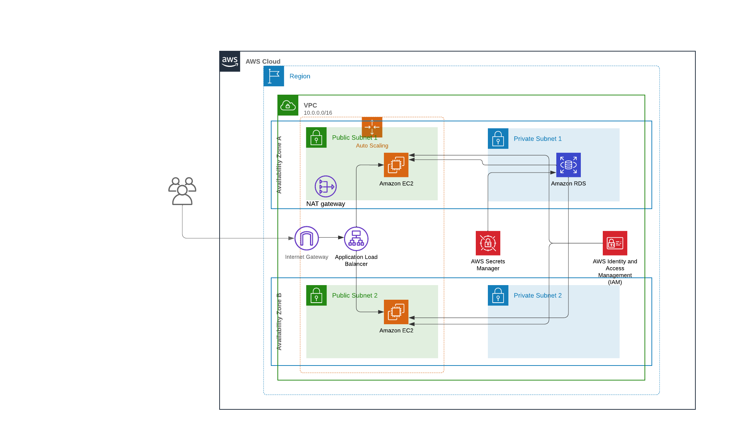
Architecture diagram of the solution :
Notes:
Note: Remove this slide from your final presentation.
This example architecture diagram shows a solution to configure a webhook to link Git with AWS. You can find this example in the Toolkits for PowerPoint at https://aws.amazon.com/architecture/icons.

Slide 5
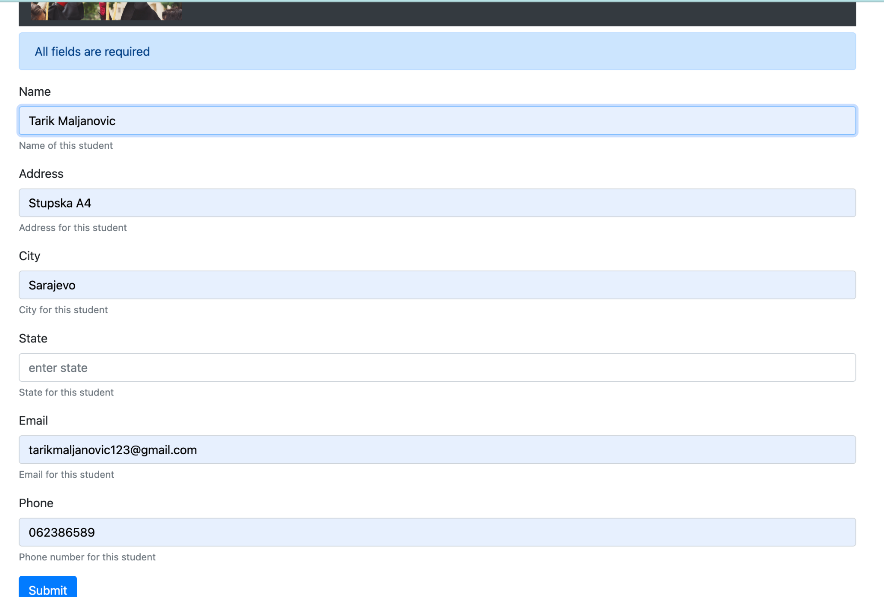
Demo
Notes:
For the demo, guide the audience through the two to three most important benefits of the solution and how it addresses the requirements.
Your demo materials can be screen captures, recordings, or to show AWS console.

Slide 6
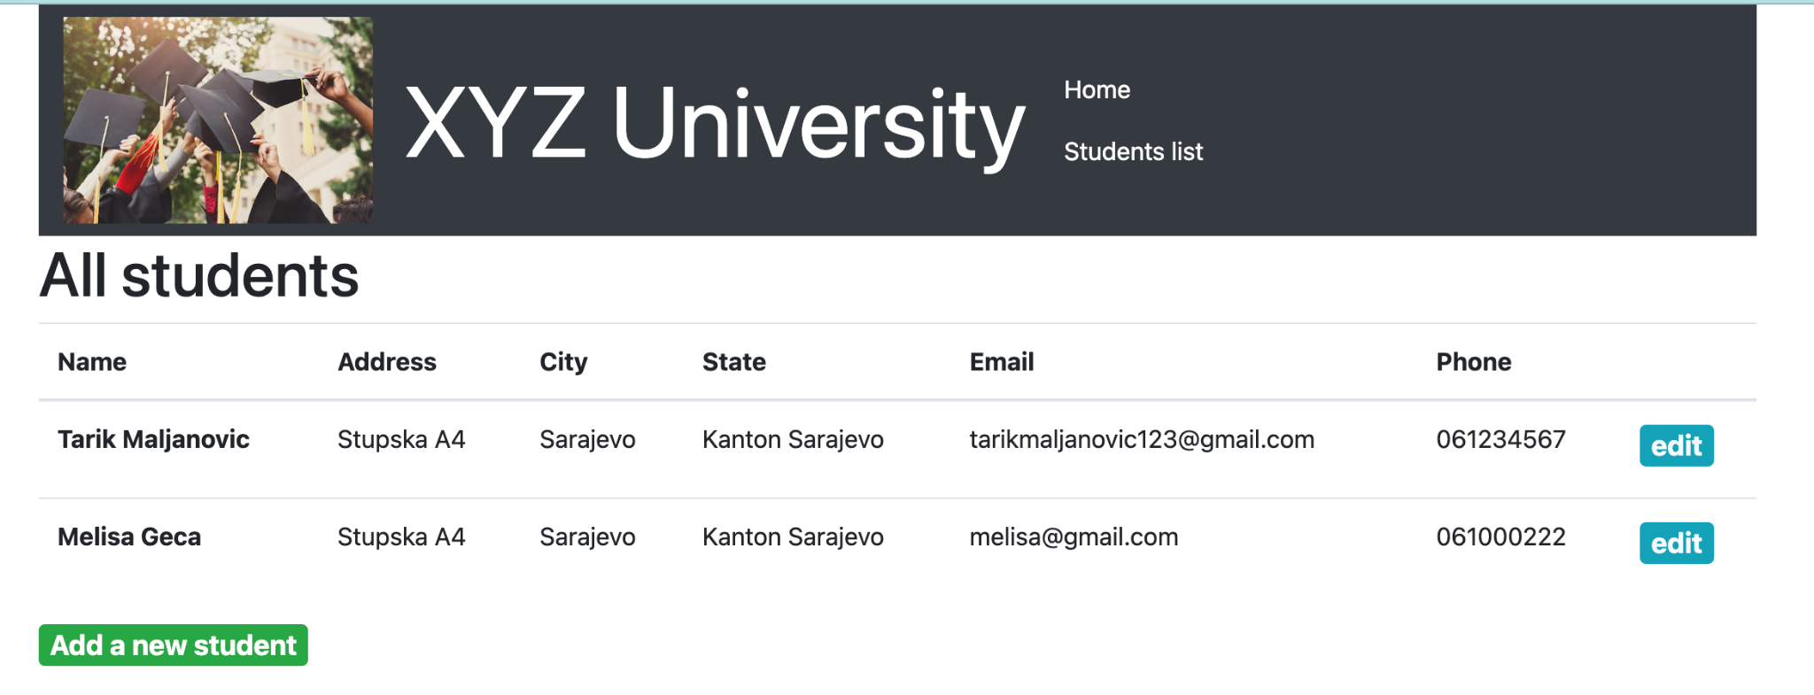
Demo
Notes:
For the demo, guide the audience through the two to three most important benefits of the solution and how it addresses the requirements.
Your demo materials can be screen captures, recordings, or to show AWS console.

Slide 7
Lessons Learned
Challenges we faced during the project execution:
Our first challenge was navigating the AWS console, with a variety of services and their scale of optimisation was overwhelming before getting comfortable with the interface.
Understanding how the services communicate with each other. For example, connecting the RDS database with the EC2 instance was not clear to us at first.
Understanding how different ways of performing a task can have different outcomes. For example, we first created the secret through the process of creating the RDS database instance, which didn’t include the necessary credentials for the EC2 instance to connect to the database (RDS endpoint, database name).
New Skills
We learned how to create a highly available and scalable web application. Specifically, we learned what needs to be set up in order to simply make the website publicly available.
We also understood the importance of separating different parts of the application by using the available services. For example, by using an RDS database instead of having the database on the EC2 instance makes the data available for every existing and newly created instance.
Out-of-scope use cases
One case we would like to perform is modifying the contents of the web application through the AWS console (cloud9 specifically), which would make the development process much easier.
Notes:
Describe any challenges that you encountered and how you overcame those challenges.
For example: “I got stuck when I was creating an EC2 instance to host the application. I used the resources that were listed in the instructions to walk myself through the process to create a new EC2, and I was able to complete the task. The links to labs in other courses were very helpful.”
Describe any new skills that you learned from this project.
For example: “I learned how to set up auto scaling correctly so my resources were automatically adjusted and allocated at the lowest possible cost.”
Discuss any future, out-of-scope use cases in the next steps.
For example: “I would like to scale out the web application so that multiple departments can use it.”

Slide 8

Questions?

Slide 9
THANK YOU!

