Slide 1

Data Types, Variables, Casting, Operators

Slide 2
Logistics
Good News For 12th Graders
About Chromebooks
Canvas

Slide 3

Homework Leaderboards
Fastest Homework: Shehza Ghaffar

Slide 4
Today’s Agenda
In-class demo
Variables Definition & Examples
Variable Naming Rule & Conventions
Do “something” with variables: Operators
Arithmetic Operators
Relational Operators
Casting
Integer Overflow

Slide 5


What Have We Done So Far?
In-class demo
Variables Definition & Examples
Variable Naming Rule & Conventions
Do “something” with variables: Operators
Arithmetic Operators
Relational Operators
Casting
Integer Overflow

Slide 6
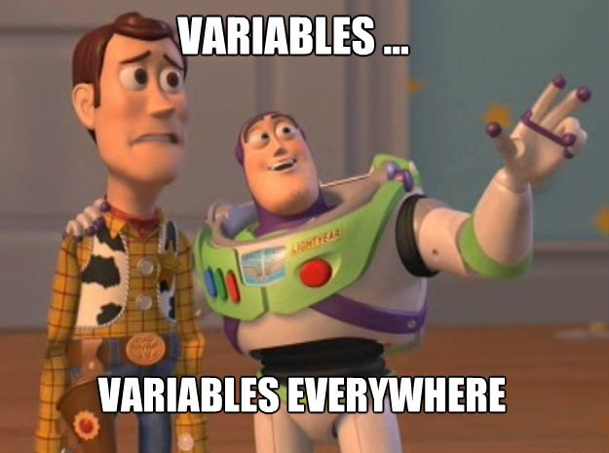
Variables
Variable: a name that refers to a value
Variables have types: int, double, string etc…
Variables have names (identifiers)

Slide 7
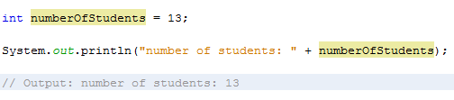
Integer Example

Slide 8
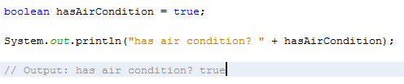
Boolean Example

Slide 9
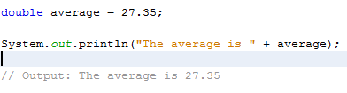
Double Example

Slide 10

Character Example

Slide 11
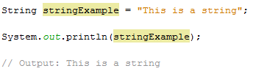
String Example

Slide 12
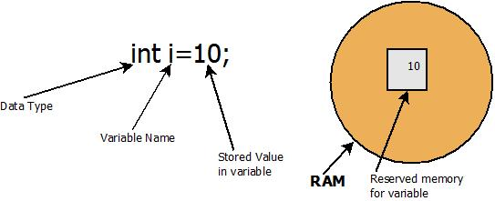

Slide 13
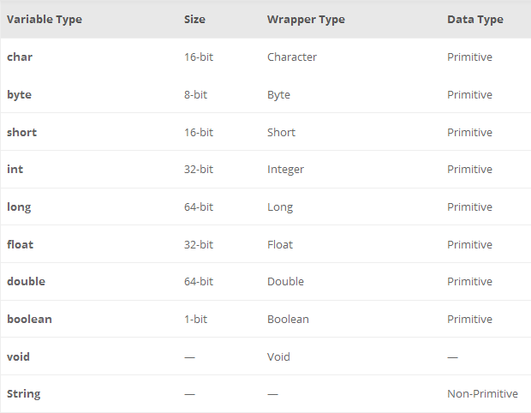

Slide 14
What Have We Done So Far?
In-class demo
Variables Definition & Examples
Variable Naming Rule & Conventions
Do “something” with variables: Operators
Arithmetic Operators
Relational Operators
Casting
Integer Overflow

Slide 15
Naming Rules & Conventions

Slide 16
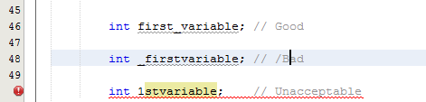
Naming Rules & Conventions
All variable names must begin with a letter of the alphabet, an underscore, or ( _ ), or a dollar sign ($)
The convention is to always use a letter of the alphabet

Slide 17

Naming Rules & Conventions
After the first initial letter, variable names may also contain letters and the digits 0 to 9.
No spaces or special characters are allowed.

Slide 18

Java is Case-Sensitive
Uppercase characters are distinct from lowercase characters (case-sensitive)
Using ALL uppercase letters are primarily used to identify constant variables

Slide 19

Use Camel Case
without capitalizing the first character

Slide 20

Choosing a Variable Name
Use short, concise, and meaningful names for variables
You cannot use a java keyword (reserved word) for a variable name.

Slide 21
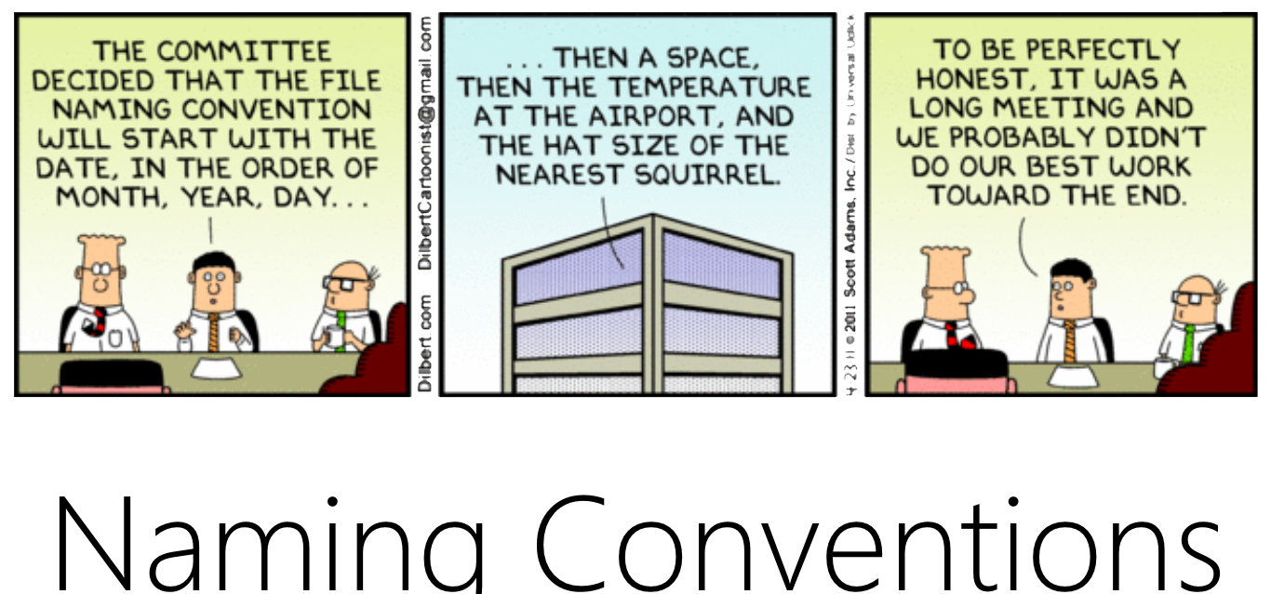

Slide 22
What Have We Done So Far?
In-class demo
Variables Definition & Examples
Variable Naming Rule & Conventions
Do “something” with variables: Operators
Arithmetic Operators
Relational Operators
Casting
Integer Overflow

Slide 23

Operators
are used to manipulate variables
are special symbols that perform specific operations on one, two, or three operands, and then return a result

Slide 24
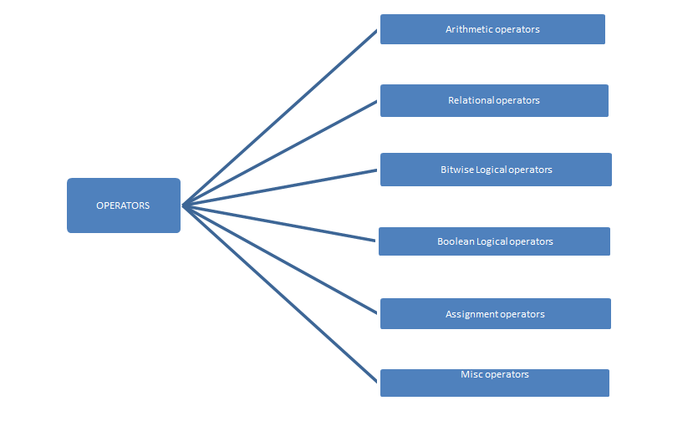

Slide 25
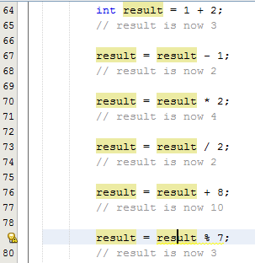
Arithmetic Operator Examples

Slide 26
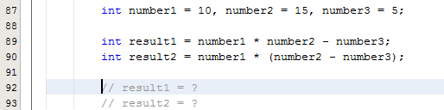
Operators Has Precedence
Just like math…
Use parentheses to avoid errors and increase readability

Slide 27

Operators Has Precedence
Just like math…
Use parentheses to avoid errors and increase readability

Slide 28
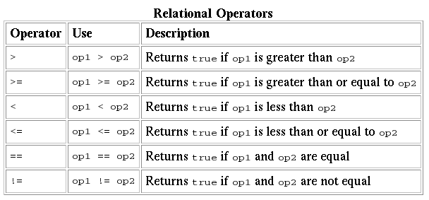
Relational Operator Examples

Slide 29
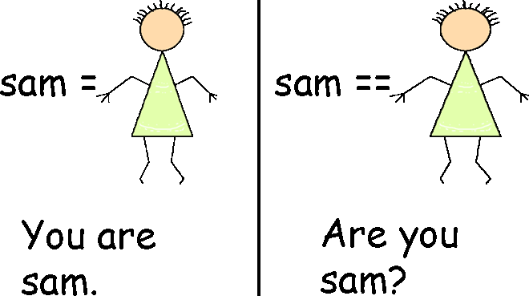
Difference Between = and ==

Slide 30
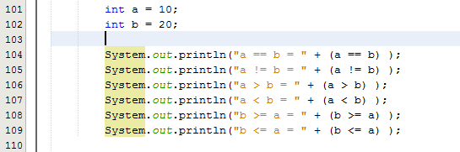
Relational Operator Examples

Slide 31
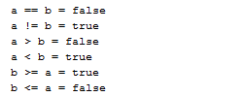
Relational Operator Examples

Slide 32
Comparing Floating Points
What is the expected value of isOne?

Slide 33
== Does not work
The output is: “1.000001 1.0E-6 false”
Computer does not store exact values of floating point numbers!
Therefore, do not use == on doubles

Slide 34
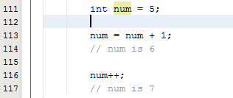
Some Operators Are Unary
Which means they take a single operand
++, --, ! are examples of unary operators

Slide 35
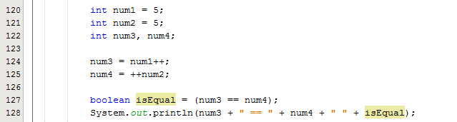
Difference Between ++num and num++ (Prefix and Postfix)
Prefix increments first
What is the output?

Slide 36
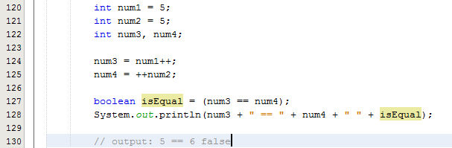
Difference Between ++num and num++ (Prefix and Postfix)
Prefix increments first

Slide 37

Casting
is taking a particular type and “turning it into” another type
Implicit casting example:

Slide 38
What Have We Done So Far?
In-class demo
Variables Definition & Examples
Variable Naming Rule & Conventions
Do “something” with variables: Operators
Arithmetic Operators
Relational Operators
Casting
Integer Overflow

Slide 39

Casting
is taking a particular type and “turning it into” another type
Implicit casting example:

Slide 40

Casting
What happens when we want to assign a double value to int?

Slide 41
Casting
Compile Error

Slide 42
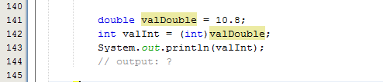
Casting
When losing information, cast explicitly!

Slide 43
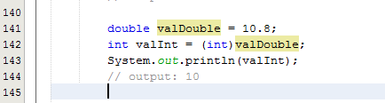
Casting
When losing information, cast explicitly!
Note that it did NOT round the number, simply truncated it.

Slide 44
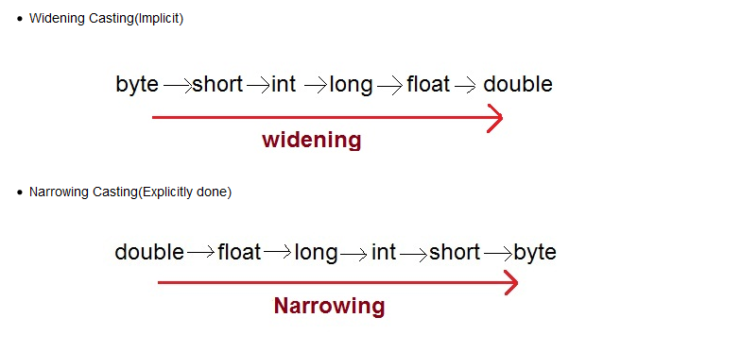
Implicit & Explicit Casting

Slide 45
What Have We Done So Far?
In-class demo
Variables Definition & Examples
Variable Naming Rule & Conventions
Do “something” with variables: Operators
Arithmetic Operators
Relational Operators
Casting
Integer Overflow

Slide 46
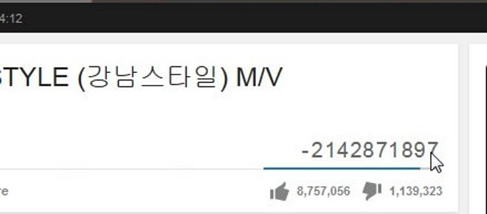

How Is This Possible?

Slide 47
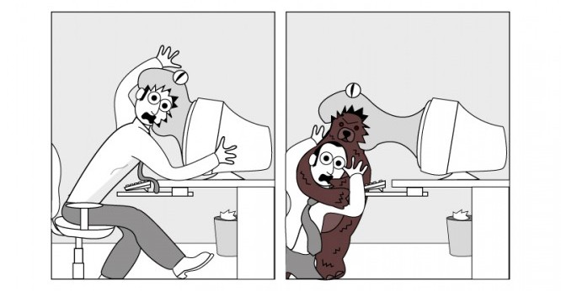
Careful While Coding
There are too many ways for a program to go wrong
Subtle errors may cause bugs, exploits, security vulnerabilities, or more serious errors

Slide 48
Integer Overflow
Types does not have unlimited size

Slide 49
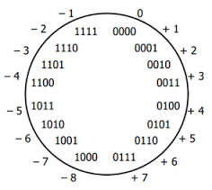
Signed Integers Are Stored in Twos Complement

Slide 50

What Happens When Max Integer is incremented?
Signed integers are stored in 2s complement
When the max positive integer is incremented, we get the minimum value, which is negative

Slide 51
Integer Overflow in Nutshell
If it overflows, it goes back to the minimum value and continues from there.
If it underflows, it goes back to the maximum value and continues from there.

Slide 52
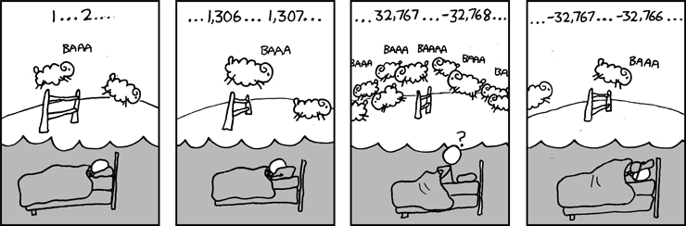

Slide 53
What Have We Done So Far?
In-class demo
Variables Definition & Examples
Variable Naming Rule & Conventions
Do “something” with variables: Operators
Arithmetic Operators
Relational Operators
Casting
Integer Overflow

