Slide 1
Decision Trees
Presented by :ilyas tammouch

Slide 2
This Lecture
Decision trees for (binary) classification
Non-linear classifiers
Learning decision trees (ID3 algorithm)
Greedy heuristic (based on information gain) Originally developed for discrete features
Some extensions to the basic algorithm
Overfitting
Some experimental issues

Slide 3
Introduction of Decision trees

Slide 4
Decision Trees
A hierarchical data structure that represents data by implementing a divide and conquer strategy
Can be used as a non-parametric classification and regression method
Given a collection of examples, learn a decision tree that represents it.
Use this representation to classify new examples
C
B
A

Slide 5
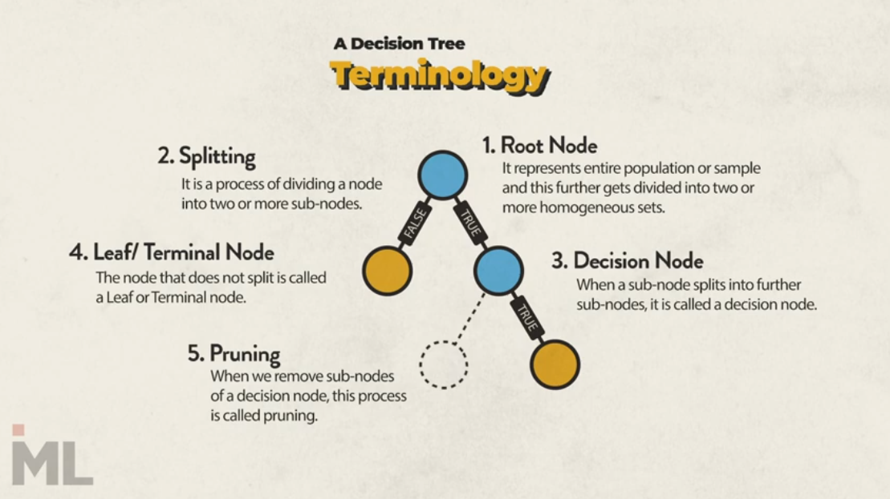

Slide 6
Learning decision trees (ID3 algorithm

Slide 7
Will I play tennis today?
 | O | T | H | W | Play?
1 | S | H | H | W | -
2 | S | H | H | S | -
3 | O | H | H | W | +
4 | R | M | H | W | +
5 | R | C | N | W | +
6 | R | C | N | S | -
7 | O | C | N | S | +
8 | S | M | H | W | -
9 | S | C | N | W | +
10 | R | M | N | W | +
11 | S | M | N | S | +
12 | O | M | H | S | +
13 | O | H | N | W | +
14 | R | M | H | S | -
Outlook: S(unny), O(vercast), R(ainy)
Temperature: H(ot), M(edium), C(ool)
Humidity: H(igh), N(ormal), L(ow)
Wind: S(trong), W(eak)

Slide 8
Will I play tennis today?
Features
Outlook: {Sun, Overcast, Rain}
Temperature: {Hot, Mild, Cool}
Humidity: {High, Normal, Low}
Wind: {Strong, Weak}
Labels
Binary classification task: Y = {+, -}

Slide 9
Basic Decision Trees Learning Algorithm
 | O | T | H | W | Play?
1 | S | H | H | W | -
2 | S | H | H | S | -
3 | O | H | H | W | +
4 | R | M | H | W | +
5 | R | C | N | W | +
6 | R | C | N | S | -
7 | O | C | N | S | +
8 | S | M | H | W | -
9 | S | C | N | W | +
10 | R | M | N | W | +
11 | S | M | N | S | +
12 | O | M | H | S | +
13 | O | H | N | W | +
14 | R | M | H | S | -
Data is processed in Batch (i.e. all the data available)
Recursively build a decision tree top down.
Algorithm?
Outlook
?
Sunny
Overcast
Rain
Humidity
Yes
Wind
High
Normal
Strong
Weak
No
Yes
No
Yes

Slide 10
Picking the Root Attribute
The goal is to have the resulting decision tree as small as possible
The recursive algorithm is a greedy search for a simple tree, but cannot guarantee optimality.
The main decision in the algorithm is the selection of the next attribute to condition on.

Slide 11
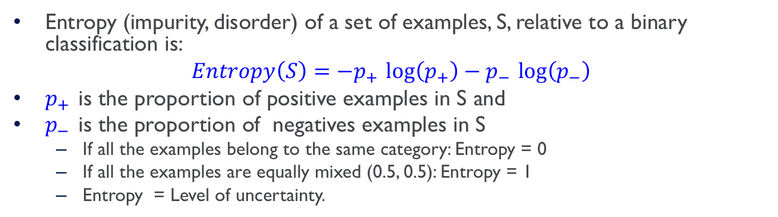
Entropy
Entropy (impurity, disorder) of a set of examples, S, relative to a binary classification is:
$$Entropy\left(S\right)=−p_{+ }\log\left(p_{+}\right)−p_{− }\log\left(p_{−}\right)$$
$p_{+ }$is the proportion of positive examples in S and
$p_{− }$is the proportion of negatives examples in S
If all the examples belong to the same category: Entropy = 0
If all the examples are equally mixed (0.5, 0.5): Entropy = 1
Entropy = Level of uncertainty.

Slide 12
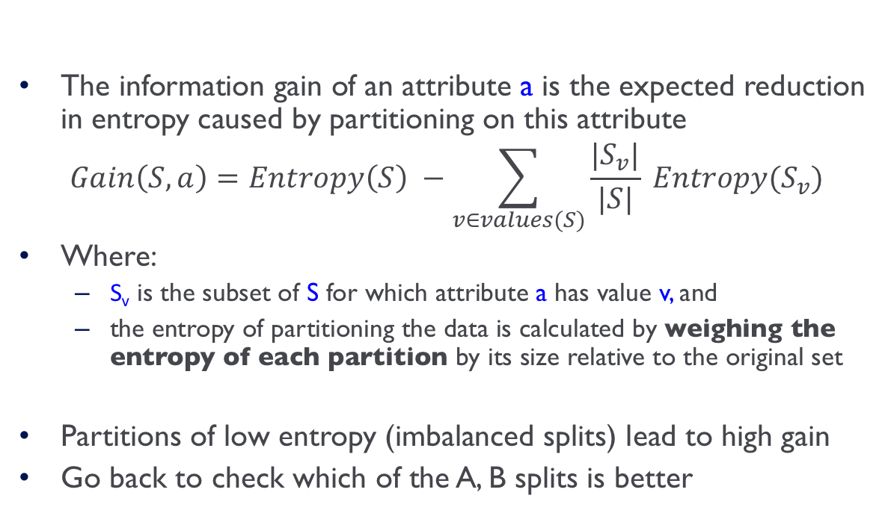
Information Gain
High Entropy – High level of Uncertainty
Low Entropy – No Uncertainty.
The information gain of an attribute a is the expected reduction in entropy caused by partitioning on this attribute
$$Gain\left(S,a\right)=Entropy\left(S\right) −\sum_{v∈values(S)}{\frac{|S_{v}|}{|S|} Entropy(S_{v})}$$
Where:
S_{v} is the subset of S for which attribute a has value v, and
the entropy of partitioning the data is calculated by weighing the entropy of each partition by its size relative to the original set
Partitions of low entropy (imbalanced splits) lead to high gain
Go back to check which of the A, B splits is better
Outlook
Sunny
Overcast
Rain
Notes:
The A, B case:
If we choose A: the reduction is: 100/203 Ent(100,0) + 103/203 Ent(100,3) ~~ 0
If we choose B: the reduction is: 53/203 Ent(53,0) + 150/203 Ent(100,50) >> 0

Slide 13
Will I play tennis today?
 | O | T | H | W | Play?
1 | S | H | H | W | -
2 | S | H | H | S | -
3 | O | H | H | W | +
4 | R | M | H | W | +
5 | R | C | N | W | +
6 | R | C | N | S | -
7 | O | C | N | S | +
8 | S | M | H | W | -
9 | S | C | N | W | +
10 | R | M | N | W | +
11 | S | M | N | S | +
12 | O | M | H | S | +
13 | O | H | N | W | +
14 | R | M | H | S | -
Outlook: S(unny), O(vercast), R(ainy)
Temperature: H(ot), M(edium), C(ool)
Humidity: H(igh), N(ormal), L(ow)
Wind: S(trong), W(eak)

Slide 14
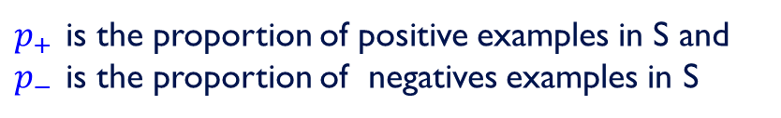

Will I play tennis today?
 | O | T | H | W | Play?
1 | S | H | H | W | -
2 | S | H | H | S | -
3 | O | H | H | W | +
4 | R | M | H | W | +
5 | R | C | N | W | +
6 | R | C | N | S | -
7 | O | C | N | S | +
8 | S | M | H | W | -
9 | S | C | N | W | +
10 | R | M | N | W | +
11 | S | M | N | S | +
12 | O | M | H | S | +
13 | O | H | N | W | +
14 | R | M | H | S | -
calculate current entropy
$p_{+ }= \frac{9}{14}$ ${ p}_{− }= \frac{5}{14}$
$Entropy\left(Play\right)=−p_{+ }\log{2\left(p_{+}\right)}−p_{− }\log{2\left(p_{−}\right)}$ $=−\frac{9}{14}log2\frac{9}{14}−\frac{5}{14}log2\frac{5}{14}$
≈ 0.94
$p_{+ }$is the proportion of positive examples in S and
$p_{− }$is the proportion of negatives examples in S

Slide 15
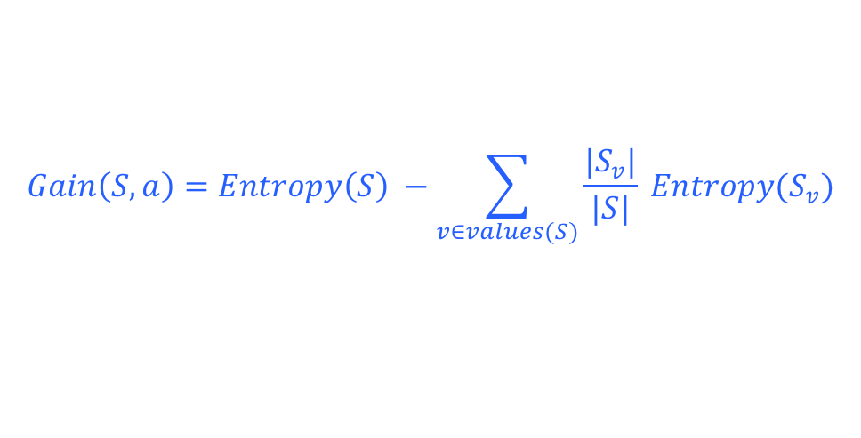
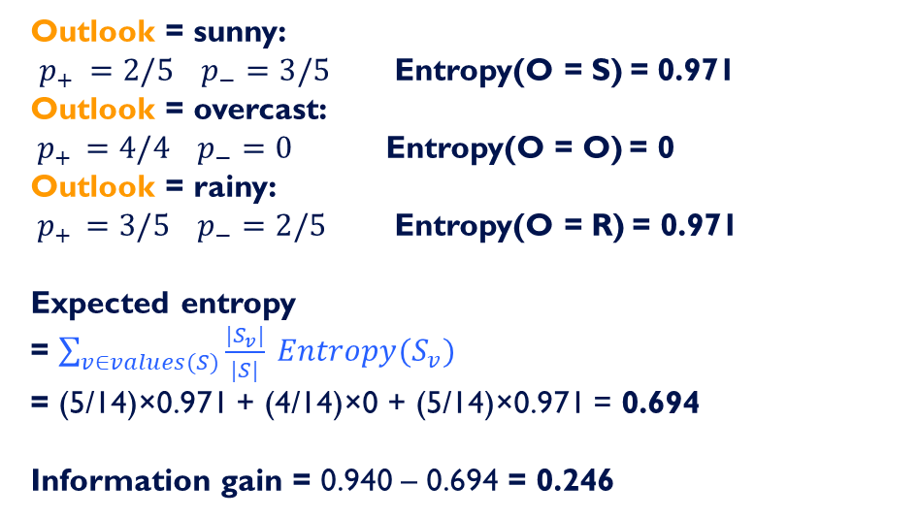

Information Gain: Outlook
$Entropy\left(Play\right)$= 0.94
$$Gain\left(S,a\right)=Entropy\left(S\right) −\sum_{v∈values(S)}{\frac{|S_{v}|}{|S|} Entropy(S_{v})}$$
 | O | T | H | W | Play?
1 | S | H | H | W | -
2 | S | H | H | S | -
3 | O | H | H | W | +
4 | R | M | H | W | +
5 | R | C | N | W | +
6 | R | C | N | S | -
7 | O | C | N | S | +
8 | S | M | H | W | -
9 | S | C | N | W | +
10 | R | M | N | W | +
11 | S | M | N | S | +
12 | O | M | H | S | +
13 | O | H | N | W | +
14 | R | M | H | S | -
Outlook = sunny: $p_{+ }=2/5$ $p_{−}=3/5$ Entropy(O = S) = 0.971 Outlook = overcast:
${ p}_{+ } =4/4$ $p_{−}=0$ Entropy(O = O) = 0
Outlook = rainy:
${ p}_{+ } =3/5$ $p_{−}=2/5$ Entropy(O = R) = 0.971
Expected entropy
= $\sum_{v∈values(S)}{\frac{|S_{v}|}{|S|} Entropy(S_{v})}$
= (5/14)×0.971 + (4/14)×0 + (5/14)×0.971 = 0.694
Information gain = 0.940 – 0.694 = 0.246

Slide 16
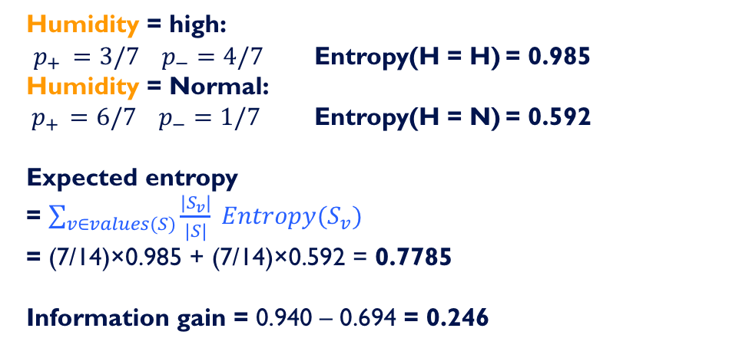
Information Gain: Humidity
$$Gain\left(S,a\right)=Entropy\left(S\right) −\sum_{v∈values(S)}{\frac{|S_{v}|}{|S|} Entropy(S_{v})}$$
 | O | T | H | W | Play?
1 | S | H | H | W | -
2 | S | H | H | S | -
3 | O | H | H | W | +
4 | R | M | H | W | +
5 | R | C | N | W | +
6 | R | C | N | S | -
7 | O | C | N | S | +
8 | S | M | H | W | -
9 | S | C | N | W | +
10 | R | M | N | W | +
11 | S | M | N | S | +
12 | O | M | H | S | +
13 | O | H | N | W | +
14 | R | M | H | S | -
Humidity = high: $p_{+ }=3/7$ $p_{−}=4/7$ Entropy(H = H) = 0.985 Humidity = Normal:
${ p}_{+ } =6/7$ $p_{−}=1/7$ Entropy(H = N) = 0.592
Expected entropy
= $\sum_{v∈values(S)}{\frac{|S_{v}|}{|S|} Entropy(S_{v})}$
= (7/14)×0.985 + (7/14)×0.592 = 0.7785
Information gain = 0.940 – 0.694 = 0.246

Slide 17
Which feature to split on?
 | O | T | H | W | Play?
1 | S | H | H | W | -
2 | S | H | H | S | -
3 | O | H | H | W | +
4 | R | M | H | W | +
5 | R | C | N | W | +
6 | R | C | N | S | -
7 | O | C | N | S | +
8 | S | M | H | W | -
9 | S | C | N | W | +
10 | R | M | N | W | +
11 | S | M | N | S | +
12 | O | M | H | S | +
13 | O | H | N | W | +
14 | R | M | H | S | -
Information gain: Outlook: 0.246 Humidity: 0.151 Wind: 0.048 Temperature: 0.029
→ Split on Outlook

Slide 18
An Illustrative Example (III)
Gain(S,Humidity)=0.151
Gain(S,Wind) = 0.048
Gain(S,Temperature) = 0.029
Gain(S,Outlook) = 0.246
Outlook

Slide 19
An Illustrative Example (III)
 | O | T | H | W | Play?
1 | S | H | H | W | -
2 | S | H | H | S | -
3 | O | H | H | W | +
4 | R | M | H | W | +
5 | R | C | N | W | +
6 | R | C | N | S | -
7 | O | C | N | S | +
8 | S | M | H | W | -
9 | S | C | N | W | +
10 | R | M | N | W | +
11 | S | M | N | S | +
12 | O | M | H | S | +
13 | O | H | N | W | +
14 | R | M | H | S | -
Outlook
Sunny
Overcast
Rain
1,2,8,9,11
3,7,12,13
4,5,6,10,14
2+,3-
4+,0-
3+,2-
?
Yes
?

Slide 20
An Illustrative Example (III)
Outlook
 | O | T | H | W | Play?
1 | S | H | H | W | -
2 | S | H | H | S | -
3 | O | H | H | W | +
4 | R | M | H | W | +
5 | R | C | N | W | +
6 | R | C | N | S | -
7 | O | C | N | S | +
8 | S | M | H | W | -
9 | S | C | N | W | +
10 | R | M | N | W | +
11 | S | M | N | S | +
12 | O | M | H | S | +
13 | O | H | N | W | +
14 | R | M | H | S | -
Sunny
Overcast
Rain
1,2,8,9,11
3,7,12,13
4,5,6,10,14
2+,3-
4+,0-
3+,2-
?
Yes
?
Continue until:
Every attribute is included in path, or,
All examples in the leaf have same label

Slide 21
An Illustrative Example (IV)
Outlook
 | O | T | H | W | Play?
1 | S | H | H | W | -
2 | S | H | H | S | -
4 | R | M | H | W | +
5 | R | C | N | W | +
6 | R | C | N | S | -
7 | O | C | N | S | +
8 | S | M | H | W | -
9 | S | C | N | W | +
10 | R | M | N | W | +
11 | S | M | N | S | +
12 | O | M | H | S | +
13 | O | H | N | W | +
14 | R | M | H | S | -
Sunny
Overcast
Rain
1,2,8,9,11
3,7,12,13
4,5,6,10,14
2+,3-
4+,0-
3+,2-
?
Yes
?
.97-(3/5) 0-(2/5) 0 = .97
.97- 0-(2/5) 1 = .57
.97-(2/5) 1 - (3/5) .92= .02
Split on Humidity

Slide 22
An Illustrative Example (V)
Outlook
Sunny
Overcast
Rain
1,2,8,9,11
3,7,12,13
4,5,6,10,14
2+,3-
4+,0-
3+,2-
?
Yes
?

Slide 23
An Illustrative Example (V)
Outlook
Sunny
Overcast
Rain
1,2,8,9,11
3,7,12,13
4,5,6,10,14
2+,3-
4+,0-
3+,2-
Humidity
Yes
?
High
Normal
No
Yes

Slide 24
An Illustrative Example (VI)
Outlook
Sunny
Overcast
Rain
1,2,8,9,11
3,7,12,13
4,5,6,10,14
2+,3-
4+,0-
3+,2-
Humidity
Yes
Wind
High
Normal
Strong
Weak
No
Yes
No
Yes

Slide 25
Hypothesis Space in Decision Tree Induction
Goal: to find the best decision tree
Best could be “smallest depth”
Best could be “minimizing the expected number of tests”

Slide 26
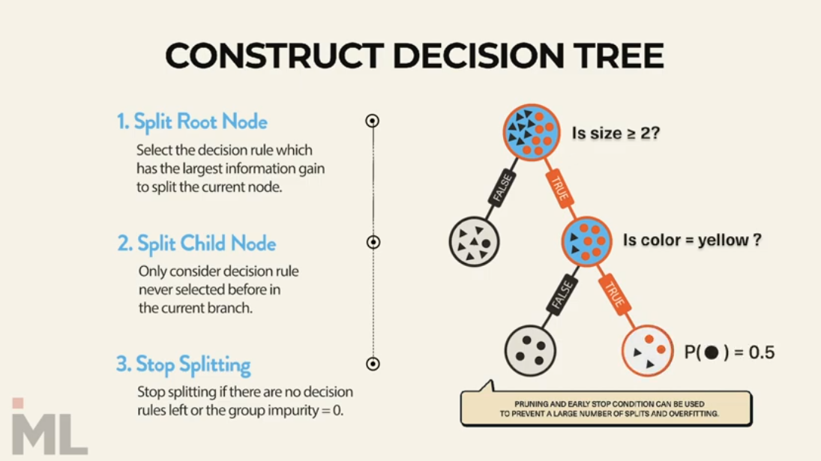
Notes:
Easy to interpret
Overfiting ‘depth

Slide 27
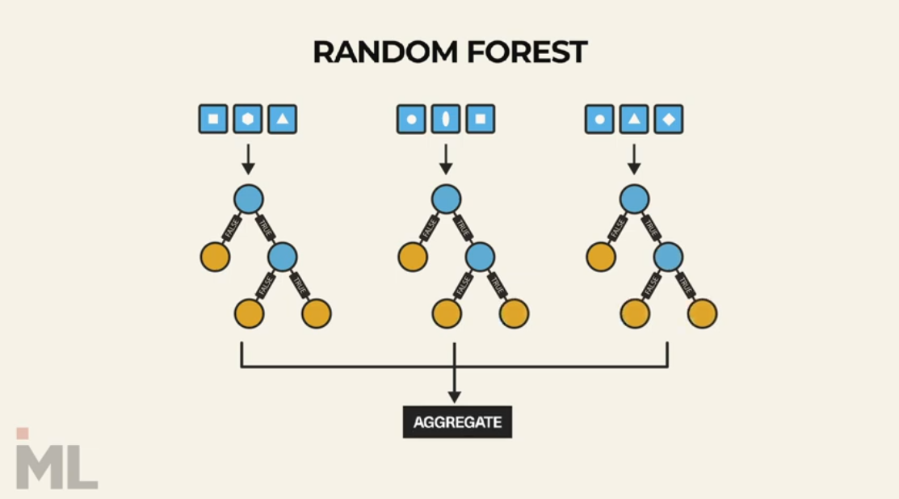
Notes:
ensembling methods

Slide 28
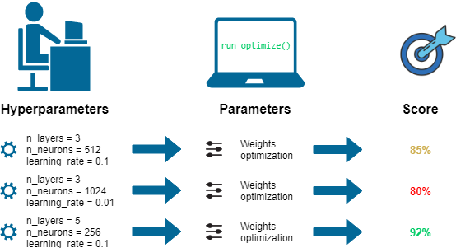
Grid search
Grid search is a method for performing hyper-parameter optimisation

Slide 29
Evaluation metrics

Slide 30
Let us consider a task to classify whether a person is pregnant or not pregnant. If the test for pregnancy is positive (+ve ), then the person is pregnant. On the other hand, if the test for pregnancy is negative (-ve) then the person is not pregnant.
Now consider the above classification ( pregnant or not pregnant ) carried out by a machine learning algorithm. The output of the machine learning algorithm can be mapped to one of the following categories.

Slide 31
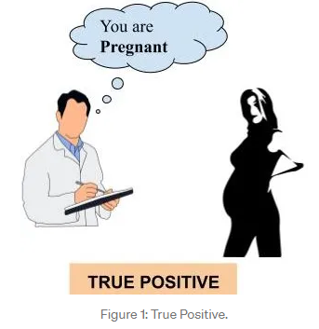
A person who is actually pregnant (positive) and classified as pregnant (positive). This is called TRUE POSITIVE (TP).

Slide 32
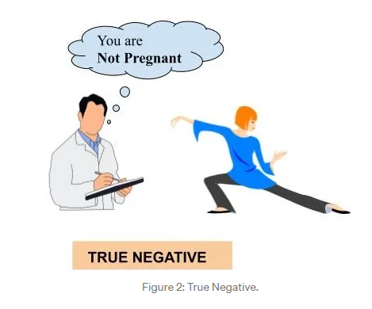
2. A person who is actually not pregnant (negative) and classified as not pregnant (negative). This is called TRUE NEGATIVE (TN).

Slide 33
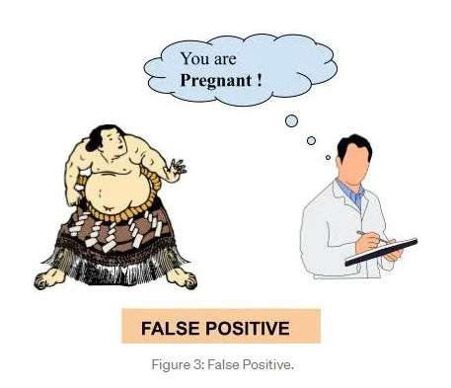
3. A person who is actually not pregnant (negative) and classified as pregnant (positive). This is called FALSE POSITIVE (FP).

Slide 34
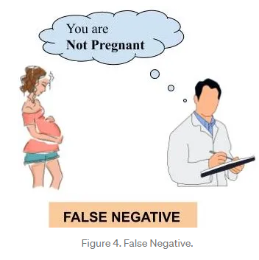
4. A person who is actually pregnant (positive) and classified as not pregnant (negative). This is called FALSE NEGATIVE (FN).

Slide 35
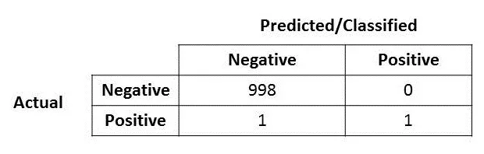
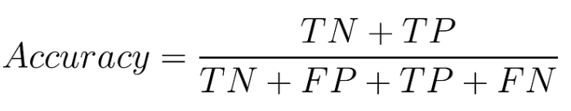
What we desire is TRUE POSITIVE and TRUE NEGATIVE but due to the misclassifications, we may also end up in FALSE POSITIVE and FALSE NEGATIVE
Firstly, let us look at the following confusion matrix. What is the accuracy for the model?
Notes:
الأداء العام للنموذج

Slide 36
Is accuracy the best measure?
Accuracy may not be a good measure if the dataset is not balanced (both negative and positive classes have different number of data instances). We will explain this with an example.
Consider the following scenario: There are 90 people who are healthy (negative) and 10 people who have some disease (positive). Now let’s say our machine learning model perfectly classified the 90 people as healthy but it also classified the unhealthy people as healthy.
Notes:
The accuracy, in this case, is 90 % but this model is very poor because all the 10 people who are unhealthy are classified as healthy. By this example what we are trying to say is that accuracy is not a good metric when the data set is unbalanced. Using accuracy in such scenarios can result in misleading interpretation of results.

Slide 37
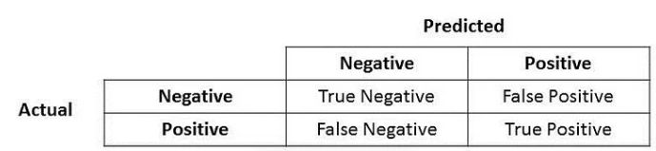
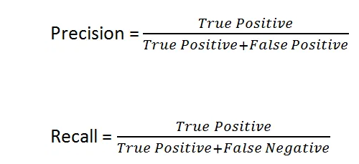
Precision and Recall
Let me put in the confusion matrix and its parts here.
Notes:
Accuracy tells you how many times the ML model was correct overall. Precision is how good the model is at predicting a specific category. Recall tells you how many times the model was able to detect a specific category.

Slide 38
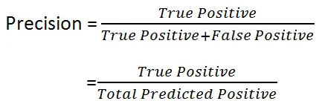
precision
Immediately, you can see that Precision talks about how precise/accurate your model is out of those predicted positive, how many of them are actual positive.
Precision is a good measure to determine, when the costs of False Positive is high. For instance, email spam detection. In email spam detection, a false positive means that an email that is non-spam (actual negative) has been identified as spam (predicted spam). The email user might lose important emails if the precision is not high for the spam detection model.
Notes:
دقة التوقعات الإيجابية )(p

Slide 39
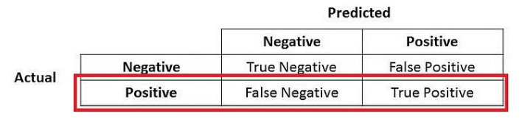
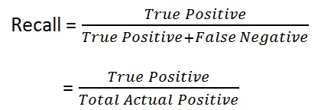
Recall
There you go! So Recall actually calculates how many of the Actual Positives our model capture through labeling it as Positive (True Positive). Applying the same understanding, we know that Recall shall be the model metric we use to select our best model when there is a high cost associated with False Negative.
Notes:
For instance, in fraud detection or sick patient detection. If a fraudulent transaction (Actual Positive) is predicted as non-fraudulent (Predicted Negative), the consequence can be very bad for the bank.
تغطية عينات التوقعات الإيجابية الفعلية
ي recall تعبر عن مدى اكتمال النموذح

Slide 40
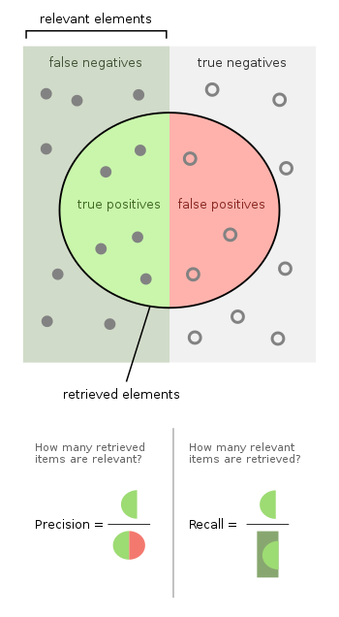
Recall | precision
This allows us to determine how many positive samples have been correctly classified using the ML model. | This allows us to measure the ability to classify the positive samples in the model.

Slide 41

F1 Score
F1 Score might be a better measure to use if we need to seek a balance between Precision and Recall AND there is an uneven class distribution (large number of Actual Negatives).
Notes:
GridSearchCV is a technique for finding the optimal parameter values from a given set of parameters

