Slide 1

University of Frontier Technology, Bangladesh
Department of Cyber Security Engineering
SmartBank v2.1
Secure File-Based Banking Simulation System
PROG 112 · OBJECT ORIENTED PROGRAMMING LANGUAGE SESSIONAL
SUBMITTED BY
SUBMITTED TO
Md. Tarikul Islam (30)
Akiqur Rahman (29)
Department of Cyber Security Engineering
UFTB
Md Masud Rana
Lecturer
Department of Cyber Security Engineering
UFTB
1

Slide 2







EXECUTIVE SUMMARY
A Console Banking Simulation, Hardened for v2.1
SmartBank models retail banking — accounts, ATM, cards, online banking, and admin oversight — with all data persisted to disk between sessions. Release v2.1's headline change: passwords are now SHA-256 hashed, never stored or compared in plain text.
SHA-256 Password Hashing
XOR-Encrypted Persistence
Simulated MFA / OTP
Hand-written, FIPS 180-4 compliant. No plain-text password ever touches memory or disk.
All flat-file databases obfuscated on write, reversed on read.
ATM withdrawals & online transfers gated behind a one-time passcode.
Lockout & Card Blocking
Full Audit Trail
Zero Dependencies
3-strikes policy; only an admin can lift the restriction.
Every security-relevant event timestamped in audit_log.txt.
Pure Standard C++11 — no external libraries required.
2

Slide 3
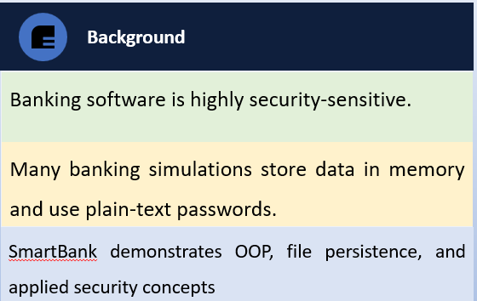

INTRODUCTION
Background & Problem Statement
Problem Statement
Many educational banking projects lack data persistence, encryption, and secure password handling.
Most systems reset after each run and do not reflect real-world banking operations.
A secure, easy-to-understand banking
simulation is needed to demonstrate OOP principles and security practices.
3

Slide 4


PROJECT GOALS & BOUNDARIES
Objectives & Scope
OBJECTIVES
Develop an OOP banking system with accounts, ATM, online portal, and admin control
Design a modular OOP banking system with accounts, cards, ATM, online portal, and admin control
Secure passwords using one-way SHA-256 hashing
Ensure portability using standard C++11 and no external libraries.
SCOPE OF THE PROJECT
In-Scope
Out-of-Scope
Account lifecycle: create, deposit, withdraw, transfer, balance enquiry
Card issuance, PIN verification, auto-block, admin unblock
ATM withdrawal (daily limit 20,000 BDT) + simulated MFA/OTP
User registration, authentication & lockout after failed logins
Online portal: transfer, bill payment, new-account application
Admin panel · encrypted persistence · SHA-256 hashing
Graphical user interface — system is console-driven by design
Real network / SMS / email delivery for OTP
Integration with an actual payment network
Multi-user concurrency or distributed storage
Relational database backend
Regulatory certifications (PCI-DSS, ISO 27001)
4

Slide 5
SYSTEM REQUIREMENTS
Functional & Non-Functional Requirements
KEY FUNCTIONAL REQUIREMENTS
ID | Requirement | Description
FR-01 | Account Operations | Deposit, withdrawal, transfer & balance enquiry.
FR-02 | Card Authentication | Verify PIN; block card after 3 consecutive failures.
FR-03 | ATM Withdrawal Limit | Configurable daily withdrawal limit (20,000 BDT).
FR-05 | User Authentication | Username/password login; lock account after 3 fails.
FR-06 | Password Hashing | SHA-256 hash every password before storing/comparing.
FR-08 | Multi-Factor Auth | Sensitive operations require simulated OTP confirmation.
FR-09 | Admin Control | Unblock cards, unlock accounts, review applications.
FR-11 | Data Persistence | All data persists across restarts via encrypted files.
NON-FUNCTIONAL & ENVIRONMENT
Portability
C++11+, no third-party library
Confidentiality
One-way hashed passwords
Auditability
Every security event traceable
Resilience
Structured exception handling
GCC ≥7 · Clang ≥6 · MSVC ≥2017
C++11 standard, Standard Library only.
OS: Windows / Linux / macOS
5

Slide 6





SYSTEM ARCHITECTURE
Five-Layer Architecture Overview
User / Console Client
main() — single entry point; renders the numbered menu and routes choices
Interface Layer
ATM · BankPortal · Admin Control Panel · Account Status Check — one user journey each
Domain Layer
Account · Card · User · AccountApplication — state & business rules per bounded context
Security Layer
SecuritySystem — SHA-256, XOR cipher, OTP, timestamping, audit logging
Persistence Layer
db_accounts · db_cards · db_users · db_applications · transaction_history · audit_log
6

Slide 7
OBJECT-ORIENTED DESIGN
Class Responsibilities
Account
Card
ATM
accountNumber, balance, accountType
cardNumber, pin, pinAttempts, isBlocked
dailyLimit, currentDailyWithdrawn
Verifies PIN, tracks failures, self-blocks after 3, supports admin unblock.
Coordinates PIN check, daily-limit enforcement & OTP confirmation.
Owns deposit/withdraw/transfer logic; persists every change immediately.
User
BankPortal
SecuritySystem
username, password (SHA-256 hash), loginAttempts
inactivityCounter
(stateless utility)
Owns authentication; hashes & verifies; self-locks after 3 failures.
New applications, transfer/bill-pay journeys, session-timeout tracking.
SHA-256, XOR, OTP, timestamping, audit log, all file save/load routines.
7

Slide 8
CORE MODULES · SECURITYSYSTEM
SHA-256 Hashing — Hand-Written, FIPS 180-4
SecuritySystem.cpp — sha256()
HOW IT WORKS
static uint32_t rightRotate(uint32_t v, unsigned c) {
return (v >> c) | (v << (32 - c));
}
// 64-round compression loop
for (int i = 0; i < 64; i++) {
uint32_t S1 = rightRotate(e,6) ^ rightRotate(e,11)
^ rightRotate(e,25);
uint32_t ch = (e & f) ^ ((~e) & g);
uint32_t t1 = hh + S1 + ch + k[i] + w[i];
uint32_t S0 = rightRotate(a,2) ^ rightRotate(a,13)
^ rightRotate(a,22);
uint32_t maj = (a & b) ^ (a & c) ^ (b & c);
uint32_t t2 = S0 + maj;
hh=g; g=f; f=e; e=d+t1;
d=c; c=b; b=a; a=t1+t2;
}
Maps any input to a fixed 256-bit (64 hex-char) digest
One-way: infeasible to recover the password from its hash
Avalanche effect — one changed character produces a totally different digest
Implemented from scratch — zero crypto library dependency
Verified against official FIPS 180-4 test vectors
8

Slide 9
CORE MODULES · SECURITYSYSTEM
XOR Cipher & Simulated OTP
XOR Cipher — encryptDecrypt()
Simulated OTP — verifyOTP()
srand((unsigned)time(0));
int otp = rand() % 9000 + 1000; // 4-digit
cout << "[SMS Gateway Simulated]: "
<< "Your OTP is: " << otp;
cin >> inputOTP;
if (inputOTP == otp) {
logEvent("OTP verification passed.");
return true;
}
logEvent("ALERT: Failed OTP attempt.");
return false;
static const char XOR_KEY = 'K'; // ASCII 75
static string encryptDecrypt(const string& d) {
string out = d;
for (size_t i=0; i<d.size(); i++)
out[i] = d[i] ^ XOR_KEY;
return out; // decrypt == encrypt
}
XOR obfuscation is NOT cryptographically strong — a single repeating-byte key is recoverable via frequency analysis. It's a lightweight layer on top of password hashing, not a substitute for it.
Gated Operations: ATM withdrawal · Fund transfer · Utility bill payment
9

Slide 10
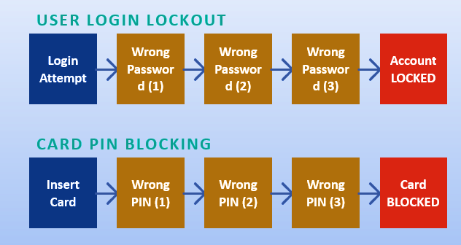
CORE MODULES · USER & CARD
Authentication & 3-Strikes Lockout Policy
3-Strikes Policy
3 wrong passwords → User account LOCKED
3 wrong PINs → Card BLOCKED
Only an admin can lift either restriction
Every lockout event is written to audit_log.txt
Console demo — login lockout
Password: wrongPass1
-> Wrong password! Attempts remaining: 2
Password: wrongPass2
-> Wrong password! Attempts remaining: 1
Password: wrongPass3
-> [SECURITY ALERT]: Account locked
due to 3 failed login attempts!
10

Slide 11
DATA PERSISTENCE
File Structure & Save/Load Flow
File | Encrypted? | Contents
db_accounts.dat | YES (XOR) | Account number · Balance · Account type
db_cards.dat | YES (XOR) | Card number · PIN · Blocked flag · Fail count
db_users.dat | YES (XOR) | Username · SHA-256 hash · Locked · Linked acc/card
db_applications.dat | YES (XOR) | Full name · Username · NID · Face-verify status
transaction_history.txt | YES (XOR) | Timestamp · Acc# · Type · Amount · Balance
audit_log.txt | PLAIN TEXT | Security events — intentionally readable for audit
💾 Save-Immediately Pattern: every write operation persists to disk instantly — the on-disk state is never more than one operation behind the in-memory state.
11

Slide 12
SAMPLE INPUT / OUTPUT
Demo Workflow — ATM Withdrawal with MFA
ATM Simulation — withdrawal with OTP
ATM SESSION FLOW
1
Insert Card (username)
Select your option: 1
--- ATM Simulation Module ---
Enter your Username to insert card: tarikul
Enter your ATM PIN: 1234
Enter withdrawal amount (BDT): 5000
[ATM Security] Verifying via MFA...
[SMS Gateway Simulated]: Your OTP: 4729
Enter the OTP sent to your phone: 4729
OTP verification successful.
Withdrawal successful: 5000.00 BDT
>>> Current Balance: 20000.00 BDT <<<
Remaining daily ATM limit: 15000.00 BDT
2
Verify PIN (3 tries)
3
Enter Amount & Check Limit
4
Verify OTP (simulated MFA)
5
Funds Released
Also OTP-gated: the same simulated-OTP flow gates online fund transfers and utility bill payments in BankPortal.
12

Slide 13
TECHNOLOGY & VALIDATION
Technology Stack & Testing Strategy
TECHNOLOGY STACK
KEY TEST CASES
Language
C++11 / C++14
TC | Description | Expected Result
TC-01 | Compile -Wall -Wextra C++11 | Zero errors or warnings
TC-02 | SHA-256 of "" and "abc" | Matches FIPS 180-4 reference exactly
TC-04 | Restart → login, correct password | Hash from disk matches re-hashed input
TC-08 | 3 consecutive failed logins | Account locked until admin unlocks
Persistence
Flat files — XOR-encoded .dat
Cryptography
Hand-written SHA-256 (FIPS 180-4)
Build Tooling
GCC / Clang / MSVC (single-file)
SHA-256 verified against FIPS 180-4: "" → e3b0c442...b855 ✓ "abc" → ba7816bf...6c63 ✓
$ g++ -std=c++11 -Wall -Wextra -o smartbank SmartBank.cpp
13

Slide 14
RISK & ROADMAP
Risks, Limitations & Future Work
Risk / Limitation | Impact / Likelihood | Mitigation / Next Step
Unsalted SHA-256 hash | Med / Med | Add per-user salt; migrate to bcrypt/Argon2
XOR is weak obfuscation | Med / Med | Migrate to AES-GCM authenticated encryption
Hard-coded admin password | High / Low | Externalise + hash the admin credential
No regression test suite | Low / Med | Lightweight unit-test harness (SecuritySystem, User)
OTP is on-screen simulation | Med / Low | Real SMS/email gateway & biometric SDK integration
PLANNED ENHANCEMENTS
Per-user salting · bcrypt / Argon2 migration · AES-GCM for data-at-rest · Hash application passwords at submission · Externalised admin credential · Automated unit tests · Real SMS/OTP & biometric integration · SQLite backend if scaling beyond single-process
14

Slide 15
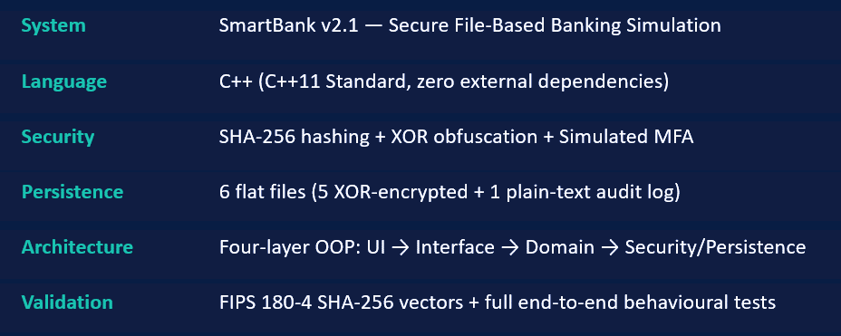
CONCLUSION
SmartBank v2.1 demonstrates that a compact, dependency-free C++ application can responsibly model realistic banking operations while respecting sound credential-handling practice. The SHA-256 upgrade closes the most significant security gap — plain-text password storage — validated both cryptographically and behaviourally.
15

