Slide 1
A Machine Learning Approach for Predicting Football Match Outcomes
Adrián Tarín Martínez

Slide 2
LITERATURE REVIEW
Review of Related Work
Overview of ML applications in football analytics
Key Insights to conduct the research

Slide 3
DATA SOURCING AND HANDLING
DATASET
Source: football-data.co.uk
CSV files covering seasons from 2018/2019 to 2023/2024
Premier Ligue, La Liga, Serie A, Bundesliga, Ligue 1
DATA PREPROCESSING
Feature Selection
Handling Missing Data
Feature Engineering

Slide 4
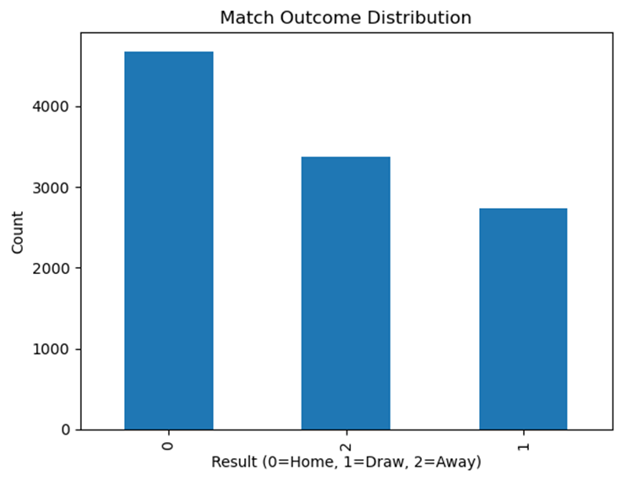
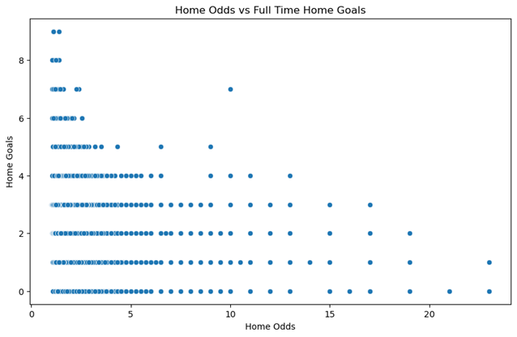
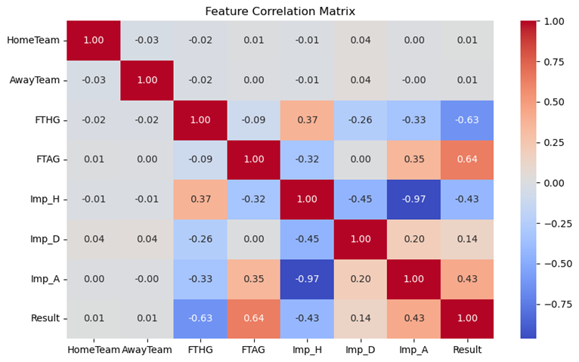
EXPLORATORY DATA ANALYSIS

Slide 5

PROOF OF CONCEPT
CHOICE OF METHODS
Logistic Regression
Random Forest
Support Vector Machine

Slide 6
POTENTIAL IMPROVEMENTS
Profitability validation (ROI) against market
League Specific modelling
Feature Engineer team form metrics
PCA to improve feature selection

Slide 7
CONCLUSION
While the current models show limitations, the evaluation framework identifies actionable improvement areas.
The combination of accuracy, F1-Score, and RMSE analysis provides a comprehensive assessment that balances theoretical correctness with practical betting applicability.
These results set the stage for targeted refinements that could bridge the gap between academic prediction models and profitable betting systems.

