Slide 1
Analyze Income Statement and Balance Sheet
Infosys Spring Board Internship

Slide 2
Aim: To automate the extraction, analysis, and summarization of financial data from PDF documents, such as income statements and balance sheets, using AI models and Python tools.
Summary of the Workflow:
Set Up Environment: Install tools and libraries.
Extract Data: Parse the PDF into structured elements.
Inspect Data: Understand the extracted content types.
Process Tables: Focus on and manipulate table data.
Summarize Data: Generate human-readable summaries using AI models.
Finalize: Review outputs and prepare them for reporting.

Slide 3
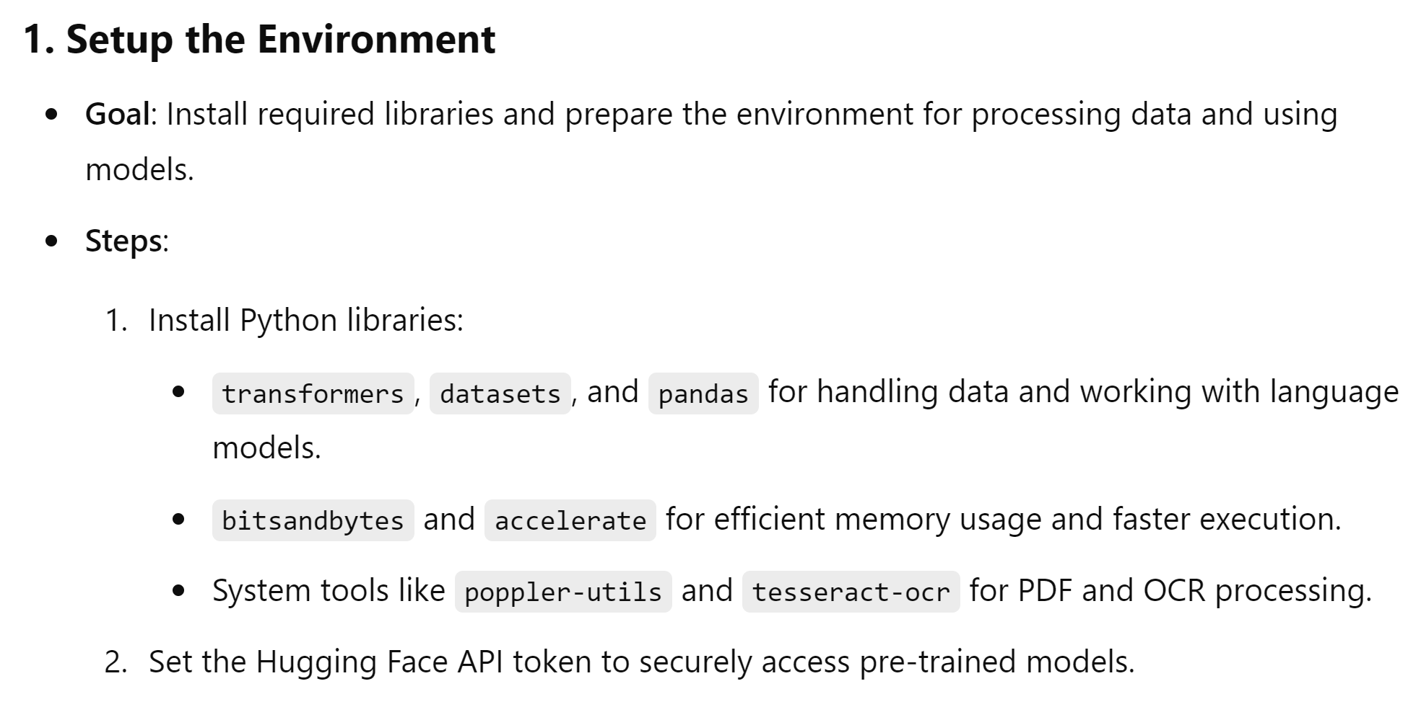
Key activities

Slide 4
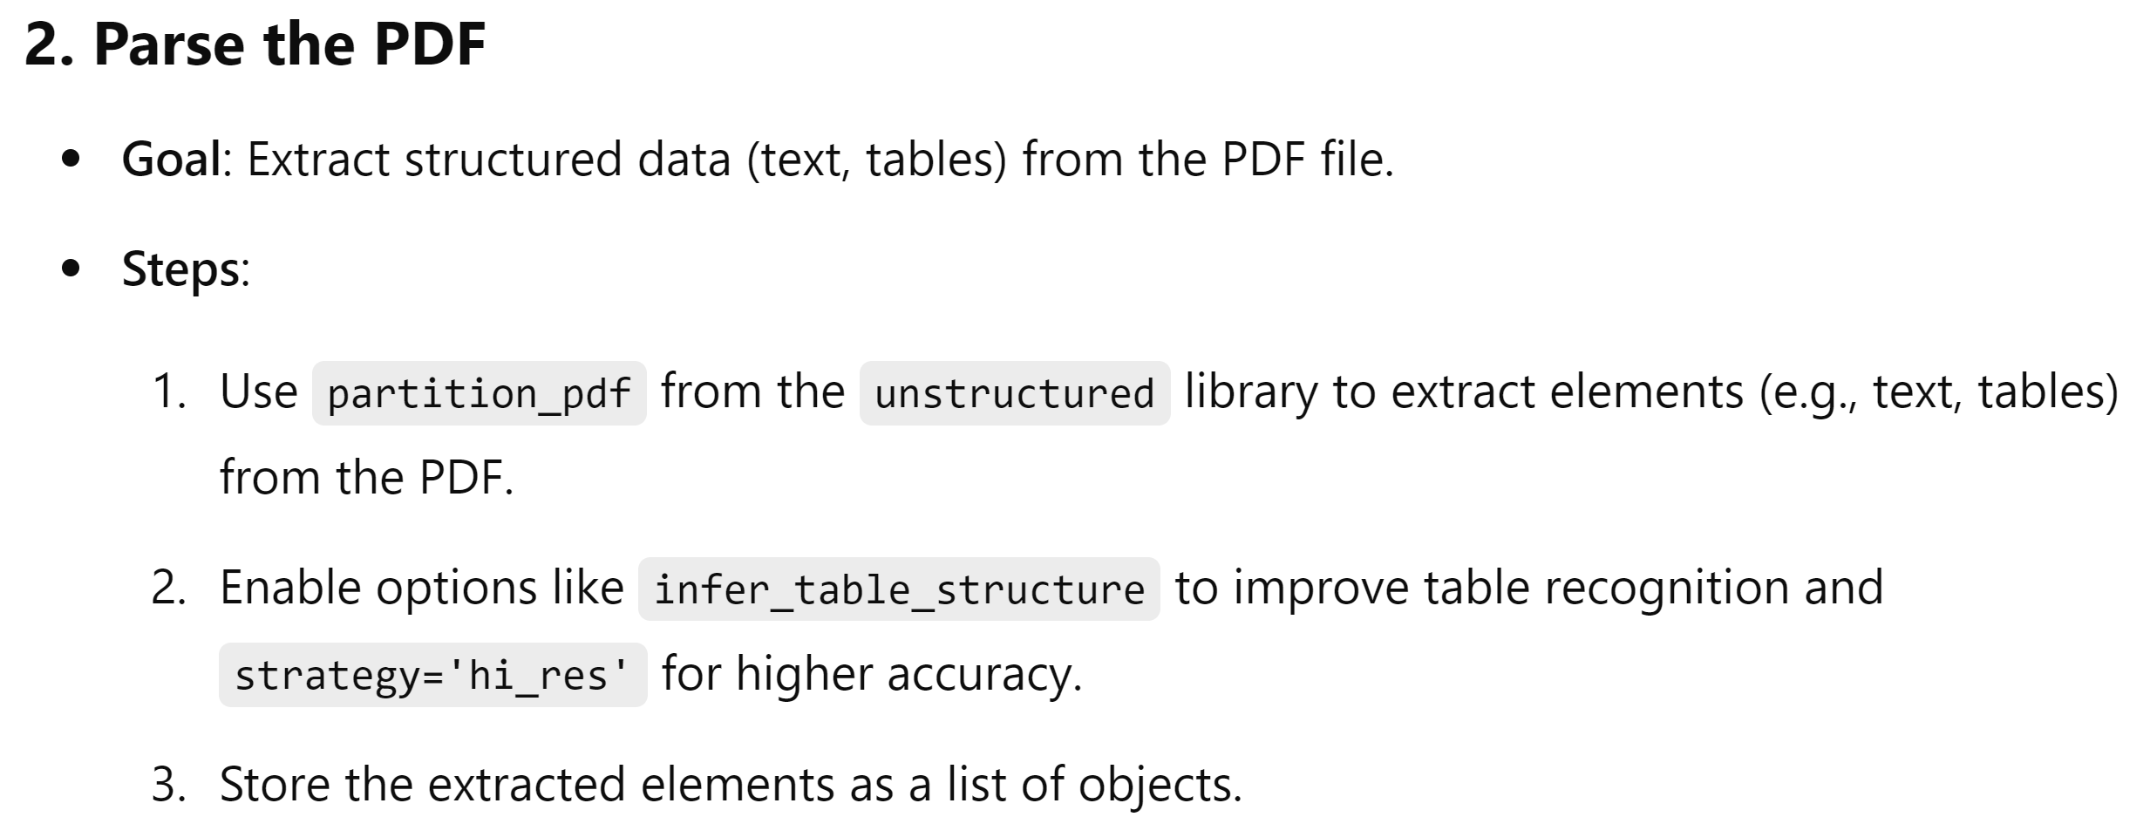

Slide 5
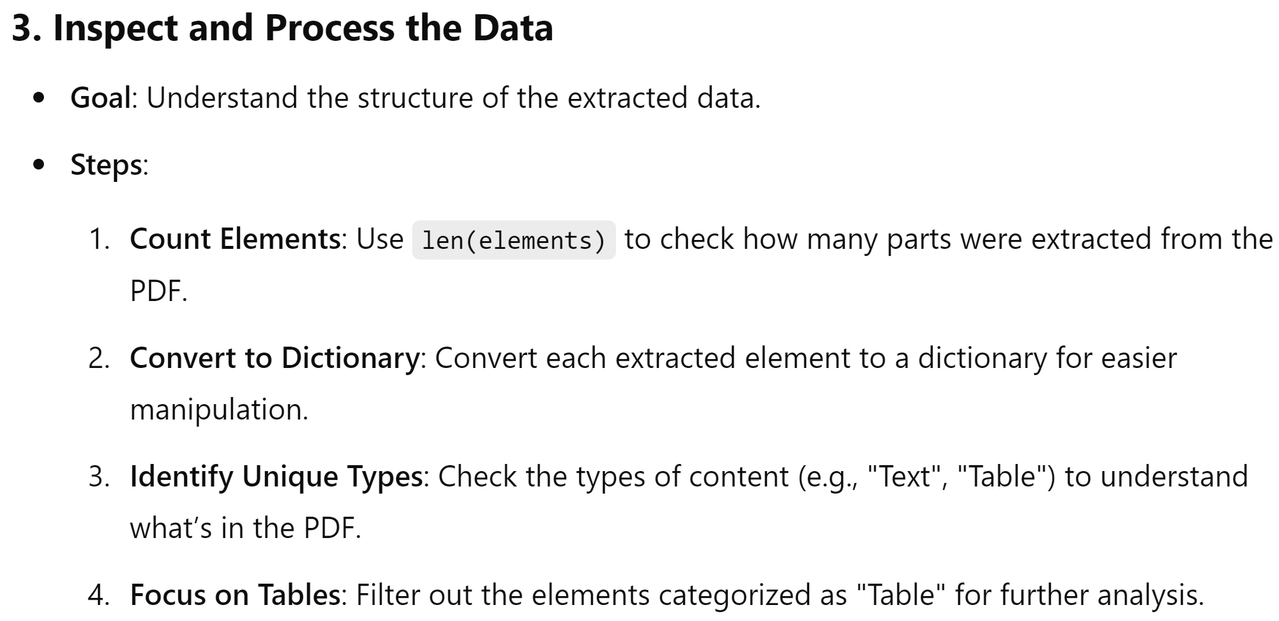

Slide 6
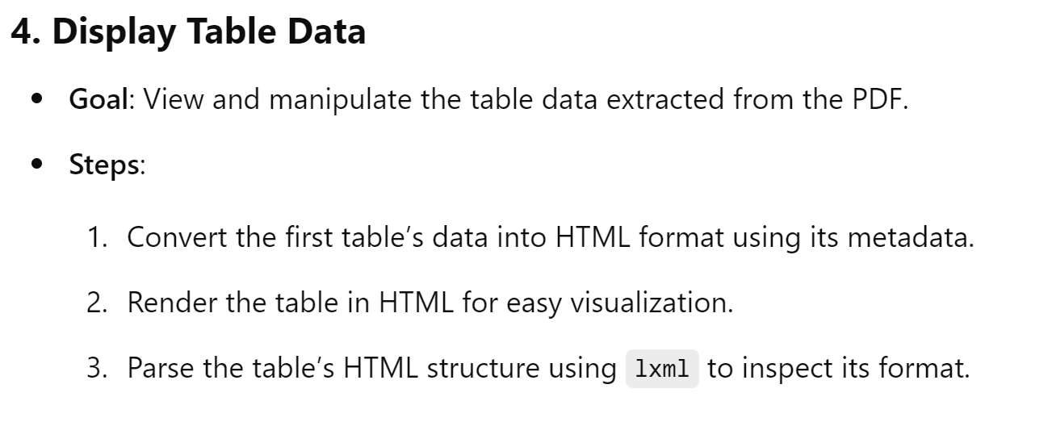
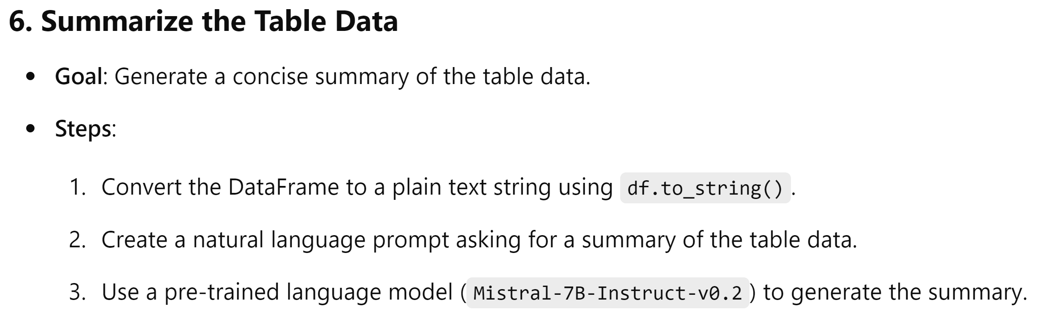
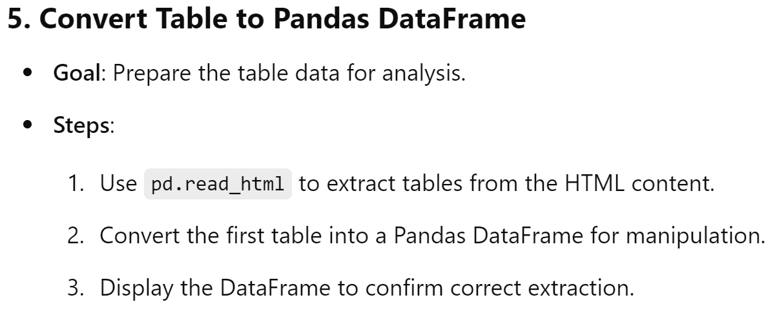
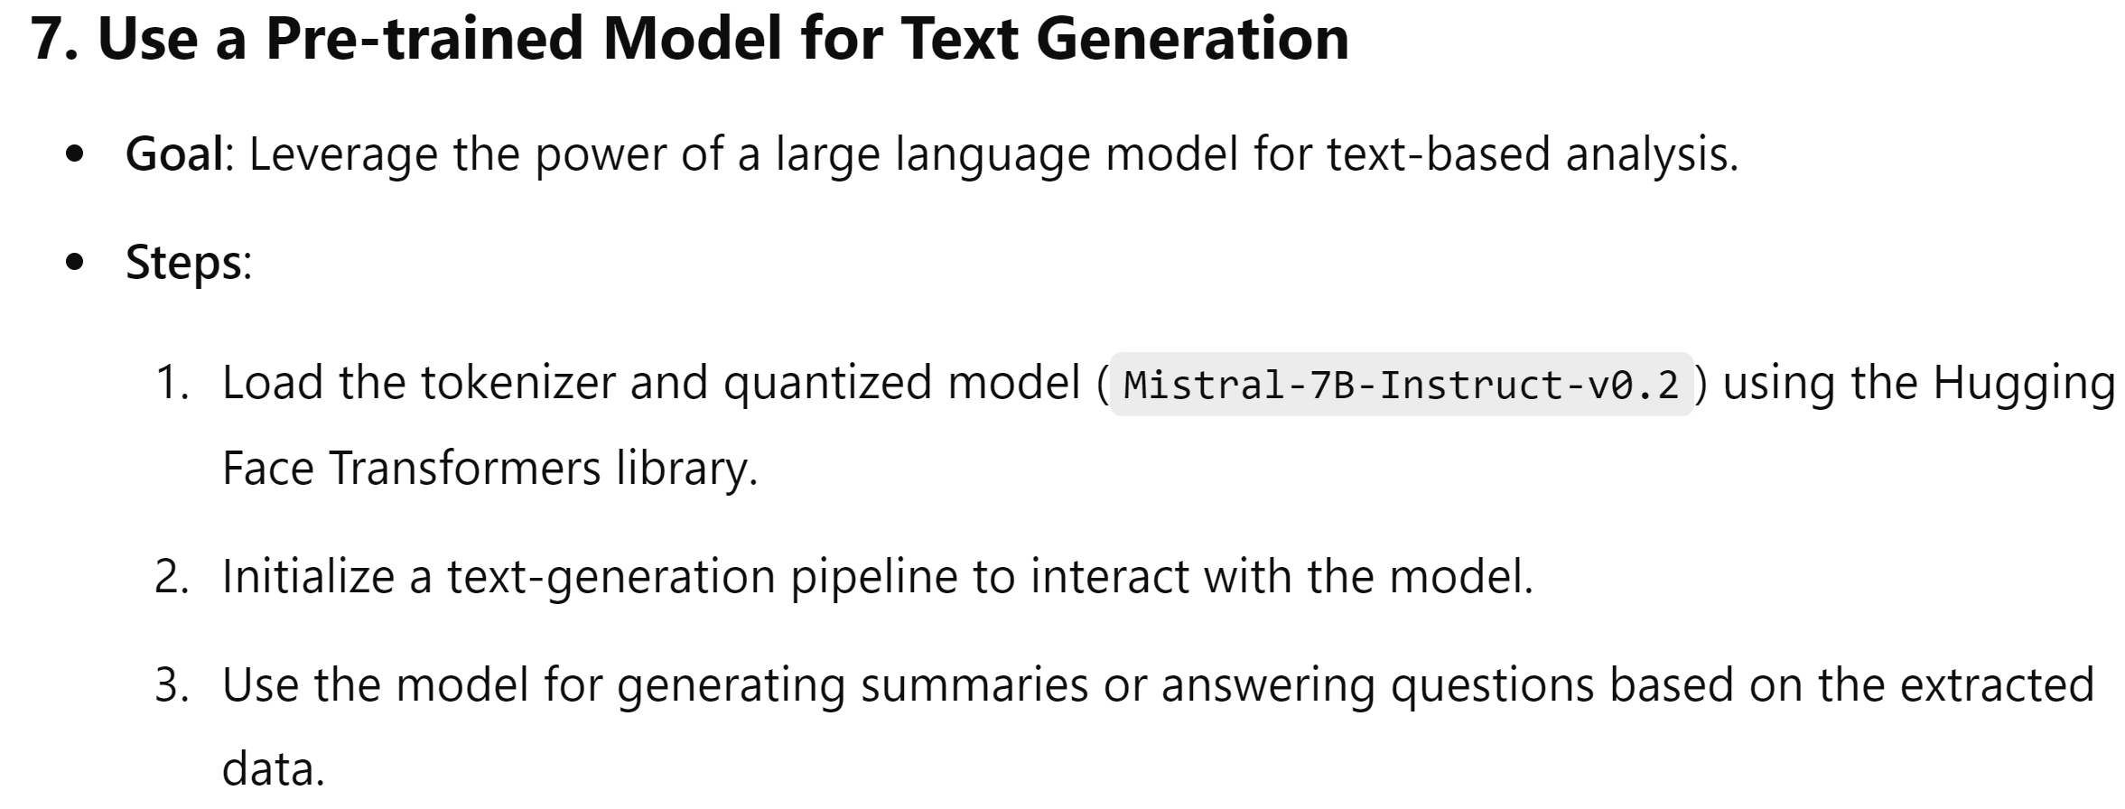

Slide 7
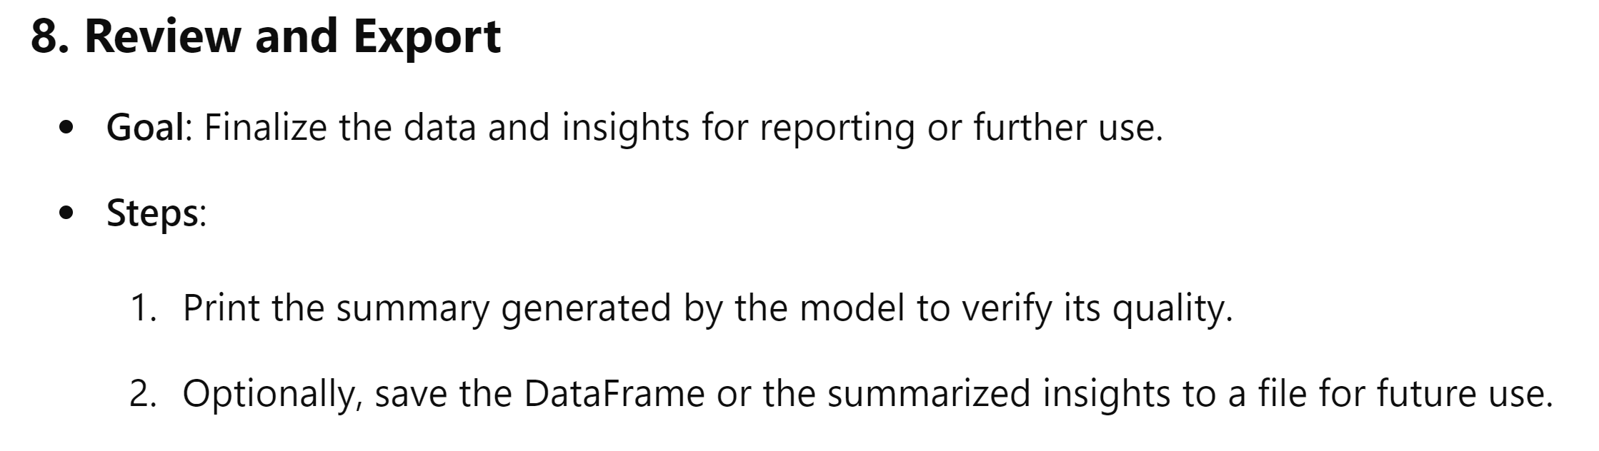

Slide 8
Introduction to LLM Architecture
Large Language Models (LLMs) are advanced AI systems designed to process and generate human-like text. These models rely on vast datasets and sophisticated algorithms to perform tasks such as natural language understanding, text completion, and conversational AI.
Example Definition: "LLM architecture refers to the design and components of large-scale machine learning models used for language processing, such as GPT (Generative Pre-trained Transformer) and BERT (Bidirectional Encoder Representations from Transformers)."
Key Components:
Training Data: Massive datasets used to train the model.
Architecture: Neural network structures like transformers.
Processing Power: High-performance GPUs or TPUs for computation.
Fine-tuning: Tailoring models for specific applications.

Slide 9
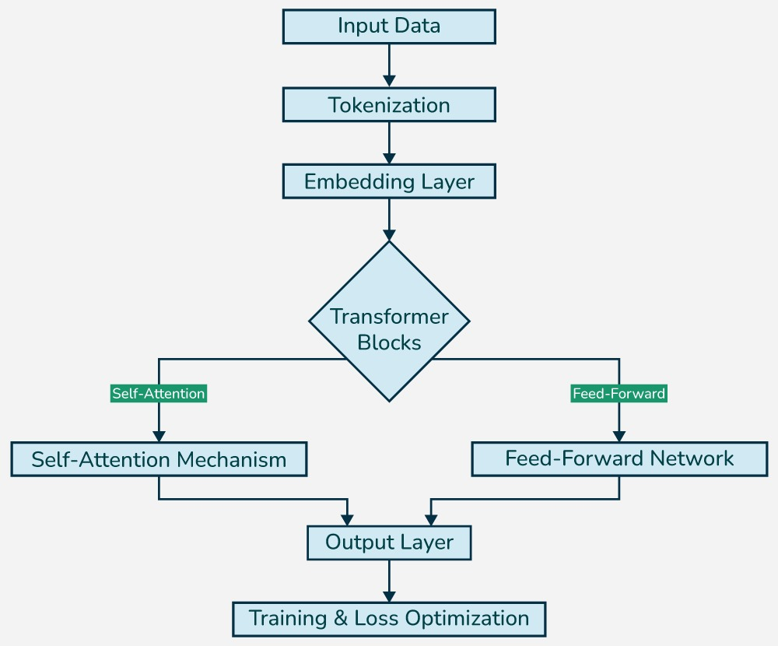
.

Slide 10
LLM Architecture
Understanding the Technical Backbone of Large Language Models
Key Components
Input Layer: Processes raw text input and tokenizes it into smaller units (tokens).
Embedding Layer: Converts tokens into dense vector representations for better context understanding.
Transformer Architecture:
Self-Attention Mechanism: Identifies relationships between tokens for context awareness.
Feedforward Layers: Processes and refines token information for output generation.
Output Layer: Generates predictions, including text completion, answers, or other outputs.
Training Process
Uses large datasets for pretraining and fine-tuning.
Optimizes parameters through techniques like gradient descent.
Scalability
Relies on distributed computing (GPUs/TPUs) to handle billions of parameters efficiently.
Applications
Chatbots, content generation, translation, and more.

Slide 11
Introduction to Transformers and Self-Attention Mechanism
Transformers are advanced neural network architectures designed for natural language processing (NLP) tasks such as summarization, translation, and text generation.
They have revolutionized AI by enabling models to process entire input sequences simultaneously, unlike RNNs and LSTMs which process sequentially.
Self-Attention Mechanism is the core component of transformers that allows the model to weigh the importance of different words in a sequence, regardless of their position.
Key Advantages:
Parallel Processing: Faster and more efficient, reducing training time.
Long-Range Dependencies: Captures relationships between distant words in the input.

Slide 12
How Self-Attention Powers Transformers
Step 1: The input text is divided into tokens, and each token is assigned a score representing its relevance to other tokens in the sequence.
Step 2: Tokens that are more relevant to the current task receive higher attention scores, allowing the model to focus on key parts of the text.
Step 3: The self-attention mechanism generates context-aware representations by aggregating these weighted scores, enabling the model to understand the full context of the input.
Benefits in Financial Analysis:
Highlights Key Metrics: Focuses on essential figures such as revenue, profit, and expenses.
Summarizes Long Documents: Processes and condenses lengthy financial reports, reducing manual review time.

Slide 13
Introduction to the Mistral Model
What is the Mistral Model?
A state-of-the-art language model developed to handle diverse natural language processing (NLP) tasks.
Based on a transformer architecture, it features billions of parameters for advanced text understanding and generation
Key Characteristics:
Scalability: Designed to perform efficiently across different domains.
Instruction-Following: Tailored to respond to user prompts effectively.
Optimized for Deployment: Supports techniques like quantization for efficient execution.

Slide 14
Why Mistral is Used in the Code
Purpose:
To leverage the model’s advanced text generation capabilities for real-world applications.
Reasons for Choice:
Performance: Delivers high-quality, coherent, and contextually relevant text outputs.
Adaptability: Can be fine-tuned or used as-is for diverse applications like content generation, summarization, and more.
Efficiency: Supports quantization methods (e.g., 8-bit), reducing memory usage and inference latency.

Slide 15
Why Mistral is Ideal for this Code
Suitability for the Task:
The code aims to deploy Mistral efficiently for text generation by leveraging GPU resources and quantization techniques.
Efficiency Gains:
The model’s compatibility with 8-bit quantization minimizes memory usage while maintaining high-quality output.
Use in Real-World Scenarios:
Provides fast and resource-efficient inference, making it suitable for dynamic and large-scale applications like real-time chatbots, summarization tools, and more.

Slide 16
Key Technologies in Financial Data Processing
Azure OpenAI
Offers robust APIs for advanced natural language processing (NLP), enabling seamless integration of AI into applications. It supports fine-tuning for domain-specific tasks and delivers accurate and context-aware results.
Usage in This Project:
Extracts and processes structured and unstructured financial data from income statements and balance sheets.
Enhances understanding of financial context to provide actionable insights and summaries.
Facilitates scalability to analyze large volumes of data efficiently.
Automates the identification of financial metrics, including revenue, expenses, assets, and liabilities, streamlining the analysis process.
LangChain
LangChain is a robust framework designed to manage interactions with large language models (LLMs). It supports chaining multiple AI-driven tasks for handling complex workflows efficiently.
Usage in the Project:
Breaks down voluminous reports into manageable and analyzable segments.
Coordinates tasks like data categorization and context-aware analysis for streamlined workflows.
Acts as a bridge between document processing and AI-driven insight generation, enhancing overall efficiency.
Facilitates the ingestion and parsing of financial documents, ensuring structured extraction of data.

Slide 17
Key Technologies in Financial Data Processing
Llama
Llama is a cutting-edge language model designed for efficiency and accuracy in natural language processing (NLP). It excels in understanding and generating human-like text.
Usage in This Project:
Performs in-depth analysis of financial data to uncover hidden patterns, trends, and anomalies.
Supports forecasting by comparing historical and current financial metrics.
Enhances decision-making by generating actionable insights, such as profitability ratios and risk assessments.
Facilitates anomaly detection to flag unusual financial activities or inconsistencies
Azure Cloud Platform
A robust cloud service providing tools for application development, secure data storage, and high-performance computing.
Usage in the Project:
Hosts the deployed AI system for analyzing financial documents.
Ensures scalability for processing high volumes of data in real time.
Supports integration with financial platforms for seamless operations.
Maintains compliance with financial data privacy and security standards.
Facilitates automated backups and disaster recovery to ensure reliability.

Slide 18
Real-Life Applications
1.Financial Analysis for Businesses: Automating the review of income statements and balance sheets to help managers and stakeholders understand company performance.
2. Investor Decision-Making: Providing concise summaries of financial data for investors to make informed decisions.
3. Auditing and Compliance: Streamlining financial document reviews for auditors to identify compliance issues quickly.
4. Banking and Credit Scoring: Analyzing financial data to assess creditworthiness and reduce manual underwriting tasks.5. Corporate Strategy: Offering insights into historical trends and future forecasts for planning.

Slide 19
Challenges
1. Data Privacy: Ensuring sensitive financial data is handled securely and complies with regulations.
2. Document Variability: Managing the diverse formats and terminologies used in financial documents.
3. Accuracy of Insights: Maintaining high accuracy in detecting financial metrics and generating summaries.
4. Scalability: Handling large-scale data processing for extensive financial documents.5. Model Interpretability: Ensuring that AI-generated insights are transparent and explainable to users.

Slide 20
Common Errors
1. Parsing Errors: Misidentifying or missing key financial terms or metrics during document parsing.
2. Insight Generation Mistakes: Overlooking trends, misinterpreting data patterns, or providing inaccurate forecasts.
3. Integration Issues: Problems with seamless deployment and real-time analysis on financial platforms.
4. Summarization Errors: Generating summaries that are too vague, overly complex, or omit critical information.5. User Adaptability: Creating tools that are not user-friendly or tailored to specific user needs.

