Slide 1
Active Virtual Circuit
Tariq Issa Hamayel

Slide 2
Outline
1- Introduction
SDN
OpenFlow
Floodlight, Mininet, REST APIs
2- Working principle
3- Results and future work

Slide 3
Introduction

Slide 4
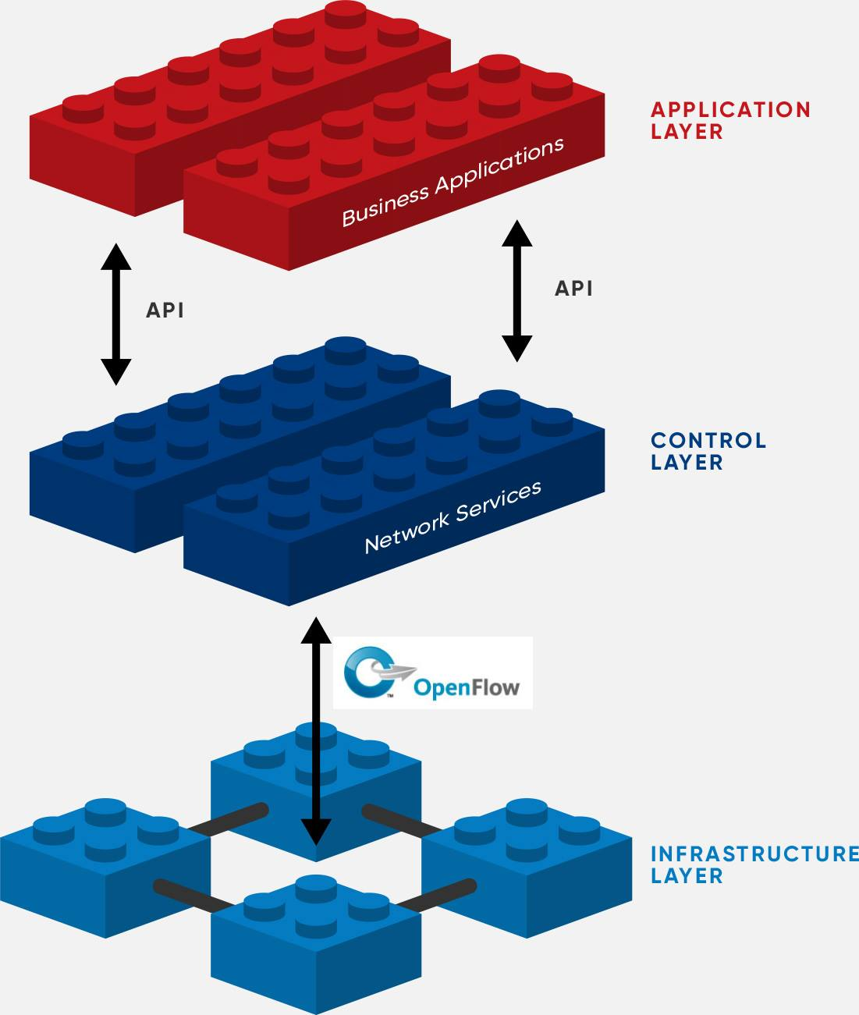
Software Defined Network (SDN)
> Separation of traffic forwarding from control
> Logically centralized control
> Programmability of network services

Slide 5
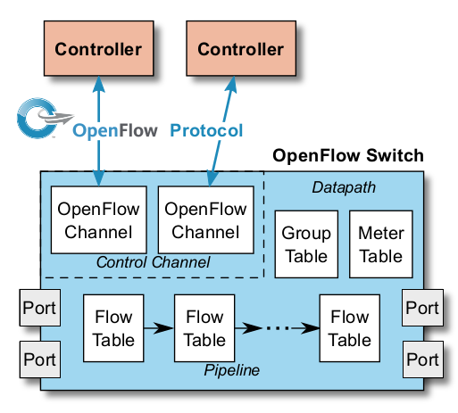

OpenFlow
> Is a communication protocol.
> Introduced OpenFlow Switch.
> Is a communication protocol.
> Introduced OpenFlow Switch.

Slide 6
Floodlight, Mininet and
REST APIs
FloodLight controller
Is a software that acts as networks OS, it controls multiple OF switches.
Mininet
Is a network emulator that creates virtual network topology .
REST API
Is the northbound API of the controller .

Slide 7
Working principle

Slide 8
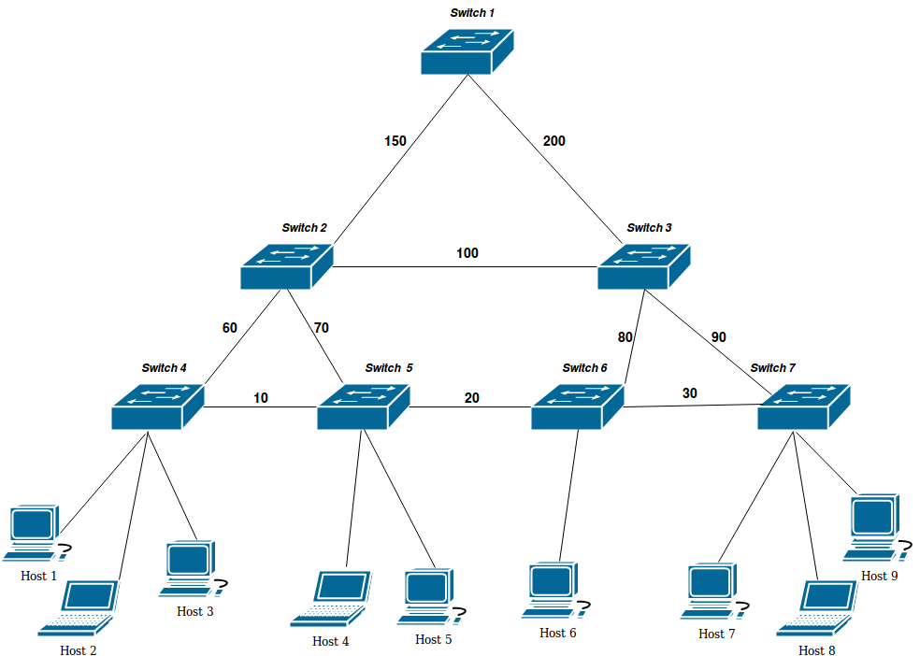
Network Topology

Slide 9
The alogrithm
- Represent the topology as a graph.
- Use Dijkstra shortest path algorithm where the chosen edges equal or greater than the bandwidth desired
- Install flow entries on the switches got from Dijkstra algorithm .

Slide 10
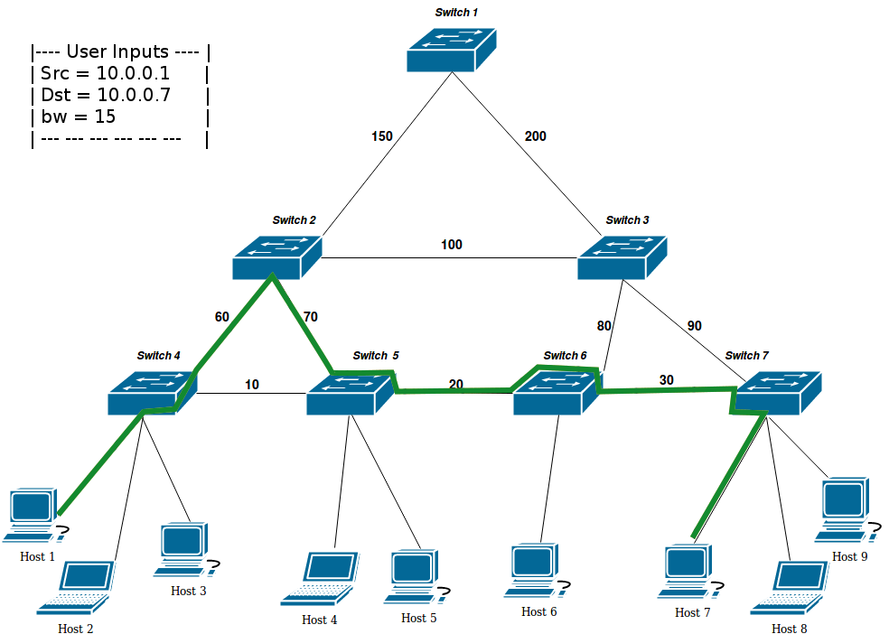
Flows Process Example :
-----------------------------------------

Slide 11
Results and Future work

Slide 12
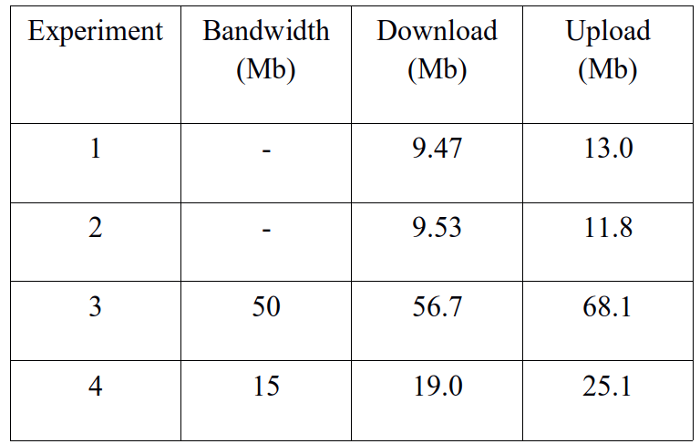

Slide 13
Future work
1- more than one virtual circuit
2- find path using more than one link between two adjacent switches

Slide 14
Thanks!
Any questions?

